Slide 1
pixy
vcftools
14
12
10
8
Frequency
6
4
2
0
0.02
0.04
0.06
0.08
0.10
0.02
0.04
0.06
0.08
0.10
Proportion of Data Missing

Slide 2
0.100
0.075
pixy pi
0.050
0.025
0.025
0.050
0.075
0.100
vcftools pi

Slide 3


genotypes
sites
1.6
1.4
1.2
1.0
method
Scaled Pi Estimate
pixy
0.8
vcftools
0.6
0.4
0.2
0.0
0.0
0.2
0.4
0.6
0.8
0.0
0.2
0.4
0.6
0.8
Proportion of Data Missing

Slide 4

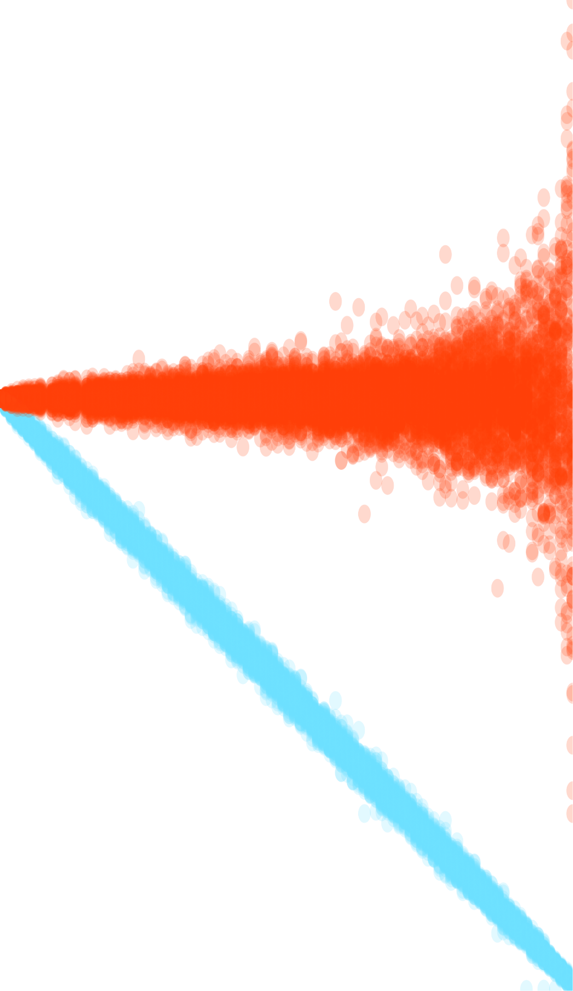
genotypes
sites
1.6
1.4
1.2
1.0
method
Scaled Pi Estimate
pixy
0.8
vcftools
0.6
0.4
0.2
0.0
0.0
0.2
0.4
0.6
0.8
0.0
0.2
0.4
0.6
0.8
Proportion of Data Missing

