Slide 1
Predicting Most liked Area in the city
IBM Data science Project
Sandeep Kumar

Slide 2
Background
Delhi India’s capital city , is a massive metropolitan area in the country’s north. Delhi has a lot of places to visit and explore including some historical monuments ,religious places etc

Slide 3
Problem
If anyone is coming to delhi for the first time and wants to know which area in the delhi people visit the most apart from historical monuments ,religious places etc etc.
To determine this I am going to see the concentration of cafes . The cluster of cafes would most probably be the place where most people will be visiting.
If there are suppose 10 cafes in 500 meter meaning a lot of people coming to that place.

Slide 4
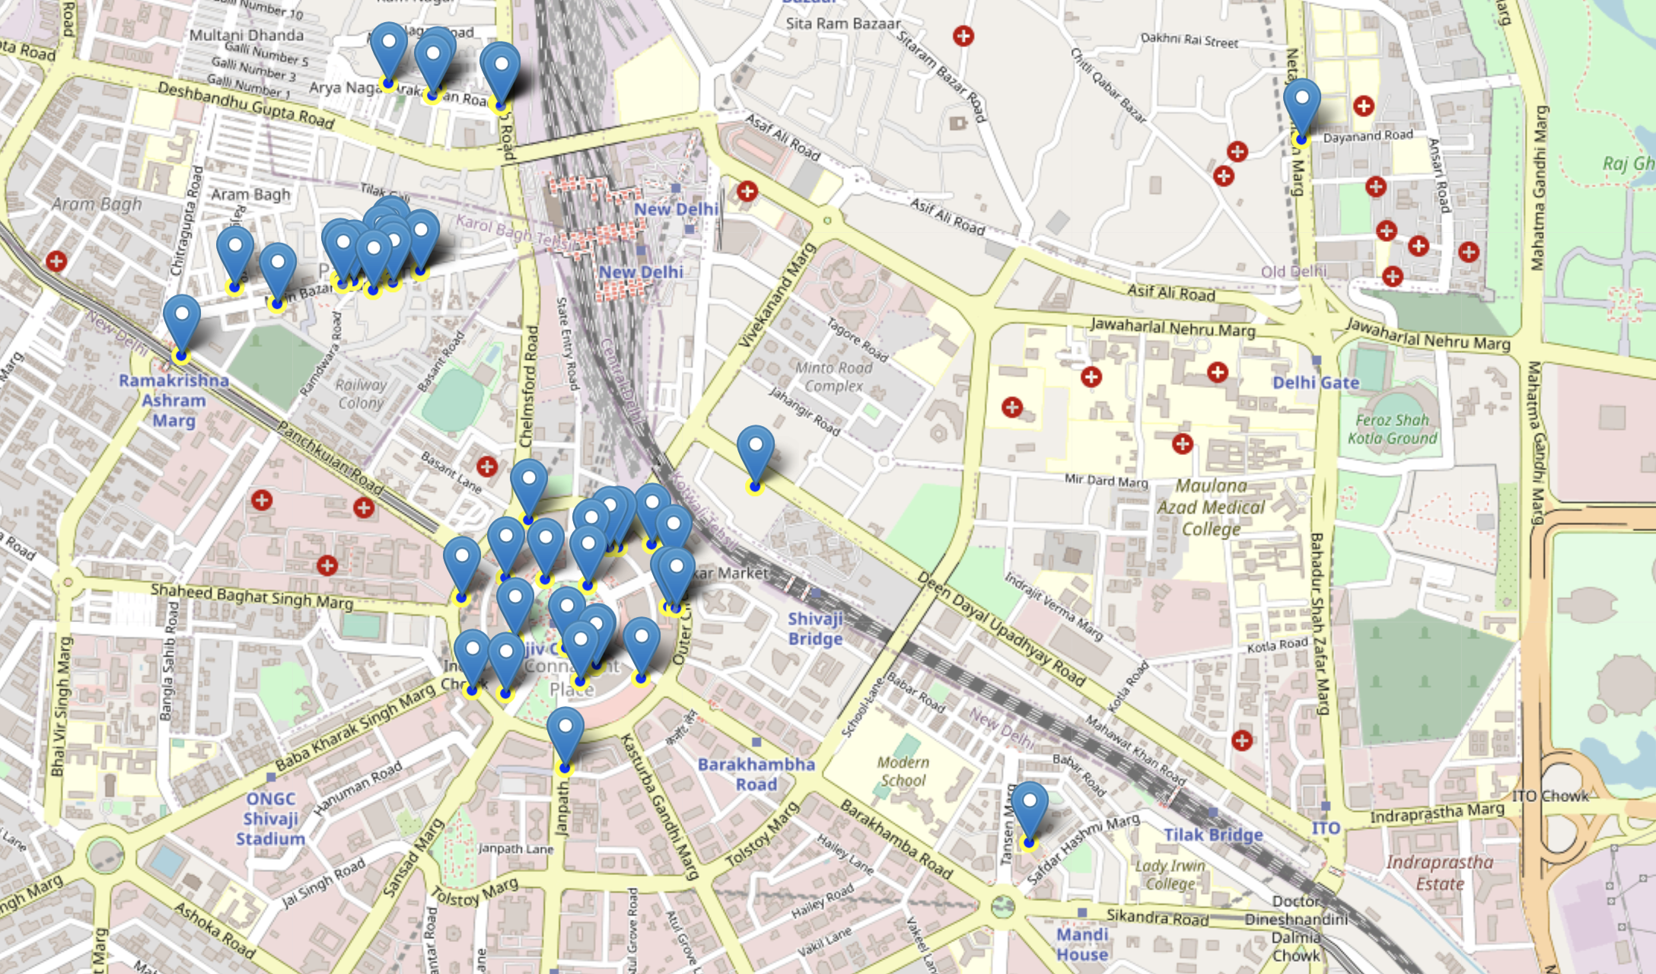
Results

Slide 5
Conclusions
In this study, I found out that Connaught Place is the most crowded area in the city. Where people visit.

