Slide 1
Threat and app risk data analysis and classification
Sandeep Kumar

Slide 2
Business Problem
With the exponential growth of mobile and web applications, ensuring the security of these apps has become increasingly challenging. Applications can contain vulnerabilities that pose significant threats to user data and overall system integrity. Therefore, there is a critical need to develop methods to analyze and classify these threats and risks effectively.

Slide 3
Objectives(Completed)
1.Threat and Risk Analysis Research: Research Related to Threat and app risk
2.Data Collection and Preprocessing: Analyze Data related to application threats and risks
from diverse sources, including public databases.
3: EDA
4: Feature Engineering: Identifying and extracting key features from the available dataset.

Slide 4
Objectives(Completed)
5. Model Development and Validation: Classification model to accurately identify threats
6: Model Evaluation: Training the classification model and evaluating its performance
7: Analysis and Interpretation: Analyzing the results from the classification model
8: Documentation and Reporting: Documenting the process,
recommendations comprehensively. Preparing a detailed
dissertation report.

Slide 5
Data Sources
Data is collected from open-source data source.
After carefully evaluating different data source below data source has been used.
dataset contains 4465 instances and 241 attributes. The target attribute for classification is
a category (malware vs good ware).
Source Name | Type of Data | URL/Access Details
Public, UCI | CSV | https://archive.ics.uci.edu/dataset/813/tunadromd
* Images taken from databricks.com

Slide 6
Data Sources
Data is collected from open-source data source.
After carefully evaluating different data source below data source has been used.
dataset contains 4465 instances and 241 attributes. The target attribute for classification is
a category (malware vs good ware).
Source Name | Type of Data | URL/Access Details
Public, UCI | CSV | https://archive.ics.uci.edu/dataset/813/tunadromd
* Images taken from databricks.com

Slide 7
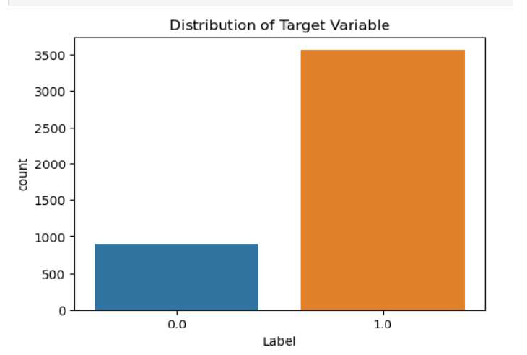
Distribution of Target Variable
* Images taken from databricks.com

Slide 8
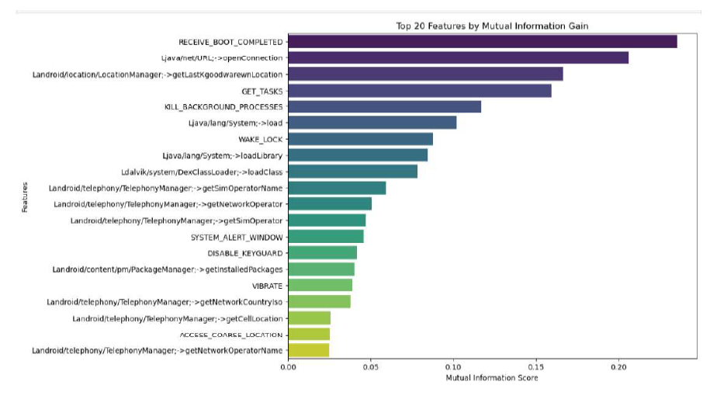
Feature Engineering
Mutual information gain
top feature by Mutual information gain

Slide 9
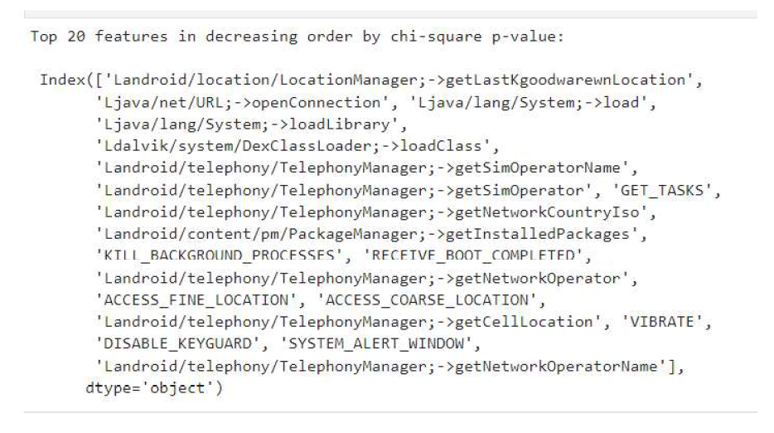
Feature Engineering
chi-square test
top feature by chi-square

Slide 10
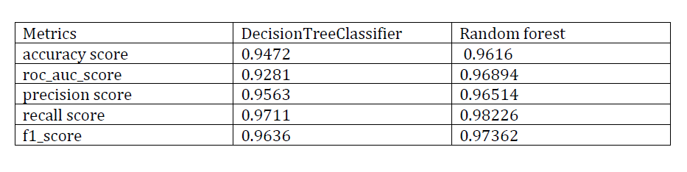
Model Development
Decision Trees
Random Forest

Slide 11
Conclusion
After Evaluating decision tree and Random Forest model when we compare metrices, it is recommended to use Random Forest model for malware detection. Its high recall ensures that most malware instances are correctly identified, while its strong precision indicates that predictions of malware are highly reliable.
This model’s overall performance makes it the most suitable choice for accurately and effectively classifying apps in the given context.

Slide 12
Thank You

