Slide 1
SANGAVI K

Slide 2
ARTISTRY AI

Slide 3
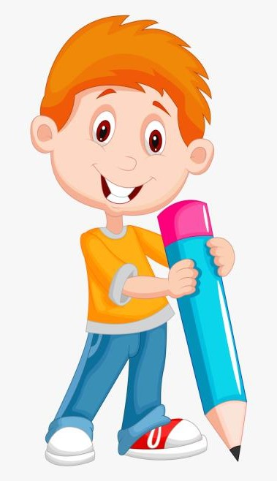

AGENDA
Problem Statement
Project Overview
Who are the End users ?
Your Solution And Value Proposition
The Wow In Your Solution
Modeling
Results
3/21/2024 Annual Review

Slide 4

PROBLEM STATEMENT
Art Creation Challenges:
Traditional art creation is a time-consuming process.
Requires significant skill and experience.
Demands diversity and innovation in artistic styles.
Industry Needs:
Various industries (e.g., entertainment, advertising, fashion) seek diverse and high-quality visual content.
There is a need for efficient, scalable art generation methods.

Slide 5
PROJECT OVERVIEW
ArtistryAI uses generative adversarial network (GAN) technology to create unique and original art images.
Objective: Develop a model that can generate visually appealing and stylistically consistent art based on a given theme or style.
Potential Applications: Visual art, entertainment, marketing, design, gaming, and more.

Slide 6

WHO ARE THE END USERS?
Artists and Designers:
Use ArtistryAI as a tool for inspiration and to enhance their creative processes.
Content Creators:
Leverage AI-generated art for social media, advertising, and digital content.
Game Developers:
Utilize AI-generated art for environments, characters, and assets in video games.
Marketers and Advertisers:
Apply AI art for campaigns, visuals, and branding materials.
Enthusiasts and Collectors:
Explore new AI art forms and collect unique pieces.

Slide 7

YOUR SOLUTION AND ITS VALUE PROPOSITION
Generative AI Art:
ArtistryAI can create novel, high-quality art pieces efficiently and on demand.
Creativity Boost:
Offers artists new sources of inspiration and new perspectives.
Customization and Flexibility:
Generate art in different styles and themes as desired.
Efficiency and Scale:
Quickly produce a large volume of diverse art with minimal human intervention.
Accessibility:
Non-experts and enthusiasts can participate in the creative process.

Slide 8
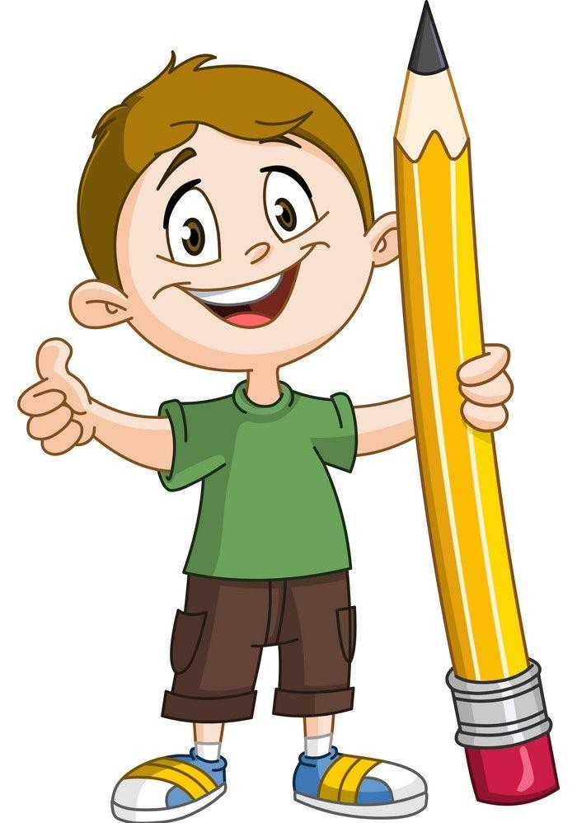
THE WOW IN YOUR SOLUTION
Advanced AI Techniques:
Utilizes GANs, a cutting-edge technology, to create art.
Diverse Art Styles:
Can learn and adapt to various artistic styles and themes from training data.
High-Quality Output:
Produces art that is visually compelling and suitable for a variety of applications.
Creative Collaboration:
Offers artists and designers a powerful tool to explore new concepts and expand their work.
3/21/2024 Annual Review
8

Slide 9
MODELLING
Generator and Discriminator:
The GAN consists of a generator and a discriminator, trained together.
Training Process:
Uses a diverse art dataset to train the GAN, enabling it to generate unique art.
Model Optimization:
Techniques such as batch normalization, learning rate adjustments, and other strategies are employed to optimize the model.
Customization:
Model can be tailored to specific styles and themes based on input data
9

Slide 10
RESULTS
Generated Art:
Produces high-quality art images in various styles.
Quality and Diversity:
Demonstrates a range of visually distinct and aesthetically pleasing outputs.
Evaluation:
Continual assessment of the model's performance and the quality of generated art.
Future Opportunities:
Further refinement and expansion of ArtistryAI to generate other forms of media or work in different creative domains.
10

