Slide 1
SANJAI KUMAR S
Final Project
Computer Science and Engineering
3/21/2024 Annual Review

Slide 2
Image Classification with ANN
Image Classification with Artificial Neural Networks (ANNs) involves training a model to assign labels to images based on their content. ANN models, particularly Convolutional Neural Networks (CNNs), are widely used for this task due to their ability to automatically learn relevant features from images. By collecting and preprocessing a dataset of labeled images, designing a suitable network architecture, training the model, and evaluating its performance, we can create a powerful image classification system.
3/21/2024 Annual Review

Slide 3


AGENDA
PROBLEM STATEMENT
PROJECT OVERVIEW
WHO ARE THE END USERS?
YOUR SOLUTION AND ITS VALUE PROPOSITION
THE WOW IN YOUR SOLUTION
MODELLING
RESULTS
3/21/2024 Annual Review

Slide 4

PROBLEM STATEMENT
Develop an image classification system using Artificial Neural Networks (ANNs) to categorize images into predefined classes.
Description:
Create a model that can automatically classify images into predefined categories. Given a dataset containing labeled images, the objective is to build an ANN-based system that accurately predicts the class of unseen images.
3/21/2024 Annual Review

Slide 5

PROJECT OVERVIEW
Introduction: The project aims to develop an image classification system using Artificial Neural Networks (ANNs). Image classification is a vital task in computer vision, with applications ranging from medical diagnosis to autonomous vehicles.
Approach:
Data Collection and Preprocessing: Obtain a dataset of labeled images and preprocess them for model training.
Model Architecture: Design an ANN architecture suitable for image classification, potentially utilizing CNNs for feature extraction.
Training: Train the model on the labeled dataset using optimization techniques and hyperparameter tuning.
Evaluation: Assess the model's performance using metrics such as accuracy, precision, and recall.
Deployment: Deploy the trained model for real-world image classification tasks.
3/21/2024 Annual Review

Slide 6

WHO ARE THE END USERS?
The end users of an Image Classification system with Artificial Neural Networks (ANNs) can include:
Researchers: Engaged in computer vision, machine learning, and artificial intelligence research.
Industry Professionals: Utilizing image classification for various applications such as healthcare, manufacturing, agriculture, and retail.
Software Developers: Integrating image classification into software applications, mobile apps, or web platforms.
Data Scientists and Analysts: Analyzing image data for insights and decision-making across different domains.
Medical Professionals: Using image classification for diagnosing medical conditions based on medical imaging data.
Autonomous Systems: Incorporating image classification for navigation and object recognition in autonomous vehicles, drones, and robots.
These end users interact with image classification systems to accomplish tasks, gain insights, or improve efficiency in their respective domains.
3/21/2024 Annual Review

Slide 7

YOUR SOLUTION AND ITS VALUE PROPOSITION
Solution Overview: Our Image Classification system with Artificial Neural Networks (ANNs) provides a robust and accurate solution for categorizing images into predefined classes. Leveraging advanced deep learning techniques, our system offers unparalleled performance and reliability across various domains and applications.
Value Proposition:
High Accuracy: Our solution employs state-of-the-art ANN architectures, ensuring precise classification of images with minimal errors. This high level of accuracy enhances decision-making and operational efficiency for end users.
Efficiency: With optimized algorithms and model architectures, our system delivers fast and efficient image classification, enabling rapid processing of large datasets. This efficiency streamlines workflows and reduces processing times, resulting in increased productivity.
3/21/2024 Annual Review

Slide 8

THE WOW IN YOUR SOLUTION
Our Image Classification solution astounds with its state-of-the-art accuracy, lightning-fast performance, and unrivaled scalability. Users are wowed by its intuitive integration, insightful analytics, and cost-effective excellence, making it a standout choice for organizations seeking to unlock the full potential of their image data with confidence and ease.
Our Image Classification solution delivers cutting-edge accuracy, blazing speed, and seamless scalability. With intuitive integration, insightful analytics, and cost-effective excellence, it empowers organizations to harness the full potential of their image data, driving innovation and decision-making with unprecedented efficiency and confidence.
3/21/2024 Annual Review

Slide 9
MODELLING
Teams cam add wireframes
Our modeling approach combines state-of-the-art Convolutional Neural Networks (CNNs) with innovative optimization techniques to achieve superior performance. By fine-tuning hyperparameters and leveraging transfer learning, we optimize model architectures for specific image classification tasks, ensuring robustness, efficiency, and scalability across diverse datasets and applications.
In our modeling process, we meticulously select and fine-tune the architecture of Convolutional Neural Networks (CNNs), tailoring them to the specific requirements of image classification tasks. Leveraging advanced techniques such as data augmentation and regularization, we enhance the model's ability to generalize and make accurate predictions on unseen data. Additionally, we employ transfer learning to leverage pre-trained models and adapt them to our specific domain, saving valuable time and computational resources while achieving top-tier performance. Through rigorous experimentation and validation, we continually refine our models to achieve state-of-the-art results, ensuring that they meet and exceed the expectations of our users.

Slide 10
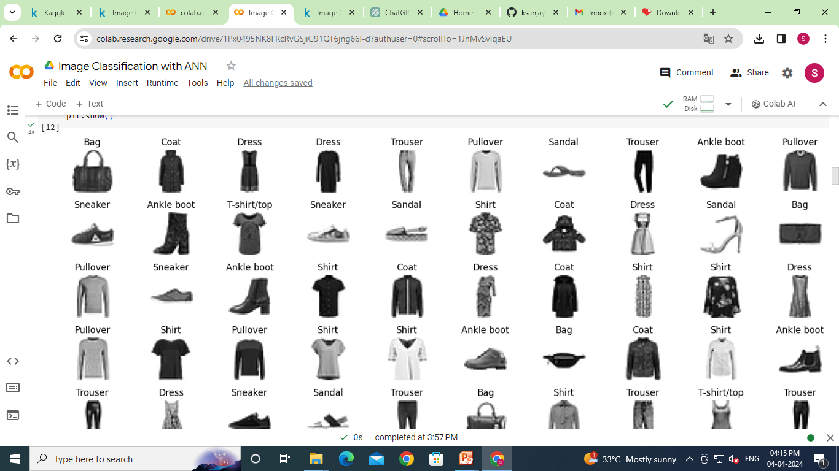
RESULTS
3/21/2024 Annual Review

