Slide 1
Comp Photography
(Spring 2016)
Final Project
Karthiksundar sankaran
ksankaran6@gatech.edu
Computational Photography @ GT
https://cs6475.wordpress.com/2016-spring/

Slide 2
Captcha Stregth Tester
Test Captcha’s resistance to being read by OCR software using computational Photography techniques
Computational Photography @ GT

Slide 3
Goal : Captcha Stregth Testing
When providing services online one of the biggest problems facing web service providers is the use of automated robots to submit forms. In many cases this is done by unwelcome users for nefarious purposes.
One of the commonly used methods to distinguish between human and robot visitors is the use of Captchas, the goal of this project is to test the strength of captchas against attacks using computational photography techniques to improve OCR accuracy.
The ultimate goal is to build Captchas that are highly resistant to common computational photography techniques and make OCR difficult. This project is motivated by real need at work where automated robots are causing great deal of financial loss.
Computational Photography @ GT

Slide 4




Captcha manipulation to make easier reading by OCR sofware
Input
Output
Current pipeline (generic) produces these images and has been overall better with an average success rate of 62% correctly identified letters and 16% success rate on exact match. Which is quiet good considering websites allow multiple tries for Captchas.
Output can be tailored to be much less jagged in the edges by adjusting parameters but the settings used now produced the best success rate overall for all the 50 images I tested with. Some pipeline improvements need to be made to make the image edges smoother while increasing OCR accuracy.
Computational Photography @ GT

Slide 5
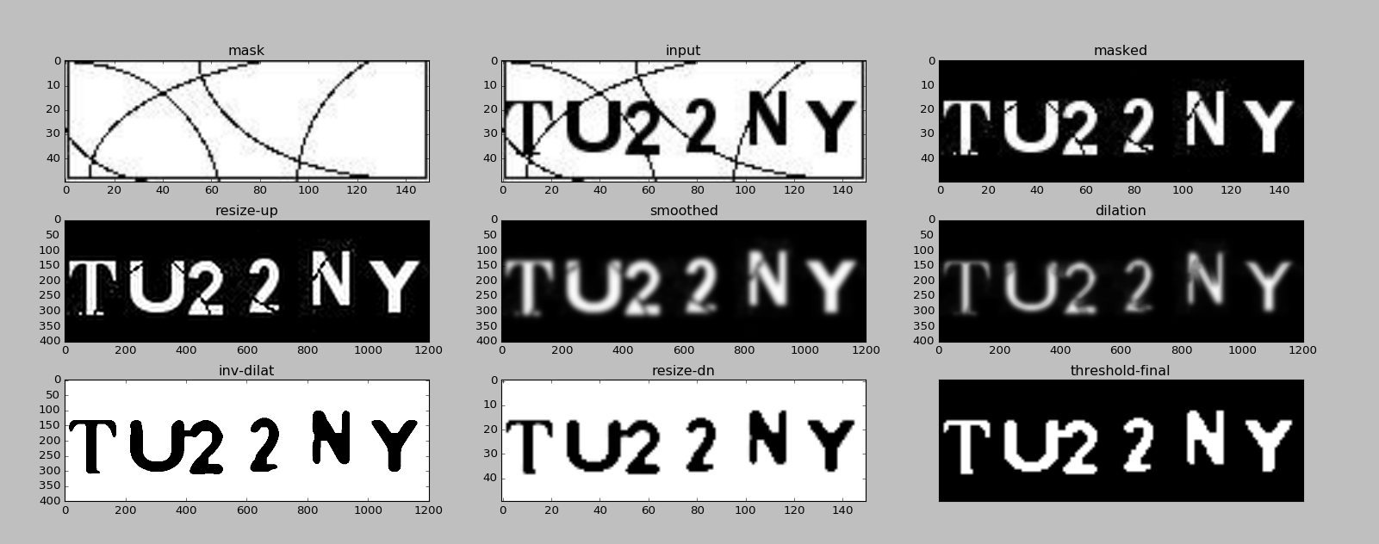
Generic transformations to clarify text

Slide 6
The Challenge
As part of this project I found that individual captchas can be easily broken by adjusting the pipeline or the different parameters used for masking, smoothing, dilating or etching.
The Major challenge is to come up with one generic pipeline that can break all captchas.
Depending on the complexity of the captcha generator what works for one image may not work for another, Visualization using pyplot of the steps helped coming up with a better pipeline.

Slide 7
Showcase your pipeline
Input
Read As Grayscale
Apply any Mask to reduce bakground noise
Interpolate to increase size by 6 times
Smooth Gaussian Blur
Send to OCR for recognition
Threshold to convert to B/W image
Etch to retain
definition
Dialate to heal cuts
Computational Photography @ GT

Slide 8
What is the best way to see your project?
Code is here:
https://github.com/ksankaran6/captcha
Rest of the details are in the powerpoint.
Computational Photography @ GT

Slide 9
What worked
Breaking individual captcha’s was easily done using the techniques learned in this course. In most cases if a single captcha was attacked by specifically tailoring the pipeline – I was able to crack the captcha.
OCR errors due to background noise introduced were easily eliminated using masking techiques learn in the class.
Thresholding and other mechanisms eliminated issues due to color variations.
Small cuts in the images were cured using smoothing (Gaussian and other) techniques to heal the cuts. OpenCV Morphology was also helpful in filling the gaps leading to better OCR results.
Computational Photography @ GT

Slide 10
What did not work? Why?
Coming with a generic pipeline for breaking captchas is still a work in progress.
Dialation and errosion tends to smooth out sharp edges leading to issues like S getting identified as 5 etc., I am looking at options like edge detection using something like Canny edge detector to preseve the contours while infilling (healing broken parts).
Computational Photography @ GT

Slide 11
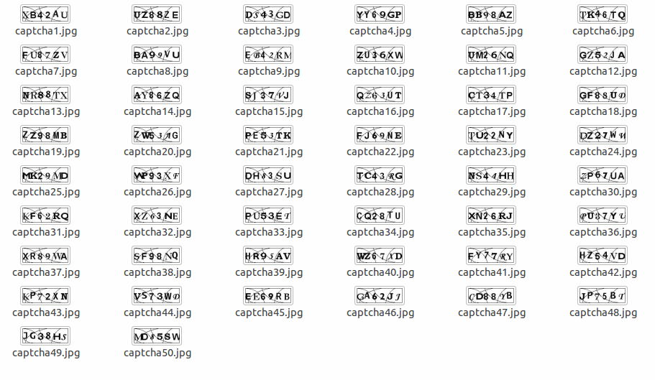
Captchas Used
Computational Photography @ GT

Slide 12
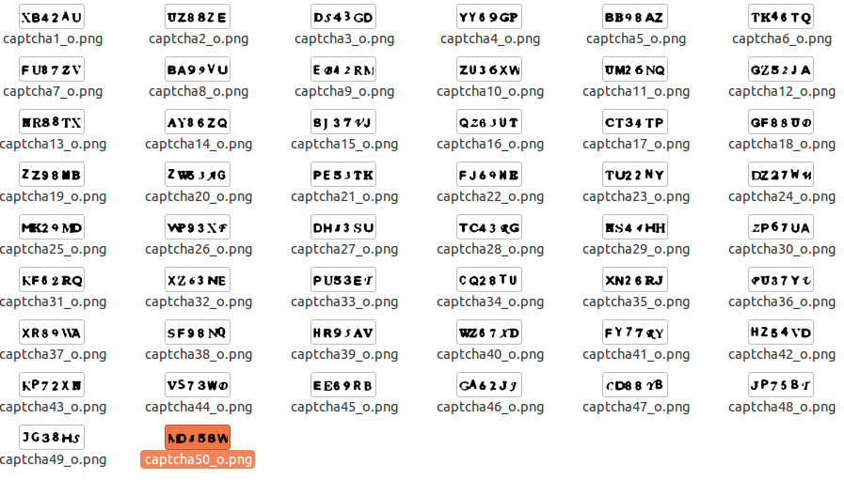
Processed Captchas

Slide 13
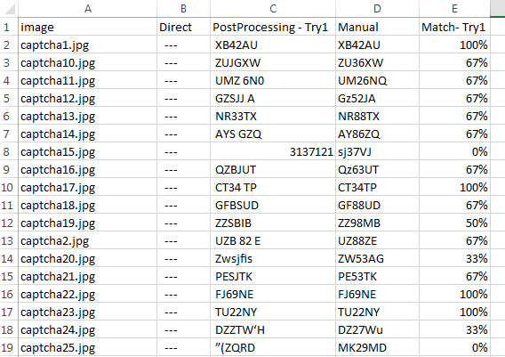
Results comparison

Slide 14
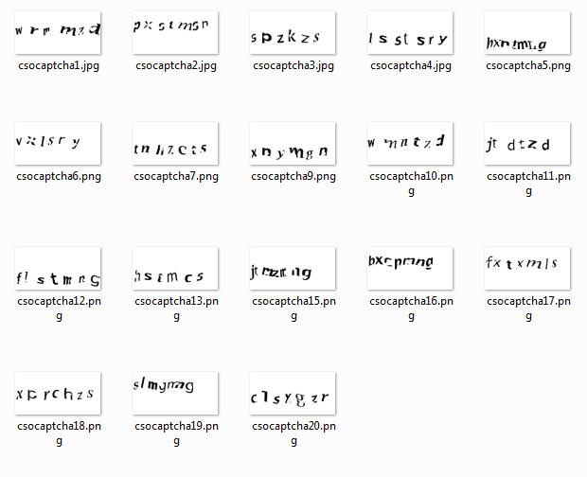
Other captchas tried
A second type of captcha was also tried with similar results as the one shown above.
Computational Photography @ GT

Slide 15
References / Pointers
tesseract-ocr - https://github.com/tesseract-ocr
PyTesseract - https://pypi.python.org/pypi/pytesseract/0.1
Captchas - From different att.com properties
Robin Davids blog - http://www.robindavid.fr/opencv-tutorial/cracking-basic-captchas-with-opencv.html
https://cdn.elie.net/publications/text-based-captcha-strengths-and-weaknesses.pdf
Computational Photography @ GT

Slide 16
Team
Karthik Sankaran – Individual project.
Computational Photography @ GT

