Slide 1

Let’s Build a liquor Store
Kyle Santana
Data Scientist

Slide 2
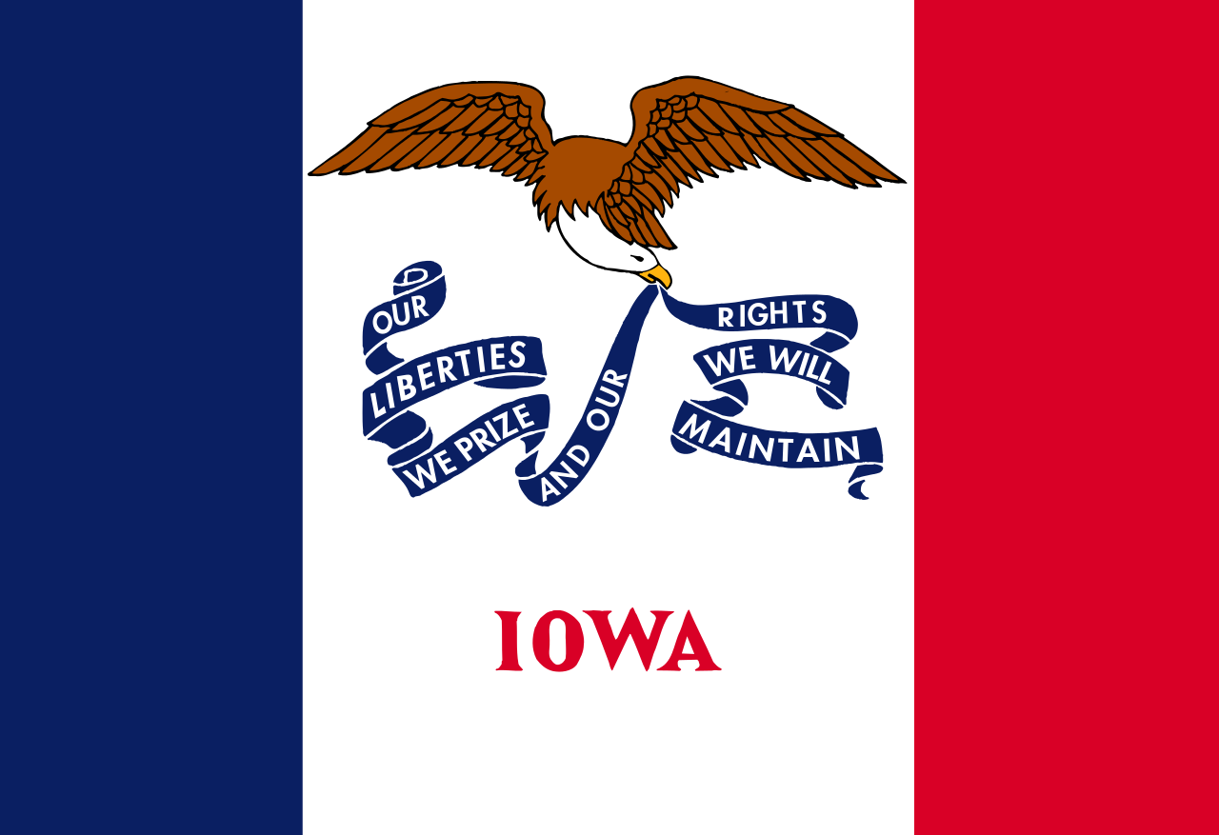
Problem
We are looking to analyze all of Iowa to find the best location for a liquor store.
We want to avoid outliers and over saturated areas.

Slide 3
Approach
Using the Iowa liquor database we will determine the best location to build a new liquor store.
We will test for the new location by measuring the total sale price and bottles sold for each county and zip code.

Slide 4
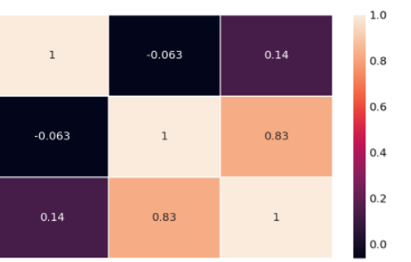
Total Sales Relation to Bottles sold
Bottle Retail Cost
Bottles Sold
Total Sales
Bottle Retail Cost | Bottles Sold | Total Sales

Slide 5
Get rid of the outliers
The majority of bottles sold were under 100 (quantity)
The average sale was under $1,000.00

Slide 6
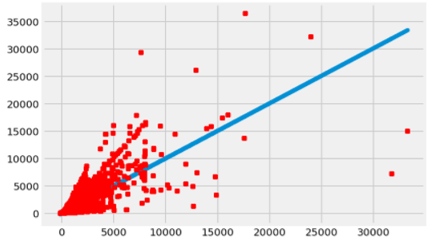
Total Sales / Bottles Sold per zip code
Total Sales
Bottles Sold per Zip Code

Slide 7

Total Sales / Bottles Sold per zip code
Total Sales
Bottles Sold per Zip Code

Slide 8
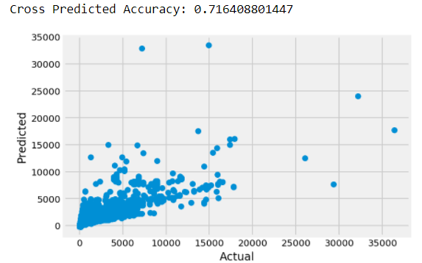
Cross Validation Test

Slide 9

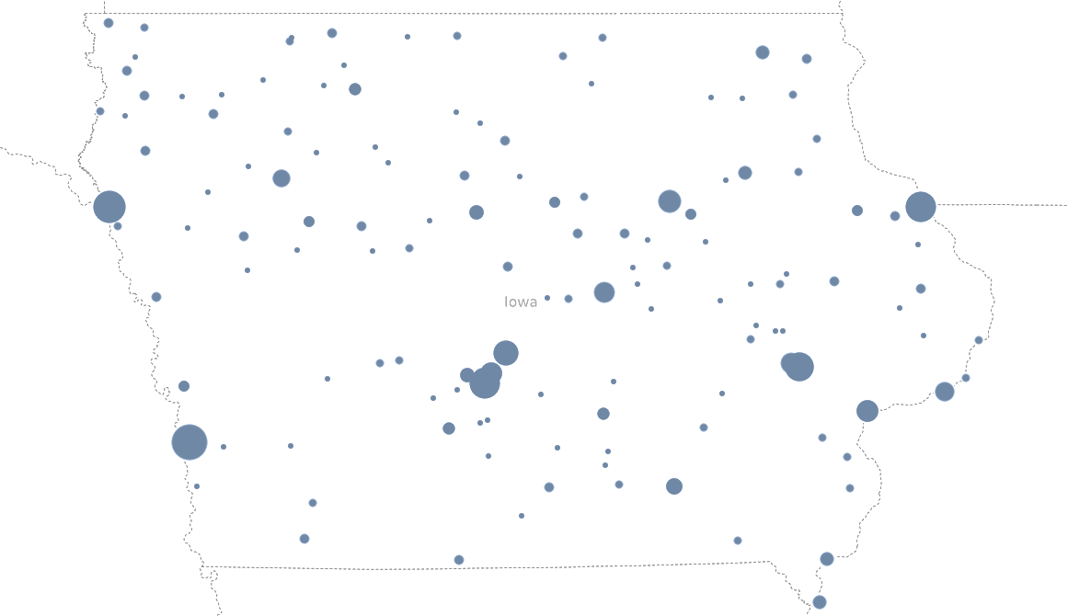
Current Active Liquor Stores in IOWA
https://data.iowa.gov/Economy/Iowa-Liquor-Sales

Slide 10
Recommendations
The zip code that we have shown to be the most promising to build a new location at is 50266
Other considerations: A new law was passed on May 9th that allows local distillers to sell directly to the consumer
Additional data requested
3rd Choice
2nd Choice
Zip Code 52154
Zip Code 50320
Zip Code 50266
1st Choice

