Slide 1
Combating the Opioid Epidemic with Treatment Program Expansion
Natalie Olivo, Matthew Bollinger, Dale Wahl, Kyle Santana, Diego Rodriguez

Slide 2
National Opioid Epidemic
53,000 opioid-related deaths in 2015
In 2013, an estimated 1.8 million people had an opioid use disorder related to prescription pain relievers, and about 517,000 people due to heroin
The Opioid Crisis: a $78 Billion in economic burden (CDC estimate)
One death equivalent to 10 treatment admissions, 32 emergency department visits, *Incarceration costs per opioid user are estimated to be 3 times hospital and ED costs
Value of a Statistical Life: $6.4 Million

Slide 3
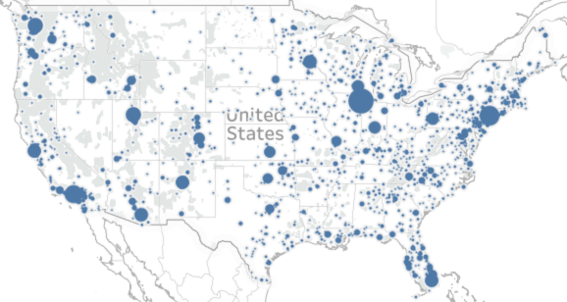
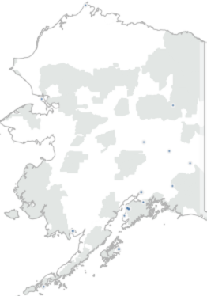

The Problem
Large sections of the U.S. do not have or have limited access to opioid treatment programs.

Slide 4
Our Solution
Our proposition is that if we leverage the $5 Billion funding, we can the increase the number of opioid treatment programs within substance abuse centers by 50% nationally, and decrease the number of opioid overdoses by 4-10%.
With $50 Million in funding, we would apply the same goal to three states

Slide 5
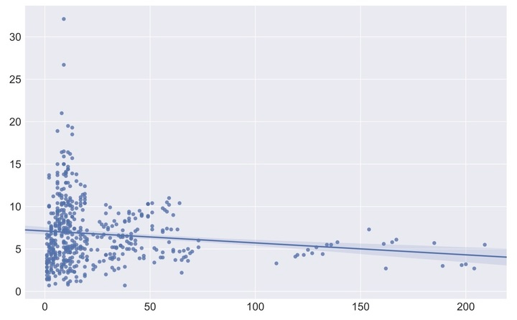
Opioid Treatment Facilities by State versus Number of Opioid Deaths
No. of Opioid Deaths per 100,000 people
No. of Opioid Treatment Facilities

Slide 6
Budget Allocation
$2.5B on the improvement of existing and development of new treatment centers
$2.5B on nationwide awareness program
Targeting existing clinic-goers and new patients
Print, radio and digital components, year-long execution
A $50 Million plan would focus on providing relief to the three states with the highest crude rates
West Virginia (32.1 overdose deaths per 100,000 people)
Nevada (19.5 overdose deaths)
Kentucky (16.2)

Slide 7
The Cost of Rehab
Detox Program: $1,000 to $1,500 in total (some with require more careful monitoring, making the price higher.
Inpatient Rehab: 6,000-$20,000 for a 30-day program.
Outpatient: $1,500-$2,500 for a 30-day program.
Medications: Year-long methadone treatment for heroin users costs around $4,700.

Slide 8
Focus on Destigmatization
“If we’re just substituting one opioid for another, we’re not moving the dial much” - Tom Price, on medication-assisted treatment
Opioid addiction is still stigmatized, preventing addicts from seeking needed care
Scotland’s See Me mental health campaign in the media achieved a 57% reduction in the use of derogatory terms for people with mental illness
A media campaign with a budget of $5 million comparable to similar campaigns in America could achieve significant results
Notes:
https://www.vox.com/policy-and-politics/2017/5/11/15613258/tom-price-opioid-epidemic https://www.ed.ac.uk/equality-diversity/news-events/news/see-me https://www.theguardian.com/society/2016/nov/29/act-up-aids-new-york-spencer-cox

Slide 9
A non-alternative: prescription drug monitoring programs
Limits opioid prescription access, monitoring and enforcement of prescriptions
Economic impact: 7.7% overall reduction in opioid deaths, AFTER an initial spike in heroin-related deaths
We would create a problem before providing a solution

Slide 10
Case Study: Oregon
Highest rate of nonmedical uses of prescription opioids for people 18 years and older in 2011–2012
In 2015-2017 ran Project Improvement Plan (PIP) aimed at improving the safety of prescription opioid management = through the funding of educational programs and clinics.
In 2016, nonmedical uses of prescription opioids dropped across all age groups.

Slide 11
References
7 - https://www.addictioncenter.com/rehab-questions/cost-of-drug-and-alcohol-treatment/

