Slide 1

Reddit Engagement
Kyle Santana Data Scientist

Slide 2
Problem
Create a Reddit post that will get the most engagement from Reddit users.
Scrape the frontpage of Reddit to collect the most up to date data.

Slide 3
Background
Reddit is the 4th most visited website in the US.
Allows users to submit, comment, and upvote or downvote on posts.
The site is divided into tens of thousands of communities, called sub-reddits.
Reddit is open source but it’s spam detection algorithm is proprietary.
Source: https://www.alexa.com/topsites/countries/US

Slide 4
Reddit Scraper
Using Python and BeautifulSoup we built a scraper that iterated through 1000 pages of Reddits /All page.
It pulled the following information: Title, Subreddit, Comment Count, Score, Author, Time .

Slide 5
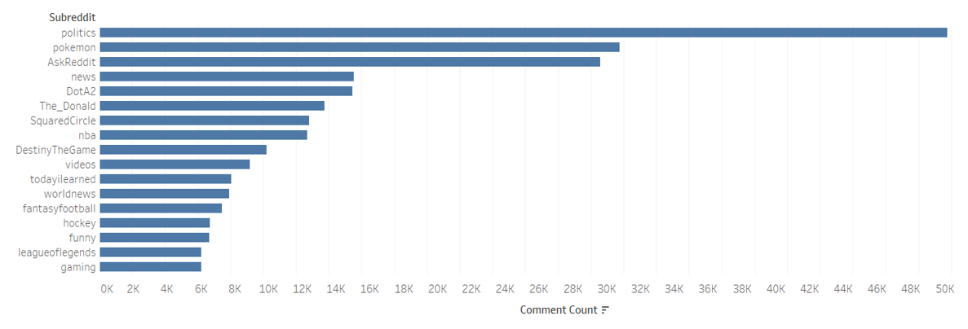
Sub-reddit Comment Count
Accuracy = 74%
Notes:
Logistic regression is a statistical method for analyzing a dataset in which there are one or more independent variables that determine an outcome. The outcome is measured with a dichotomous variable (in which there are only two possible outcomes).

Slide 6
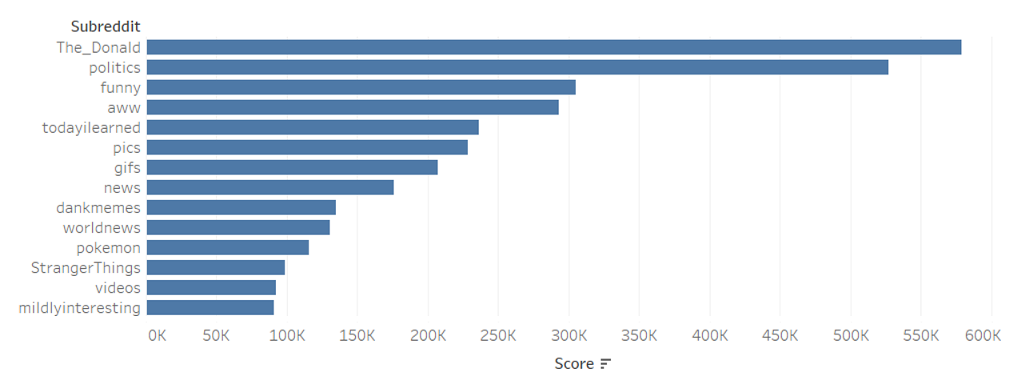
Sub-reddit Score Count
Accuracy = 72%
Notes:
Logistic regression is a statistical method for analyzing a dataset in which there are one or more independent variables that determine an outcome. The outcome is measured with a dichotomous variable (in which there are only two possible outcomes).

Slide 7
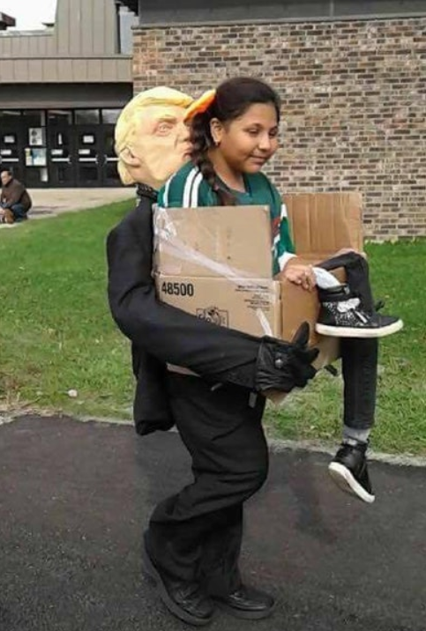
Word Popularity
3 most popular words at time scraped were:
Halloween
Trump
Mueller
"Getting deported by Trump" Halloween costume

Slide 8
Natural Language Processing
As you recall from the beginning of the presentation we also collected the post titles.
By themselves the post titles are not very helpful.
However we can run them through a countvectorizer which breaks the words into their constituted parts.
Notes:
TFIDF, short for term frequency–inverse document frequency

Slide 9
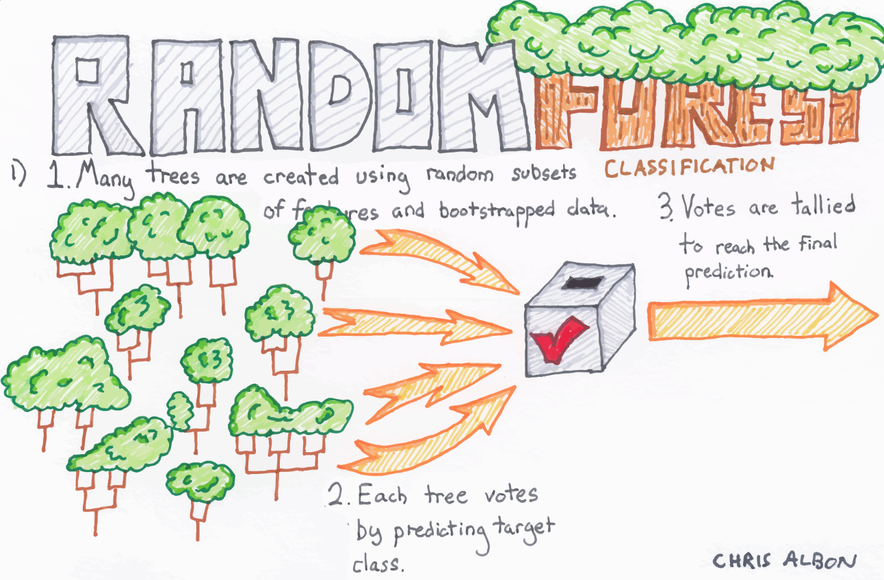
Random Forest
After using countvectorizing the titles we ran it through a random forest comparing them to total comments.
Notes:
ensemble methods use multiple learning algorithms to obtain better predictive performance than could be obtained from any of the constituent learning algorithms alone.

Slide 10

Recommendations
The ideal post for maximum user engagement would be posted in the politics sub-Reddit and discuss President Trump along with any holiday that is coming up.

Slide 11
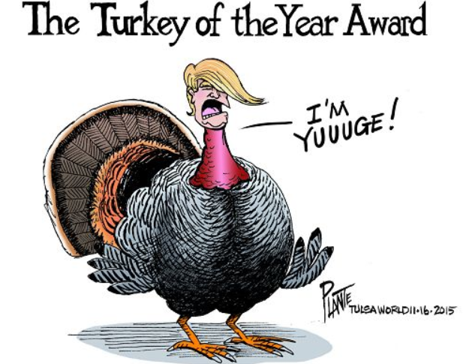
MAKE AMERICA GOBBLE AGAIN!
Article title for maximum effectiveness:
Trumps 10 Recipes for a Successful Thanksgiving Visualized.

Slide 12
Conclusion
We investigated using logistic regression, gridsearch, and random forest models with sub-reddits as a variable. Our highest model using gridsearch achieved an accuracy score of 76%.
We have found a correlation that posting a political post can lead to an increased amount of comments.

Slide 13
Further Analysis
While researching the best way to increase user comments on Reddit we noticed that certain sub-reddits have vastly different cultures.
Given more time I would like to explore those culture differences to more accurately predict higher engagement models.

Slide 14

Questions?

