Slide 1
Project 1
By Kyle Santana
For Data Science immersive

Slide 2

Problem:
How can we improve participation in the SATs?
Since 2012 ACT has surpassed SAT in the Assessment test Market.

Slide 3
Approach
By looking at recent data we will put together a plan of action on increasing the SAT participation rate.

Slide 4
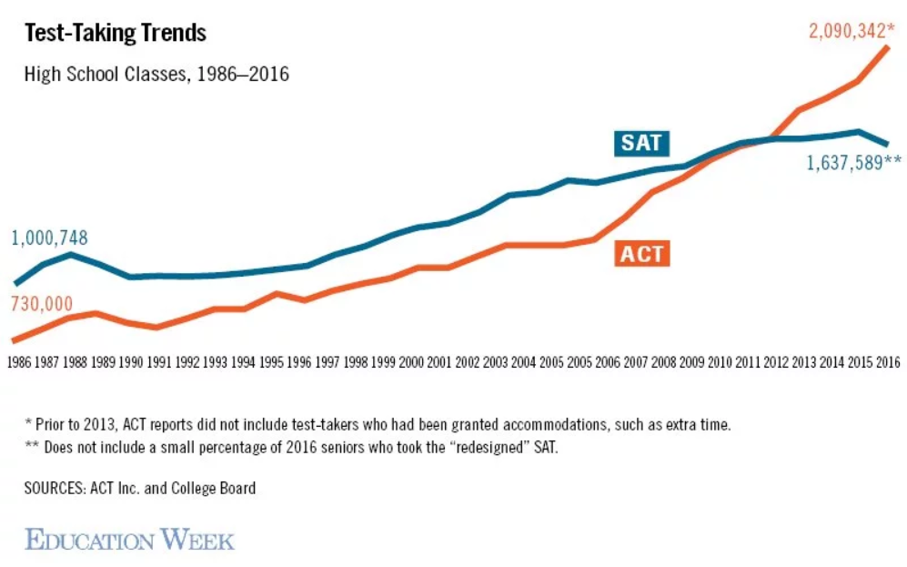
What is happening now
Recent changes to the SAT
Free SAT Prep
Rights only scoring

Slide 5
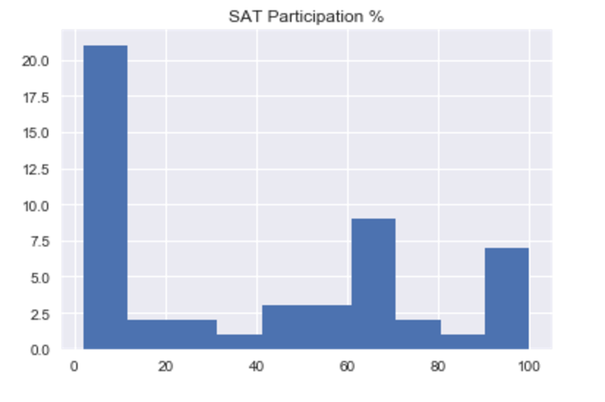
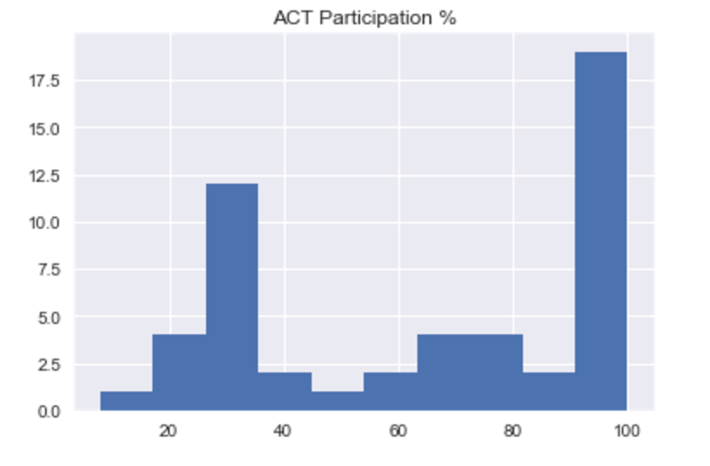
SAT vs ACT Participation

Slide 6
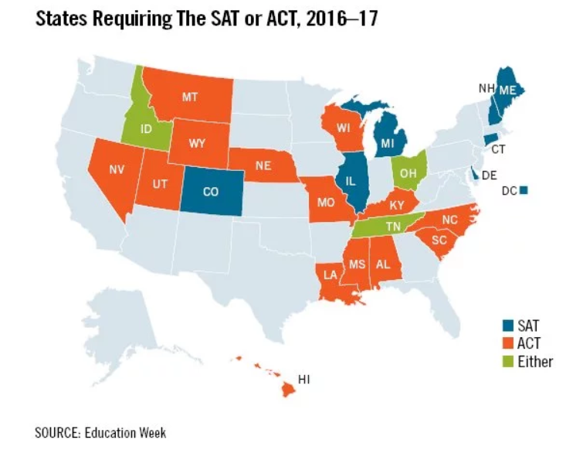
States requiring the SAT or ACT
Source: http://www.edweek.org

Slide 7

Proposed Solution
Offer all 11th graders a free SAT exam.
Provide a story.
“Improve your chances for success one bubble at a time”

Slide 8
Resources
Please visit my website at https://ksantana3.github.io/portfolio-website/to view data and formulas used.

