Slide 1
Iterated Prisoner’s Dilemma: Can We Improve?
Kolby Sarson, Joel Rorseth, Michael Melanson, Michael Bianchi

Slide 2
Goals
Compare common known strategies to determine which is the most effective
Design and implement artificially intelligent algorithms that can generate an optimal strategy when competing against the common strategies selected
Compare the ability of our artificially intelligent algorithms to produce effective strategies

Slide 3
Algorithms/Strategies
Search Algorithms
Hill Climbing Algorithm
Genetic Algorithm
Strategies
Tit for Tat
Tit for 2 Tat
Suspicious Tit for Tat

Slide 4
Comparison of Known Strategies
Axelrod
Python library designed to simulate IPD and strategies
Simulation of both individual games, and tournaments
Can include any number of different strategies in a given simulation
Ran simulations for TFT, TF2T and STFT
Used the results to determine which strategy was the most effective

Slide 5
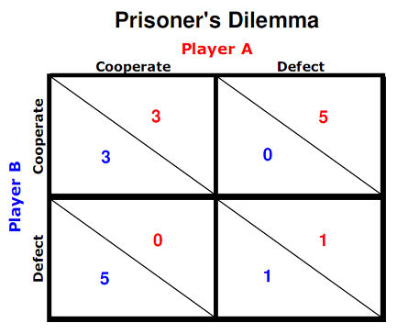
Setup: Scoring Method
Robert Axelrod

Slide 6
What We Did
Determined the most effective common strategy using Axelrod
Designed both a genetic and hill climbing algorithm
Designed a program that could pit our algorithms against the strategies previously mentioned
Ran numerous experiments with multiple variations

Slide 7
Strategies
TFT and TF2T can both be seen as trusting strategies
They will never fall into an infinite loop of defection
STFT is susceptible to this loop as it is not considered trusting
TFT works best when its opponent will try to maximize its score
When TFT is pinned against a random opponent, it will sink to its opponent’s level
TFT is not the best strategy for this scenario

Slide 8
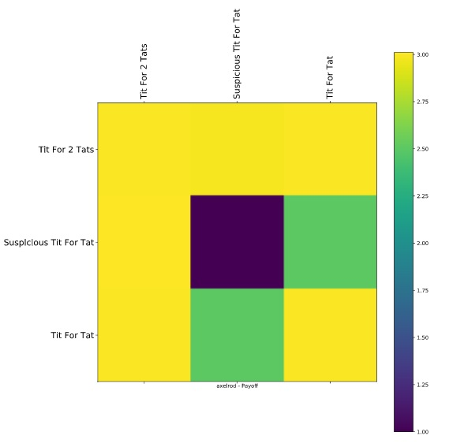
Axelrod Results
Shared the same score:
TFT vs TF2T
TFT vs TFT
TF2T vs TF2T
STFT vs TF2T
STFT always wins by 5
STFT vs STFT
Ties but always lowest score since it always defects
TFT vs STFT
Ties but slightly lower score
5pts/2turns rather than the max of 6pts/2turns
Payoff Table between TFT, TF2T and STFT

Slide 9
Search Strategy #1 - Hill Climbing
Initial State
Randomly generate 'C'/'D' sequence, hope for good relative placement
Successor Function
Determine all successors, defined as sequences with one differing element
For sequence of size n, there exists n successors
Fitness Function
Scoring metric used is score, defined by R. Axelrod [1]
Traversal
Traverse to most fit successor repeatedly, until no successor yields improved score
Obviously prone to local maxima, although cycles are avoided
[1] - Axelrod, R. (1980). Effective Choice in the Prisoner's Dilemma. The Journal of Conflict Resolution, 24(1), 3-25. Retrieved from http://www.jstor.org/stable/173932

Slide 10
Hill Climbing
Initialize a random sequence of C/D, of size n
Initialize the current node, defined as the most fit sequence in a given iteration, equal to this sequence
REPEAT :
Generate all successors, defined as any sequence differing by exactly one element in sequence
Determine next node, which is the most fit (highest scoring) sequence of all successors
IF (next node is has a strictly larger score than current node ):
current node is set equal to next node
ELSE
Return current node, the final best sequence determined

Slide 11
Search Strategy #2 - Genetic Algorithm
Initial Population
Collection of randomly generated sequences of 'C'/'D's, fixed size
Fitness Evaluation
Sequence fitness is simply score [1] when played against known strategy
Selection
Use a weighted random selection process that favours fit parents
Crossover
One child produced for every two selected parents by crossing over at a random point
Mutation
Varied probability of flipping 'D'/'C' at any given index in new children
[1] - Axelrod, R. (1980). Effective Choice in the Prisoner's Dilemma. The Journal of Conflict Resolution, 24(1), 3-25. Retrieved from http://www.jstor.org/stable/173932

Slide 12
Genetic Algorithm
Randomly generate a random initial population of size s
REPEAT (for each generation g):
Score each sequence in the population, initialize next generation with top n sequences (Elitist)
For the remaining (s - n) sequences:
Selection: Select two parents, proportionally likely to be fit sequences
Crossover: Form new child sequence by combining parent sequences about random index
Mutation: Consider for each element in sequence, flipping 'C'/'D' with probability p
Add child sequence to the next generation
Population is replaced with next generation, this population is evaluated to find most fit sequence

Slide 13
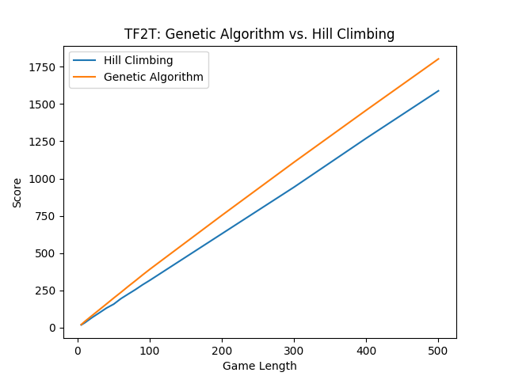
GA: Population size = # generations = 100
Mutation probability = 0.015
* Scores averaged over 10 games

Slide 14
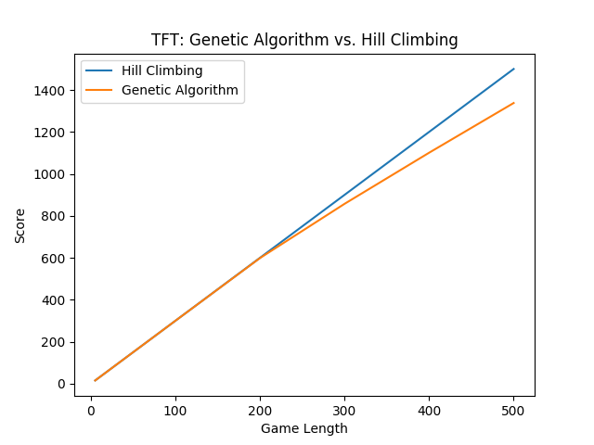
Identical simulation parameters to last slide
Hill Climber performs better at times due to ordering defined by successor function

Slide 15
Genetic Algorithm: Fitness
Given player sequence (genome), opponent genome can be determined by its definition
Axelrod scoring applied to score the player, evaluating move by move
Fitness heuristic aims to maximize the player score
Comparison such as hamming distance would be poor, since matching opponents moves is never necessarily beneficial

Slide 16
Genetic Algorithm: Generations
Elitism was used successfully to boost eventual fitness
Elitism sustains a small number of only the most fit members of population, between generations
Elitism simulates memory depth for our purposes
The top n sequences from the current generation are saved
Memory depth greater than 1 paired with elitism would cause redundancy
This allows fit sequences to remain to spawn similar children
Remaining new member of each generation are generated using standard selection, crossover, and mutation techniques

Slide 17
Current State of Our GA
Our GA is currently not producing the maximum score that it could be producing assuming a STFT opponent
We hypothesized that this was due to the GA vs STFT match becoming stuck in an infinite loop of defecting
After doing some research [1], and running multiple tests, we were able to confirm this hypothesis
In order to counteract this defection loop, our algorithm would need to access the past matches against its opponent
Doing this would transition our algorithm away from being genetic
[1] - Bendor, J. & Swistak, P. The evolution of norms. Am. J. Social. 1943-1545 (2001)

Slide 18
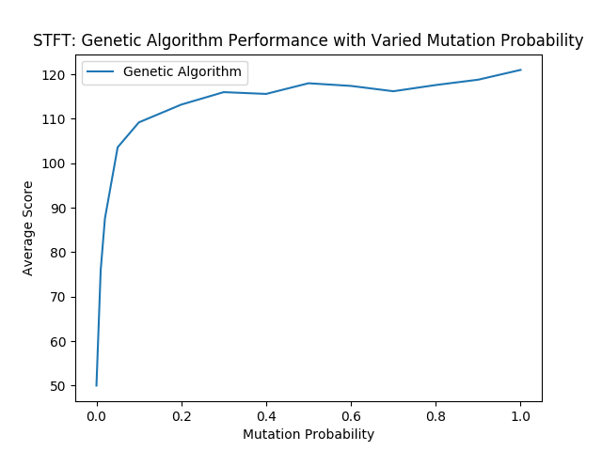
GA: Population size = # generations = 100, game size = 50 moves
* Scores averaged over 10 games
GA performance against STFT opponent is positively correlated with mutation probability, but not normally for other strategies

Slide 19
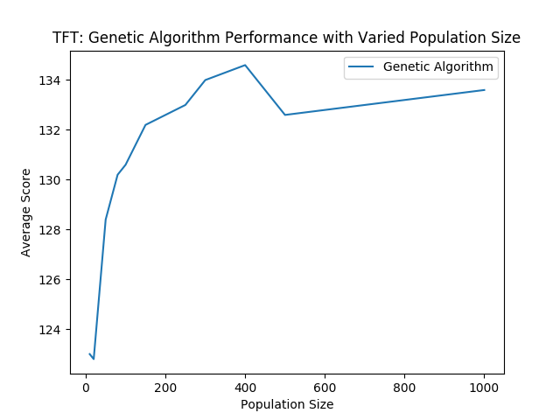
GA: # generations = 5, game size = 50 moves, mutation probability = 0.015
* Scores averaged over 10 games
With few generations, large population size yields more possible optimal solutions

Slide 20
Conclusions
Each of Hill Climbing and Genetic Algorithms have certain situations in which they outperform each other
GA appear to outperform HC Algorithms more often
Genetic Algorithms are largely sensitive to their mutation rate
Seen when competing against STFT
The “best” sequence against an opponent is dynamic
The selected opponents are also intelligent agents
The opponent’s sequence acted dynamically against our algorithms, which led to the “best” sequence being dynamic as well

