Slide 1
SECURE DATA HIDING IN IMAGES USING STEGANOGRAPHY
CAPSTONE PROJECT
Presented By:
Student Name : SASIREKHA K
College Name & Department : Sri Manakula Vinayagar Engineering College & B.Tech. Artificial Intelligence and Data Science

Slide 2
OUTLINE
Problem Statement
Technology used
Wow factor
End users
Result
Conclusion
Git-hub Link
Future scope

Slide 3
Problem Statement
This project aims to develop a secure image-based steganography system for military communications. It will enable encryption and decryption of sensitive data within images to ensure covert transmission. The solution enhances data security, prevents unauthorized access, and safeguards critical military information during storage and exchange.

Slide 4
Technology used
Libraries and platforms:
Streamlit
Open cv2
Numpy
os

Slide 5
Wow factors
Strong AES encryption for secure data
A user-friendly Streamlit interface
Support for multiple image formats
Suitability for military-grade secure communication

Slide 6
End users
Military personnel
Intelligence agencies
Defense organizations
Cybersecurity teams

Slide 7
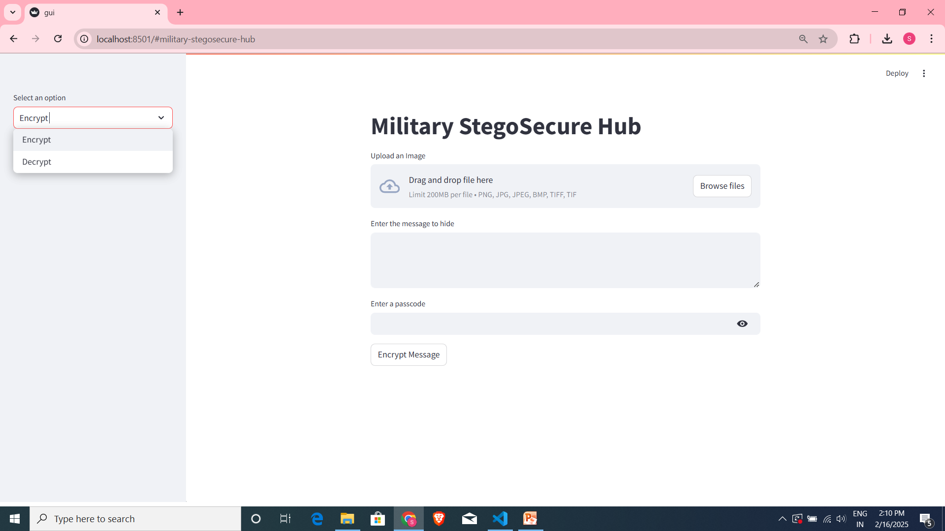
Results(GUI)

Slide 8
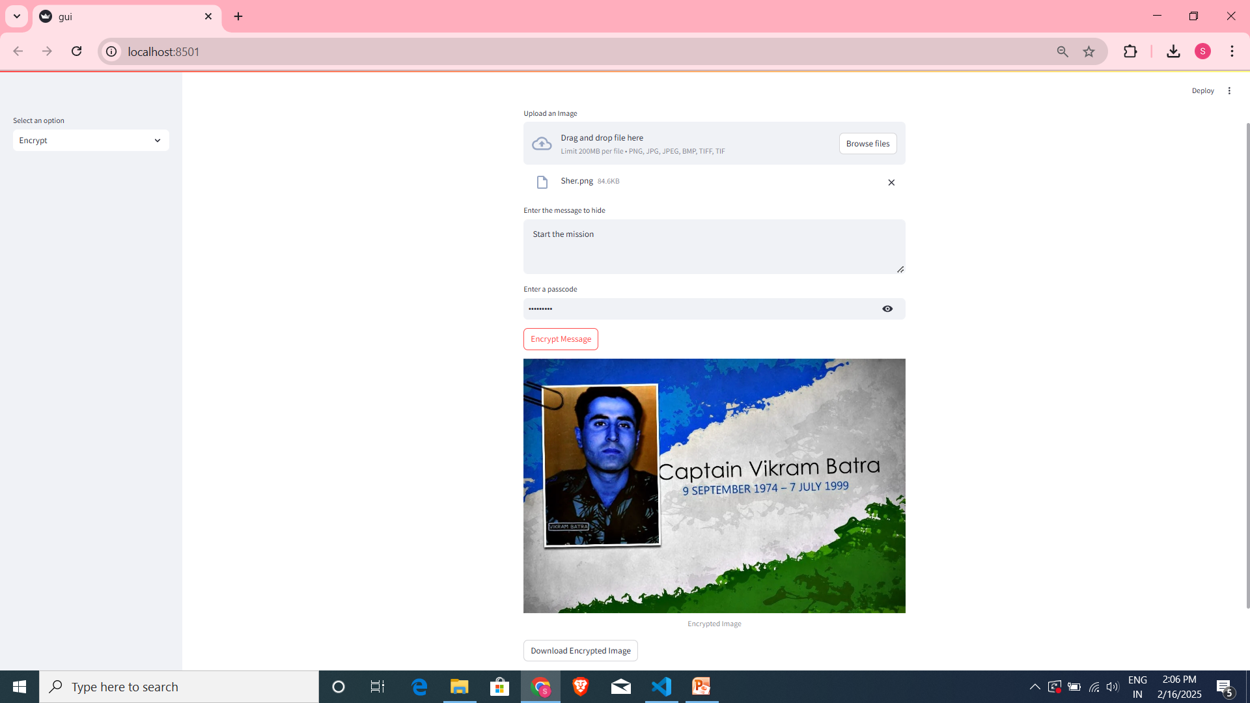
Results(Encryption phase)

Slide 9
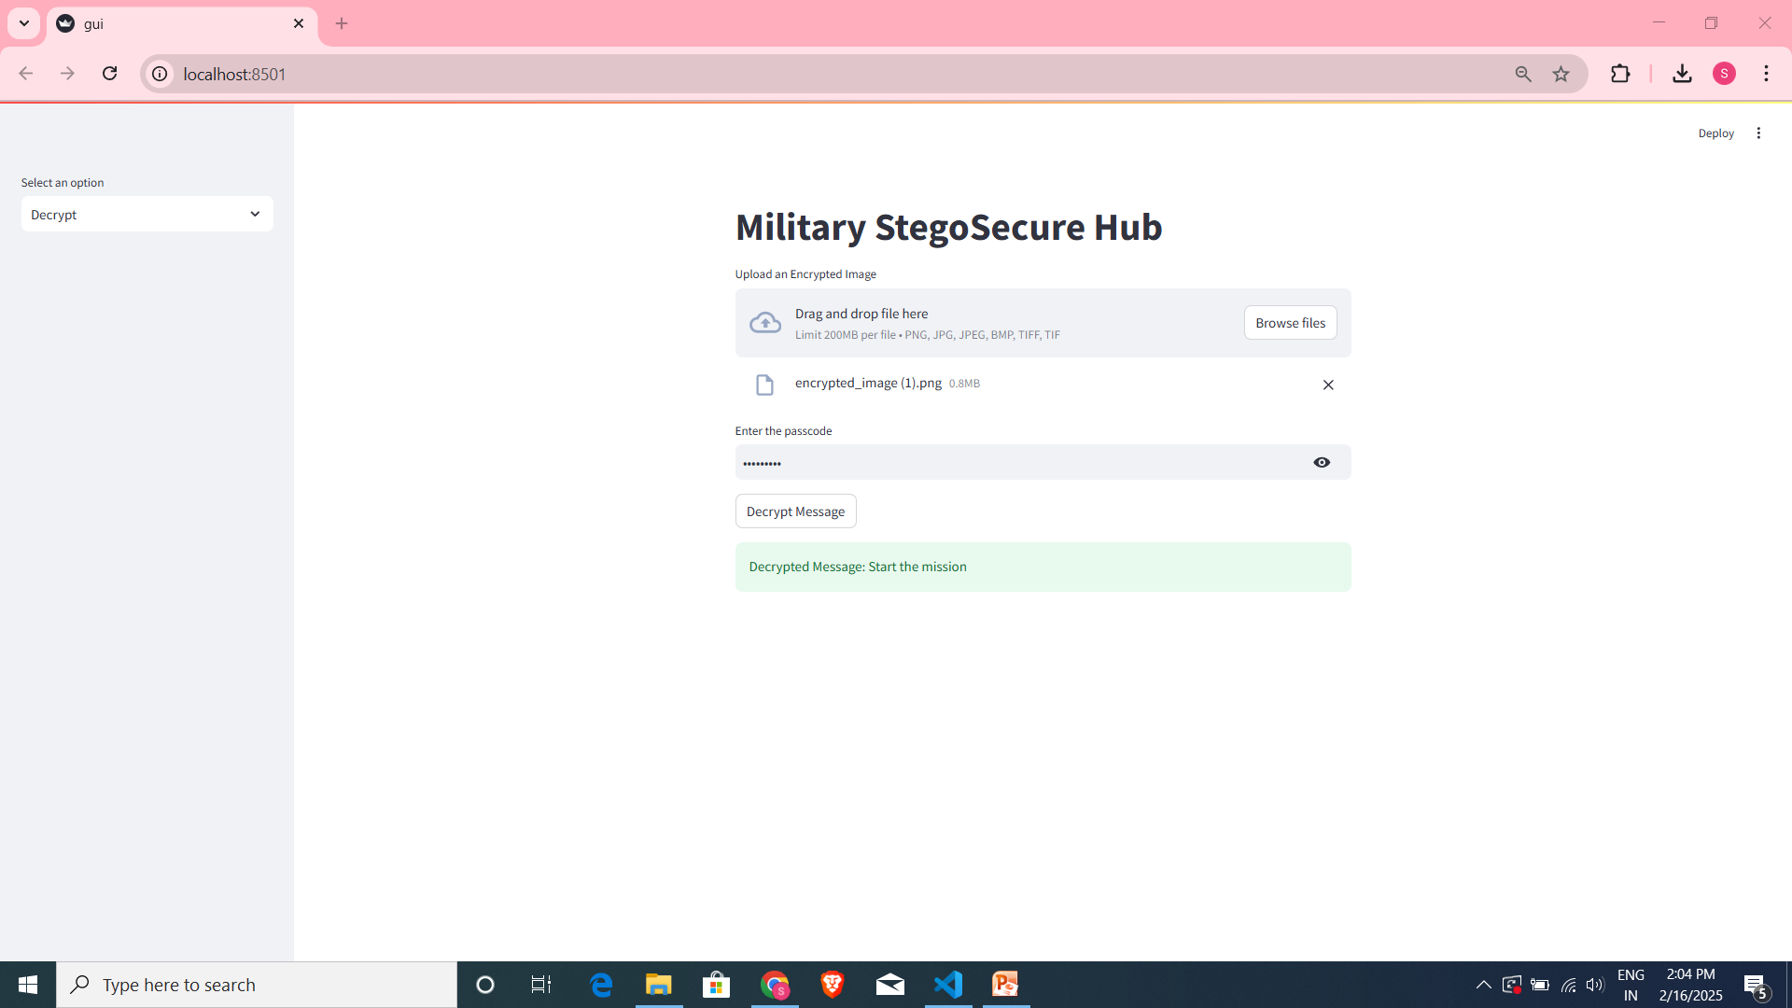
Results(decryption phase)

Slide 10
Conclusion
This project, 'Military StegoSecure Hub,' provides a secure solution for military image steganography using AES encryption, ensuring sensitive data remains protected. The Streamlit GUI offers easy encryption and decryption with support for multiple formats. It stands out for its strong security, usability, and relevance in military communications.

Slide 11
GitHub Link
https://github.com/ksasirekha/Military-StegoSecure-Hub.git

Slide 12
Future scope
This project can be extended to include audio and video steganography for comprehensive multimedia security in military operations. Integration with blockchain technology can enhance data integrity and tracking. Advanced AI algorithms can be added for automated detection of tampering, and cloud-based deployment can ensure secure remote access and scalability.

Slide 13
THANK YOU

