Slide 1
GenSpark PowerPoint Template
Spark the future

Slide 2
Customer Mgt. Web app

Slide 3
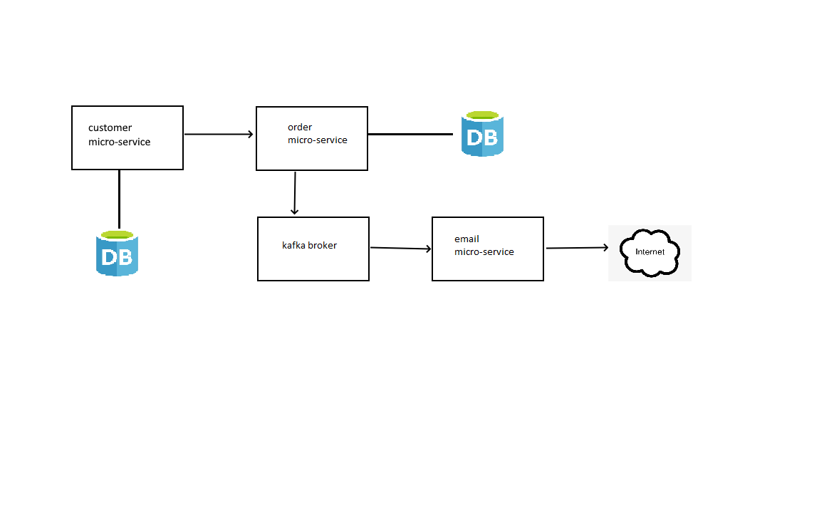
Architectural Design

Slide 4
Technologies used
Java
Spring Boot
Spring Security
Spring JavaMailSender
Spring Data JPA
Kafka/Zookeeper
MySQL
Thymleaf
MVC and REST API with Spring Boot
Spring for Apache Kafka
Eureka Service Registry

Slide 5
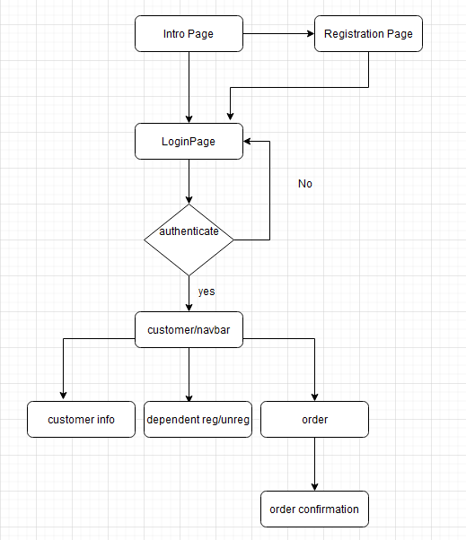
Flow Chart

Slide 6
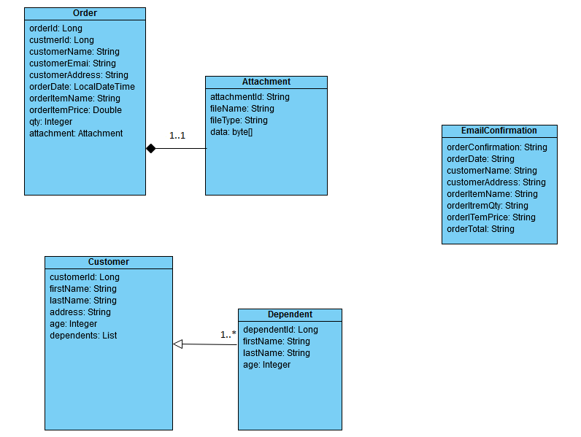
Class Diagram

Slide 7
JUnit Tests
//Create and Save Customer
@Test
public void testCreateCustomer() {
Customer customer = new Customer();
customer.setEmail("Kashman@gmail.com");
customer.setPassword("kash2023");
customer.setFirstName("Kash");
customer.setLastName("Sattar");
Customer savedCustomer = customerService.saveCustomer(customer);
Customer existCustomer = customerService.findCustomer(savedCustomer.getCustomerId());
assertThat(savedCustomer).isEqualTo(existCustomer);
}

Slide 8
JUnit Test
// Add/Remove dependents
@Test
public void testCreateRemoveDependent(){
Customer customer = new Customer();
customer.setEmail("Kashman@gmail.com");
customer.setPassword("kash2023");
customer.setFirstName("Kash");
customer.setLastName("Sattar");
customer.addDependent(new Dependent("Mickey","Mouse",11));
customer.addDependent(new Dependent("Thomas","Mouse",8));
//test add dependent
Customer savedCustomer = customerService.saveCustomer(customer);
List<Dependent> savedDependents = customerService.saveCustomer(customer).getDependents();
Customer existCustomer = customerService.findCustomer(savedCustomer.getCustomerId());
List<Dependent> existDependents = existCustomer.getDependents();
log.info(savedDependents.toString());

Slide 9
JUnit Tests
assertThat(savedDependents).isEqualTo(existDependents);
//test remove dependent
customer = savedCustomer;
customer.removeDependent(savedCustomer.getDependents().get(0).getDependentId());
savedDependents = customerService.saveCustomer(customer).getDependents();
existCustomer = customerService.findCustomer(customer.getCustomerId());
existDependents = existCustomer.getDependents();
log.info(savedDependents.toString());
assertThat(savedDependents).isEqualTo(existDependents);
}

