Slide 1
Case Study: Analysis of Online Hotel Booking Data and Interpreting the results for strategic decision making
Prepared By:
Saurav Kumar

Slide 2
Content
Brief Description of the Case
Basic Assumptions
Landing Page (Data Driven Questions/Visual list)
Charts/Plots
Marketing Mix and Funnel Process

Slide 3
Brief Description of the Case
Online Booking Data for the period of Aug, 2016 to Dec, 2016
Total No of records: 49061 (total bookings)
5 dummy city: A,B,C,D, and E
Fields/Variables:
ADR_USD
hotel_id
city_id
star_rating
accommodation_type_name
chain_hotel
booking_date
checkin_date
checkout_date
Task: Analyzing data and suggesting data driven recommendations

Slide 4
Assumptions
The data shared with us is only data available to do the analysis and take decision.
All hotels/properties are present throughout the given period.
No data is provided for room/capacity of the properties. Thus, even a single booking of the hotel has been considered as fully occupied for that day.

Slide 5
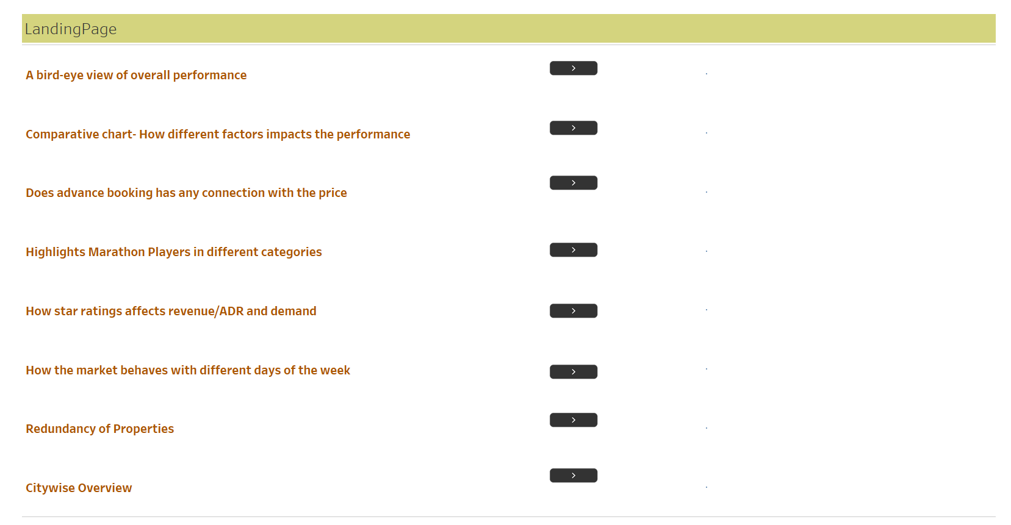

Slide 6
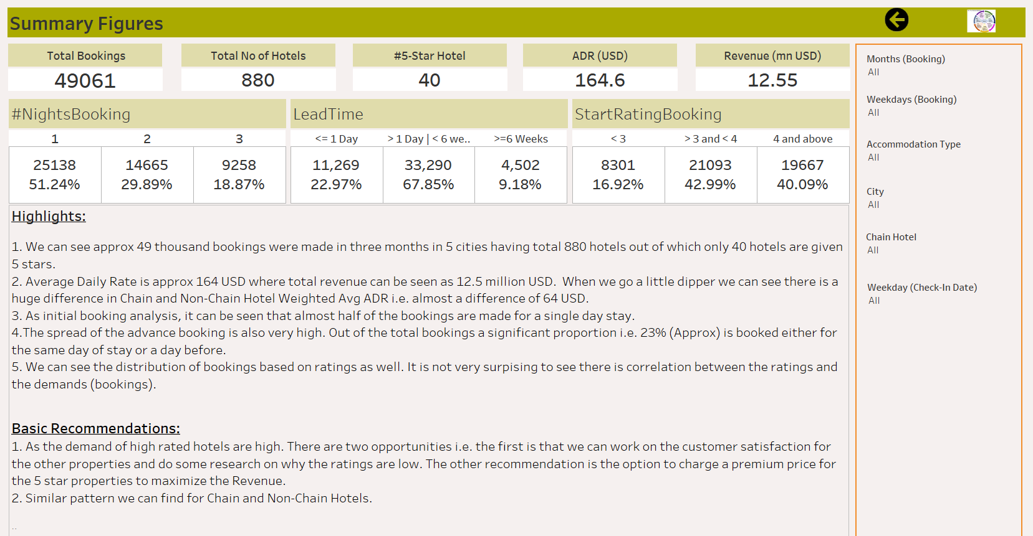

Slide 7
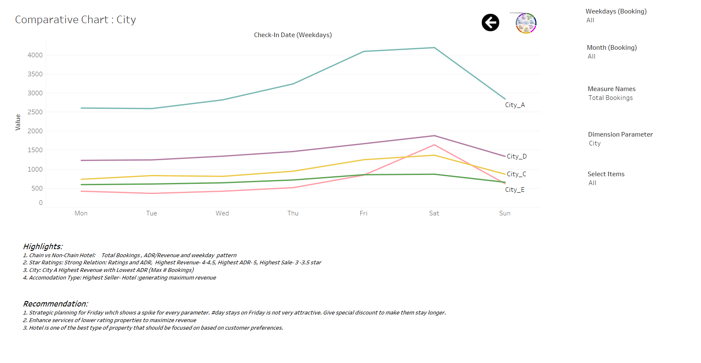

Slide 8
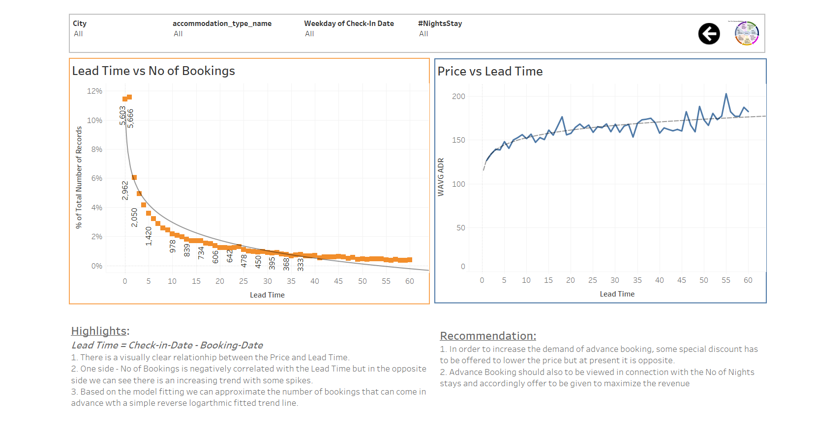

Slide 9
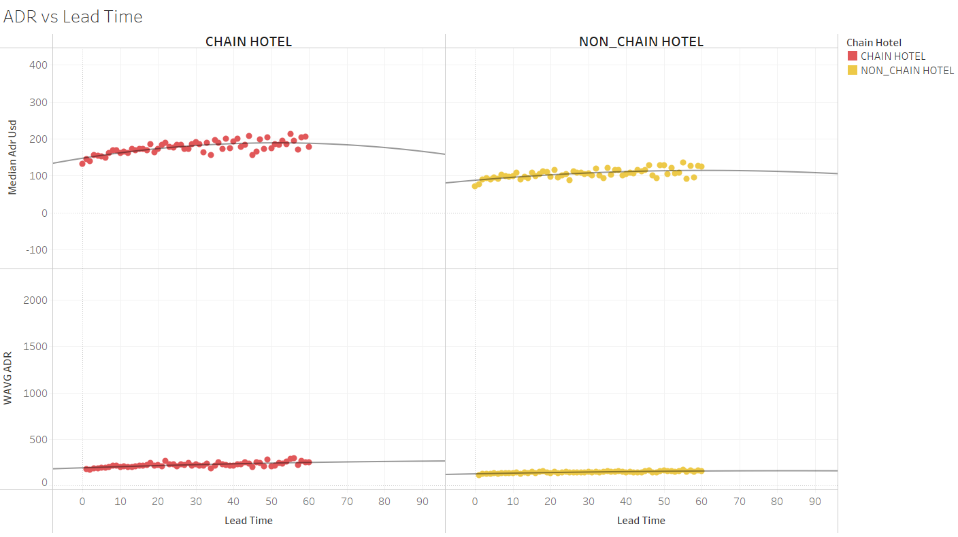

Slide 10
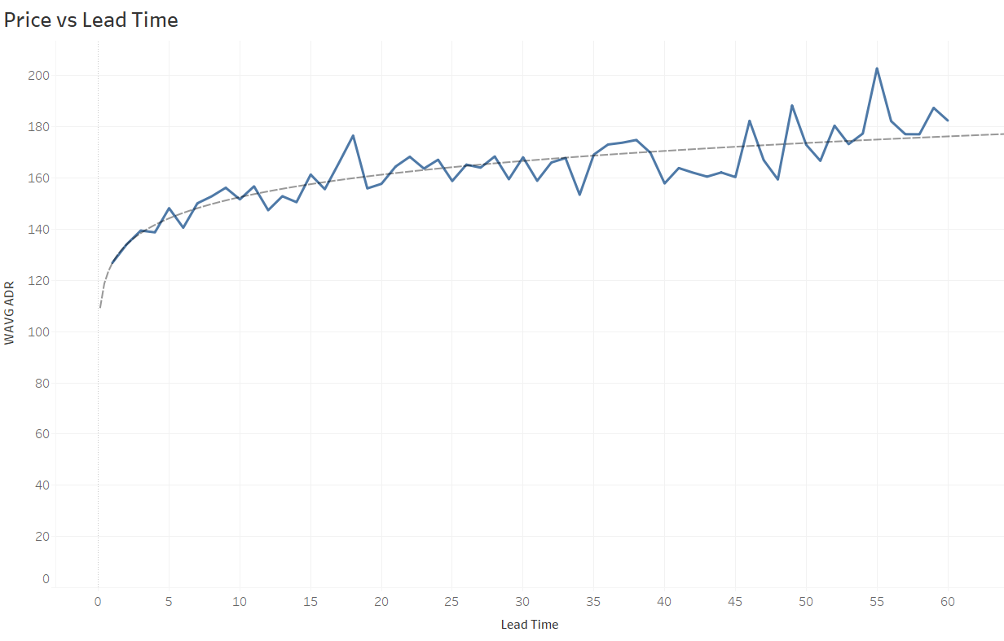

Slide 11
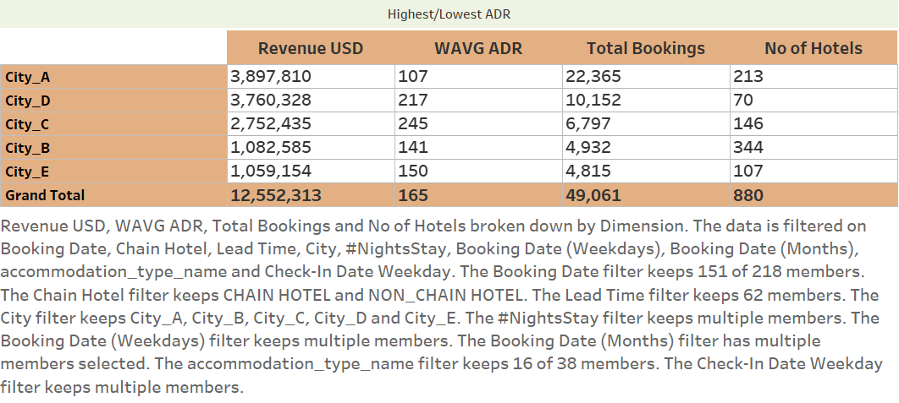
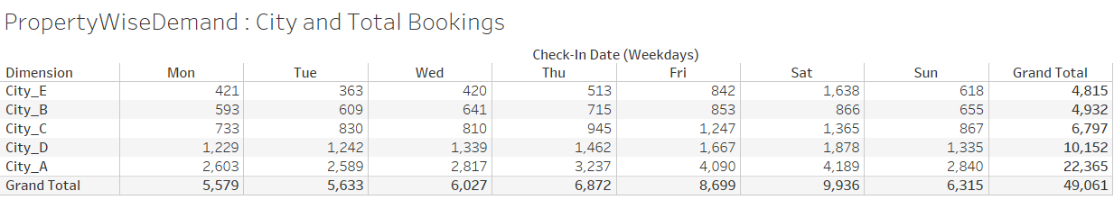

Slide 12
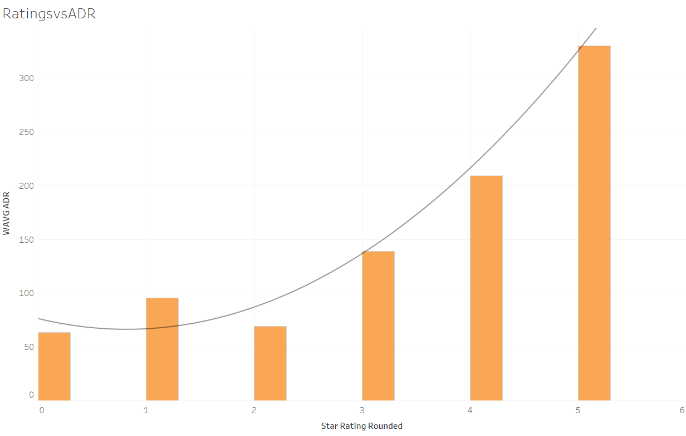

Slide 13
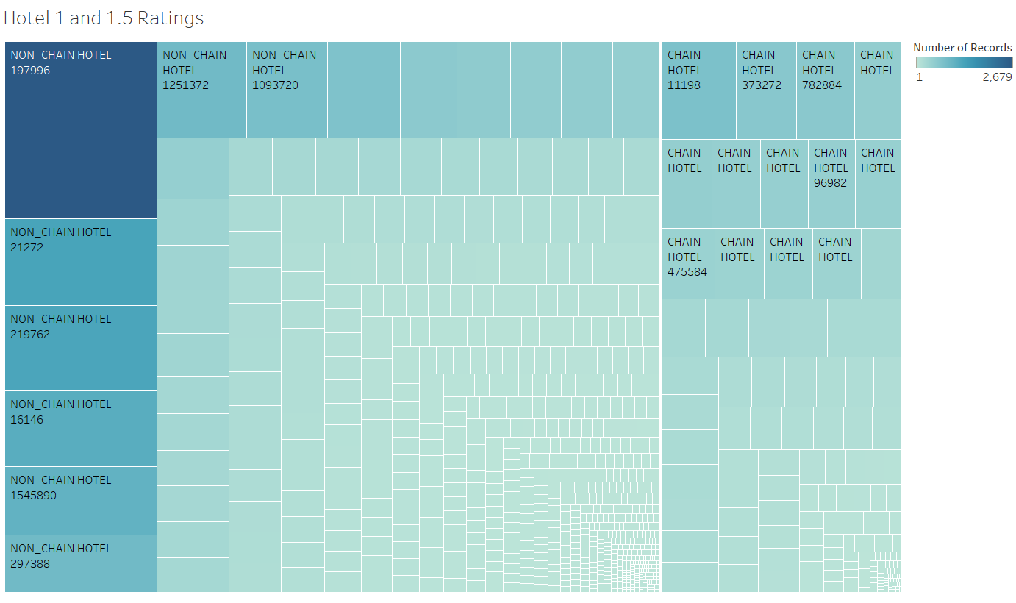

Slide 14
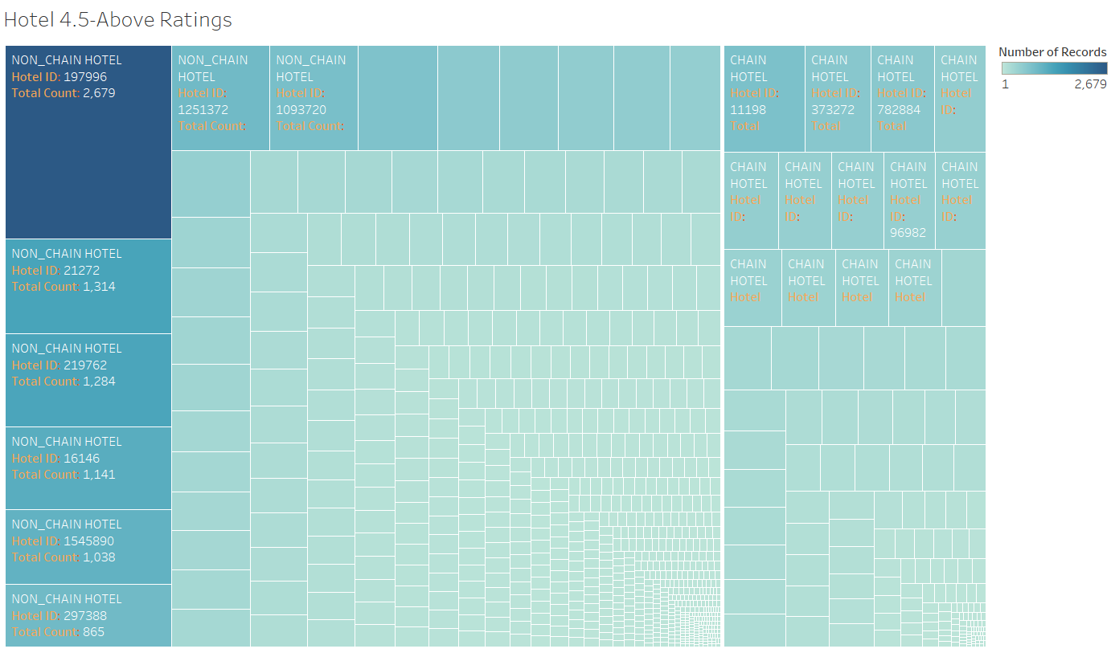

Slide 15
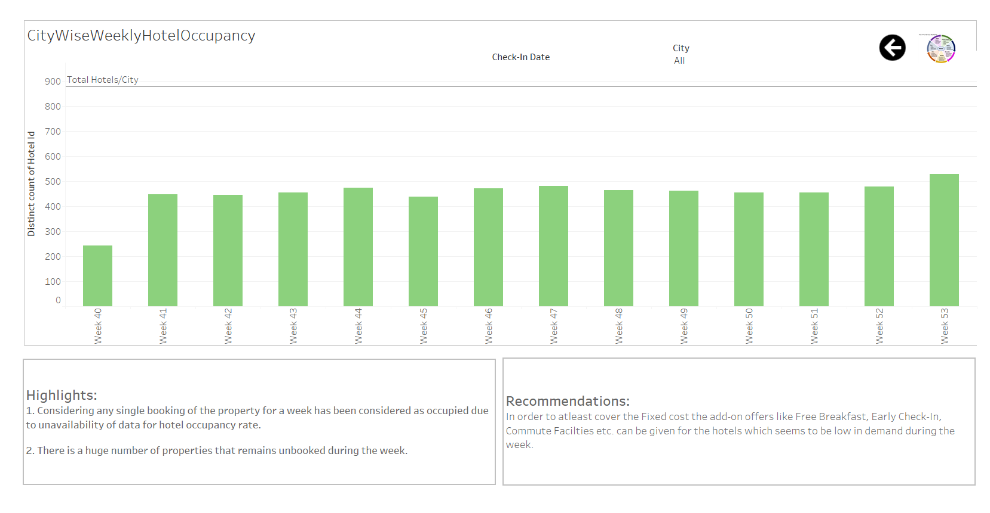

Slide 16
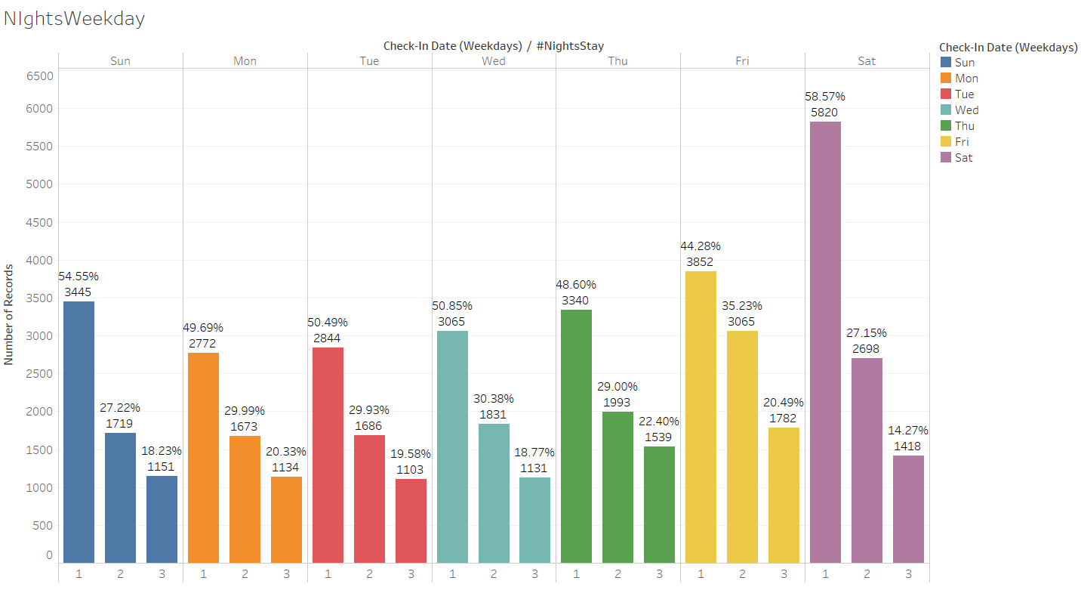

Slide 17
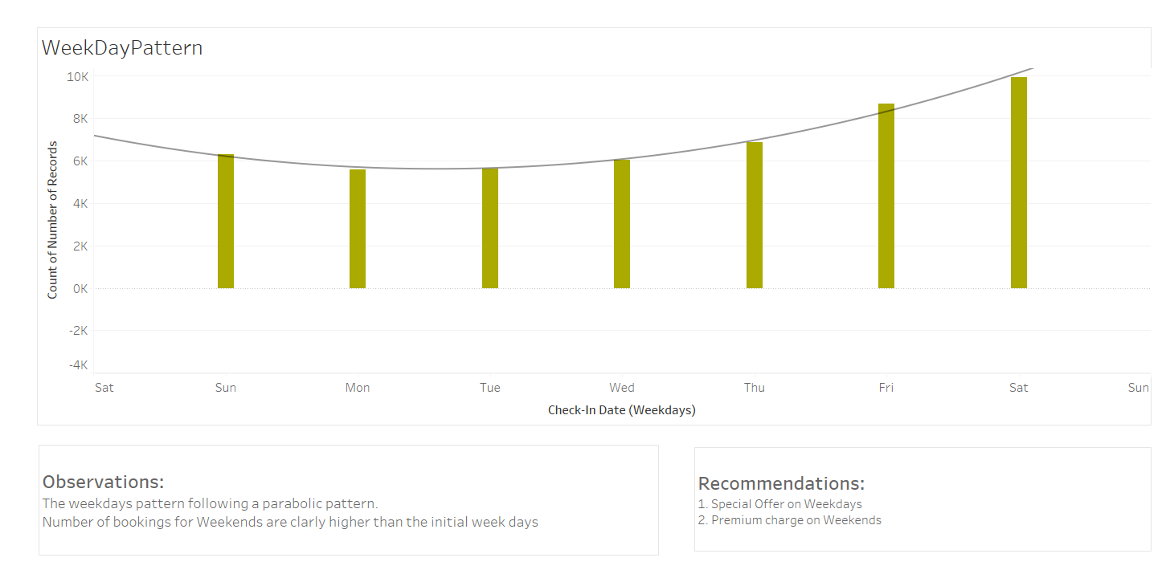

Slide 18
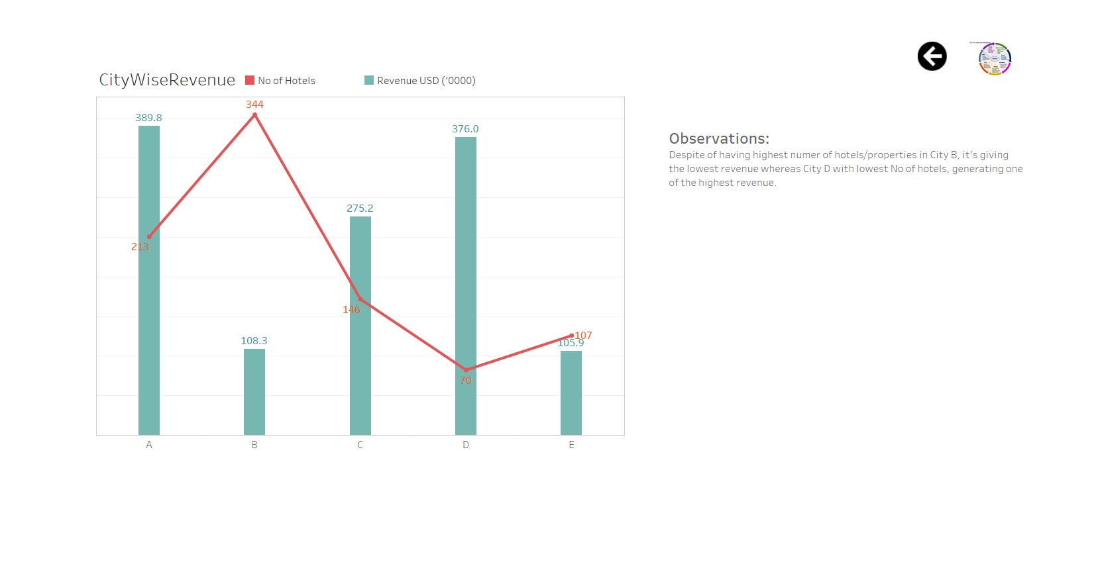

Slide 19
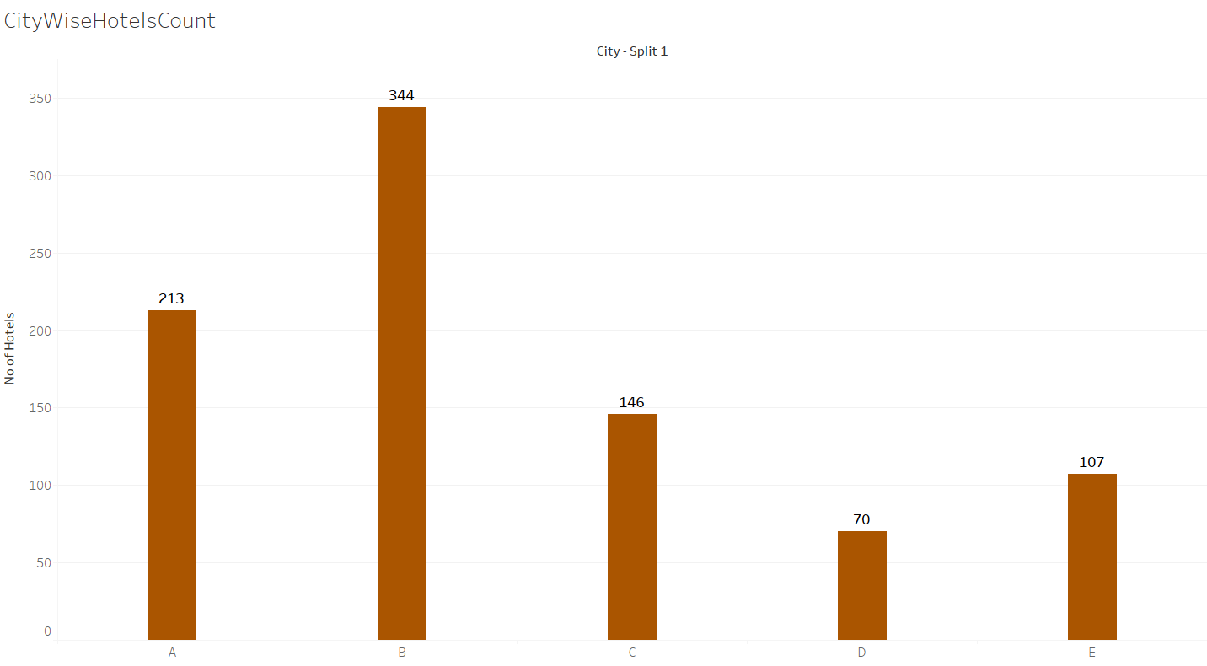

Slide 20
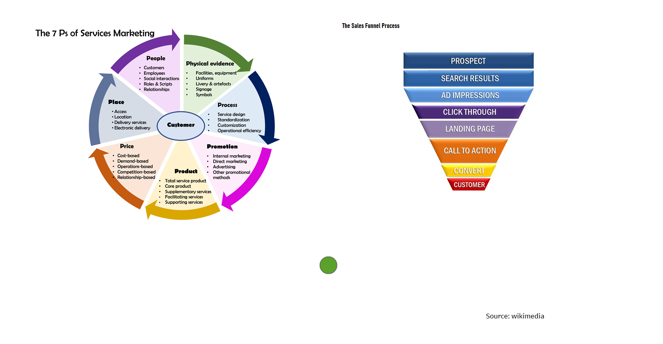

Slide 21
Major Findings & Recommendations
More discount should be offered in cities with lesser demand
Maximum bookings are generally made on the day of check-in or a day prior. So, the certainty of the customer check-in should be better ensured.
Bookings generally consists of single room for single nights.
Demand of hotels in weekends are higher thus a better strategic planning with premium price for demanding cities can help to get more revenues.
The price in city B is the lowest and the no of properties is the highest. It means other tangible benefits must be provided in order to increase the occupancy.
Number of hotel should be increased in city D as it has the highest rate. So the revenue can be maximized.
Price and Lead Time (Advance Booking) has a strange pattern which should be reversed to attract more customers to book in advance.
There is a direct relation between star ratings and price. More focus to be given to bring more properties under higher start categories. Only 4% of the properties are having 5 stars.

Slide 22
Thank you
Questions Please??

