Slide 1
Telecom Customer Churn Prediction
PRESENTED BY:-
1. GANGADHAR EPILI
2. Karishma Sawant
3. MADHUR NAGARAJAN

Slide 2
Agenda:-
Introduction
Data Set
Data Analysis
Unit Root Test
Arima Model implementation and Forecasting
Accuracy Check
Conclusion

Slide 3
INTRODUCTION
GOAL
What factors influence customers to part ways with their existing service provider?
QUESTIONS:
1. What are the demographics of people who chose to stay/leave?
2. What kind of services do the existing customers subscribe to?
3. Does loyalty and money billed have an affect on the churn?

Slide 4
DATA SET
Each row represents a customer, each column contains customer’s attributes described on the column Metadata.
The data set includes information about:
Customers who left within the last month – the column is called Churn
Services that each customer has signed up for – phone, multiple lines, internet, online security, online backup, device protection, tech support, and streaming TV and movies
Customer account information – how long they’ve been a customer, contract, payment method, paperless billing, monthly charges, and total charges
Demographic info about customers – gender, age range, and if they have partners and dependents

Slide 5
Problem Statement
Exploratory Data
Analysis
Objectives
Assumptions
K-fold
Cross- Validation
Logistic Regression Model
Support Vector Machine
Random Forest Model

Slide 6
STEPS TO PREDICT IF THERE IS A CUSTOMER CHURN OR NOT?
Data Manipulation
Replacing spaces with null values in total charges column
Separating churn and non churn customers
Separating categorical and numerical columns
Conducting Exploratory Data Analysis
Gender Distribution in customer attrition
Senior Citizen Distribution
Phone Service Distribution
Customer attrition in Various Age groups
Monthly charges, total charges and tenure in customer attrition
Data preprocessing
Scaling Numerical columns
Imputed Missing Data
Model Building and Evaluation
Random Forest
Support Vector Machine(SVM)
Logistic Regression

Slide 7
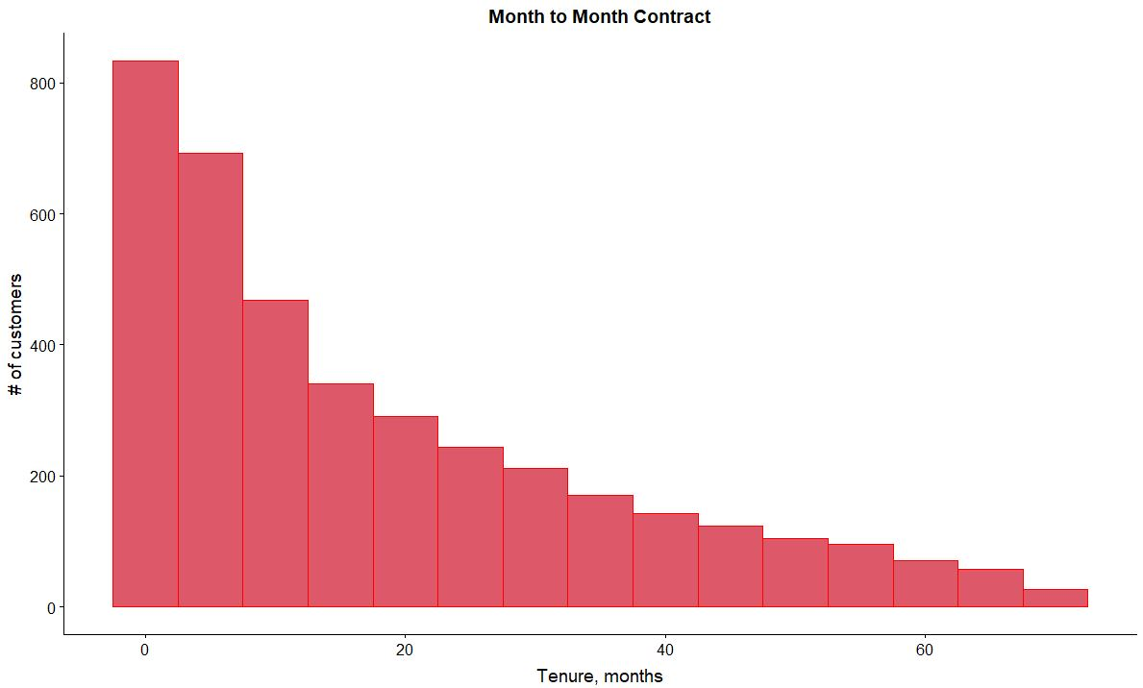
Exploratory Data Analysis
Churn rate by the type of contract histograms for both subsets demonstrate higher churn rates for customers on Month-to-month service agreement.
Interestingly, customers subscribed to phone services had much lower churn rate than internet customers, meaning that there is an obvious problem with internet services
Churn rates by the type of contract for both subsets demonstrate higher churn rates for customers on Month-to-month service agreement.

Slide 8
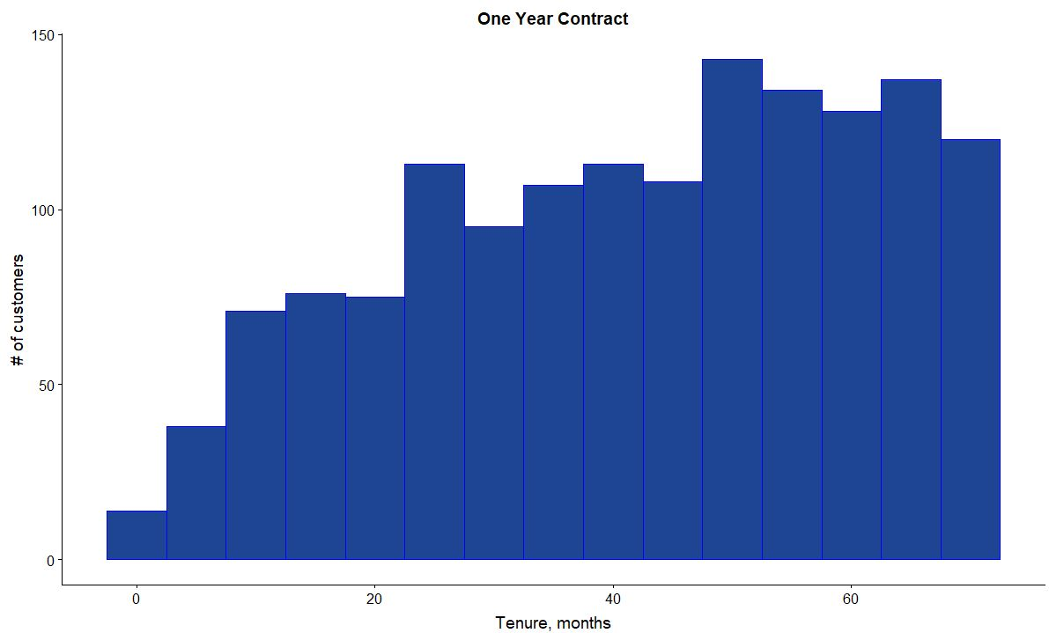
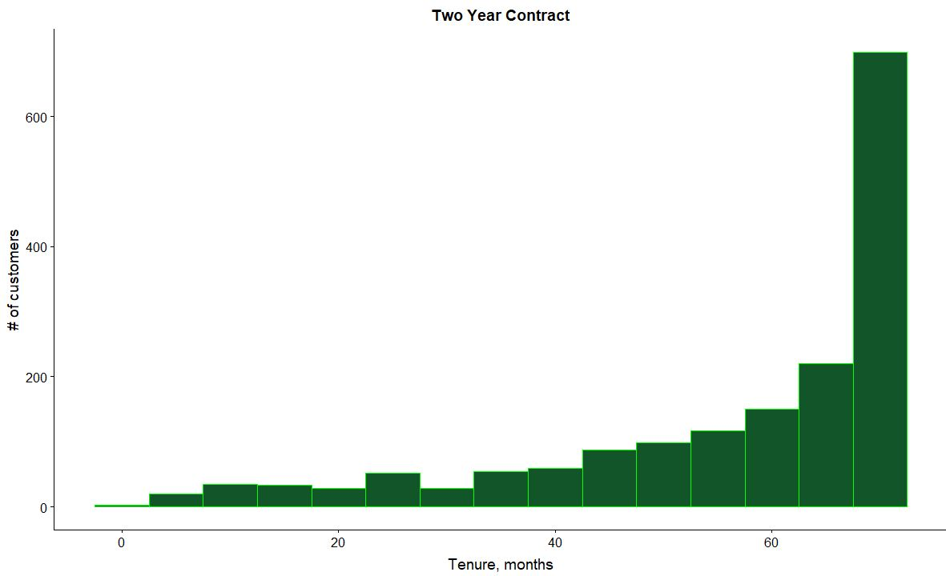
You can see , how tenure changes and becomes longer for customers on a two year agreement. This shows that customers with longer contract are more loyal to the company and tend to stay with it for a longer period of time.

Slide 9

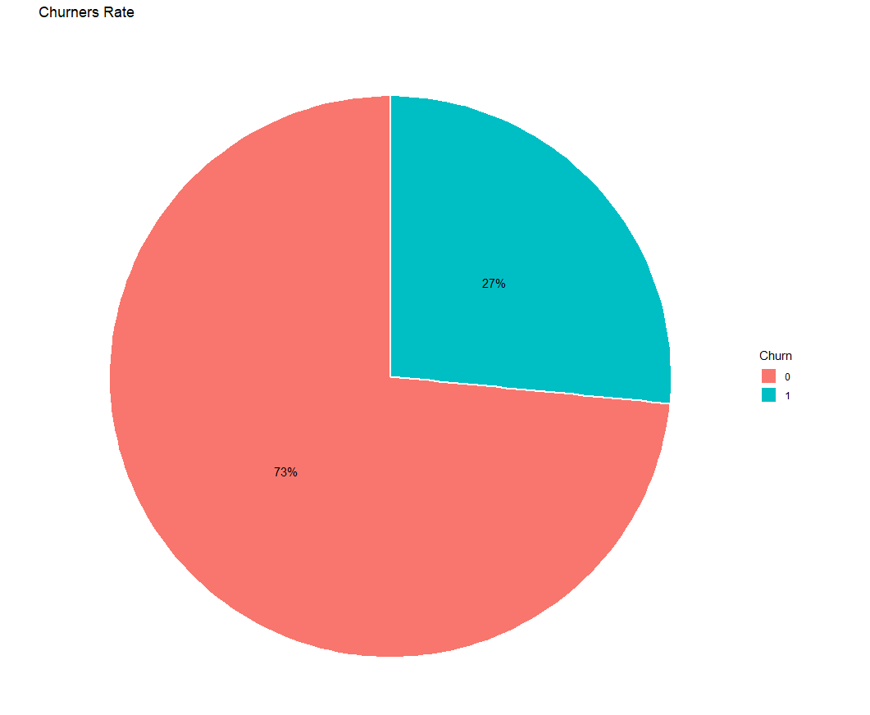



This shows us the Churn rate. According to our analysis 73% stay with the Telecomm service provider and 27% moved to other provider.

Slide 10
