Slide 1
Financial Risk &
Data Integrity Audit
Analyzing Loan Default Risk Using Machine Learning
Kevin Sayavong | Data Analytics Bootcamp | Capstone Project
Dataset: LendingClub Loan Data (Kaggle) | 9,578 Records | Logistic Regression Model

Slide 2
About Me
Background & why this project matters personally
Kevin Sayavong
Why This Project?
Data Analytics Bootcamp | Capstone Project
At Northwestern Mutual, clean and reliable Master Data is the foundation of every risk decision the company makes.
Role: Developer — Master Data Management Dept.
This project directly mirrors that work — raw financial data must be validated, transformed, and engineered before any meaningful analysis can begin.
Company: Northwestern Mutual Life Insurance
Focus: Data integrity, validation pipelines, and reliable data systems that power financial risk models
The question of who will repay a loan is fundamentally a data quality and data engineering problem as much as a data science one.
Kevin Sayavong | Data Analytics Capstone | LendingClub Loan Default Analysis

Slide 3
The Business Problem
Why does predicting loan default matter?
LendingClub must decide who to lend money to before knowing if that person will pay it back.
PROJECT GOALS
1. Data quality validation & cleaning
Approve a risky loan → borrower defaults, lender loses money
2. Risk factor correlation analysis
Reject a good borrower → lost revenue + harm to the applicant
3. Loan purpose default profiling
No screening model → both errors happen constantly at scale
4. Predictive model for default risk
5. Actionable lending recommendations
Kevin Sayavong | Data Analytics Capstone | LendingClub Loan Default Analysis

Slide 4
The Dataset
LendingClub Loan Data — Kaggle Imbalance Dataset
9,578
22
0
16%
Total Loan Records
Variables
Missing Values
Overall Default Rate
Key Variables
Variable
Description
FICO Score
Borrower credit score (612–827)
Interest Rate
Rate assigned by LendingClub
Installment as Percent of Income*
Payment ÷ Monthly income
Debt-to-Income Ratio
Existing debt vs. income
Loan Purpose
Reason for borrowing (8 categories)
Not Fully Paid
Target: Defaulted, Repaid
* = not in original dataset — engineered for this analysis
Kevin Sayavong | Data Analytics Capstone | LendingClub Loan Default Analysis

Slide 5
Data Cleaning & Feature Engineering
Turning raw CSV into analysis-ready data
CLEANING STEPS
* Feature Engineering
1
Symbol Removal
Stripped $ and commas from Installments column
Monthly Income
= exp(Log Annual Income) ÷ 12
Converts the mathematically stored log value back into a real monthly dollar figure.
2
Type Conversion
All numeric fields: text → float using pd.to_numeric()
3
Categorical Encoding
Installment as Percent of Income *
"Purpose" → 8 binary columns via one-hot encoding
= Installment ÷ Monthly Income
Mirrors the real-world "payment-to-income" ratio used in mortgage lending.
* Not present in original dataset.
4
Rate Standardization
DTI & Revolving Utilization divided by 100 → decimals
5
Column Removal
Unnamed artifact columns + redundant FICO Bucket removed
Kevin Sayavong | Data Analytics Capstone | LendingClub Loan Default Analysis

Slide 6
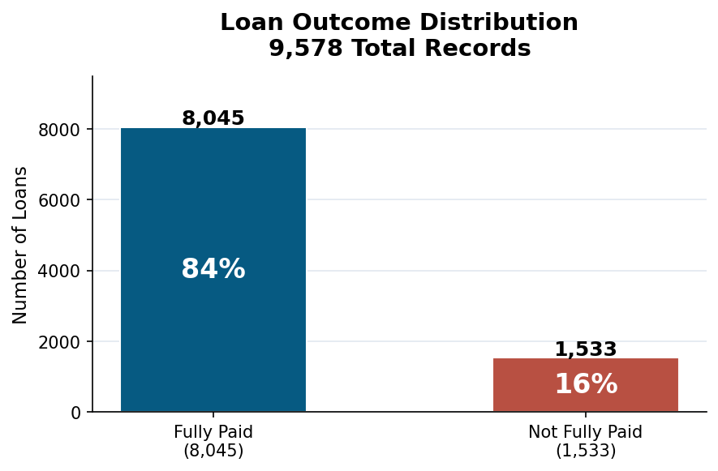
Analytical Methodology
How we built a fair, reproducible predictive model
METHODOLOGY DECISIONS
Class Imbalance Fix
Oversampled minority class to 8,045 records using sklearn resample(). Without this, a model can "cheat" — predicting repaid every time and be 84% accurate while catching 0% of defaults.
StandardScaler
Rescaled all features to mean=0, std=1. Prevents large-number columns (income) from dominating small-number columns (FICO) in the model.
80/20 Train/Test Split
Model trained on 80% of data; evaluated on 20% it has never seen. Ensures performance metrics reflect real-world accuracy, not memorization.
Fig 1: Raw class imbalance — 84% paid, 16% defaulted
Logistic Regression
Selected for interpretability: every coefficient directly shows a variable's influence. Appropriate for binary classification (paid vs. defaulted).
Kevin Sayavong | Data Analytics Capstone | LendingClub Loan Default Analysis

Slide 7
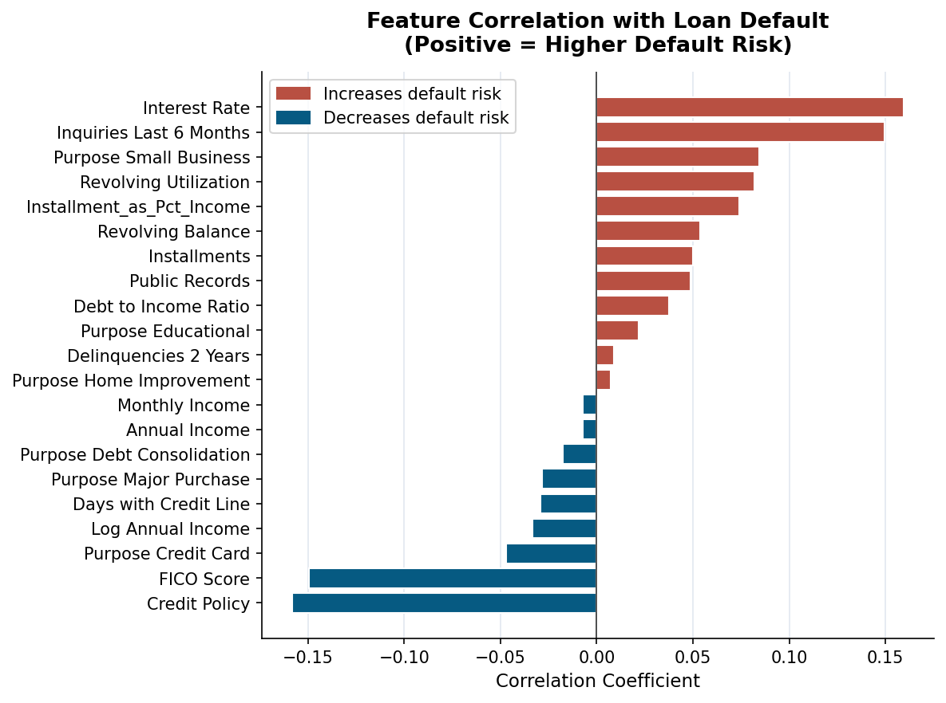
Finding 1: What Actually Drives Default?
Pearson correlation analysis across all 21 features
HIGHEST RISK SIGNALS
↑ Interest Rate (+0.16)
↑ Inquiries Last 6 Months (+0.15)
↑ Small Business Purpose (+0.08)
↑ Installment as Percent of Income (+0.07) *
STRONGEST PROTECTION
↓ Meets Credit Policy (−0.16)
↓ High FICO Score (−0.15)
* = not in original dataset
Kevin Sayavong | Data Analytics Capstone | LendingClub Loan Default Analysis

Slide 8
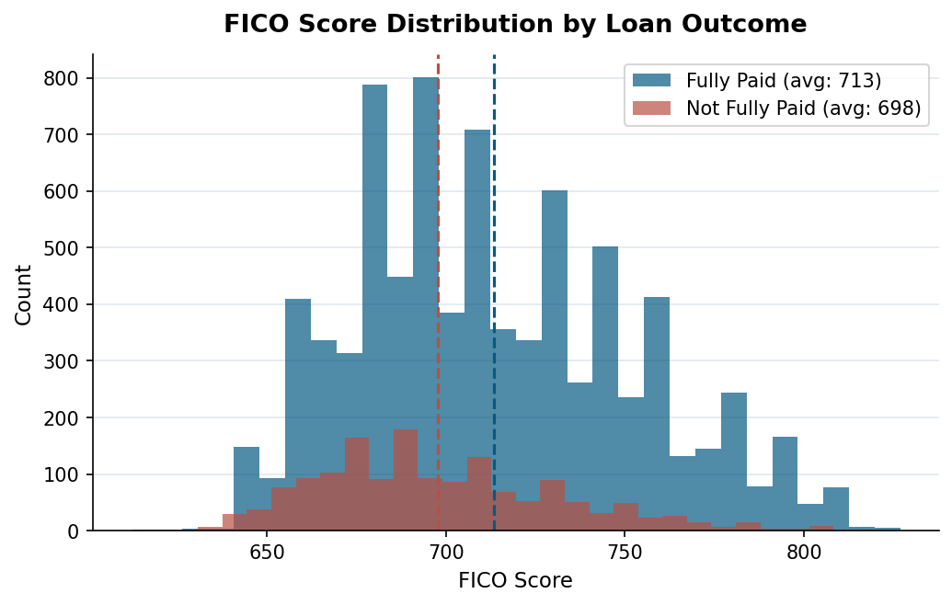
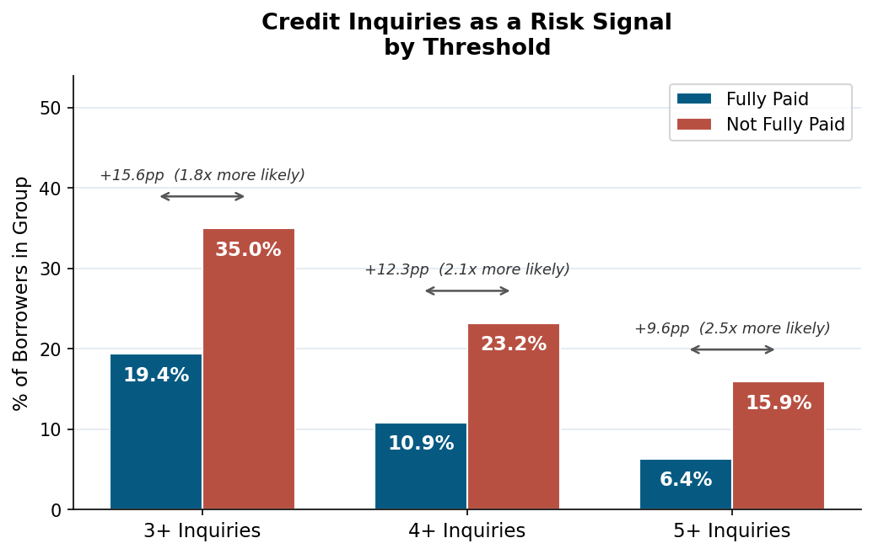
Finding 2: FICO Score & Credit Inquiries
Statistical significance testing and a key risk signal
Statistical Result: The 15-point gap is statistically significant (p<0.001), but the effect size is small (Cohen's d=0.43). Large distribution overlap means FICO alone cannot reliably separate defaulters from repayers — it must be combined with other variables.
Key Signal: At 4+ inquiries, defaulted borrowers are more than twice as likely to hit that threshold (23.2% vs. 10.9%). The signal strengthens at 5+ (2.5x more likely). 4+ may be a more defensible underwriting flag than 3+ — sharper signal, less noise.
Kevin Sayavong | Data Analytics Capstone | LendingClub Loan Default Analysis

Slide 9
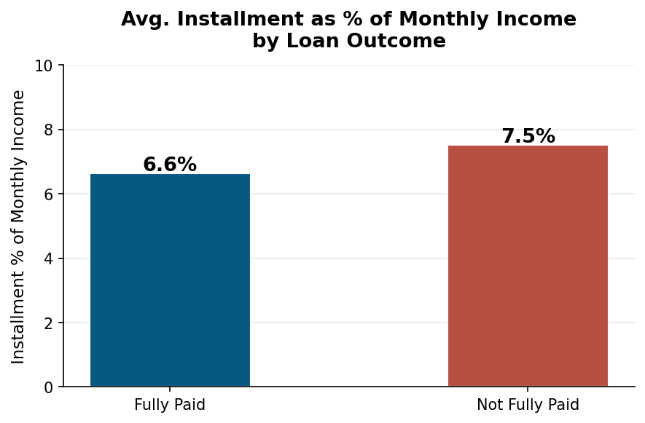
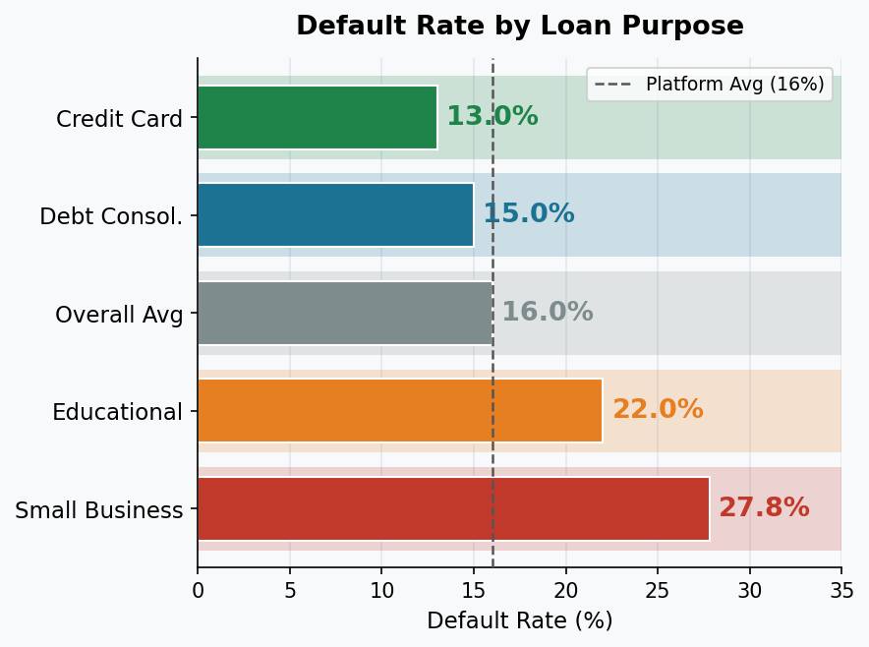
Finding 3: Payment Burden & Loan Purpose
Engineered metric analysis and default rates by purpose
Statistical Note: Statistically significant (p<0.001), but the effect size is very small (Cohen's d=0.19). The 0.89% gap and heavy overlap mean this variable is not a reliable standalone predictor. Further data exploration is needed before establishing a policy threshold.
Dashed line = platform average (16.0%)
Kevin Sayavong | Data Analytics Capstone | LendingClub Loan Default Analysis

Slide 10
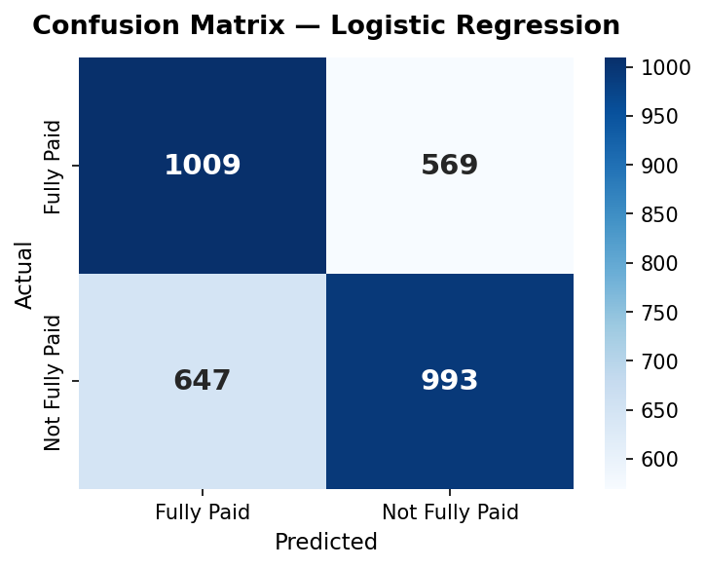
Predictive Model Results
Logistic Regression — Balanced Dataset — 80/20 Train/Test Split
62%
61%
64%
Overall Accuracy
Default Recall
(defaults caught)
Default Precision
How to interpret these results
• Our model catches 61% of actual defaults.
• A model that always predicts "repaid" would be 84% accurate — but catch 0% of defaults.
• 62% is only 12 points above random chance (50%). This model needs further development before real-world use.
Confusion matrix on held-out test data
• To improve: add payment history, employment duration, total assets, and bank account data.
Kevin Sayavong | Data Analytics Capstone | LendingClub Loan Default Analysis

Slide 11
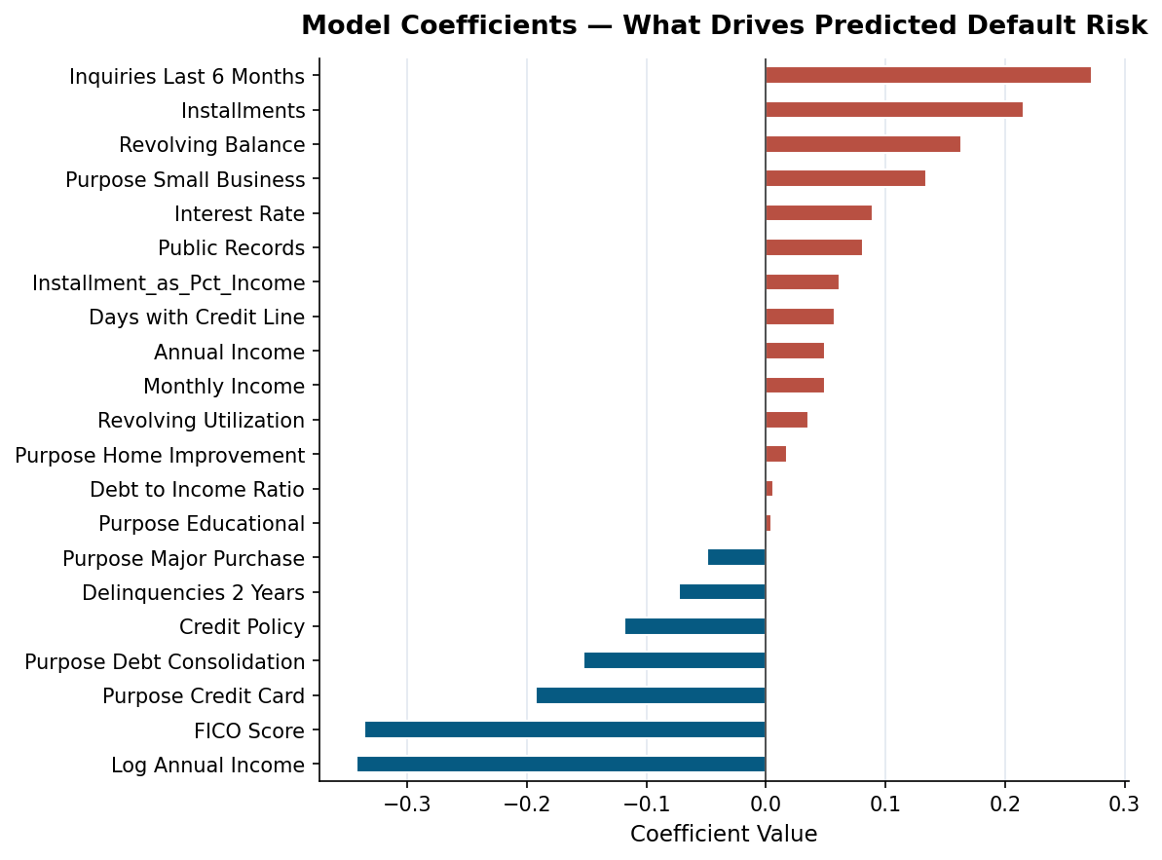
What the Model Learned
Comparing model coefficients to the correlation analysis
Notable shifts vs. Correlation:
Correlation: Interest Rate = #1 risk signal
Model: Inquiries in Last 6 Months moved to strongest predictor of default
Correlation: FICO = top protective signal
Model: FICO remains strong, but Log Annual Income emerged as equally important
Installment as Percent of Income* appears in both — but small effect size suggests caution in over-relying on it
* Not in original dataset. Presence in both analyses supports further exploration
Kevin Sayavong | Data Analytics Capstone | LendingClub Loan Default Analysis

Slide 12
Recommendations & Conclusion
What the data suggests — and where to go from here
1
Further Explore Payment Burden Metrics
3
Flag 4+ Inquiries for Underwriting Review
Installment as Percent of Income showed a significant but small effect. Other calculations — total debt service ratio, liquid asset coverage — may prove more predictive. More data science work is needed.
At 4+ inquiries, defaulted borrowers are more than 2x as likely to hit that threshold (23.2% vs. 10.9%). This could indicate financial stress — use as a flag for additional manual review, not automatic denial.
2
Separate Risk Framework for Small Business
4
Improve the Model With Additional Data
At 27.8% default — nearly double the platform average — small business loans warrant higher FICO minimums or adjusted interest rate pricing.
Debt-service-to-income ratio (DTI) is already standard in mortgage lending and adds signal beyond FICO and interest rate alone. Adding payment history, total assets, employment duration, and bank account activity would further increase accuracy.
Kevin Sayavong | Data Analytics Capstone | LendingClub Loan Default Analysis

Slide 13
Thank You
Questions Welcome
Kevin Sayavong | Data Analytics Bootcamp | Dataset: LendingClub Loan Data, Kaggle
loan_data_Python_Data3.csv | Logistic Regression | sklearn · pandas · numpy · scipy · matplolib · seaborn

