Slide 1

Bank of CLI
A terminal banking application
Java · Postgres · Maven · Layered Architecture
Kenya Sayles Jr.
Notes:
Bank of CLI: a fully functional banking application that runs entirely in the terminal. Built in Java with a Postgres database, following a strict layered architecture.

Slide 2

Overview
A "Core Ledger" banking system operated entirely from the command line. Users register, log in, and manage money — every action backed by a persistent SQL database.
Secure register & login (Account ID + PIN)
Deposit, withdraw, and transfer funds
Balance checks and transaction history
Activity logging to a file
Persistent
Every balance and transaction survives restarts — stored in Postgres, not memory.
Notes:
The app is a core ledger. Everything is persistent — stored in Postgres so data survives the program closing.

Slide 3


Layered Architecture
API Layer
Separation of concerns
Terminal I/O, menus, routing
Each layer talks only to the one below it. The API never touches SQL; the database never sees the terminal.
▼
Service Layer
Banking rules & decisions
▼
Repository Layer
All SQL / JDBC database access
Notes:
The whole app follows a strict three-layer architecture. API talks only to Service, Service talks only to Repository, Repository is the only layer that touches the database. This separation is why I could swap a text-file store for Postgres without changing the upper layers.

Slide 4
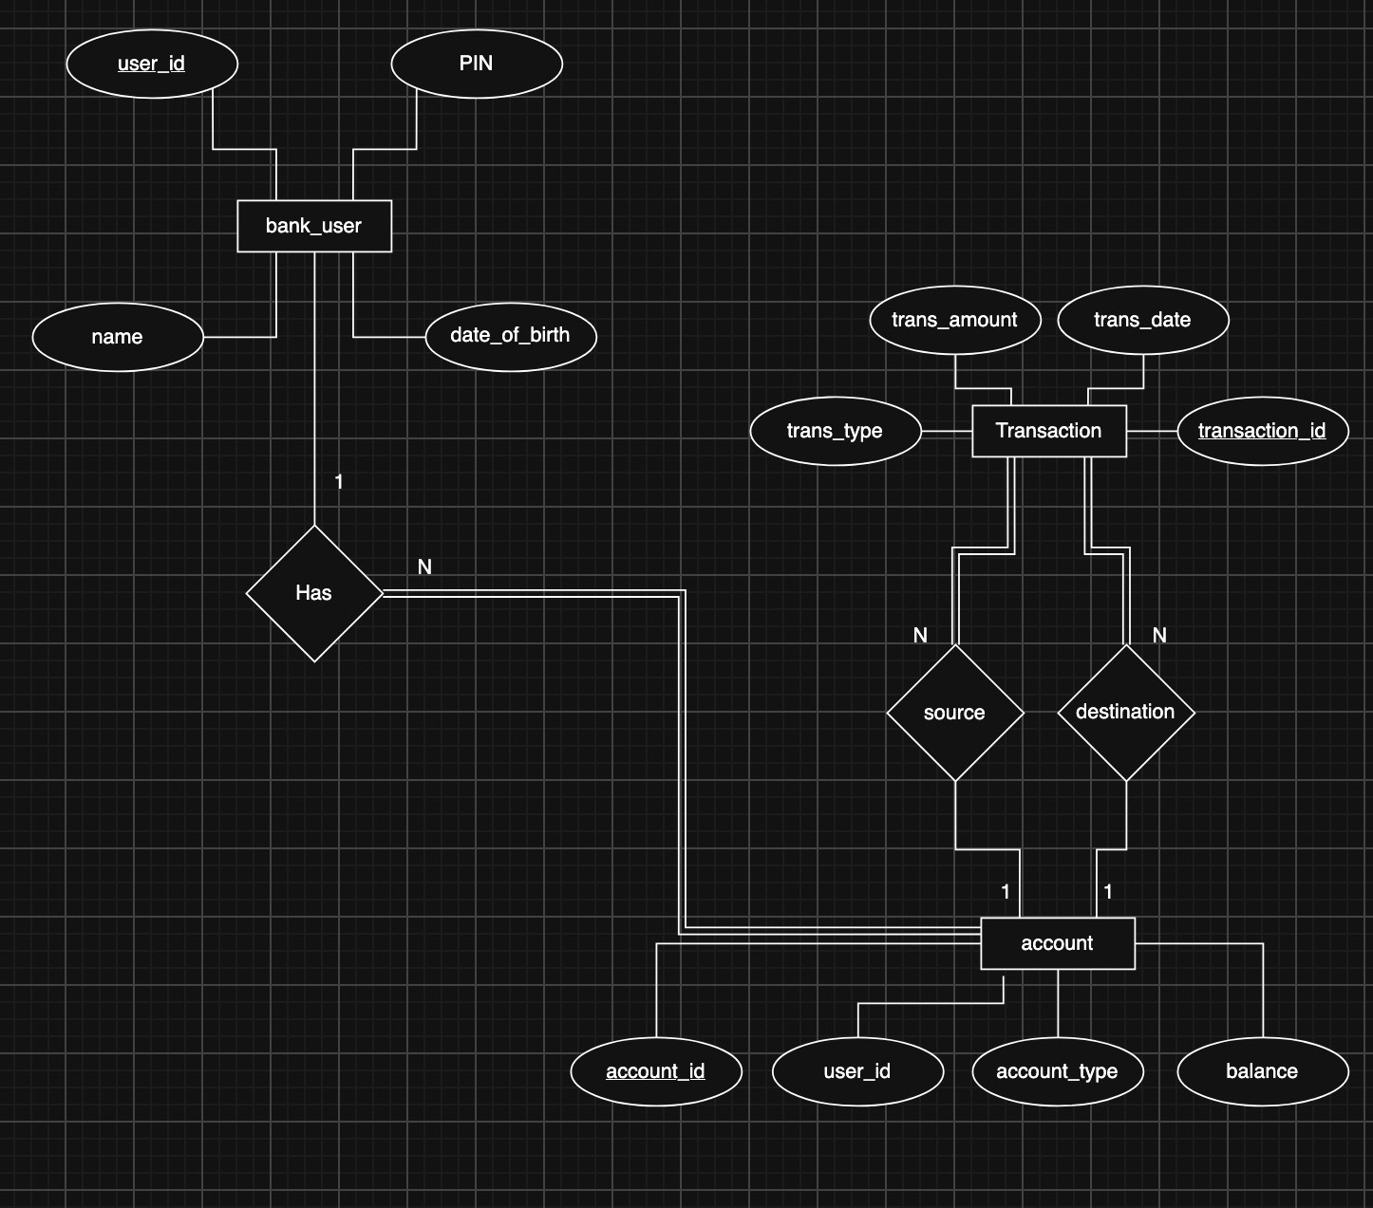
Database Design
Three tables model the system: users, their accounts, and a transaction ledger. Foreign keys tie each account to its owner and each transaction to its accounts.
Notes:
This is the entity-relationship diagram for the database. Three entities: bank_user, account, and transaction. A user has many accounts (one-to-many). Each transaction references a source account and a destination account, which is how deposits, withdrawals, and transfers are all recorded in one ledger.

Slide 5

Register & Login
Register creates a user and their first account in one step
Log in with Account ID + PIN
A Session object tracks who is logged in
Logged-out users can only reach login / register
PINs are hashed
PINs are stored with BCrypt hashing — never in plain text. Even a database breach exposes no PINs.
$2a$10$5azr9MueMYiSX98JnX9nZe...
Notes:
Registration creates the user and their first checking account together. Login verifies the PIN. Security note: PINs are hashed with BCrypt, so the database stores a scrambled hash, never the real PIN.

Slide 6

Check Balance
Balance is always read live from the database
The session tells us which account; the database gives its current value
Guarantees the displayed balance is never stale
Current balance
$50.00
accurate, to the cent
Notes:
Balance is read live from the database every time, not cached from login — so it is always accurate, even right after a deposit or transfer.

Slide 7


Deposit & Withdraw
Deposit
Withdraw
Adds funds to the account
Rejects zero or negative amounts
Records an audit entry
Removes funds from the account
Prevents overdrawing — blocks any withdrawal beyond the balance
Guarded twice: service rule + DB constraint
Notes:
Deposit adds funds; withdraw removes them. The key rule is overdraft protection — you cannot withdraw more than your balance. It is enforced in the service AND by a database CHECK constraint, so a bug in one still cannot produce a negative balance.

Slide 8

Transfer Funds
Moves money between two accounts
Validates positive amount, different accounts, sufficient funds
Source is always the logged-in account (you move your own money)
Atomic — all or nothing
The debit and credit happen in one database transaction. If either fails, the whole thing rolls back — money can never vanish.
Verified with a forced-failure rollback test
Notes:
Transfer moves money between accounts. The critical property is atomicity: the debit from one account and credit to the other happen as a single database transaction. If any part fails, it all rolls back. I verified this by injecting a failure mid-transfer and confirming the balance was untouched — no money vanished.

Slide 9

Transaction History
Every deposit, withdrawal, and transfer is recorded
Shown newest-first, with a timestamp
Deposits have no source; withdrawals have no destination
Recent activity
2026-09-24 TRANSFER $5.00
2026-09-24 TRANSFER $10.00
2026-09-23 WITHDRAW $25.00
2026-09-23 DEPOSIT $50.00
Notes:
History reads the transaction table and shows every operation for the account, newest first, with timestamps. It reads like a real bank statement.

Slide 10

Logging
SLF4J + Logback writing to a log file
INFO for successful actions
ERROR for failures and security events
Technical detail logged; user sees only a friendly message
[INFO] User successfully logged in: account 1
[INFO] Deposit of 50 to account 1
[ERROR] Deposit rejected - amount must be positive
Notes:
Logging uses SLF4J with Logback, writing to a file. INFO records successes like logins and deposits; ERROR records failures. When the database fails, the technical detail goes to the log while the user sees only a polite "service unavailable" message — never a stack trace.

Slide 11

Testing
JUnit 5 tests validate the withdraw logic — the spec's own example — with both a passing and a failing case.
Positive test
Negative test
A valid withdrawal succeeds and updates the balance correctly.
Withdrawing more than the balance is rejected gracefully — and the balance is left untouched.
Notes:
Testing uses JUnit 5 with fake DAOs, so the service logic is tested in isolation with no database. The positive test proves a valid withdrawal works; the negative test proves an overdraft is rejected and the balance is not changed. Both pass.

Slide 12


Tech Stack
Java 17
Postgres
Maven
Application language
Persistent storage (Docker)
Build & dependencies
JUnit 5
BCrypt
SLF4J + Logback
Testing
PIN hashing
Logging
github.com/ksaylesjr/Bank_of_CLI
Notes:
The full stack: Java 17, Postgres in Docker, Maven, JUnit 5, BCrypt for security, and SLF4J/Logback for logging. Source is on GitHub. Thank you — happy to take questions or give a live demo.

