Slide 1
Antialiasing
Basic raytracing shoots one ray through the center of each pixel, so is subject to aliasing
  Staircase edges, beating, etc
Simple solution: Cast multiple rays per pixel
  Sub-pixel sampling, can be adaptive
  Sub-samples can be regular, or random
Random sub-sampling replaces aliasing with noise

Slide 2
Distributed Ray Tracing
Cook, Porter, Carpenter 1984
Addresses the inability of ray tracing to capture:
  non-ideal reflection/transmission
  soft shadows
  motion blur
  depth of field
Basic idea: Don’t just vary the direction of each initial ray, also vary time, reflection, etc
Rays are distributed, not the algorithm. Should probably be called distribution ray tracing.

Slide 3
Specific Cases
Sample several directions around the reflected direction to get non-ideal reflection, and specularities
Sample over the area of extended light sources to get soft shadows
Sample over time to get motion blur
Sample lens and aperture paths to get depth-of-field
Must take care not to correlate choices

Slide 4
What’s Good? What’s Bad?
Easy to implement - standard ray tracer plus simple sampling
Which L(D|S)*E paths does it get?
Which previous method could it be combined with to good effect?

Slide 5
Path Tracing
Path tracing algorithms determine the intensity of each pixel by tracing light transport paths
  Paths that start at light sources and carry energy
A path of length k is a sequence of vertices, <x₀,…,x_{k-1}> where every x_{i} and x_{i+1} is mutually visible, and x₀ is on a light
Clearly, we are most interested in “important” paths

Slide 6
“Important” Paths
Consider only paths that go from a light source to the eye
  Other useful paths are sub-paths of these
  Paths that miss the image plane contribute nothing, so are not important
Paths that carry more energy are more important
Why is that?

Slide 7
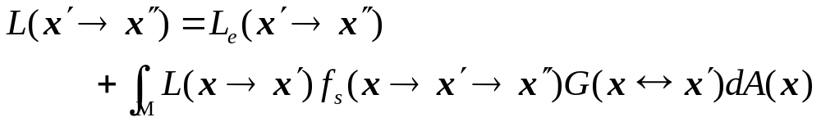
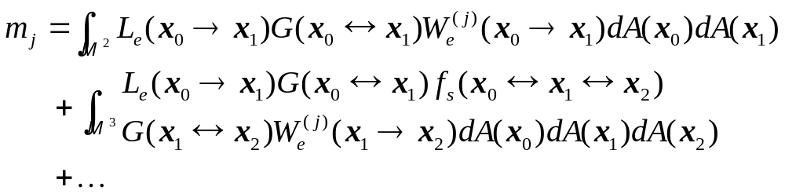
Return to the Rendering Equation
Can express value at each pixel as a sum of integrals, each one integrating over a different path length (Veach 97)

Slide 8
Sampling Important Paths
We can evaluate that integral using importance sampling
  Sample paths of various lengths
  Weight their contribution to pixel intensity by their importance
We wish to sample important paths
  those for which integration kernel is large
The big question: How are those paths found?

Slide 9
Naïve Path Tracing (version 1)
Start at light
Build a path by randomly choosing a direction at each bounce, and adding point hit by ray in that direction
Join last point to eye
What is the basic problem? What paths does it get?

Slide 10
Naïve Path Tracing (version 2)
Start at eye
Build a path by randomly choosing a direction at each bounce, and adding point hit by ray in that direction
(optional) Join last point to light
What is the basic problem? What paths does it get?

Slide 11
Path Tracing (Kajiya): Description
Start at eye
Build a path by, at each bounce, sampling a direction according to some distribution
At each point on the path, cast a shadow ray and add direct lighting contribution at that point
Multiple paths per pixel, average contributions to get intensity

Slide 12
Path Tracing (Kajiya):
Sampling Strategies
The method of choosing the direction at each bounce is important
Can choose using:
  stratified sampling
    Break possible directions into sub-regions, and cast one sample per sub-region
    Various ways to be adaptive
  Importance sampling
    Sample according to BRDF

Slide 13
Path Tracing (Kajiya): Analysis
Doesn’t waste time on things that aren’t visible
Unlike ray tracing, spends equal time on all path lengths (ray tracing spends more time on longer paths)
Downsides:
  Little information gain for each ray cast
  Not easy to get good (important) samples
  Spends equal time on slow-varying diffuse components and fast varying specular components

Slide 14
Pure Bi-Directional:Approach
Veach 94; Lafortune and Willems 94(?)
Build a path by working from the eye and the light and join in the middle
Don’t just look at overall path, also weigh contributions from all sub-paths:
x₂
x₁
x₃
Pixel x₀
x₄ Light

Slide 15
Pure Bi-Directional: Analysis
Advantages:
  Each ray cast contributes to many paths
  Building from both ends can catch difficult cases
    All specular paths
    Caustics
  Extends to participating media (anisotropic, heterogeneous)
Disadvantages:
  Still using lots of effort to catch slow varying diffuse components
  May not sample difficult to find paths

Slide 16
Combining Estimators
Veach 95 describes a way to combine the results of various estimators
Useful when:
  different methods are suited to different aspects of the scene
  It is not known a-priori which method will work

Slide 17
Metropolis Light Transport:
Approach
Other algorithms generate independent samples
  Easy to control bias
Metropolis algorithms generate a sequence of paths where each path can depend on the previous one
For each sample:
  Propose a new candidate depending on the previous sample
  Choose to accept or reject according to a computed probability (if reject, re-use the old sample)
Can prove the estimates for pixel intensities are correct

Slide 18
Metropolis Proposal Strategies
Task: Given the previous sample, generate a new one
  Should be very different, but should also be good
Methods:
  Randomly chop out some part of the path and replace it with a new piece
  Randomly perturb a vertex on the path
  Less randomly change the pixel that is affected
  Other choices possible

Slide 19
Metropolis: Analysis
Easy to implement basic algorithm
  Some of the details for good results are difficult
  Easy to parallelize
Can do difficult scenarios:
  Light through a crack, almost impossible any other way
  Caustics from light reflecting off the bottom of a wavy pool
But, still computes diffuse illumination on a per point basis

Slide 20
Still to come…
Computing the diffuse component efficiently
Various algorithms:
  Radiosity textures
  Radiance
  Photon-maps

