Slide 1
Home Automation & Security System For Elderly People
Under the guidance of
Mrs. Bansari Deb Majumder
Head of Department, EIE
Electronics and Instrumentation Engineering
NARULA INSTITUTE OF TECHNOLOGY

Slide 2
CONTENTS
Introduction
Components Used
Conclusion
Acknowledgement
References

Slide 3
Introduction
This project aims to reduce human efforts.
Automatic systems are being preferred over manual systems.
Internet of things is a growing network of everyday object.
The aim of this project is to design and implement home automation on the basis of voice recognition.
The project is implemented in hardware and software components that interact through WIFI(wireless fidelity) connections.
An ESP8266 WIFI module, relay and a mobile phone with an Android platform running on top of it are the hardware and software used.

Slide 4
Component Used
Blynk.
Cloud Storage.
Google Assistant.
NodeMCU.
Arduino Mega.
Relay.
Servo Motor.
PIR Motion Sensor.
Gas sensor.
12 Volt DC Fan.
Night Bulb.
Buzzer.
9 Volt Battery.
Connecting Wires.

Slide 5
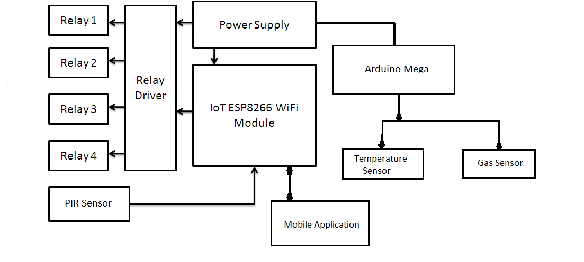
Block Diagram

Slide 6
Description of Block Diagram
Mobile application: Using this (blynk)application we can control the switches accordingly.
Nodemcu (Esp 8266): The command from mobile application or Google assistant (through blynk cloud ) is being processed accordingly and this signal is transmitted to relay driver.
PIR sensor: A sensor connected with NodeMCU .If any deviation occurs across the PIR sensor an alert is send to the user through blynk cloud.
Relay Driver: It acts like a switch. It receives input from NodeMCU to respective relays (like relay 1, relay 2).The loads (like fan, lights etc) are connected to the relay1, relay2, relay3, relay4 accordingly. So if relay is turn on then the load will be activated and vice versa.

Slide 7
Power Supply: A single external power supply is connected to relay driver(5v), nodemcu(3.3v) and arduino mega (5v).
Arduino mega: It’s a microcontroller which is connected to gas sensor (MQ6) and temperature sensor (thermistor).

Slide 8
Project Objective
Objective of the project is to design and construct a home automation and security system that will remotely switch on and off any household appliances connected to it.
The range of implementation of home automation is gigantic but for the time being we have accomplished the following things:
Suppose in your absence a fire broken out in your house. It would have been easier if you had the knowledge about this event before you reached home only to find the debris. This can happen with the installation of home automation, where a temperature sensor (thermistor 10k) is needed to be placed within your house which will constantly keep a check on the temperature. Any uncanny behavior in the temperature would be noted by the sensor and a buzzer might go off to alarm the people nearby.
2. A gas leak is a result of human negligence. This human error can be taken care of by mounting a gas sensor (MQ6 Smoke & Flammable gas sensor) in your house. This Gas Sensor is sensitive to flammable/combustible gasses like LPG, Propane & Hydrogen. As soon as it detects a gas leak, a buzzer will go off and the windows will be flung open automatically.

Slide 9
3. In your absence, a case of burglary take place in your household, you can be instantly notified about the event with the help of home automation. This needs the installation of a PIR sensors which detect any movement at a particular place. As soon as it detects, a message would be sent in your cell phone and accordingly you can take an action.
But these above “range of implementation “ can only be applied in contrast to a wireless system. The technologies which uses a wireless system (such as Wi-Fi, Cloud Networks) are of great use in everyday and everywhere.

Slide 10
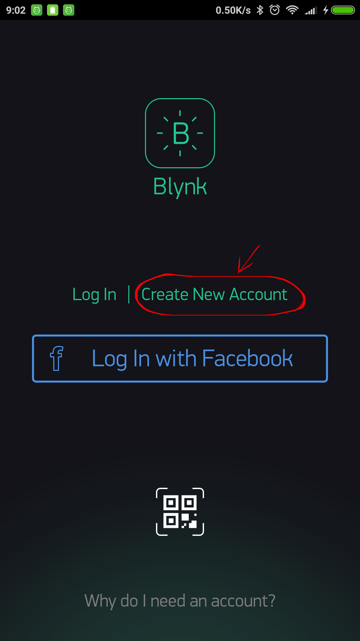
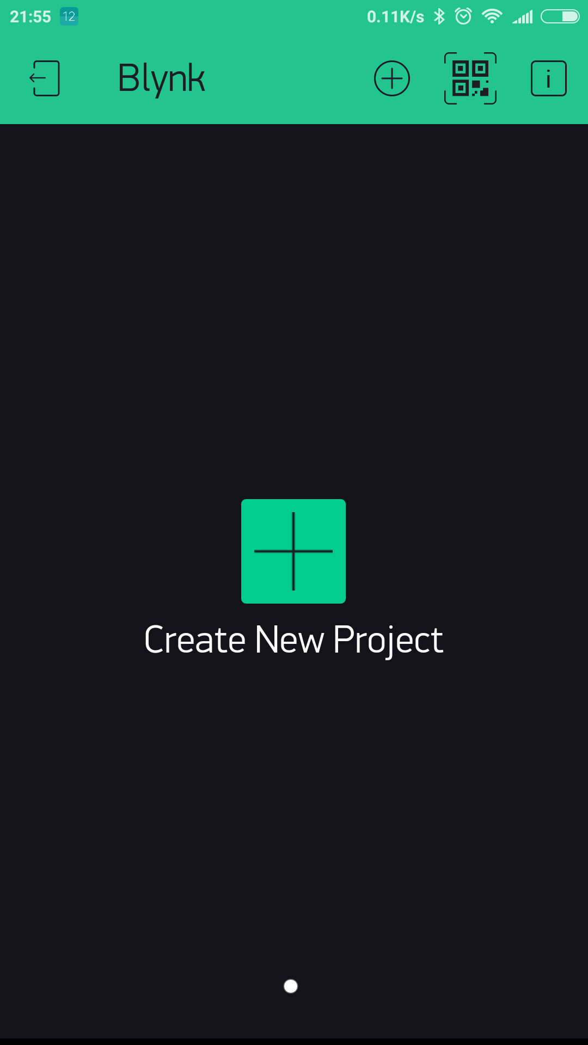
Methodology
Getting Started With The Blynk App
1. Create a Blynk Account.
2. Create a New Project.

Slide 11
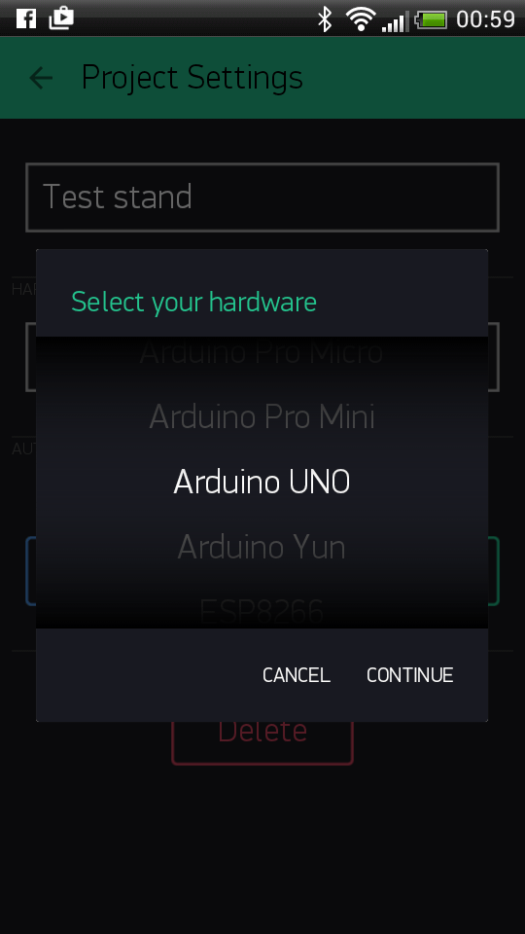
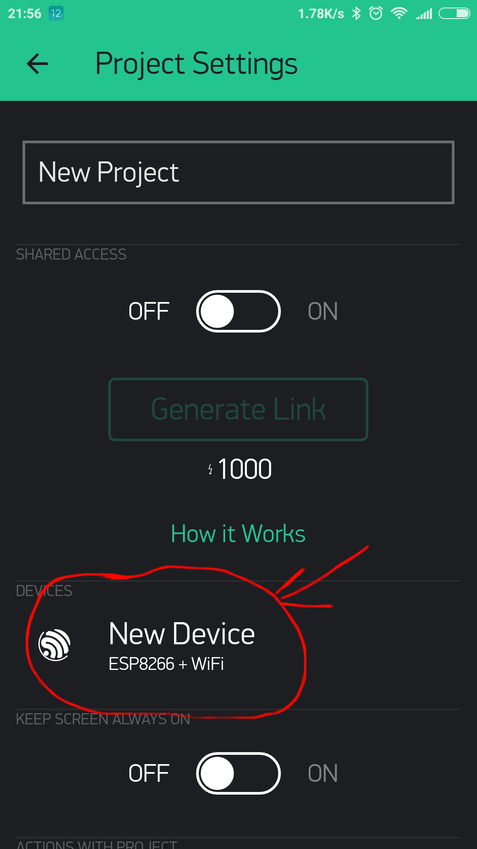
3. Choose Your Hardware.
4. Auth Token . (Click on the new device).

Slide 12
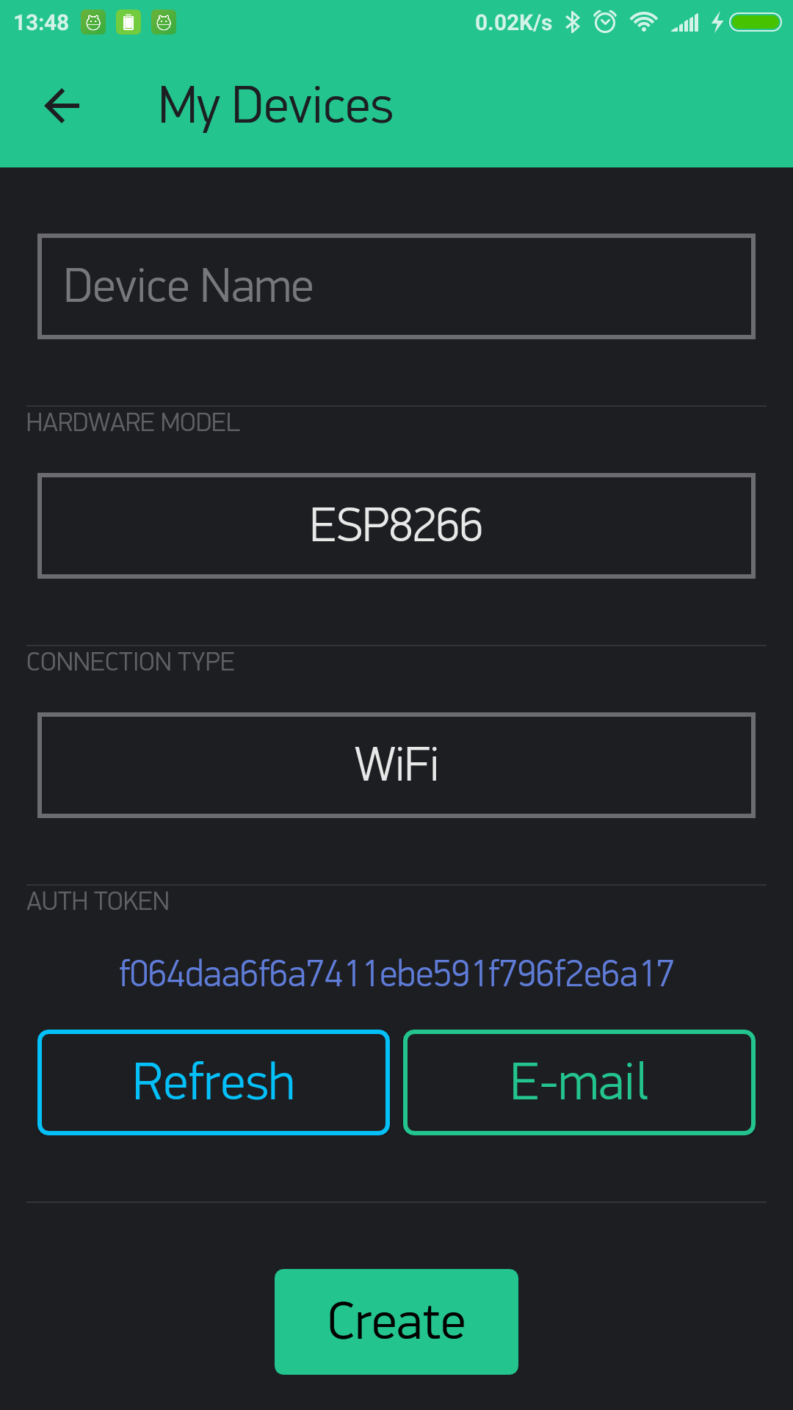
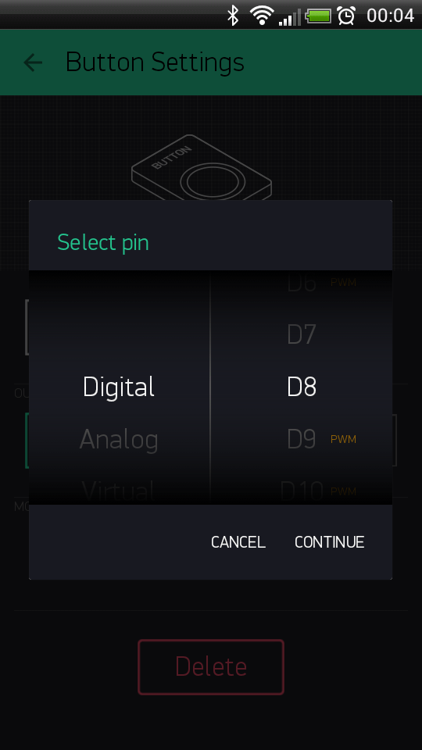
5. Token.(Now press the “Create” button).
6. Set PIN.

Slide 13
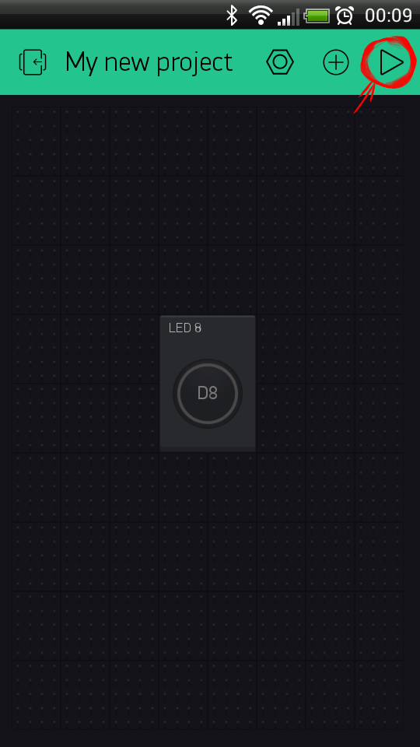
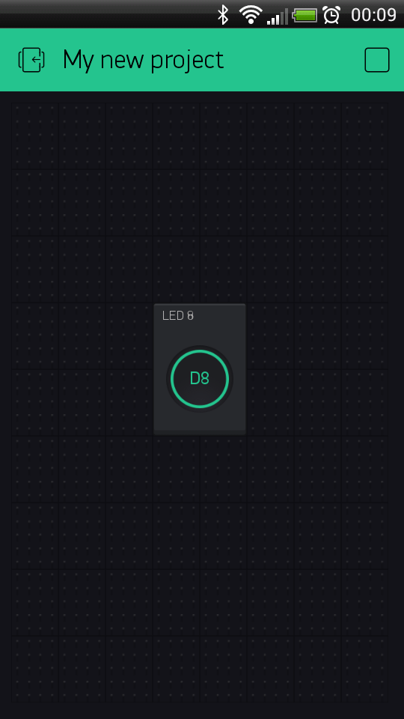
7. Run The Project.
8. Blynking.

Slide 14
CONCLUSION
The purpose of the project is to construct an user friendly wireless home automation system. The WIFI connection is going to replace the wired connections that we used to have in our households. We can switch on and off almost all the in-house electronic instruments with the help of simple voice commands.

Slide 15
ACKNOWLEDGEMENT
We would like to express our gratitude to Mrs. Bansari Deb Majumder, HOD, Electronics and Instrumentation Engineering Department, Narula Institute of Technology for her valuable guidance which helped us a lot in due course of the project work, for giving all the support for performing experiments in this regard and extending all the facilities of the department for the project work.

Slide 16
REFERENCES
Charith Perera, Student Member, IEEE, Arkady Zaslavsky, Member, IEEE, “Context Aware Computing for The Internet of Things: A Survey”. IEEE COMMUNICATIONS SURVEYS & TUTORIAL
Bill N. Schilit, Norman Adams, and Roy Want, “Context-Aware Computing Applications”.
Inderpreet Kaur, “Microcontroller Based Home Automation System with Security” at IJACSA) International Journal of Advanced Computer Science and Applications. Vol.1 , No. 6, December 2010.
Paul Jasmin Rani(student member IEEE) ; Jason Bakthakumar Voice controlled home automation system using Natural Language Processing (NLP) and Internet of Things (IoT).
Abdul Aziz Md (lecturer, CSE dept RGUKT,APIIIT ), “cost effective voice control home automation using IOT”.
Design of an Intelligent Voice Controlled Home Automation System Sonali Sen, Shamik Chakrabarty, Ankita Bhaumik, Department of Computer Science, St. Xavier’s College, Kolkata

Slide 17
Thank You

