Slide 1


Ketan Sharma
July 31, 2017

Slide 2
Outline
Introduction
Technologies
Class Diagram
Demonstration
Challenges
Further Work
Conclusion

Slide 3

What is RentNow?
What is RentNow?

Slide 4



What is RentNow?
What is RentNow?

Slide 5


What is RentNow?

Slide 6
Features
Online rental listing application
User Registration, login, and profile updates
Avatar
List properties
Featured Advertisements
Paypal integration
Search Filters
User Reviews
Messaging
Report as spam
Share on social media

Slide 7
Outline
Introduction
Technologies
Class Diagram
Demonstration
Challenges
Further Work
Conclusion

Slide 8











Technologies
Back End

Slide 9








Technologies
Front End

Slide 10


Technologies
Version Management

Slide 11
Security Features
Password encryption
SQL injection prevention
XSS prevention
Form validation

Slide 12
Outline
Introduction
Technologies
Class Diagram
Demonstration
Challenges
Further Work
Conclusion

Slide 13
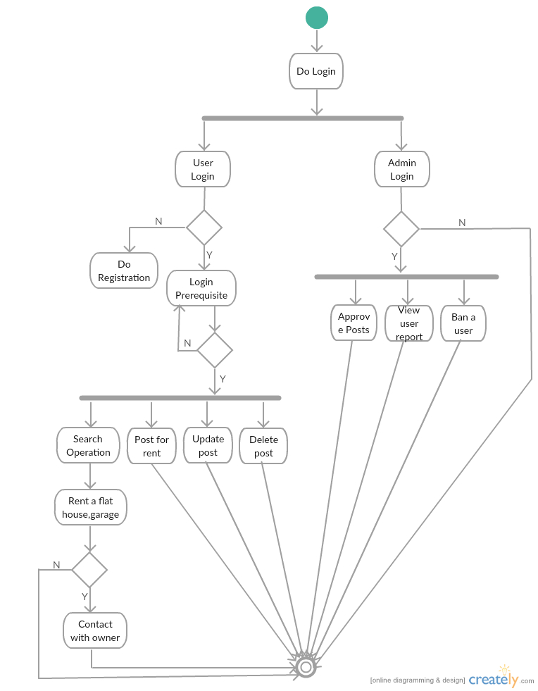
Activity Diagram

Slide 14
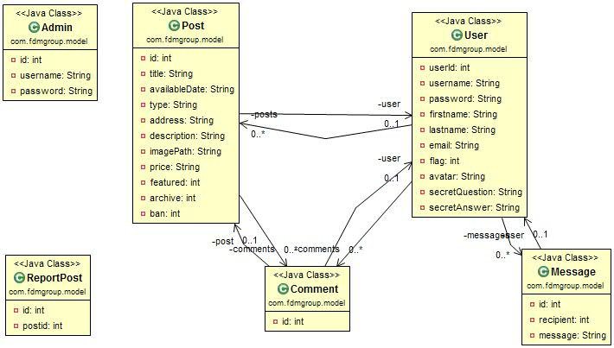
Class Diagram

Slide 15
Outline
Introduction
Technologies
Class Diagram
Demonstration
Challenges
Further Work
Conclusion

Slide 16
Outline
Introduction
Technologies
Class Diagram
Demonstration
Challenges
Further Work
Conclusion

Slide 17
Challenges
FDM Firewall
Time Constraint
Frontend

Slide 18
Outline
Introduction
Technologies
Class Diagram
Demonstration
Challenges
Further Work
Conclusion

Slide 19
Future Work
Sign-up with Google and Facebook
Improved search filters
Improvement in frontend
More flexible messaging
Email notifications
Reset password

Slide 20
Outline
Introduction
Technologies
Class Diagram
Demonstration
Challenges
Further Work
Conclusion

Slide 21
Conclusion
Design the model, entities and their attributes carefully
Prioritize tasks

Slide 22


