Slide 1
Hockey Power Play Analytics
By: Kirsten Bystrom
Allen Lee
Aron Zhao

Slide 2
R Shiny Hockey Slider

Slide 3
R Shiny Hockey Slider
Advantages:
-Good visualization tool
Disadvantages:
-Takes a long time to load

Slide 4
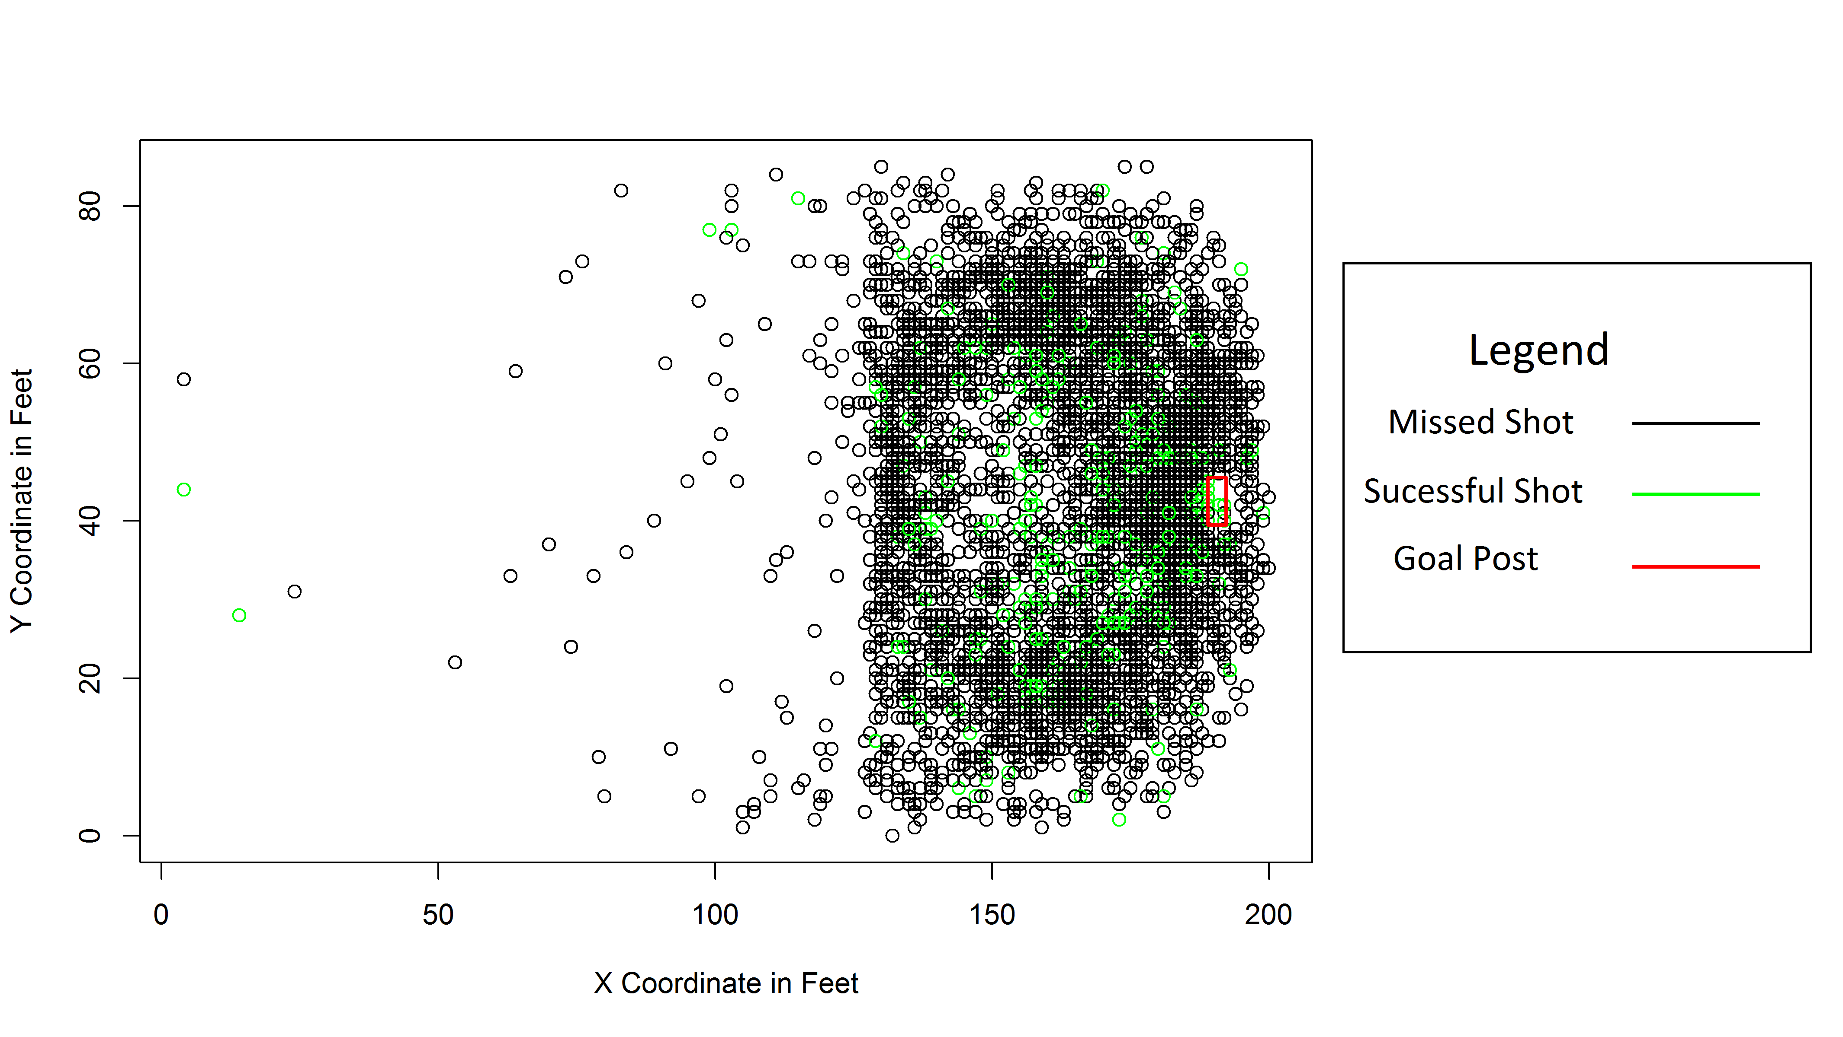
Statistical Summary Of Goal Attempts

Slide 5
Inferences from Summary Statistic

Slide 6
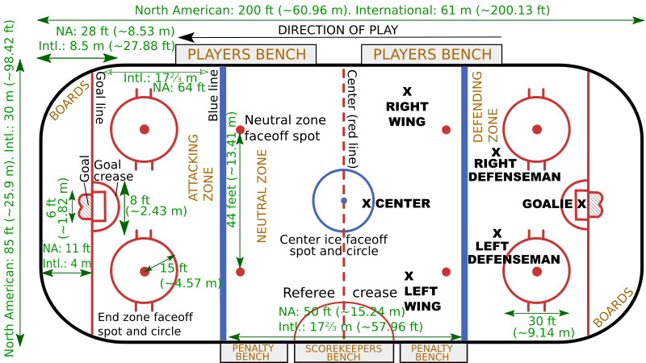
Measurements of Hockey Rink

Slide 7
Logistic Regression
Coefficients:
Estimate Std. Error z value Pr(>|z|)
(Intercept) -3.434700 0.403603 -8.510 < 2e-16 ***
X-Coordinate 0.006427 0.002354 2.731 0.00632 *

Slide 8
