Slide 1
RIVER VALLEY VIKINGS
2026 DEFENSIVE SYSTEM
Coaches Meeting 1 | Introduction to the Defense
Confidential — Coaching Staff Only

Slide 2
TODAY’S AGENDA
1. Defensive Identity — Who We Are
2. Position Designations — Our Language
3. Technique & Gap Names — Alignment Language
4. Call Grammar — How We Communicate
5. The System Overview — What’s in the Toolbox
6. How It Fits Together — Diagrams
7. Next Steps
Goal: Walk out speaking the same language, knowing the system, and ready to teach it.
River Valley Vikings | 2026 Defense

Slide 3
DEFENSIVE IDENTITY
Who We Are

Slide 4
OUR PHILOSOPHY
We’re a pressure defense. We attack with plus-one advantages
and play zero behind it. When we’re not pressuring,
we play man. If they pick it up, we change the picture
and come again.
We don’t sit back and wait for offenses to beat us. We attack.
We set edges, we own our gaps, and we get 11 hats to the ball.
No explosives. No free yards. Make them earn every first down,
and when they don’t, take the ball.

Slide 5
BASE STRUCTURE
Element | Detail
Personnel | 4-2-5 base; 3-4 / 3-2-6 packages
Strength | Field
Shell | Two-high
Box | 6-man
Call Format | Front + Stunt + Blitz + Coverage/Tags
Communication | Signaled front/stunt/blitz; coverage is verbal. Safeties echo and relay.
Multiple looks, simple rules. The picture changes — the principles don’t.
River Valley Vikings | 2026 Defense

Slide 6
THE NON-NEGOTIABLES
1. No explosives. Make them snap it again. Eliminate busts and cheap yards.
2. Aggressive with discipline. Attack without losing leverage or committing penalties.
3. Box the run. Set hard edges, compress gaps, keep the ball in help.
4. Relentless pursuit. 11 to the ball, correct angles, swarming tackles.
5. Win situations. 1st down sets the series; 3rd down = get off the field.
6. Smart aggression. Plus-one rushers with zero behind it. No-win for the offense. Call off the dawgs when needed.
7. Communication standard. Simple, loud, early. Everyone echoes. Alerts: BUMP / BANJO / EXCHANGE / UNDER.
River Valley Vikings | 2026 Defense

Slide 7
THE STANDARD
The baseline. Every snap, every rep, every day.
No busted coverages — know your call, know your rules, communicate
Stay in phase — maintain leverage in man; no trailing, no freelancing
No free routes — collision every release; reroute, disrupt timing, deny easy access
No lost edges — contain player keeps QB and ball inside
No uncovered gaps — adjust instantly if gap changes with stunt/pressure
No missed tackles — leverage + near foot + wrap; eliminate YAC
No penalties that extend drives
No loafs — pursuit is mandatory
River Valley Vikings | 2026 Defense

Slide 8
WHAT WE WILL LIVE BY
STORM
HAVOC
"Bring the STORM."
"Create HAVOC."
S — Sound. Gap integrity, assignment football.
T — Tough. Physical at the point, finish every rep.
O — Overwhelming. Plus-one advantage, pressure from every angle.
R — Relentless. 11 to the ball, pursuit is mandatory.
M — Multiple. Same shell, different answers, keep them guessing.
H — Hit. Collision every route, attack the ball carrier.
A — Attack. Pressure with purpose. Zeus, Zorro, zero.
V — Violence at the point. Win at the LOS, dominate gaps.
O — Overwhelm. Multiple looks, disguise, put them in conflict.
C — Contain. No lost edges, no free runners, discipline in chaos.
This is what we stand for. Pick the one that fits.
River Valley Vikings | 2026 Defense

Slide 9
POSITION DESIGNATIONS
Our Language

Slide 10
THE 11 POSITIONS
Letter | Name | Attributes
FC | Field Corner | Speed, cover skills, tackling in space
FS | Field Safety | Range, communication, run support, ball skills
B | Bandit (Nickel) | Versatile — DB in coverage, OLB in 3-down; physical, athletic
A | Anchor (Field DE) | Edge setter, pass rusher, QB player (CAMP)
T | Tackle (Field DT) | Power, interior push, gap control
N | Nose (Boundary DT) | Anchor, interior push, gap control
E | Edge (Boundary DE) | Edge setter, pass rusher; OLB in 3-down
M | Mike (Field ILB) | Instincts, physicality, coverage range
W | Will (Boundary ILB) | Instincts, physicality, coverage range
D | Dawg (Boundary S) | Physicality, run support, communication, coverage
BC | Boundary Corner | Physical, press ability, tackling
River Valley Vikings | 2026 Defense

Slide 11
DEFAULT SIDES & KEY RULES
FIELD SIDE (wide side)
BOUNDARY SIDE (short side)
A (Anchor) — Field DE
T (Tackle) — Field DT
B (Bandit) — Nickel / Field force
FC / FS — Field corner & safety
E (Edge) — Boundary DE
N (Nose) — Boundary DT
D (Dawg) — Boundary safety / force
BC — Boundary corner
Key Rules
Contain: Maintain outside leverage. Squeeze run inside. Set the edge.
Force: Collision at or behind LOS. Turn the ball inside. More aggressive than contain.
CAMP: A ‘CAMP rule’ is a default rule — it’s always on unless told otherwise. Example: whoever has contain has the QB.
Safeties are fixers. FS owns field-side calls. D owns boundary-side calls. They echo and relay.
River Valley Vikings | 2026 Defense

Slide 12
TECHNIQUE & GAP NAMES
Alignment Language

Slide 13
DL TECHNIQUE CHART
Tech | Alignment
0 | Head up on Center
1 | Shade on Center
2i | Inside shade on Guard
2 | Head up on Guard
3 | Outside shade on Guard
4i | Inside shade on Tackle
4 | Head up on Tackle
5 | Outside shade on Tackle
6i | Inside shade on TE
6 | Head up on TE
7 | Outside shade on TE
8i | Inside shade on Wing
8 | Head up on Wing
9 | Outside shade on Wing
River Valley Vikings | 2026 Defense

Slide 14
GAP NAMES
Every gap has a name. Every defender owns a gap.
Gap | Location
A Gap | Between Center and Guard
B Gap | Between Guard and Tackle
C Gap | Between Tackle and TE (or outside Tackle if no TE)
D Gap | Outside the TE
E Gap | Outside the Wing
Alley | Outside contain lane — where the force / contain player operates
Gaps exist on both sides of the center. A/B/C/D field + A/B/C/D boundary.
River Valley Vikings | 2026 Defense

Slide 15
CALL GRAMMAR
How We Communicate

Slide 16
THE FORMULA
FRONT + STUNT + BLITZ + COVERAGE / TAGS
Examples:
SHADE + NINJA
UNDER + SLANT + ZEUS
GRIZZLY + sWarM + ZORRO
EYES + JACKS + sWarM + ZORRO
Front/stunt/blitz calls signaled — coverage is verbal. Safeties echo and relay.
River Valley Vikings | 2026 Defense

Slide 17
TEMPO CALL
When the offense’s tempo is faster than we can signal, the defense defaults to the tempo call.
DEFAULT: SHADE + NINJA
Set before each possession. Can change at any point during the game.
Safeties must know the current tempo call at all times.
Tempo call is our safety net — everyone knows exactly what to do.
River Valley Vikings | 2026 Defense

Slide 18
THE SYSTEM
What’s in the Toolbox

Slide 19
FRONT MENU — 4-DOWN
Front | Interior (A/T/N/E) | Key Feature
SHADE | 5 / 3 / 2i / 5 | Base front. 3-tech field, 2i boundary. Our home.
UNDER | 5 / 2i / 3 / 5 | Flipped interior. 3-tech to boundary.
EYES | 5 / 2i / 2i / 5 | Balanced interior. Both DTs inside shade.
WIDE | 5 / 3 / 3 / 5 | Both DTs outside shade. Closes B gaps, forces bounce.
DEUCES | 5 / 2 / 2 / 5 | Head-up guards. Read-and-react interior.
GRIZZLY | 4i / 2i / 2i / 4i | Tight interior. Edges at 4i. Goal-line / short-yardage.
BOSS | 5 / 3(F) / 1(F) / 5 | Both DTs set field. Overload look.
BOSS UNDER | 5 / 1(B) / 3(B) / 5 | Both DTs set boundary. Overload look.
TE SET rule overrides all fronts except GRIZZLY when TE is attached. (F) = both DTs set to field. (B) = both DTs set to boundary.
River Valley Vikings | 2026 Defense

Slide 20
3-DOWN PACKAGES
Our odd-front package. Triggered by offensive personnel.
Package | Interior (A/T/N) | Key Feature
MINT | 4i / 0 / 4i | Base 3-down. Contain adjusts by coverage.
ACE | 4 / 0 / 4 | 2-gap interior. Physical, read-and-react.
JET | 5 / 0 / 5 | Edges at 5. T is 2-gapping.
SLIP | 5 / 0 / 4i | 1-gap. Takes B out of run/pass conflict.
B = Field OLB. E = Boundary OLB. Strength = Field.
River Valley Vikings | 2026 Defense

Slide 21
STUNT MENU
Coordinated DL movement. In 4-down: stunts involve T+N. In 3-down: A joins.
SLANT — Slant to field
ANGLE — Slant to boundary
PINCH — Pinch inside (A gaps / B gaps)
JACKS — Shoot out (B gaps / C gaps)
VEER — Slant to motion / to TE
SPLIT — BOSS / BOSS UNDER / GRIZZLY only
CRASH — Everyone shoots inside
ANCHOR ATTACK — A washes OL inside
EDGE ATTACK — E washes OL inside
ANCHOR RAVEN — A shoots B gap
EDGE RAVEN — E shoots B gap
Front-stunt legality matrix exists — not every stunt works with every front.
River Valley Vikings | 2026 Defense

Slide 22
PRESSURE MENU
Singles
Combos
Packaged
Mike
Will
Bandit
Dawg
sWarM (M+W)
BooM (B+M)
BoW (B+W)
MaD (M+D)
Eat (M+W+B)
Hammer — B edge + Anchor Attack
Shave — W edge + Edge Attack
Bandit Raven — B blitzes C, A shoots B
Will Raven — W blitzes C, E shoots B
MUG: M and/or W walk up to the LOS at their gap. Same job, different picture. Weekly menu locked by Friday. Game-plan specials installed as needed.
River Valley Vikings | 2026 Defense

Slide 23
THE FOUR COVERAGE FAMILIES
NINJA — MOD / CLAMP / POACH
Pattern-match quarters. Our base coverage. Most of our snaps. Two-high shell stays two-high.
COVER 1 (One Free Man)
Oregon (FS = MOF) / Oklahoma (D = MOF) / Ohio (B = MOF). Man assignments + one free safety.
COVER 0 / Z-FAMILY
Zero coverage. Zeus / Zorro / Zunnel / Zill / Zike. Run-first reads, then rush. No deep help.
VIKING (Cover 3)
Spot-drop Cover 3. Safe, anti-explosive. Primary call-off after showing Zeus.
Zeus and Zorro are our identity. NINJA is the engine. Viking is the safety net.
River Valley Vikings | 2026 Defense

Slide 24
HOW IT FITS TOGETHER
Same picture pre-snap. Different answers post-snap.

Slide 25
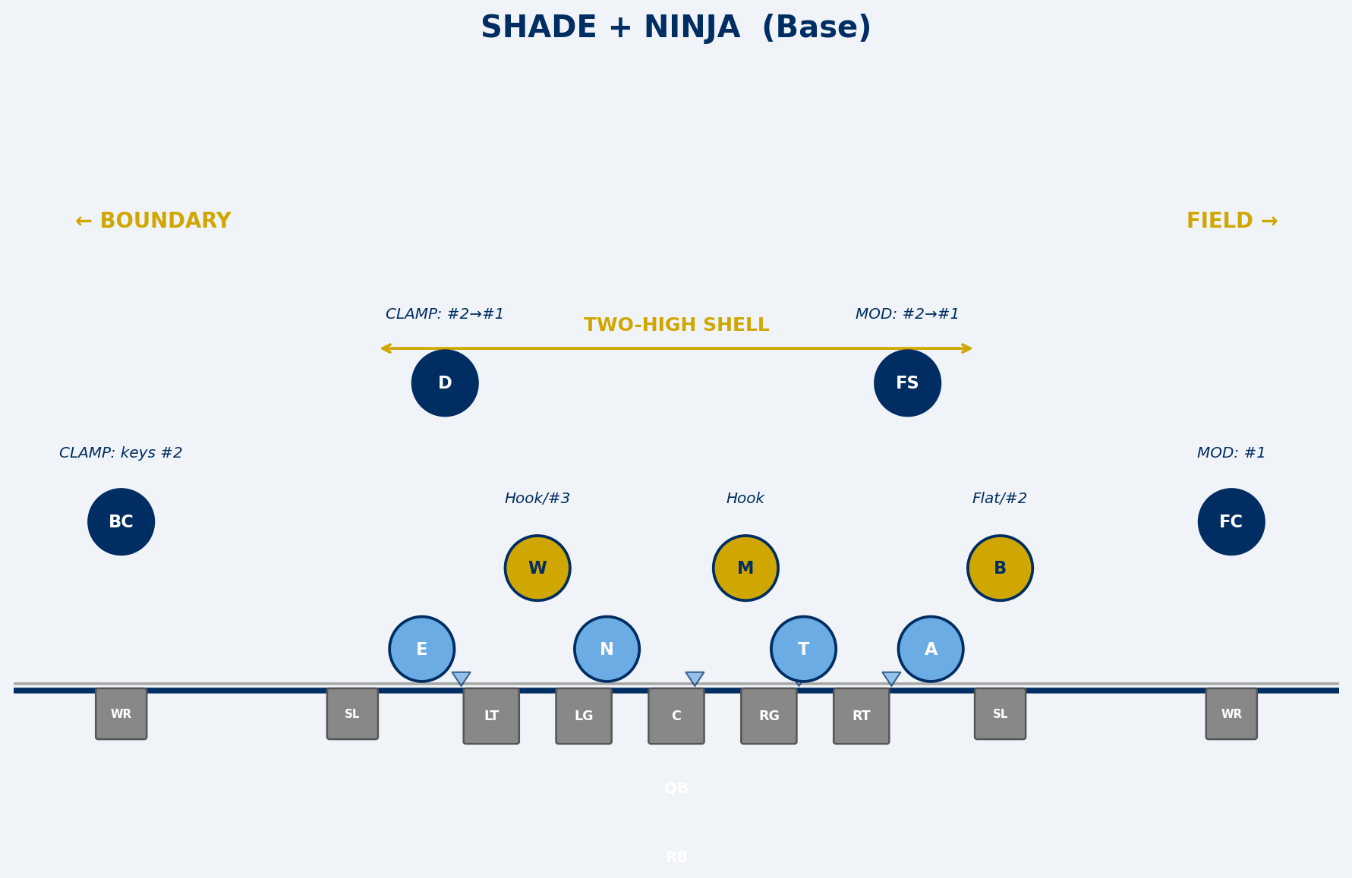
SHADE + NINJA — BASE LOOK
River Valley Vikings | 2026 Defense

Slide 26
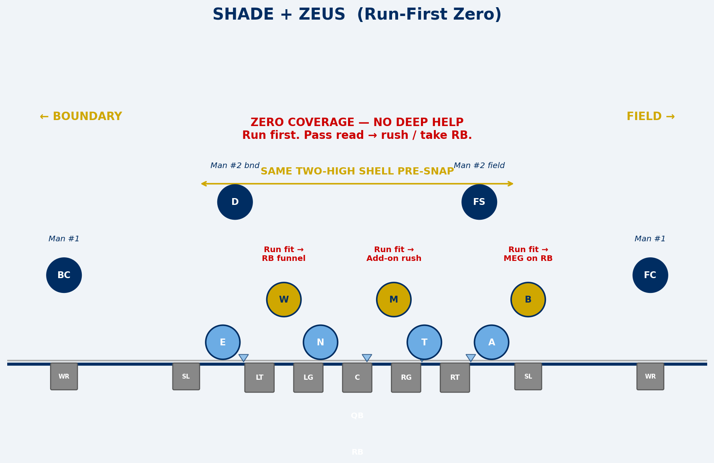
SHADE + ZEUS — RUN-FIRST ZERO
River Valley Vikings | 2026 Defense

Slide 27
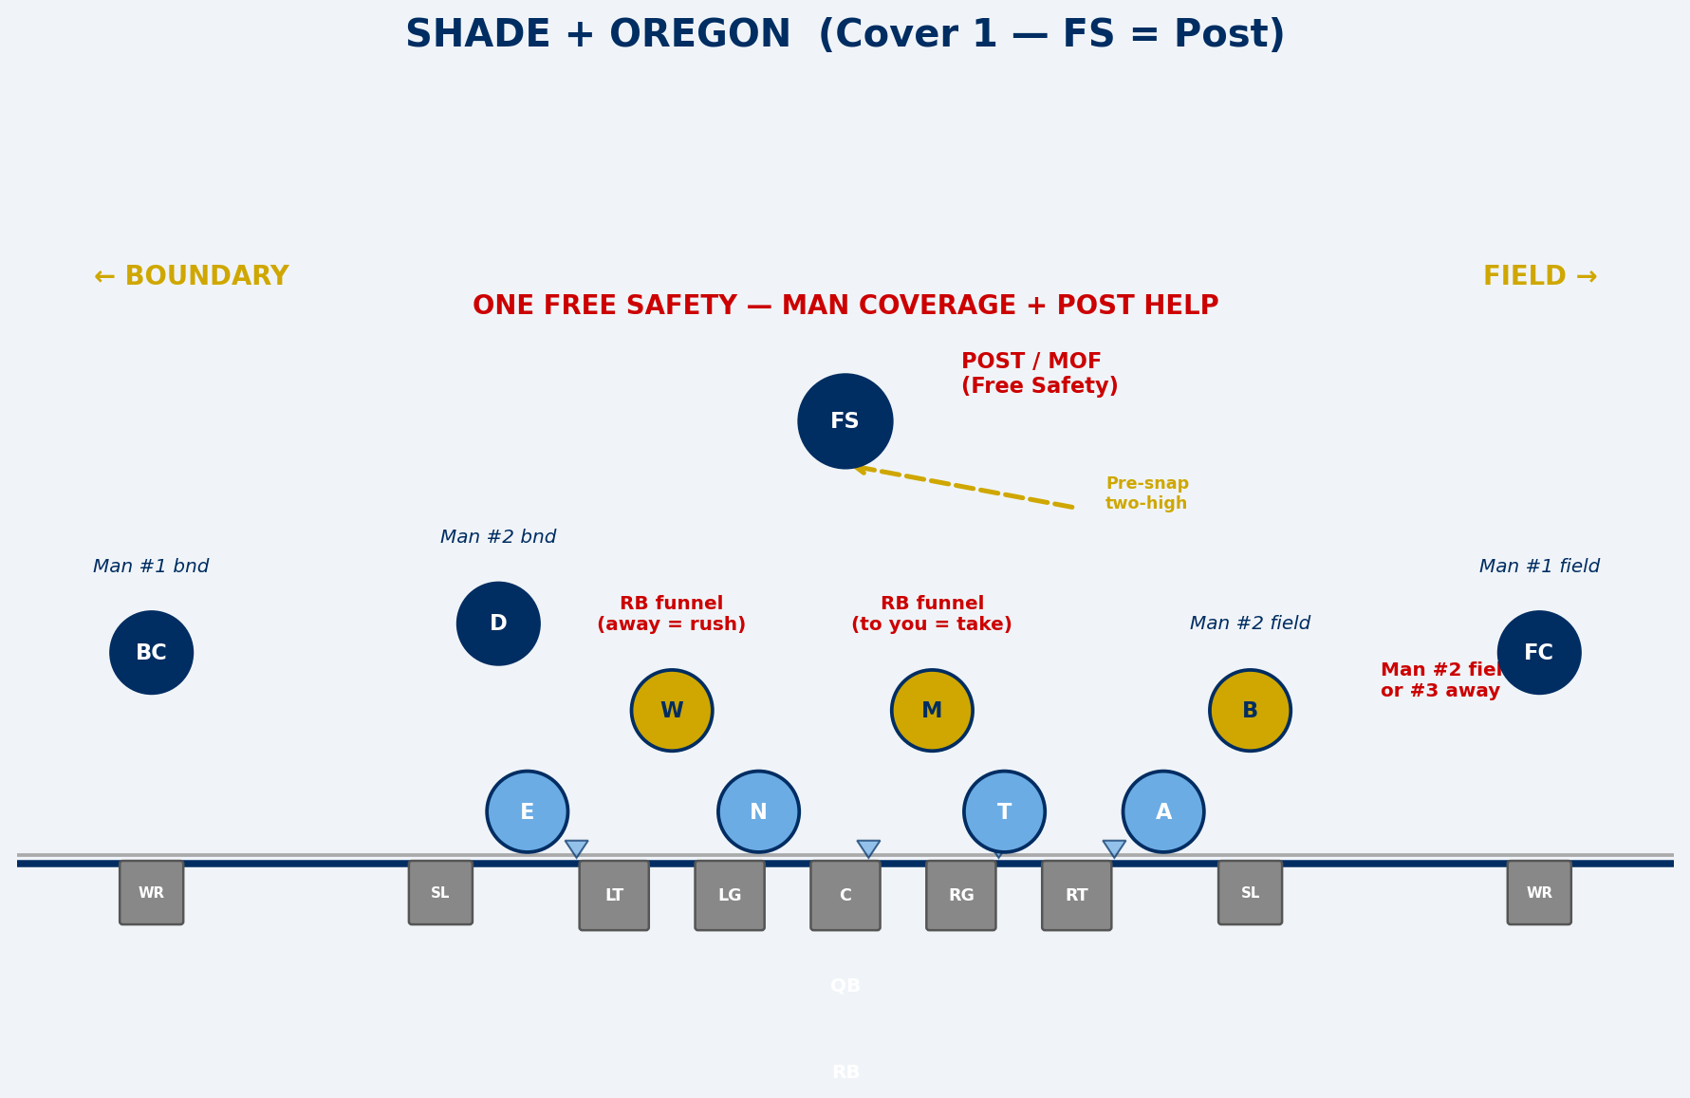
SHADE + OREGON — COVER 1 (ONE FREE)
River Valley Vikings | 2026 Defense

Slide 28
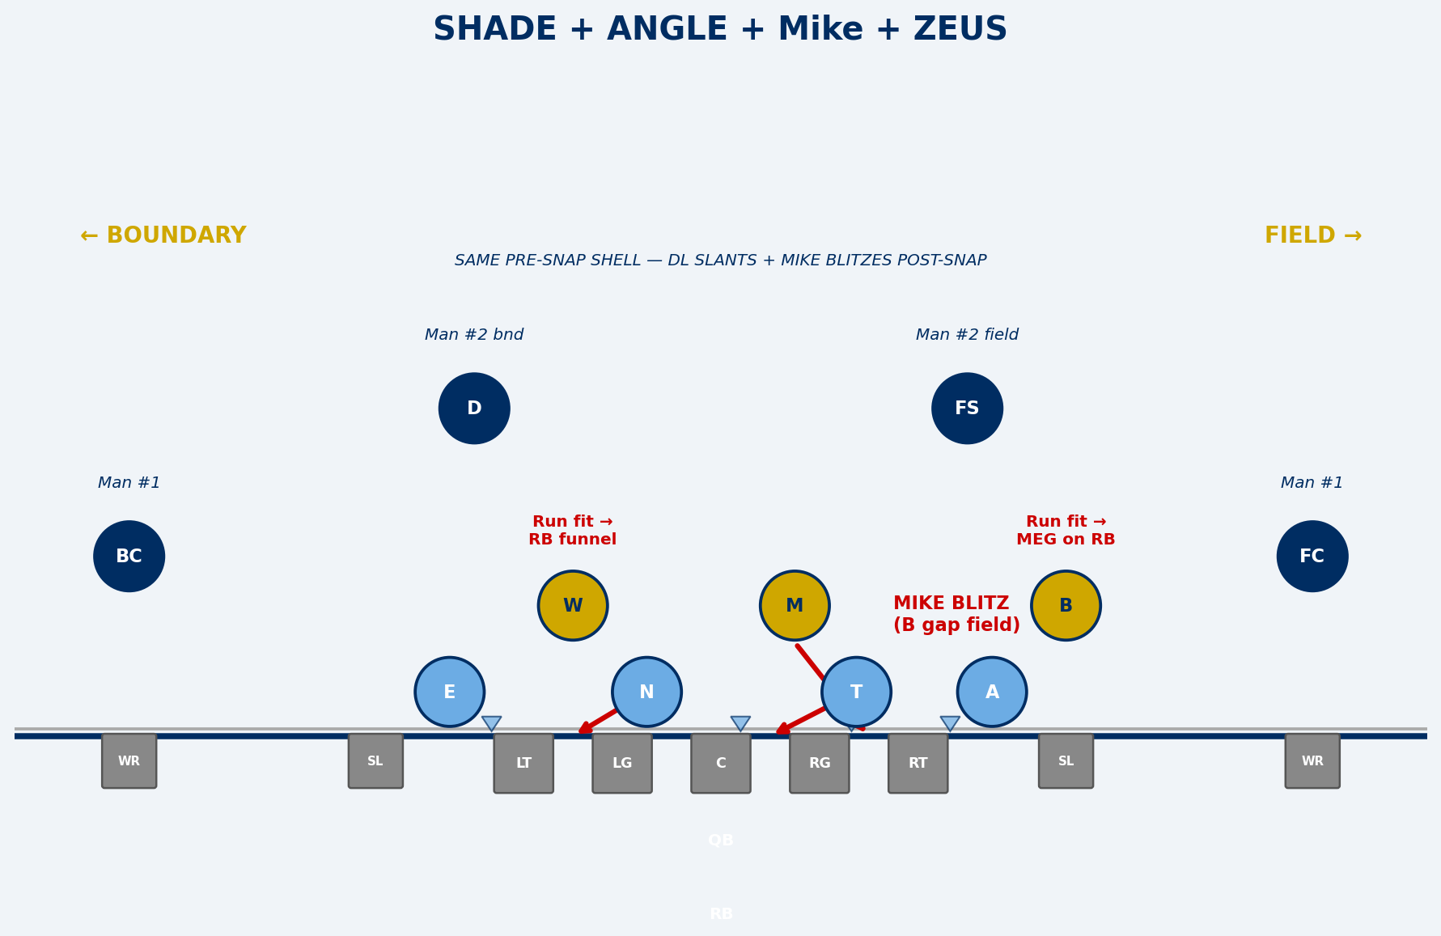
SHADE + ANGLE + MIKE + ZEUS — PRESSURE FROM DISGUISE
River Valley Vikings | 2026 Defense

Slide 29
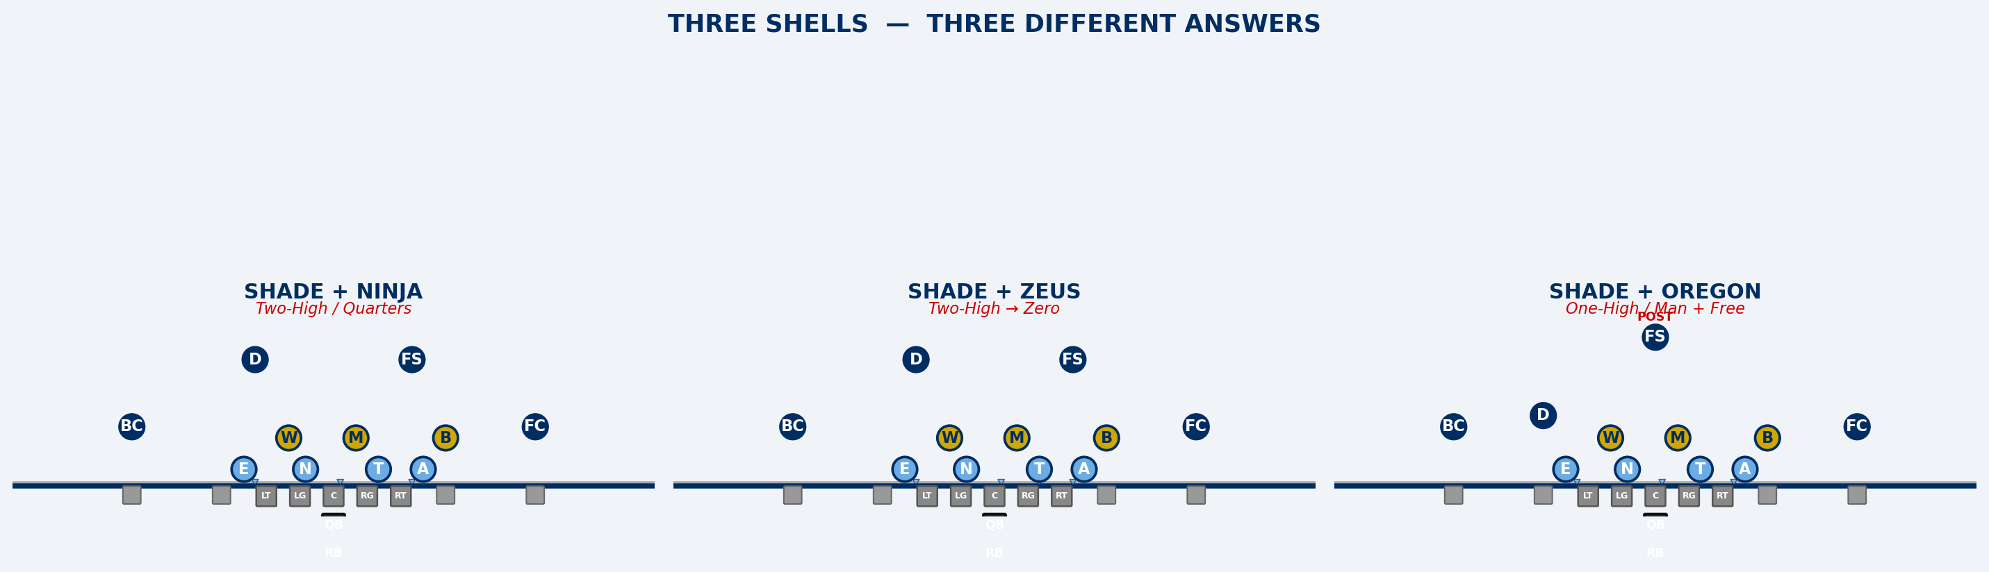
THREE SHELLS, THREE ANSWERS
River Valley Vikings | 2026 Defense

Slide 30
SYSTEM AT A GLANCE
Category | Count | Detail
4-Down Fronts | 8 | SHADE, UNDER, EYES, WIDE, DEUCES, GRIZZLY, BOSS, BOSS UNDER
3-Down Packages | 4 | MINT, ACE, JET, SLIP
Stunts | 11 | SLANT, ANGLE, PINCH, JACKS, SPLIT, CRASH, VEER, AA, EA, AR, ER
Single Pressures | 4 | Mike, Will, Bandit, Dawg
Combo Pressures | 5 | sWarM, BooM, BoW, MaD, Eat
Packaged Pressures | 4 | Hammer, Shave, Bandit Raven, Will Raven
Coverage Families | 4 | NINJA, Cover 1, Cover 0/Z, VIKING
Z-Family Calls | 5 | Zeus, Zorro, Zunnel, Zill, Zike
Alerts | 4 | BUMP, BANJO, EXCHANGE, UNDER
Multiple looks. Simple, consistent rules. Layered install.
River Valley Vikings | 2026 Defense

Slide 31
NEXT STEPS
Playbook — Full document (27+ sections) will be shared via Google Drive after this meeting.
Unit meetings — DL, LBs, DBs will each get deep-dives on their responsibilities.
Diagram documents — Visual references for every front, coverage, and pressure.
Quick-reference cards — M/W gap fits, NINJA teaching summary, coverage families, Bandit assignment.
Camp install plan — Coming once camp schedule is finalized.
3-2-6 shell — In development with Coach J. Arndt. Same rules, different personnel package.
This presentation — Will be on the Drive after the meeting.
River Valley Vikings | 2026 Defense

Slide 32
NO EXPLOSIVES. NO FREE YARDS.
MAKE THEM EARN IT.
River Valley Vikings | 2026
Questions?

