Slide 1

PROJECT PRESENTATION ON: Password Cracking
SUBMITTED BY:
Chokshi Khushi (23082291058)
Amin Purvang Vyom (23082291111)
SUBMITTED TO:
Department of Computer Science
GANPAT UNIVERSITY
2025 -26

Slide 2
PROJECT PROFILE
PROJECT TITLE: | Password Cracking
OBJECTIVE: | Aspiring penetration tester seeking opportunities to apply ethical password auditing and vulnerability assessment skills to strengthen organizational authentication controls and reduce account compromise risk.
SUPPORT TOOLS and Technology: | Html , css , javascript,VsCode
OPERATING SYSTEM: | Windows 10/11
GUIDE: | -
GROUP NO: | -
SUBMITTED BY: | Khushi Chokshi (23082291058), Vyom Amin (23082291111)
SUBMITTED TO: | Department Of Computer Science

Slide 3
REQUIREMENTS
SYSTEM REQUIREMENTS
PROCESSOR | 4 CORES(Minimum)
RAM | 8GB(Minimum)
OS | Windows 10/11
SHELL | Windows PowerShell
VS code | VS code1.104
SYSTEM REQUIREMENTS
Editor | VS Code
Report Format | HTML

Slide 4
INTRODUCTION TO PASSWORD CRACKING
What is password cracking?
Password cracking is the process of trying to discover a user’s password by testing possible values until the correct one is found. It’s a technical way to recover or guess passwords — and like a hammer, it can be used for good (recovering your own password, penetration testing with permission) or for harm (unauthorized access).
How it works — a quick analogy
Imagine a locked box with a combination lock. If you try every possible combination from 0000 to 9999, that’s brute force. If you first try combinations that people often choose — like 1234 or birth years — that’s like a dictionary attack (you try the likely combinations first).
Brute-force: Systematically try every possible password (guaranteed to find it, but may be impractically slow).

Slide 5
UI & navigation
Tabbed interface — two tabs: Create Account and Login & Cracker for a clear workflow.
Responsive card layout — neat cards, form controls and a live monospace log area for readability.
Progress bar & live stats — visual progress, attempts counter, estimated rate and elapsed timer.

Slide 6
2.Account management (local-only)
Create account stored in localStorage — saves {user, pass} locally in the browser (no server).
Password rules enforced — exactly 8 characters, only lowercase a–z and digits 0–9 (validated with a regex).
Clear / Save controls — create account, clear form; feedback messages for success / errors.

Slide 7
3. Login simulation
Local login check — compare entered username + password to locally saved account and show success/failure messages.
Logout button — clear login inputs and show logged-out message.
4. Logging & export
Attempt log — a monospace live log that shows time-stamped messages (recent entries shown in UI).
Export CSV — export the recorded log entries to a CSV file for saving or later analysis.

Slide 8
5.Cracker simulation (educational)
Two cracking modes:
Random non-repeating (sampling) — generates random 8-char guesses from the allowed alphabet.
Sequential (lexicographic) — generates guesses in lexicographic order (only for small demo runs; limited to avoid huge iteration).
Speed control — slider to set attempts per second (10 → 200,000), with live numeric display.
Start / Stop / Reset controls — start the simulation, stop mid-run, and reset counters & logs (reset requires stopping first).
Batching loop — attempts are run in small batches to keep the UI responsive while approximating the requested attempts/sec.
Demo progress scaling — because the full space (36⁸) is enormous, the progress bar is scaled to a demo cap (1,000,000) so the UI shows progress visibly.

Slide 9
6. Statistics & math display
Combinatorics explained — shows alphabet size (36), formula 36^8, and the exact big integer 2,821,109,907,456 combinations.
Example time estimates — illustrative estimates for different attempt rates (1k/sec, 10k/sec, 1M/sec) so viewers get a feel for scale.
Live counters — Attempts count, rate estimate (attempt/sec), elapsed time, and total space shown in the UI.

Slide 10
7. Safety & ethics
Local-only demonstration — no network requests; stored data is only in browser localStorage.
Clear ethics notice — the page repeatedly warns this is educational only and must not be used against real systems without authorization.

Slide 11
8. Implementation details (technical)
Client-side only (HTML+CSS+JS) — standalone page you can open in any browser; no backend.
Alphabet & combinatorics implemented — builds alphabet array programmatically (a–z + 0–9) and computes TOTAL_SPACE as a BigInt.
Regex validation — validatePassword() uses /^[a-z0-9]{8}$/ to enforce the rule.
Performance safety — sequential mode has a demo limit (stops if index exceeds practical bounds) and random mode doesn’t attempt to track all tried combinations (would be memory-prohibitive).
Formatted big integers & elapsed formatting — helper functions format large numbers with commas and format elapsed time HH:MM:SS.

Slide 12
9. Limitations (important to mention)
Not exhaustive — the demo never actually iterates 2.8 trillion combinations; it samples or stops early for practicality.
Not a real cracker — it does not compute or compare hashes, nor does it attack networked services. It only compares plaintext guesses to the locally stored plaintext password.
Random mode may repeat — because full-space de-duplication is infeasible, random sampling can repeat guesses (but probability is tiny for short runs).
Security of localStorage — saved demo account is visible to anyone with access to the browser profile; it’s not secure storage

Slide 13
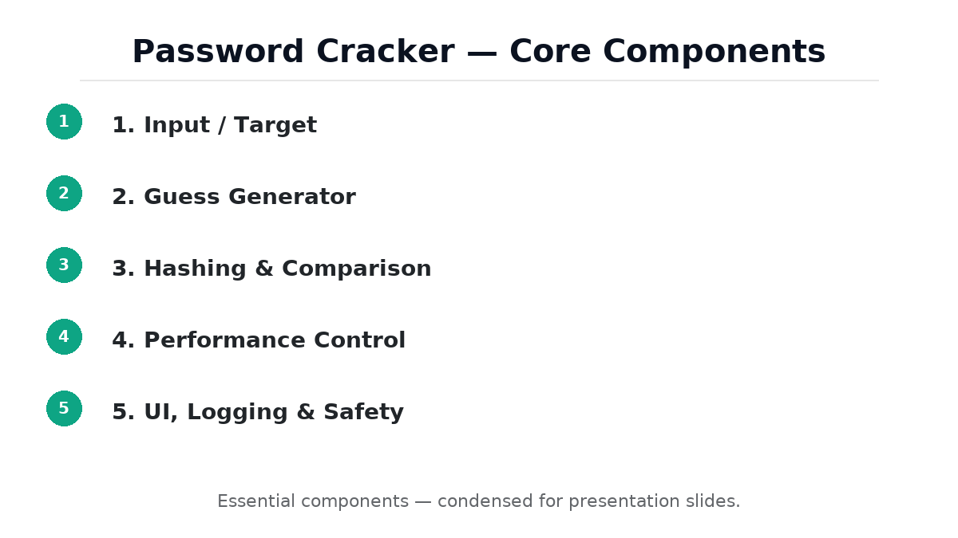

Slide 14
Input / Target
Where the cracker gets data (plain password field for demo, or imported hash/salt for offline tests).
Target source — where the password data comes from (plain-text demo field, imported hash file, or captured/login endpoint).
Account store — temporary/local storage of username/password or hashes for the demo.

Slide 15
2.Guess generators
Brute-force generator — produces every possible combination from the charset (usually impractical for large spaces).
Dictionary generator — reads a wordlist of likely passwords.
Hybrid generator — combines dictionary words + rule transforms.
Random sampler — picks random guesses (useful in demos or probabilistic attacks).
Sequential (lexicographic) generator — steps through candidates in a deterministic order.

Slide 16
3.Hashing / Comparison
Hashes each guess (if needed) and checks whether it matches the stored value.
Hash function implementation — computes hashes (MD5, SHA-1, SHA-256, or KDFs
like PBKDF2/bcrypt/argon2) to compare guesses to stored hashes.
Salt handling — supports prefix/suffix or stored salts when comparing salted hashes.
Plaintext compare — simple string compare used in basic demos.

Slide 17
4.Performance Control
Rate/batching and optional acceleration (simulate GPU or tune attempts/sec) to
manage speed and responsiveness.
Acceleration & Safe Simulation — simulate or optionally
use hardware acceleration (GPU/native) while providing safe defaults;
don’t let the app saturate the device.

Slide 18
5.UI / Logging & Safety
Start/stop controls, progress display, log/export, and mandatory consent
/ local-only warnings.
Consent modal — explicit confirmation that user has authorization.
Local-only enforcement — no network uploads, explicit localStorage usage or
ephemeral mode.
Wipe / clear data button to remove saved values.
Safe defaults — capped speeds and simulated heavy workloads instead of
actually freezing the browser

Slide 19
PRACTICAL WORK

Slide 20
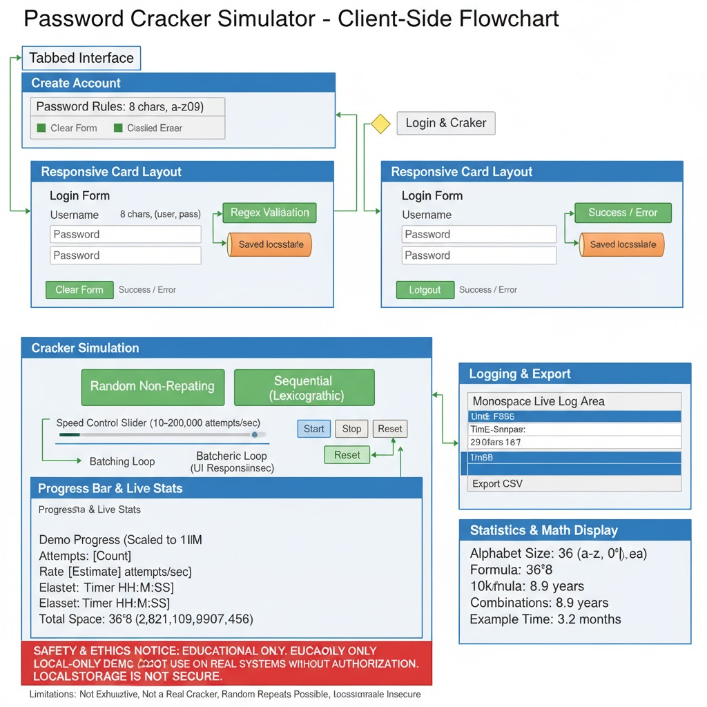
1.Client-Side Flow of Password Cracking Simulation

Slide 21
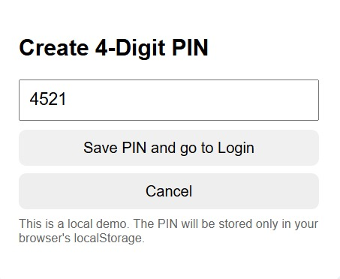
2.PIN Creation Module

Slide 22
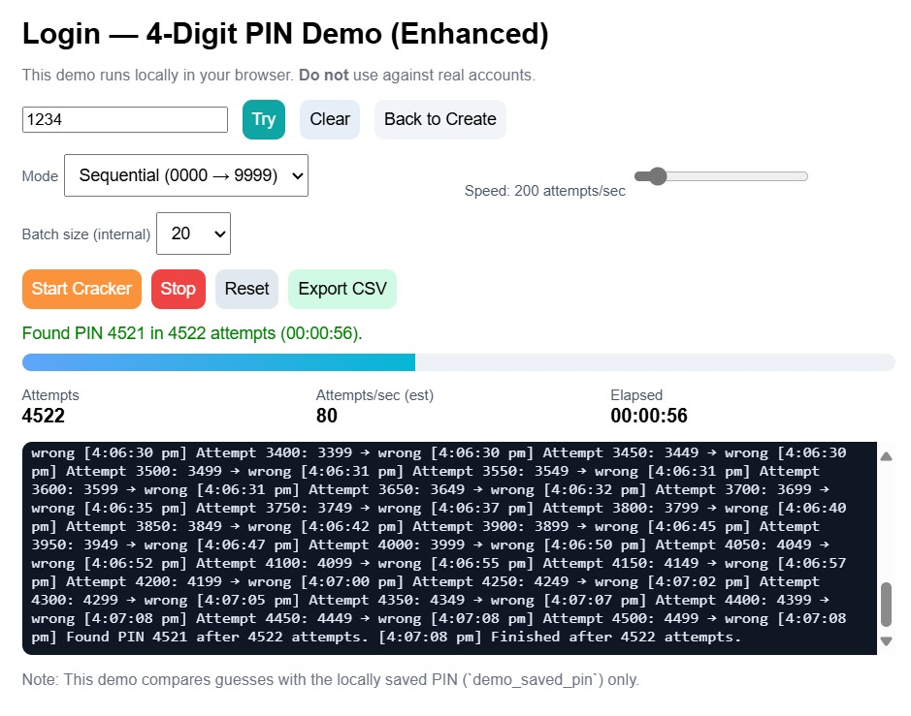
3.PIN Verification & Cracking Result Display

Slide 23
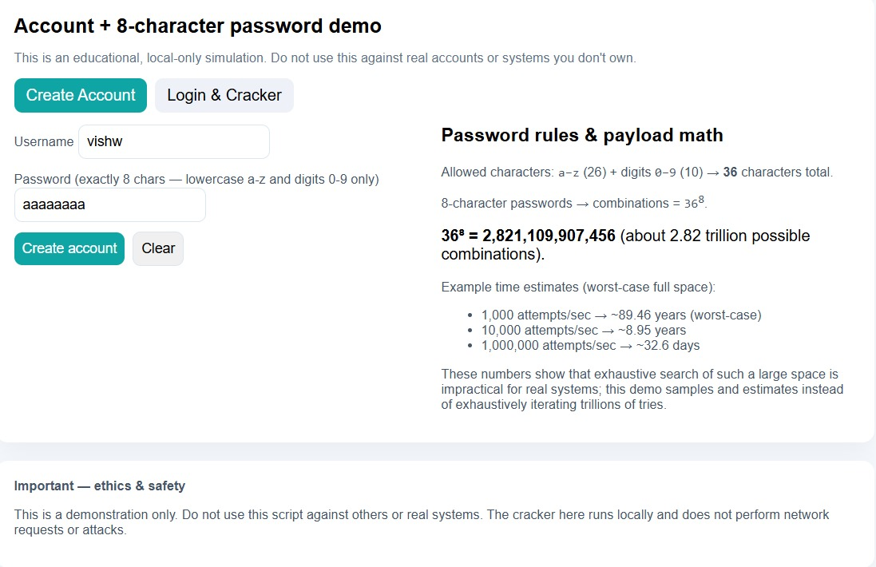
4.Password Generation and Complexity Analysis

Slide 24
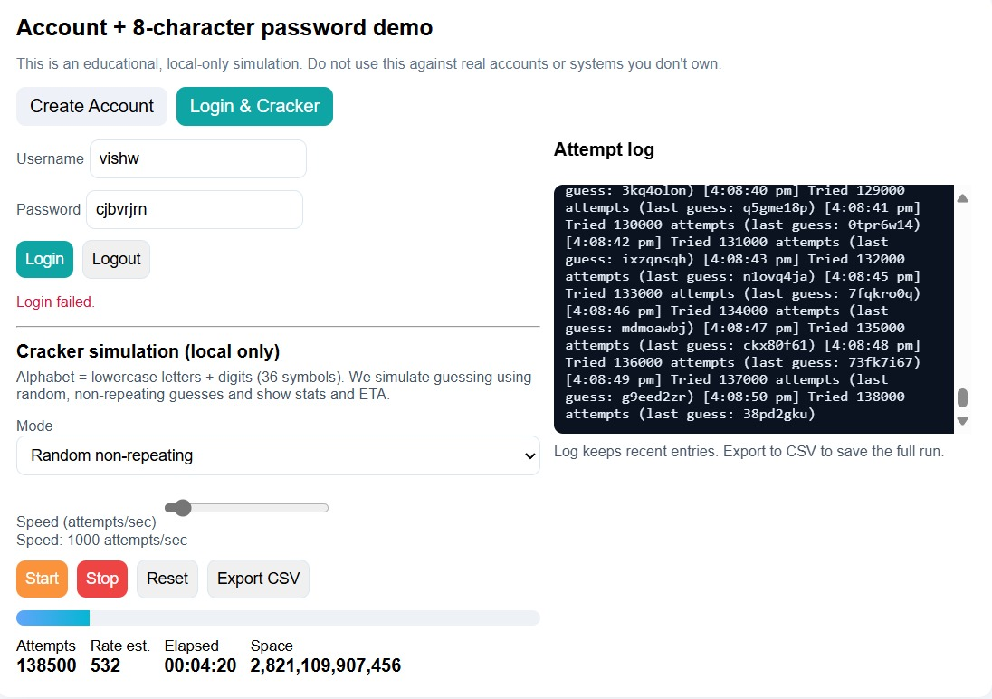
5.Brute Force Simulation for 8-Character Password

Slide 25
Future Enhancement

Slide 26
Conclusion
Password cracking helps us understand how weak passwords can be easily broken, and why strong password security is important.
Through this demo, we can see how different cracking methods (like brute force or dictionary attacks) work in a controlled and educational way.
It shows that even simple 8-character passwords can take years or just seconds to crack, depending on their strength and the attacker’s resources.
The main goal is awareness, not misuse — to educate users on creating stronger, unique, and more secure passwords.
In the future, we can make this project more realistic by adding hash comparison, salting, and better visual tools, while always keeping it ethical and safe.

