Slide 1

A Project Presentation on Password Cracking by Brute Force
Submitted By:
Khushi Chokshi: | 23082291057
Vyom Amin : | 23082291111
B.Sc. IT (Cyber Security) Semester-V
Internal Guide Prof. Chetana Prajapati
Submitted To:
JULY-NOV 2025

Slide 2
PROJECT PROFILE
PROJECT TITLE: | Password Cracking
OBJECTIVE: | Aspiring penetration tester seeking opportunities to apply ethical password auditing and vulnerability assessment skills to strengthen organizational authentication controls and reduce account compromise risk.
SUPPORT TOOLS and Technology: | Html , css , javascript,VsCode
OPERATING SYSTEM: | Windows 10/11
GUIDE: | Prof. Kashyap C. Patel
GROUP NO: | -
SUBMITTED BY: | Khushi Chokshi (23082291057), Vyom Amin (23082291111)
SUBMITTED TO: | Department Of Computer Science

Slide 3
REQUIREMENTS
SYSTEM REQUIREMENTS
PROCESSOR | 4 CORES(Minimum)
RAM | 8GB(Minimum)
OS | Windows 10/11
SHELL | Windows PowerShell
VS code | VS code1.104
SYSTEM REQUIREMENTS
Editor | VS Code
Report Format | HTML

Slide 4
INTRODUCTION TO PASSWORD CRACKING
What is password cracking?
Password cracking is the process of trying to discover a user’s password by testing possible values until the correct one is found. It’s a technical way to recover or guess passwords — and like a hammer, it can be used for good (recovering your own password, penetration testing with permission) or for harm (unauthorized access).
How it works — a quick analogy
Imagine a locked box with a combination lock. If you try every possible combination from 0000 to 9999, that’s brute force. If you first try combinations that people often choose — like 1234 or birth years — that’s like a dictionary attack (you try the likely combinations first).
Brute-force: Systematically try every possible password (guaranteed to find it, but may be impractically slow).

Slide 5
Why Passwords Get Cracked Easily
People use simple passwords like 123456 or password
Many reuse the same password on multiple sites
Hackers use leaked passwords from old breaches
Weak passwords are easy to guess or brute-force
Notes:
Explain that weak and reused passwords are the main reason for successful attacks.

Slide 6
UI & navigation
Tabbed interface — two tabs: Create Account and Login & Cracker for a clear workflow.
Responsive card layout — neat cards, form controls and a live monospace log area for readability.
Progress bar & live stats — visual progress, attempts counter, estimated rate and elapsed timer.

Slide 7
2.Account management (local-only)
Create account stored in localStorage — saves {user, pass} locally in the browser (no server).
Password rules enforced — exactly 8 characters, only lowercase a–z and digits 0–9 (validated with a regex).
Clear / Save controls — create account, clear form; feedback messages for success / errors.

Slide 8
3. Login simulation
Local login check — compare entered username + password to locally saved account and show success/failure messages.
Logout button — clear login inputs and show logged-out message.
4. Logging & export
Attempt log — a monospace live log that shows time-stamped messages (recent entries shown in UI).
Export CSV — export the recorded log entries to a CSV file for saving or later analysis.

Slide 9
5.Cracker simulation (educational)
Two cracking modes:
Random non-repeating (sampling) — generates random 8-char guesses from the allowed alphabet.
Sequential (lexicographic) — generates guesses in lexicographic order (only for small demo runs; limited to avoid huge iteration).
Speed control — slider to set attempts per second (10 → 200,000), with live numeric display.
Start / Stop / Reset controls — start the simulation, stop mid-run, and reset counters & logs (reset requires stopping first).
Batching loop — attempts are run in small batches to keep the UI responsive while approximating the requested attempts/sec.
Demo progress scaling — because the full space (36⁸) is enormous, the progress bar is scaled to a demo cap (1,000,000) so the UI shows progress visibly.

Slide 10
6. Statistics & math display
Combinatorics explained — shows alphabet size (36), formula 36^8, and the exact big integer 2,821,109,907,456 combinations.
Example time estimates — illustrative estimates for different attempt rates (1k/sec, 10k/sec, 1M/sec) so viewers get a feel for scale.
Live counters — Attempts count, rate estimate (attempt/sec), elapsed time, and total space shown in the UI.

Slide 11
7. Safety & ethics
Local-only demonstration — no network requests; stored data is only in browser localStorage.
Clear ethics notice — the page repeatedly warns this is educational only and must not be used against real systems without authorization.

Slide 12
8. Implementation details (technical)
Client-side only (HTML+CSS+JS) — standalone page you can open in any browser; no backend.
Alphabet & combinatorics implemented — builds alphabet array programmatically (a–z + 0–9) and computes TOTAL_SPACE as a BigInt.
Regex validation — validatePassword() uses /^[a-z0-9]{8}$/ to enforce the rule.
Performance safety — sequential mode has a demo limit (stops if index exceeds practical bounds) and random mode doesn’t attempt to track all tried combinations (would be memory-prohibitive).
Formatted big integers & elapsed formatting — helper functions format large numbers with commas and format elapsed time HH:MM:SS.

Slide 13
9. Limitations (important to mention)
Not exhaustive — the demo never actually iterates 2.8 trillion combinations; it samples or stops early for practicality.
Not a real cracker — it does not compute or compare hashes, nor does it attack networked services. It only compares plaintext guesses to the locally stored plaintext password.
Random mode may repeat — because full-space de-duplication is infeasible, random sampling can repeat guesses (but probability is tiny for short runs).
Security of localStorage — saved demo account is visible to anyone with access to the browser profile; it’s not secure storage

Slide 14
Key Features of Password-Cracking Tools
• Attack types: Brute-force, Dictionary, Mask, Rule-based
• GPU acceleration for large-scale parallel attempts
• Multi-threading — use multiple CPU cores
• Hash & salt handling for realistic offline cracking
• Session resume & progress tracking
• Ethical & educational use (authorized tests only)
Notes:
Real cracking tools combine many techniques. Brute-force tries everything; dictionary and mask attacks focus guesses to be faster. GPUs and multiple cores speed things up massively. Handling hashes and salts makes attacks realistic for offline data. Good tools let you pause/resume and show progress — and importantly, they should only be used with permission for testing or learning.

Slide 15
Deep Dive — Attack Types
Brute-force: try all combinations — guaranteed but slow
Dictionary: use common words/password lists (fast for human-chosen passwords)
Mask attacks: target patterns (e.g., ?u?l?l?d for 1 upper, 2 lower, 1 digit)
Rule-based: transform dictionary entries (leet substitutions, append years)
Hybrid: combine dictionary + brute-force for variants
Notes:
Explain real examples: brute-force for short PINs, dictionary for leaked-password style guesses, masks when you know password format (like a capital + name + 2 digits). Rule-based attacks are powerful because they mimic how users modify words.

Slide 16
Guess generators
Brute-force generator — produces every possible combination from the charset (usually impractical for large spaces).
Dictionary generator — reads a wordlist of likely passwords.
Hybrid generator — combines dictionary words + rule transforms.
Random sampler — picks random guesses (useful in demos or probabilistic attacks).
Sequential (lexicographic) generator — steps through candidates in a deterministic order.

Slide 17
Hashing / Comparison
Hashes each guess (if needed) and checks whether it matches the stored value.
Hash function implementation — computes hashes (MD5, SHA-1, SHA-256, or KDFs
like PBKDF2/bcrypt/argon2) to compare guesses to stored hashes.
Salt handling — supports prefix/suffix or stored salts when comparing salted hashes.
Plaintext compare — simple string compare used in basic demos.

Slide 18
Hashing Methods Overview
MD5 – very fast but not secure
SHA-1 – outdated, also unsafe
SHA-256 – stronger but still needs a salt
bcrypt / Argon2 – modern, slow and secure
Notes:
Compare hash methods and emphasize bcrypt and Argon2 as best for real password protection.

Slide 19
Hashing & Salting (Future Scope)
Hash — one-way transform: password → scrambled string (not reversible)
Salt — random value added before hashing (unique per password)
Salting prevents rainbow-table attacks and makes identical passwords produce different hashes
Future enhancement: Offline Hash Mode (with salt) to demo real comparisons safely
Notes:
A hash stores a scrambled version of the password so the original can’t be retrieved directly. A salt is extra random data mixed into the password before hashing — it ensures identical passwords don’t create identical hashes, which defeats precomputed attacks like rainbow tables. Adding an offline hash + salt demo would make our simulation much more realistic while keeping it local and safe.

Slide 20
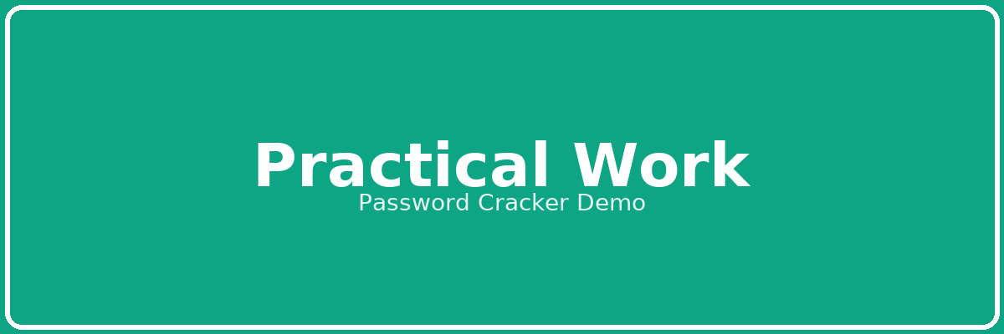

Slide 21
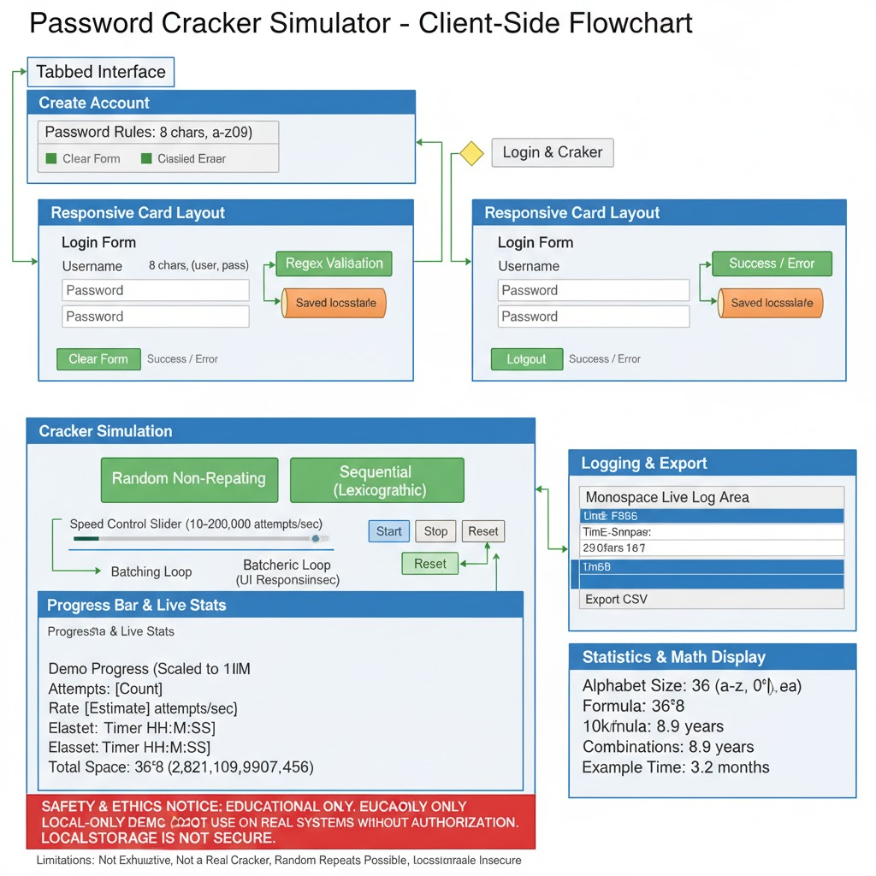
1.Client-Side Flow of Password Cracking Simulation

Slide 22
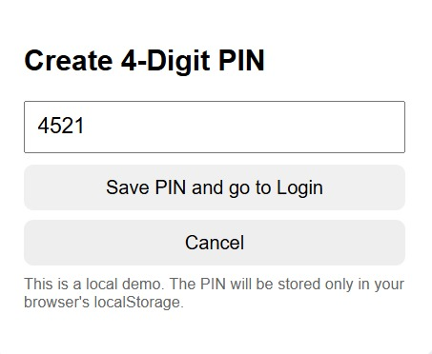
2.PIN Creation Module

Slide 23
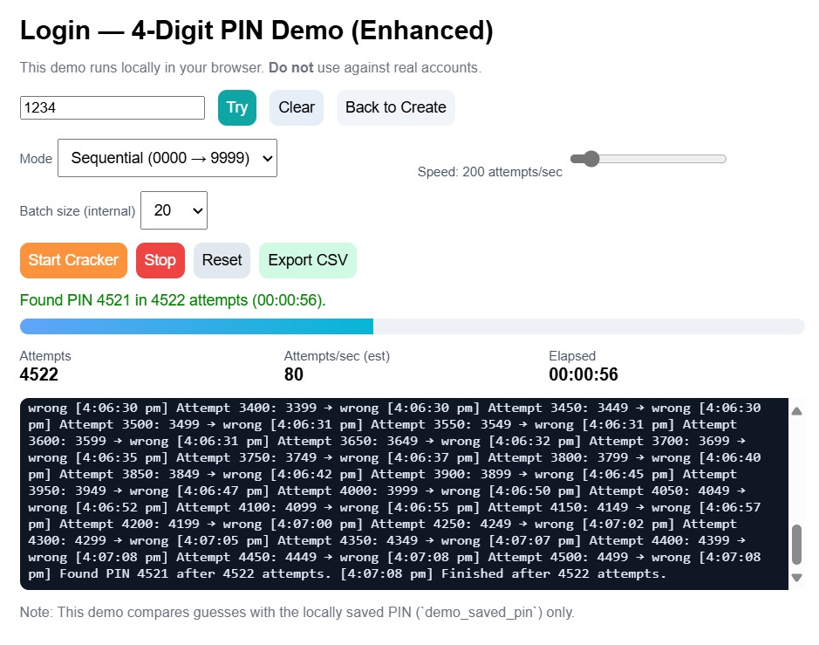
3.PIN Verification & Cracking Result Display

Slide 24
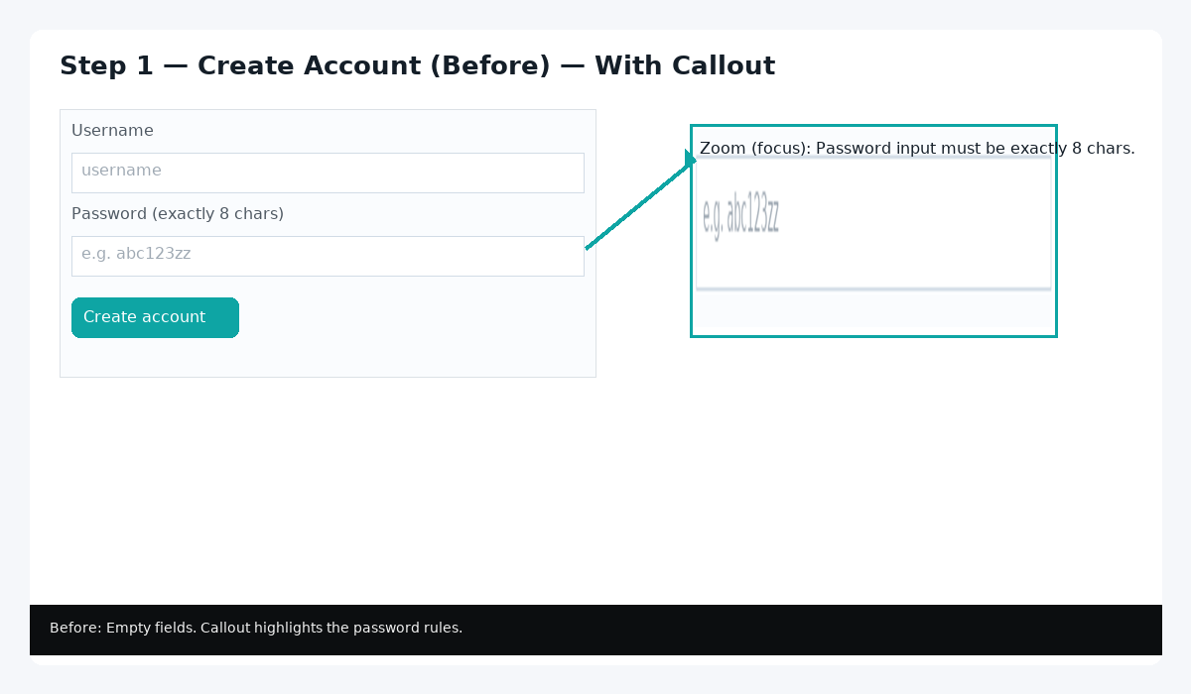
4.Check the Password Rules First

Slide 25
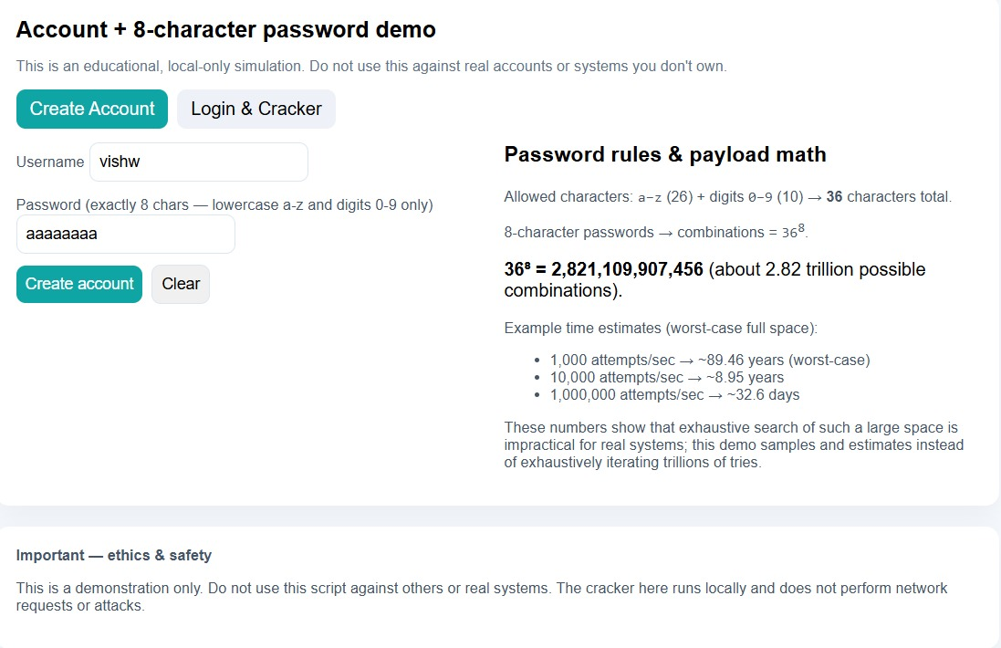
5.Password Generation and Complexity Analysis

Slide 26
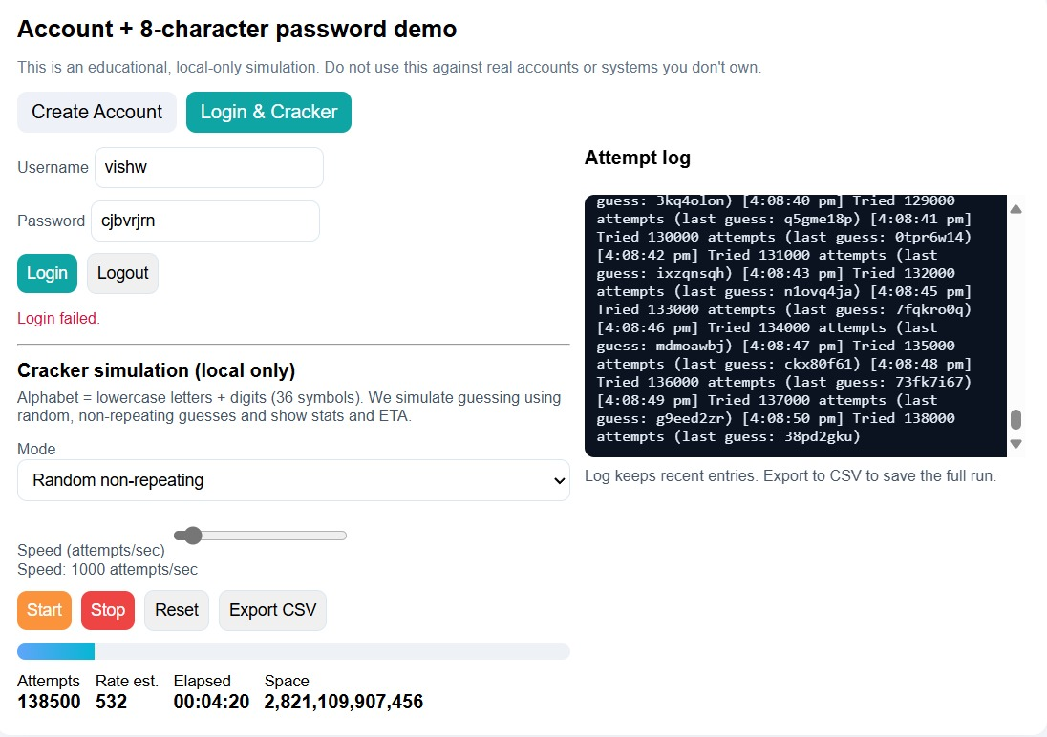
6.Brute Force Simulation for 8-Character Password

Slide 27
Future Enhancement
1.Offline Hash Mode (with Salt) Accept a password hash (and optional salt) and test guesses
locally to show how real cracking works.
2.Wordlists + Simple Rules Let users upload/choose common wordlists and apply transforms
(add “123”, capitalize) so attacks look practical, not random.
3.Consent + Wipe Controls Require a permission checkbox before running and add a one-click
“Wipe demo data” to erase localStorage for safety.
4.Visual Presets & Charts Add one-click scenarios (e.g., “Weak PIN”, “Salted hash”)
and simple charts (attempts/sec, ETA) to teach faster

Slide 28
Future of Password Security
Passwordless logins using fingerprints or face recognition.
Two-Factor Authentication (2FA) becoming standard.
Hardware keys (like YubiKey) for stronger protection.
AI-based threat detection to stop brute-force attack.

Slide 29
Real-World Importance
Weak passwords lead to data breaches and identity theft
Cracking (ethically) helps security teams find and fix weak passwords
Use of strong, unique passwords + MFA reduces risk
Always perform cracking with written permission — for training, audits, and research only
Notes:
This demo isn’t about wrongdoing — it shows why strong passwords matter. Ethical cracking helps organizations find weak credentials so they can strengthen defenses. Best defenses are long, unique passwords stored in a password manager and multi-factor authentication. Always stress: any cracking must be authorized in writing for legal and ethical reasons.

Slide 30


