Slide 1
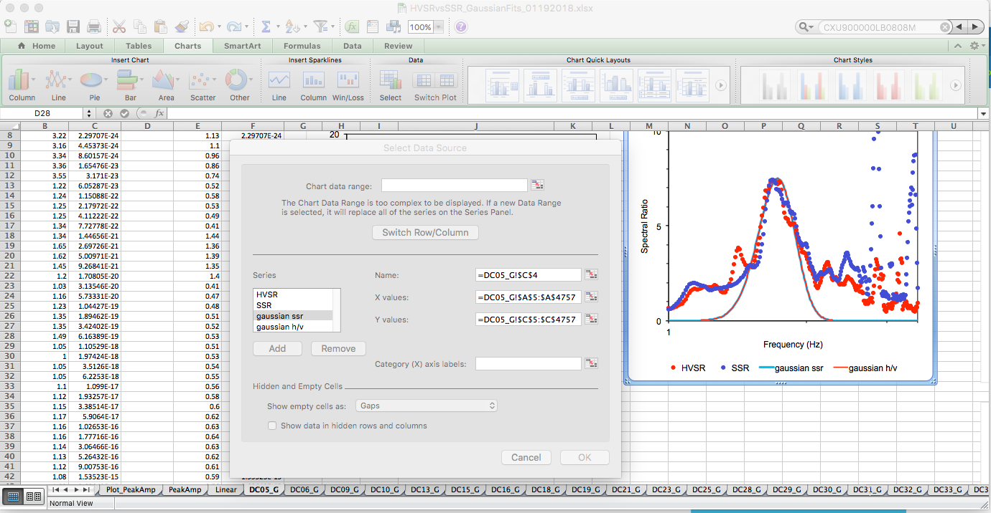
Python Tips Lightning Talk Replacing spreadsheet with Python notebook

Slide 2
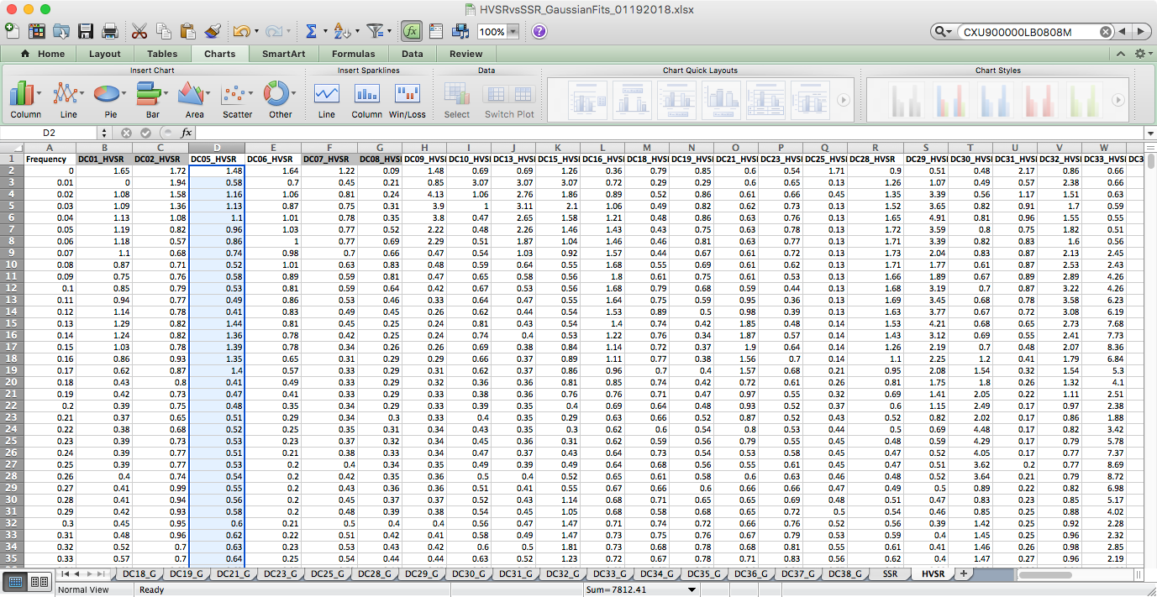
Python Tips Lightning Talk Replacing spreadsheet with Python notebook

Slide 3
Python Tips Lightning Talk Replacing spreadsheet with Python notebook
Excel analysis and plotting grows out of control
This Spectral seismometer data from DC started in text files
A better way is Python:
Python pandas.read_csv
matplotlib.pyplot.plot
cd /Users/karl/ipython_notebook/lisaplot
jupiter notebook
Open plot_dc5_ssr_svsr.ipynb

Slide 4
Python Tips Lightning Talk Replacing spreadsheets with Python notebooks

