Slide 1

Berkeley DB for TinyIot
Sejong Univ
Name : Park Minji
E-mail : iorw0224@gmail.com

Slide 2
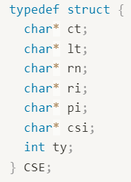
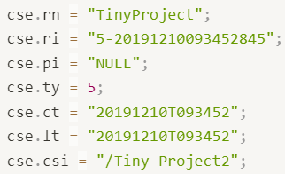
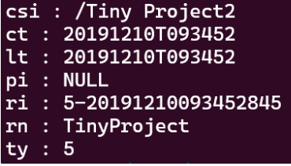
Berkeley DB
Use Cursor - DB_KEYLAST : Create a new record, as the last of the duplicate records for the supplied key.
Set Flag - DB_DUP : Permit duplicate data items in the database. The ordering of duplicates in the database is determined by the order of insertion, unless the ordering is otherwise specified by use of a cursor operation or a duplicate sort function.
Struct CSE
CSE.db
Key
Value
Store_CSE(CSE* cse_object)
csi
ct
lt
pi
ri
rn
ty
/Tiny Project2
20191210T093452
20191210T093452
NULL
5-20191210093452845
TinyProject
5
Struct CSE
Get_CSE(char* ri)

Slide 3
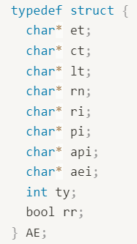
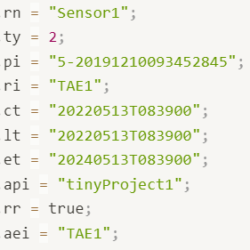
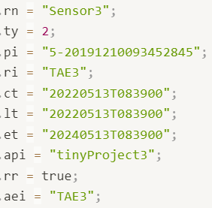
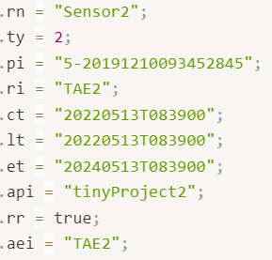

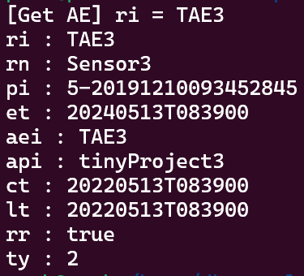
Berkeley DB
Permit duplicate data items in the database
AE1
AE3
AE2
AE.db
Struct AE
Key
Value
aei
aei
aei
api
api
api
ct
ct
ct
et
et
et
lt
lt
lt
pi
pi
pi
ri
ri
ri
rn
rn
rn
rr
rr
rr
ty
ty
ty
TAE1
TAE3
TAE2
tinyProject1
tinyProject3
tinyProject2
20220513T083900
20220513T083900
20220513T083900
20240513T083900
20240513T083900
20240513T083900
20220513T083900
20220513T083900
20220513T083900
5-20191210093452845
5-20191210093452845
5-20191210093452845
TAE1
TAE3
TAE2
Sensor1
Sensor3
Sensor2
true
true
true
2
2
2
Store_AE(AE* ae_object)
Struct AE3
Cursor
Find “TAE3”
Index[1]
Get_AE(char* ri)

Slide 4
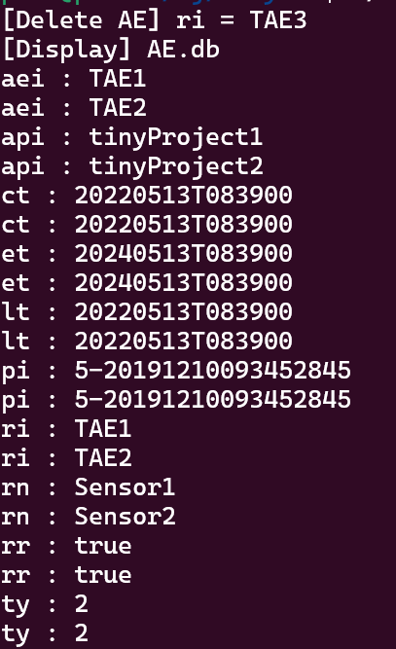

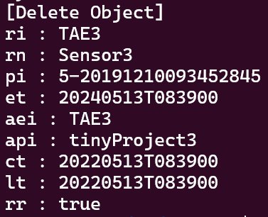
Berkeley DB
Delete ri=“TAE3”
AE.db
AE.db
Key
Value
aei
aei
aei
api
api
api
ct
ct
ct
et
et
et
lt
lt
lt
pi
pi
pi
ri
ri
ri
rn
rn
rn
rr
rr
rr
ty
ty
ty
TAE1
TAE3
TAE2
tinyProject1
tinyProject3
tinyProject2
20220513T083900
20220513T083900
20220513T083900
20240513T083900
20240513T083900
20240513T083900
20220513T083900
20220513T083900
20220513T083900
5-20191210093452845
5-20191210093452845
5-20191210093452845
TAE1
TAE3
TAE2
Sensor1
Sensor3
Sensor2
true
true
true
2
2
2
Del_AE(char* ri)
ri not found
Return delete object
Cursor
Find “TAE3”
Index[1]

