Slide 1
Berkeley DB for TinyIoT
S
TinyloT
Sejong Univ.
Name : Park Minji
E-mail : iorw0224@gmail.com

Slide 2


Berkeley DB
이번주 진행 상황
1
DB 저장 형태별 실행 시간 비교
2
sub_bit -> net 로 대체
3
SubNode -> Node
4
Filter Criteria
Github
Notion

Slide 3


Part 1
DB 저장 형태별 실행 시간 비교
Subscription
SUB.db
Key(label)
Value(uri)
3-20220406084023203796
3-20210406084023203796
3-20220406084023203796
3-20210406084023203796
3-20220406084023203796
3-20210406084023203796
3-20220406084023203796
3-20210406084023203796
3-20220406084023203796
3-20210406084023203796
3-20220406084023203796
3-20210406084023203796
3-20220406084023203796
3-20210406084023203796
3-20220406084023203796
3-20210406084023203796
3-20220406084023203796
3-20210406084023203796
Sub1
23-2022040684653299304 http://223.131.176.101:3000/ct=json
1
20220406T084653
20260406T084653
20220406T084653
23
1
Sub2
23-2021040684653299304 http://223.131.176.101:3000/ct=json
4
20210406T084653
20250406T084653
20210406T084653
23
1
같은 키를 갖는 저장 방식
Get_Sub_Pi

Slide 4


Part 1
DB 저장 형태별 실행 시간 비교
Subscription_2
SUB_2.db
Key(label)
Value(uri)
net
net
ct
ct
et
et
Lt
lt
nu
nu
pi
pi
ri
ri
rn
rn
ty
ty
1
4
20220406T084653
20210406T084653
20220406T084653
20210406T084653
20220406T084653
20210406T084653
http://127.0.0.1:7000?ct=json
http://127.0.0.1:7000?ct=json
3-20220406084023203796
3-20210406084023203796
23-2022040684653299304
23-2021040684653299304
Sub1
Sub2
23
23
다른 키를 갖는 저장 방식
Get_Sub_Pi_2

Slide 5
Part 1
DB 저장 형태별 실행 시간 비교
Subscription_2
Subscription
SUB_2.db
SUB.db
Key(label)
Value(uri)
Key(label)
Value(uri)
net
net
ct
ct
et
et
Lt
lt
nu
nu
pi
pi
ri
ri
rn
rn
ty
ty
1
4
20220406T084653
20210406T084653
20220406T084653
20210406T084653
20220406T084653
20210406T084653
http://127.0.0.1:7000?ct=json
http://127.0.0.1:7000?ct=json
3-20220406084023203796
3-20210406084023203796
23-2022040684653299304
23-2021040684653299304
Sub1
Sub2
23
23
3-20220406084023203796
3-20210406084023203796
3-20220406084023203796
3-20210406084023203796
3-20220406084023203796
3-20210406084023203796
3-20220406084023203796
3-20210406084023203796
3-20220406084023203796
3-20210406084023203796
3-20220406084023203796
3-20210406084023203796
3-20220406084023203796
3-20210406084023203796
3-20220406084023203796
3-20210406084023203796
3-20220406084023203796
3-20210406084023203796
Sub1
23-2022040684653299304 http://223.131.176.101:3000/ct=json
1
20220406T084653
20260406T084653
20220406T084653
23
1
Sub2
23-2021040684653299304 http://223.131.176.101:3000/ct=json
4
20210406T084653
20250406T084653
20210406T084653
23
1
Get_Sub_Pi
Get_Sub_Pi_2

Slide 6
2
net 저장 방식 수정

Slide 7
Part 2
net 저장 방식 수정
SUB.db
Key(label)
Value(uri)
3-20220406084023203796
3-20210406084023203796
3-20220406084023203796
3-20210406084023203796
3-20220406084023203796
3-20210406084023203796
3-20220406084023203796
3-20210406084023203796
3-20220406084023203796
3-20210406084023203796
3-20220406084023203796
3-20210406084023203796
3-20220406084023203796
3-20210406084023203796
3-20220406084023203796
3-20210406084023203796
3-20220406084023203796
3-20210406084023203796
Sub1
23-2022040684653299304 http://223.131.176.101:3000/ct=json
1 (net)
20220406T084653
20260406T084653
20220406T084653
23
1
Sub2
23-2021040684653299304 http://223.131.176.101:3000/ct=json
4 (net)
20210406T084653
20250406T084653
20210406T084653
23
1
rn : Sub1
ri : 23-2022040684653299304
nu : http://223.131.176.101:3000/ct=json
net : 1
pi : 3-20220406084023203796
“1”
1
NetToBit()
Char*
int
rn : Sub2
ri : 23-2021040684653299304
nu : http://223.131.176.101:3000/ct=json
net : 8
pi : 3-20220406084023203796
“4”
8
NetToBit()
int
Char*

Slide 8
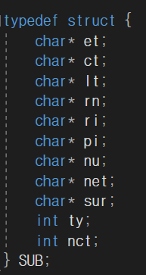
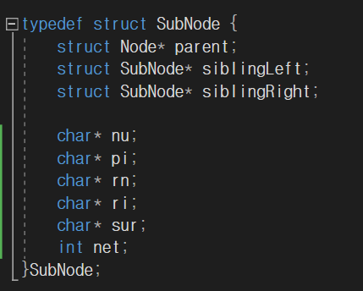
Part 2
net 저장 방식 수정
SUB.db
Key(label)
Value(uri)
3-20220406084023203796
3-20210406084023203796
3-20220406084023203796
3-20210406084023203796
3-20220406084023203796
3-20210406084023203796
3-20220406084023203796
3-20210406084023203796
3-20220406084023203796
3-20210406084023203796
3-20220406084023203796
3-20210406084023203796
3-20220406084023203796
3-20210406084023203796
3-20220406084023203796
3-20210406084023203796
3-20220406084023203796
3-20210406084023203796
Sub1
23-2022040684653299304 http://223.131.176.101:3000/ct=json
1 (net)
20220406T084653
20260406T084653
20220406T084653
23
1
Sub2
23-2021040684653299304 http://223.131.176.101:3000/ct=json
4 (net)
20210406T084653
20250406T084653
20210406T084653
23
1
NetToBit()
int NetToBit(char* net) {
int netLen = strlen(net);
int ret = 0;
for (int i = 0; i < netLen; i++) {
int exp = atoi(net + i);
if (exp > 0) ret = (ret | (int)pow(2, exp - 1));
}
return ret;
}

Slide 9
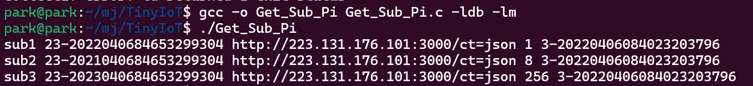
Part 2
net 저장 방식 수정
Ubuntu에서 C언어 math.h 헤더의 pow함수 사용 할 때
[gcc] undefined reference to `pow’ 오류 발생
컴파일 시 –lm 붙혀서 해결
https://forum.ubuntu-kr.org/viewtopic.php?t=16668

Slide 10
3
SubNode 수정

Slide 11
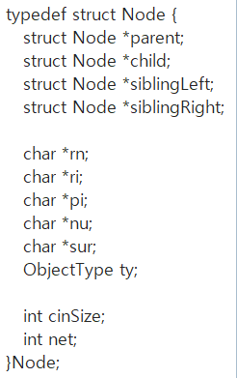
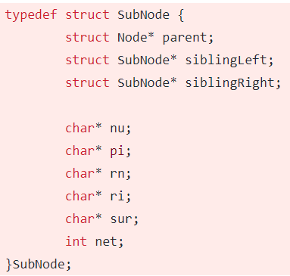
Part 3
Node 수정
SubNode를 따로 사용하지 않고 기존 Node에 변수 추가하여 사용
SubNode
Node
수정 사유 : SubNode는 기존 Node관련 함수들 재활용이 힘듦

Slide 12
4
다음주 수정 사항

Slide 13
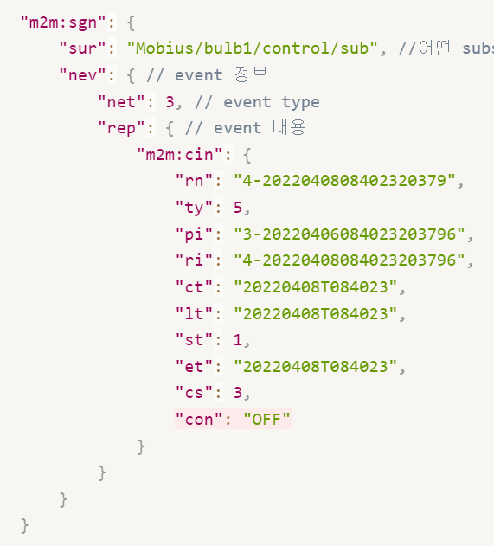
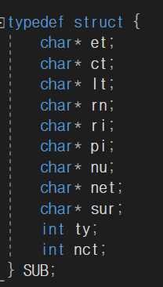
Part 4
다음주 수정 사항
Sub 구조체에 char *sur 추가

Slide 14
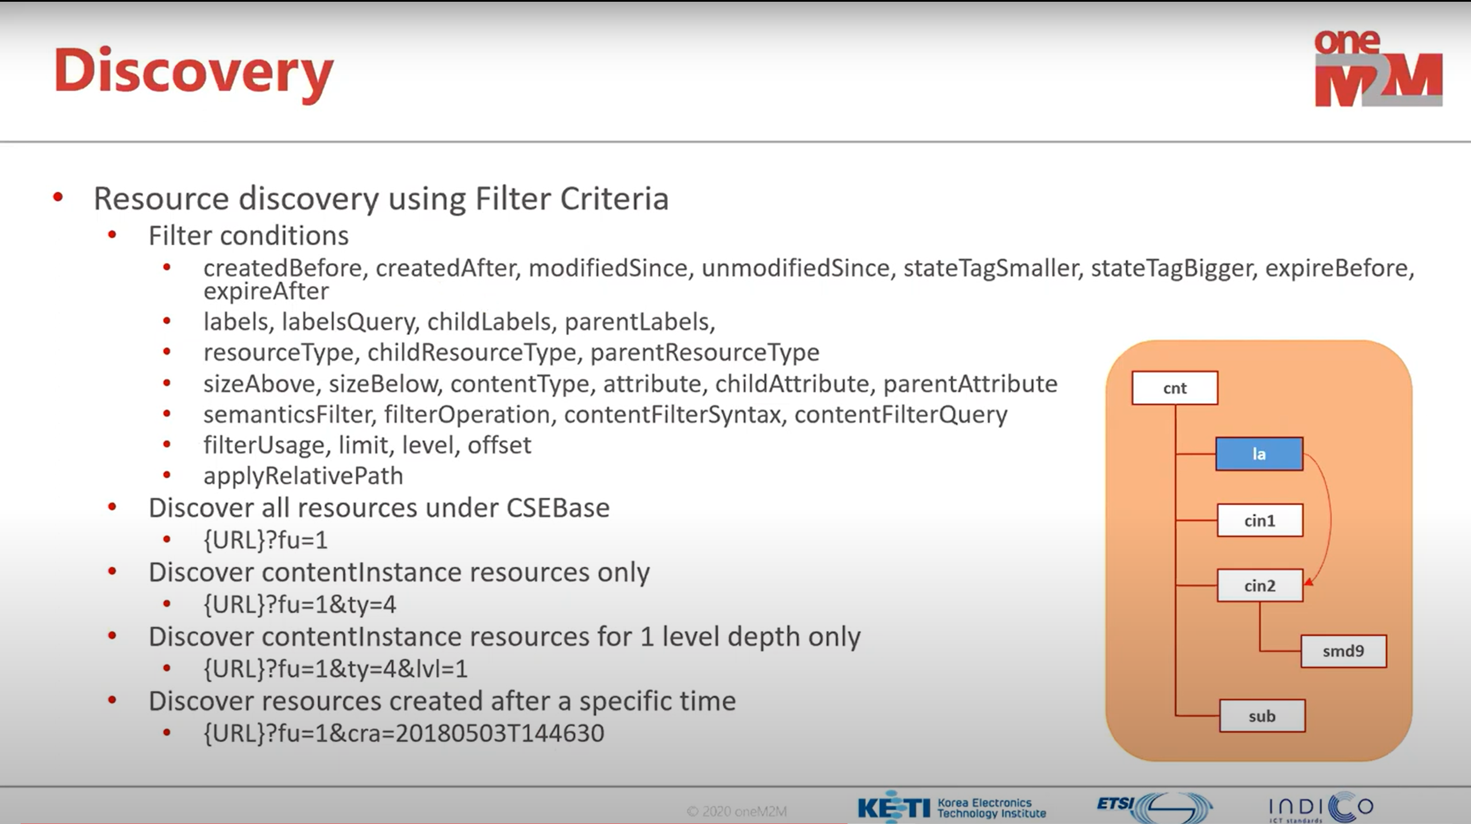
Part 1
Discovery

Slide 15
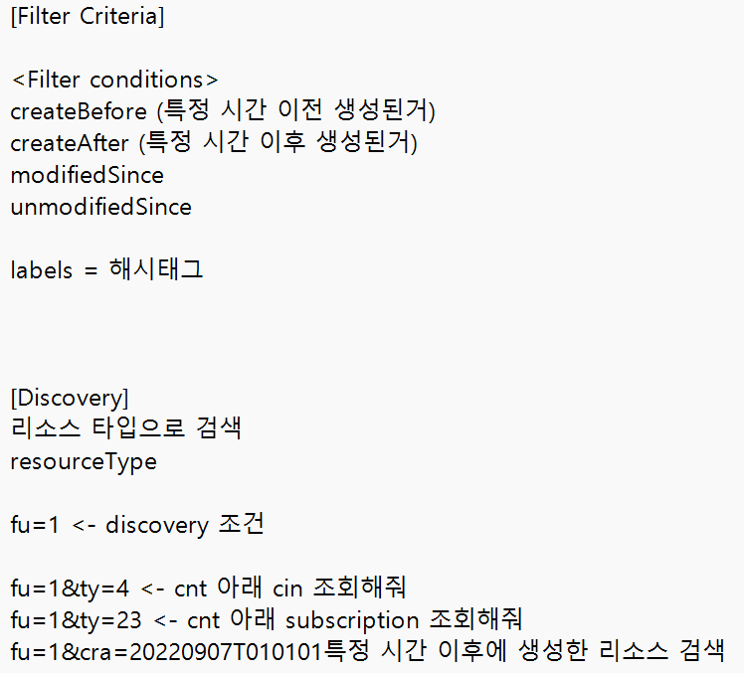
Part 4
다음주 수정 사항

