Slide 1

Bank Marketing
Presented by: Kyle Schryver, Cathy Liu

Slide 2

Dataset Background
The data is related with direct marketing campaigns, specifically phone calls, of a Portuguese banking institution. Many prospects were contacted multiple times.
Classification goal: predict if the client will subscribe (yes/no) to a term deposit (variable y)
Number of instances: 41,188
Number of attributes: 20 input variables (categorical and numeric), 1 output variable
NaN and Missing values: none
[Moro et al., 2014] S. Moro, P. Cortez and P. Rita. A Data-Driven Approach to Predict the Success of Bank Telemarketing. Decision Support Systems, Elsevier, 62:22-31, June 2014

Slide 3
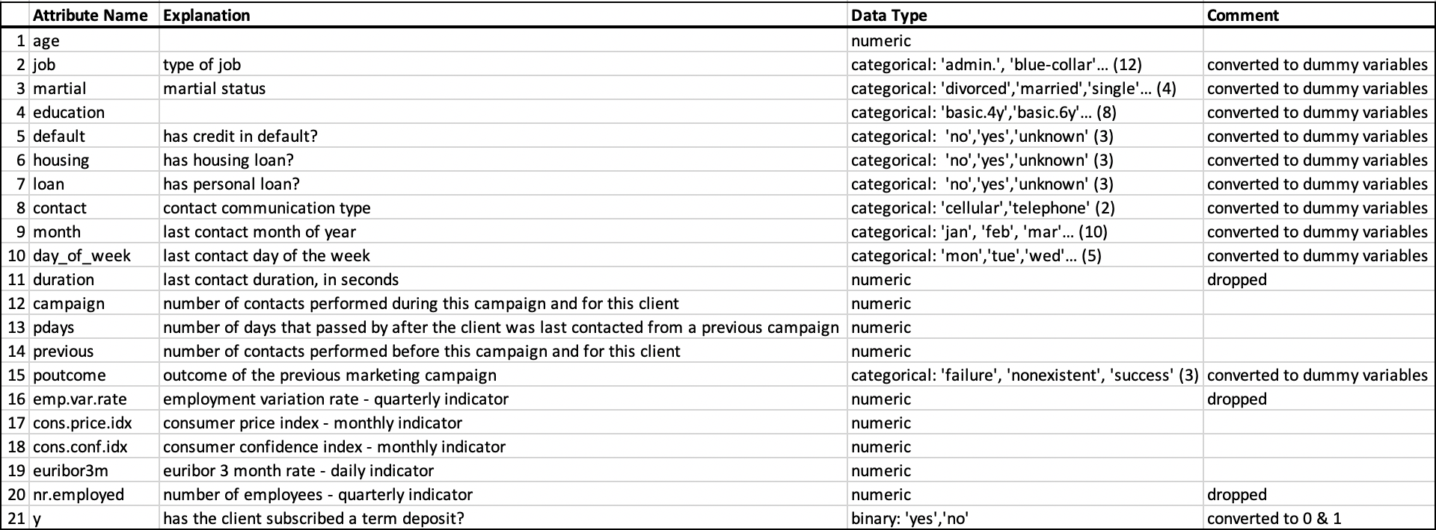
Attribute Information
End up having 60 attributes and 1 target value

Slide 4
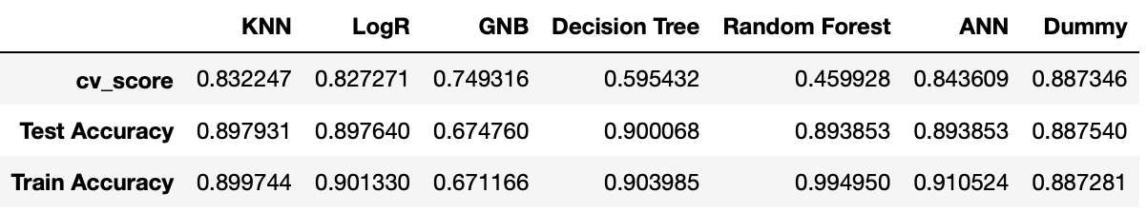
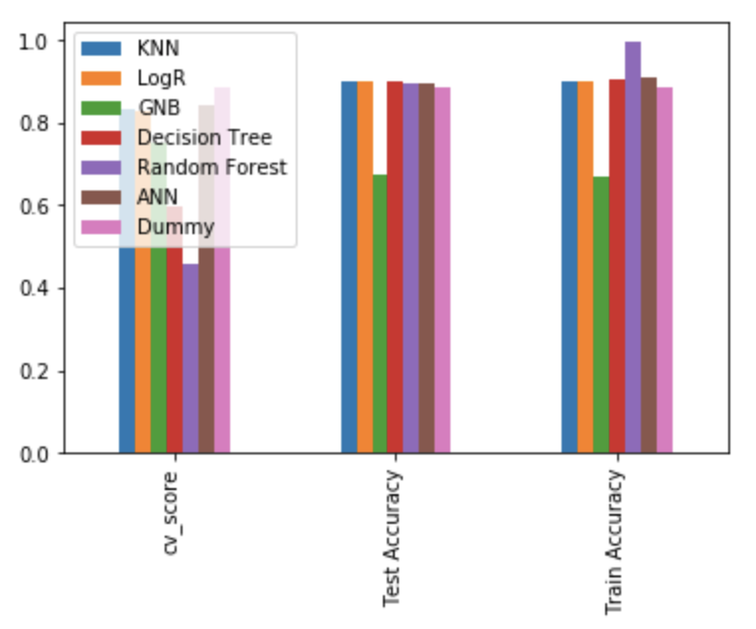
Model Selection & Comparison
cv_score
Test Accuracy
Train Accuracy

Slide 5
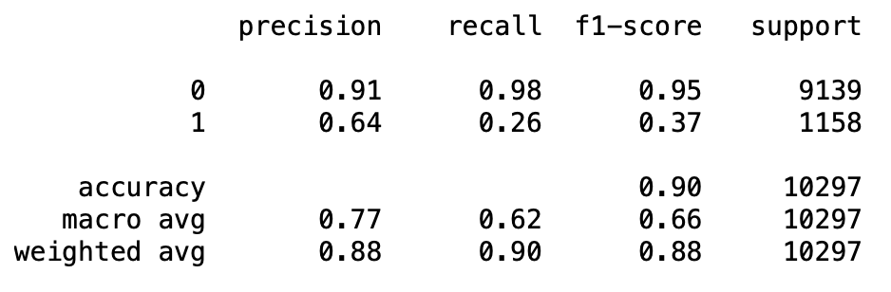
Evaluation Metrics of Decision Tree
No →
Yes →

Slide 6
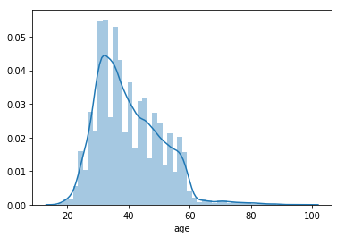
Interesting Findings
1
“Euribor 3 month rate” is the most important feature for the result generated by Decision Tree model (feature importance = 0.714748)
2
The number of times a client had been previously contacted had little effect on the outcome of the call
3
75% of the data can be captured within the age range of 32-47, signaling that people targeted were generally young or middle aged adults.
Notes:
Euribor 3 month rate is a macroeconomic feature showing the employement rate over a 3 month weighted moving average period. This being the most important feature tells us that macroeconomics played a larger role in determining the outcome rather than any specific feature of the client or things like cadence of calling the client as outreach. This was very interesting to find as the business could put more effort into outreach during certain economic climates in order to increase their revenue during that time. They could also decrease sales and marketing efforts during poor economic times in order to cut costs, since the outreach will be less effective.
We also found that calling clients multiple times did not have a material impact on the success rate. Thus following up on clients who previously said no is not particularily effective, however it still may be worth doing since calling a new client is not anymore effective either.
Finally, we determined that the bank was targeting young and middle aged adults, which makes sense since they are younger and less likely to already have their money invested in a bank or retirement account. They may have avoided 20-30 year olds since they likely have less savings and are looking to buy large things such as houses and cars. Older people most likely already have a trusted bank and retirement account and are unlikely to switch to a new bank with a short term deposit.

Slide 7
Bias & Variance In Our Models
Model | Bias | Variance
KNN | Low | High
Logistic Regression | High | Low
SVM (SVC) | Low | High
GNB | High | Low
Decision Tree | Low | High
Random Forest | Low | High
ANN (MLP Classifier) | Low | High
Notes:
The goal of any supervised machine learning algorithm is to achieve low bias and low variance. In turn the algorithm should achieve good prediction performance. In our tests we found linear machine learning algorithms such as logistic regression and naive bayes often have a high bias but a low variance while nonlinear machine learning algorithms such as Trees, forests, and knn often have a low bias but a high variance. We looked at a variety of models to determine which would perform best given their propensity towards bias or variance. To look at one model in particular, KNN, we tried multiple k values in order to find one that balanced bias and variance. Increasing k increased bias due to an increasing training error while decreasing k increased variance by reducing test error.

Slide 8
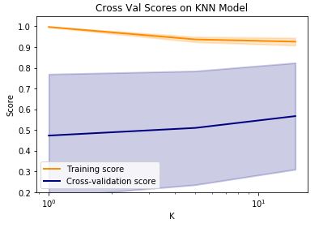
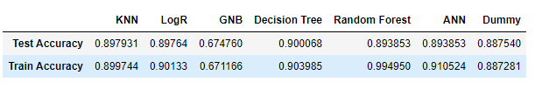
Overfitting and Underfitting
Using 10 folds led us to the best cross validation score after initially using 5 folds
With most of our models, we were able to keep them correctly fitted
Outliers were ANN (~.02 diff) and Random forest (.1 diff)
Notes:
Through multiple tests, we found that using 10 folds for our cross validation allowed us to achieve the highest scores and reduce overfitting. In terms of overfitting, all of our models were in line with our goals except for random forest. A random forest is a meta estimator that fits a number of decision tree classifiers on various sub-samples of the dataset. In pracitcal use, random forests use averaging to improve the predictive accuracy and control over-fitting. When tuning our random forest, we found that reducing overfitting did not necessarily lead to a better test score and thus kept the model as is to maximize its effectiveness.

Slide 9
Conclusion
This data set is unbalanced as the majority result is not to subscribe to the term deposit
The Decision Tree model has the highest accuracy score on the testing data set, and it indicates the “euribor 3 month rate” is the most important factor to the result
90% seems to be a soft limit as to how accurate our model can be
Notes:
Unbalanced due to a very low success rate
Euribor 3 month rate is a macroeconomic feature, meaning that larger world features had a greater impact on the success rather than any other trackable metrics specific to the call or person being called. The next most important feature was pdays, incidcating that the number of days between calls was positively correlated with the success rate of the calls. This could be used to better identify the exact cadence with which clients should be reached out to in order to maximize the success right.
90% seems like a pretty high soft cap we were happy with given the natural entropy of our data (people are not perfectly predictable, not all metrics can be tracked in the data such as the person calling, time of day calling, etc).

Slide 10
What we Learned
Real world data are much harder to predict (lower accuracy score)
It’s important to consider which features are important for the target value and which are not
The fit time of a model can be very long depending on its complexity
Notes:
Cathy
Include model selection, what we now know about which models are good for our task

Slide 11
Thank You & Happy Coding!

