Slide 1

Next Gen Terminal Review
7/9/2020

Slide 2
Topics for Discussion
Introduction
Problem statement
Review of current business
Enter a simulation based approach
Model Review & Assumptions
Model Output and Interpretation of Results

Slide 3
Intro
Problem statement
Our business is too complex to keep doing what we are doing and expect to improve our financial performance
Review of current business
Demand for our products is seldom forecasted and is “lumpy”
Requirements come in frequently for products for which we have no inventory
The above forces us to “think outside the box” and find ways to make product available given the commitment communicated to the customer and lengthy product lead times
Enter a simulation-based approach
To test multiple, randomly generated, scenarios I teamed up with my old professor
This method allows us to test and review impacts on the organization BEFORE products/processes are rolled out

Slide 4
Model Review & Assumptions
Product at supplier is available in infinite quantities
Lead time for all products is 1 “period”
Period is any time frame you want (minutes, hours, weeks, years, etc.) as long as it is consistent
Forecast and Demand is normally distributed
Different models
Oversimplified
Terminals are not reworked to meet requirements; they are air shipped in the exact configurations that are believed to be required
Semi-optimal
Terminals are reworked from least-to-most difficult
Components are air shipped as required
Contradictory messages from MRP system: telling us to expedite material in despite the fact we have plenty of inventory we can use to rework into the product we need.
Optimal
All annoying aspects about the “Semi-optimal” approach are handled by the system
“Postponement” is fully implemented
APICS Postponement Definition: A product design or supply chain strategy that deliberately delays final differentiation (assembly, production, packaging, tagging, etc.) until the latest possible time in the process. This shifts product differentiation closer to the consumer to reduce anticipatory risk, eliminating excess inventory in the form of finished goods in the supply chain

Slide 5
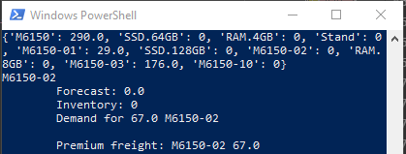
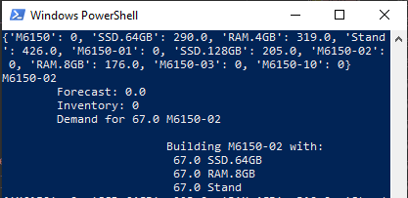
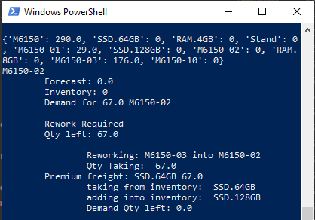
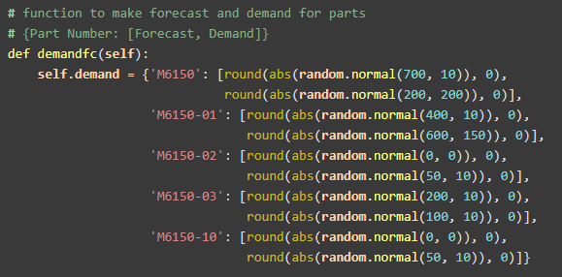
Model Outputs and Results
Different Models in practice:
D
A
3.
Demand:

Slide 6
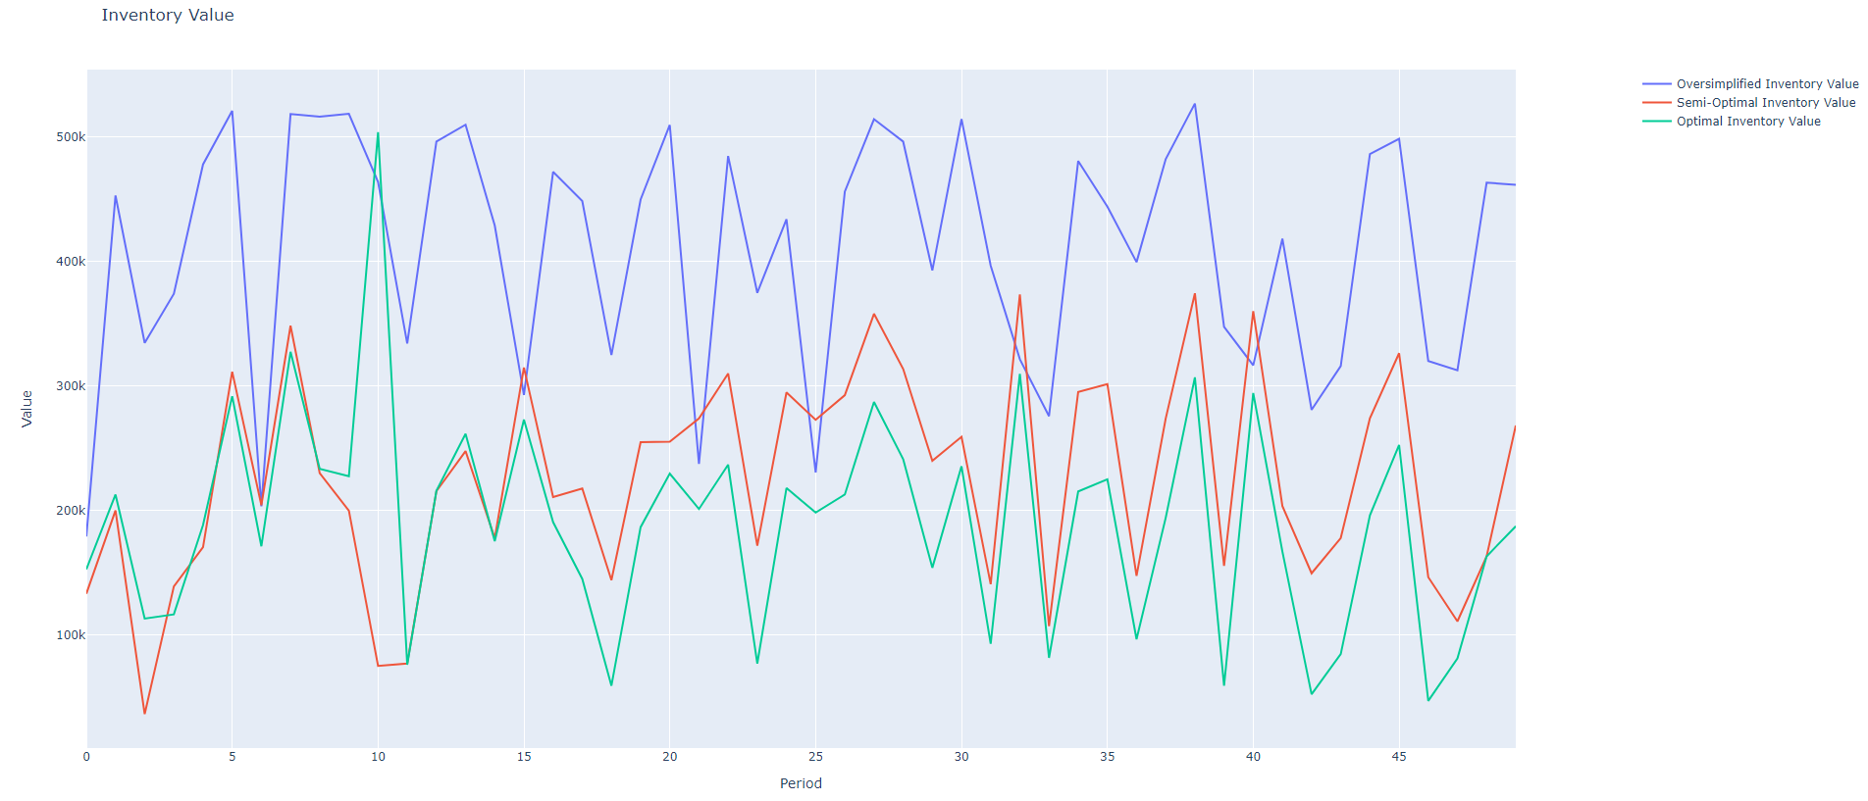
Model Review: Inventory Value

Slide 7
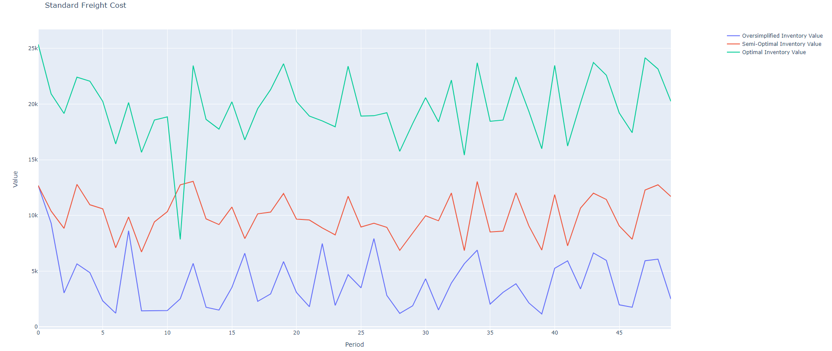
Model Output: Standard Freight (cost)

Slide 8
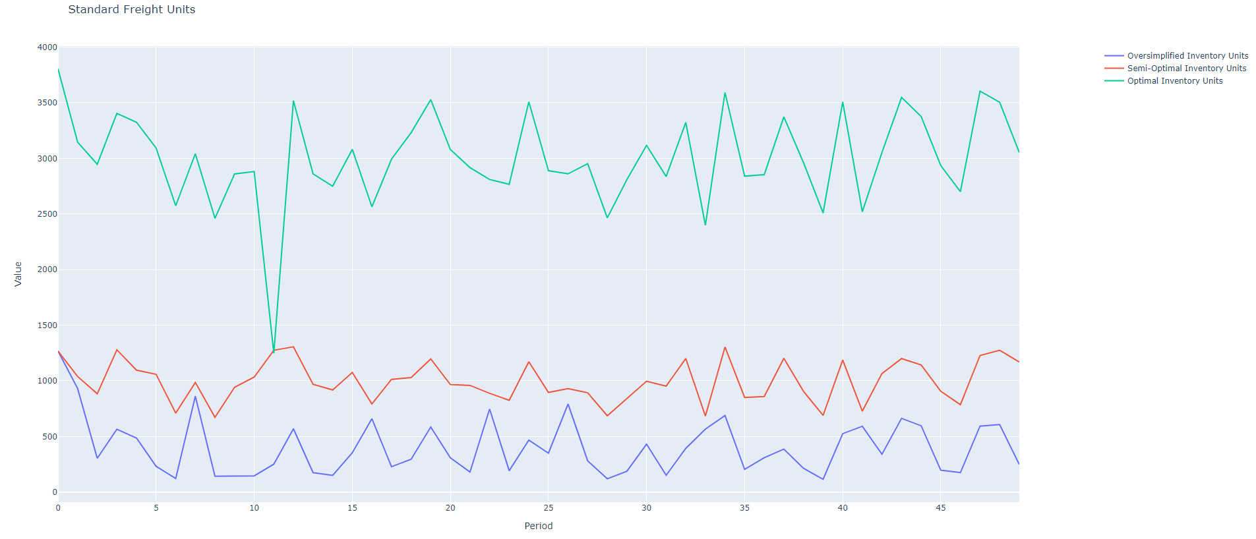
Model Output: Standard Freight (units)

Slide 9
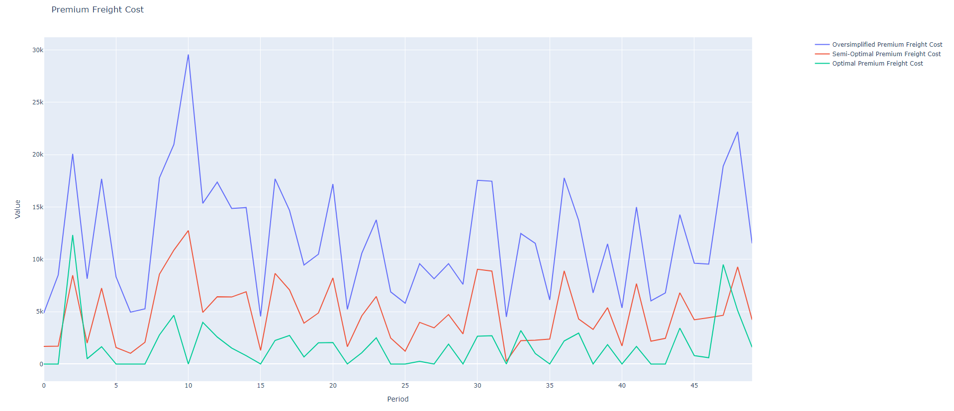
Model Output: Premium Freight (cost)

Slide 10
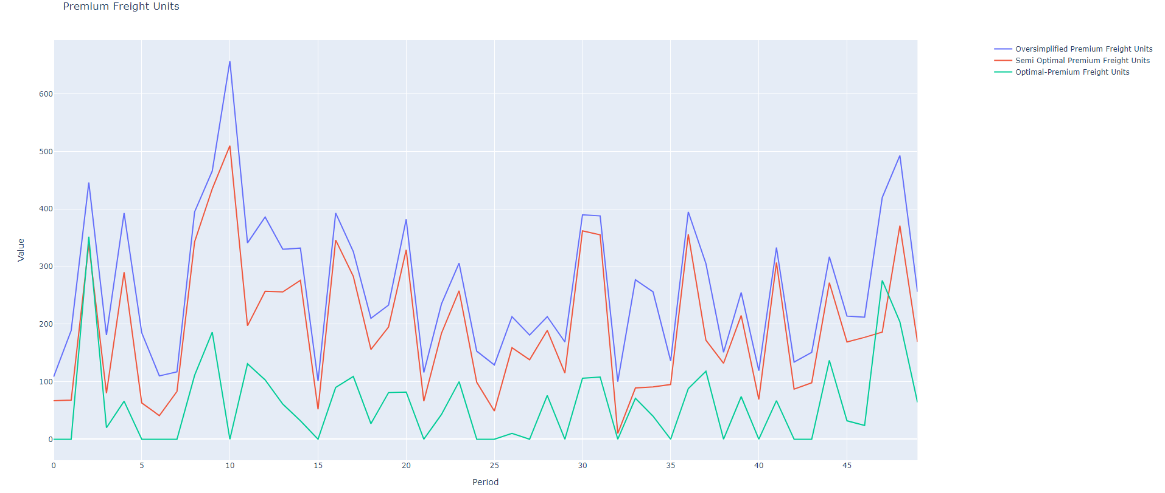
Model Output: Premium Freight (units)

Slide 11
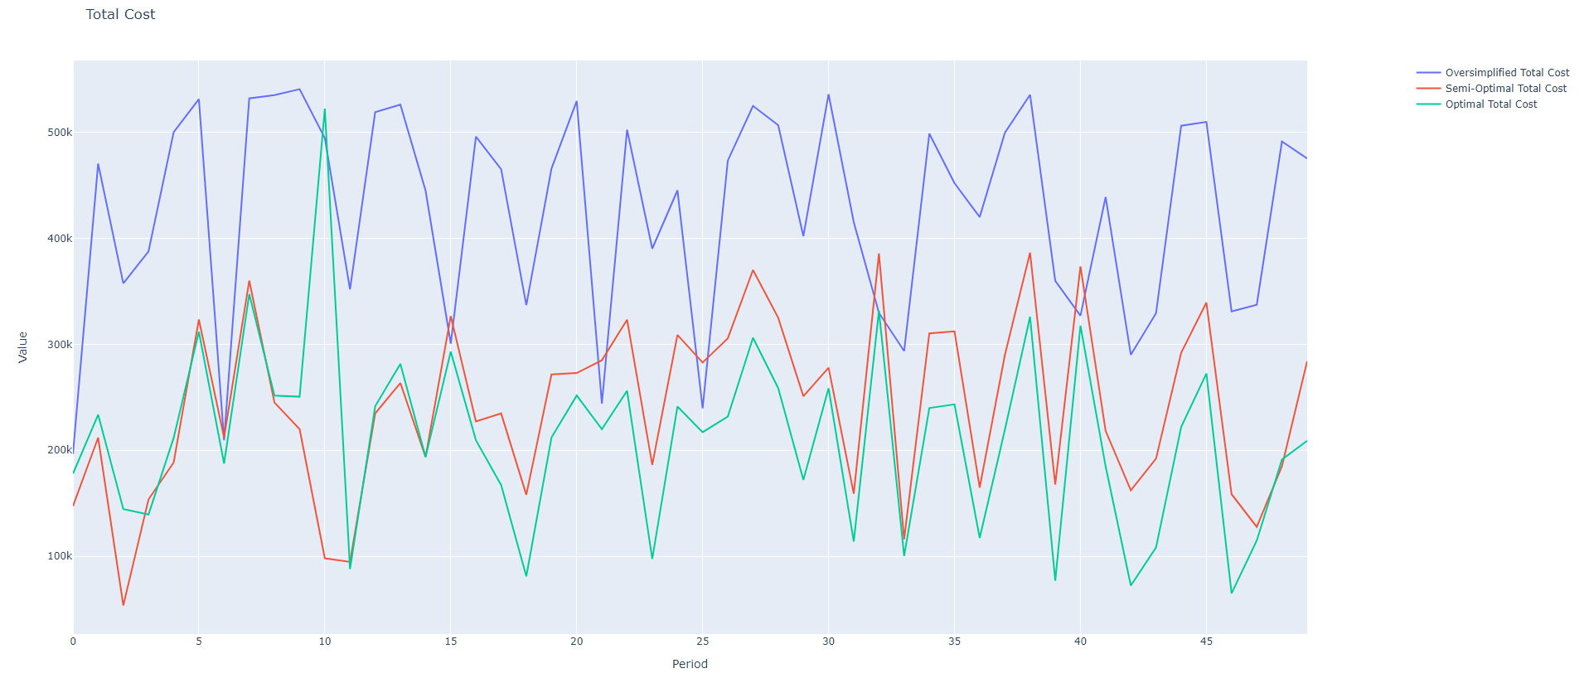
Model Output: Total Cost

Slide 12
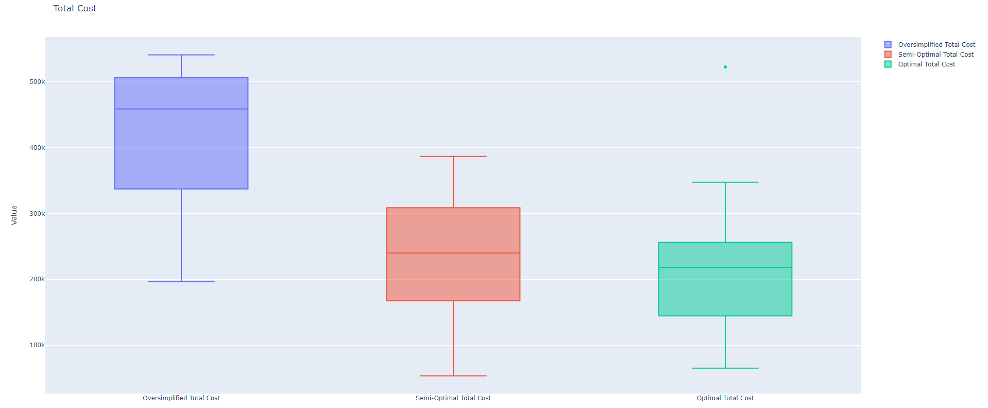
Model Output: Boxplot

Slide 13
Questions? Comments? Concerns?

Slide 14
Thank You!

