Slide 1

Employee Data Analysis Kati Schuerger

Slide 2

Project analysis slide 10
Agenda
Attrition Model
730
Salary Prediction Model
140

Slide 3
Attrition Model

Slide 4
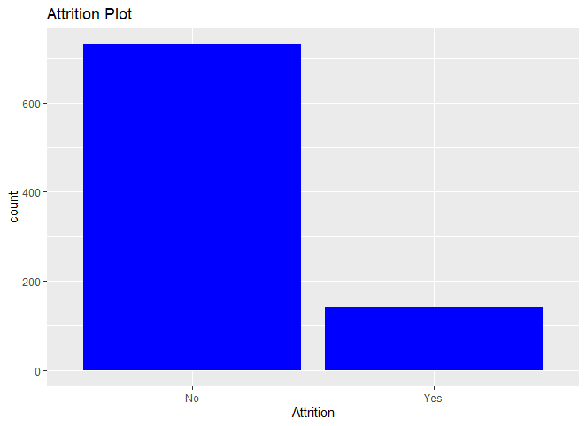

Project analysis slide 10
Initial EDA
During our initial EDA (exploratory data analysis), we identified 6 columns that could be removed from the data.
730
Our Attrition data is uneven:
84% No
16% Yes
140
Solution: Under-sample the No group – random selection of 140 rows from the “No” data set to compare to the 140 “Yes” data set.

Slide 5
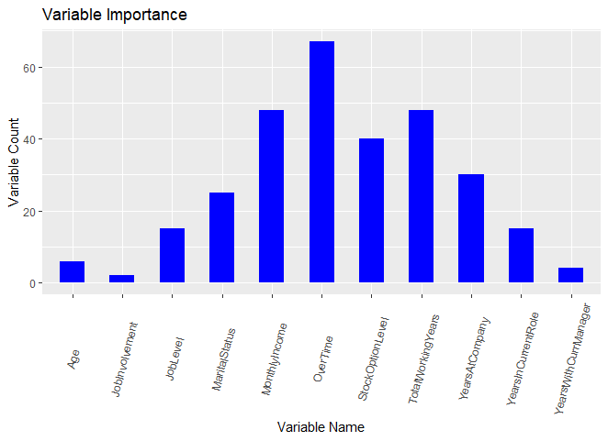
Project analysis slide 10
Attrition Model
Variable Selection
Method: ROC analysis of Naive Bayes on an under-sampling of the Attrition = No data
730
Variables Selected: Overtime, Monthly Income, Total Working Years
140

Slide 6
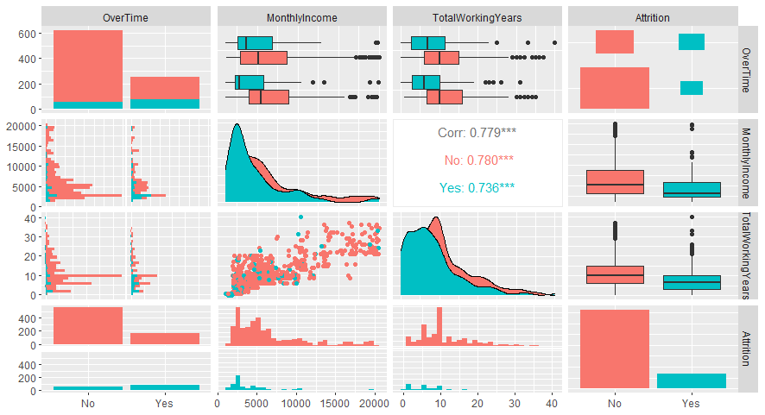
Project analysis slide 10
Attrition Model
Variables
730
140
Observations
Monthly Income and Total Working Years both appear to be lower for employees that leave.
More employees that work Overtime also tend to fall into the Attrition Yes bucket more often than the Attrition No group.

Slide 7
Project analysis slide 10
Attrition Model
Performance
Mean Accuracy: 65.8%
Mean Sensitivity: 60.9%
Mean Specificity: 71.4%
730
140

Slide 8
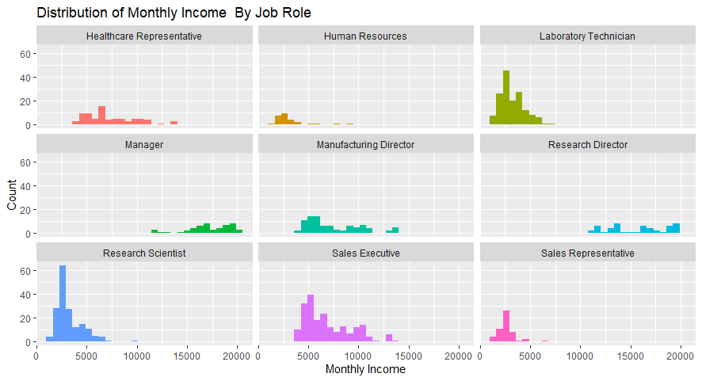
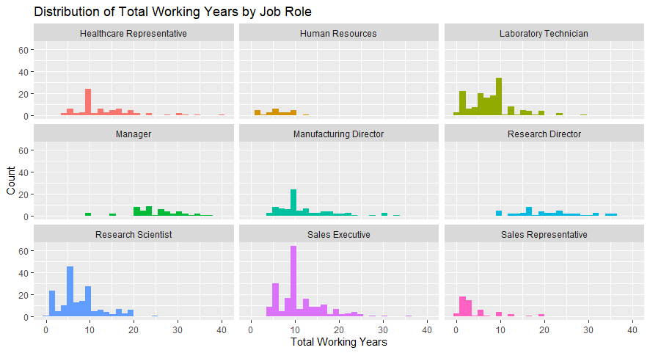
Project analysis slide 10
Attrition Model
Additional Insights
730
140
Observations
Sales Representatives tend to have both lower monthly incomes and lower total working years.
Sales Representatives may be at greater risk for attrition.

Slide 9
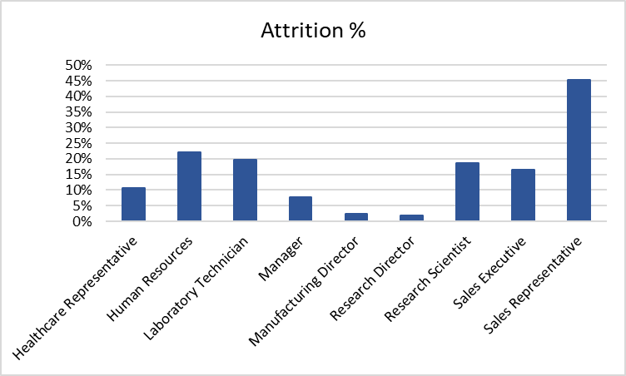
Project analysis slide 10
Attrition Model
Sales Representatives
730
140

Slide 10
Salary Model

Slide 11
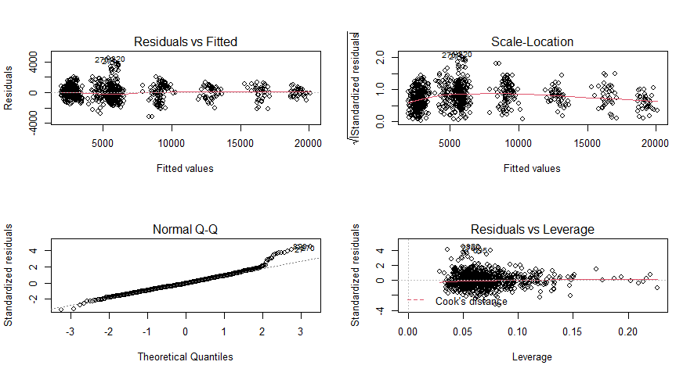
Project analysis slide 10
Salary Model
Variable Selection
Backward & Stepwise Selection
Variables Selected
Business Travel
Job Level
Job Role
Percent Salary Hike
Performance Rating
Total Working Years
730
140
Using a linear model created with these variables, it is possible to predict the mean monthly income for an employee with an accuracy of plus or minus $991.07, and to account for approximately 95.4% of the variation in the means of monthly income.

Slide 12
Project analysis slide 10
Salary Model
Variable Selection
Forward Selection
Variables Selected
Business Travel
Department
Distance from Home
Education
Gender
Job Level
Job Role
Percent Salary Hike
Performance Rating
Total Working Years
730
140
Adding 4 additional variables does not improve how much of the variation we can explain as due to these variables (remains 95.4%). Only improves our RMSE slightly (from 991.07 to 983.53).

Slide 13
Thank You

