Slide 1
Mixed-Signal Analyzer streamlining Virtuoso ADE to MATLAB
Kerry Schutz
Application Engineer

Slide 2
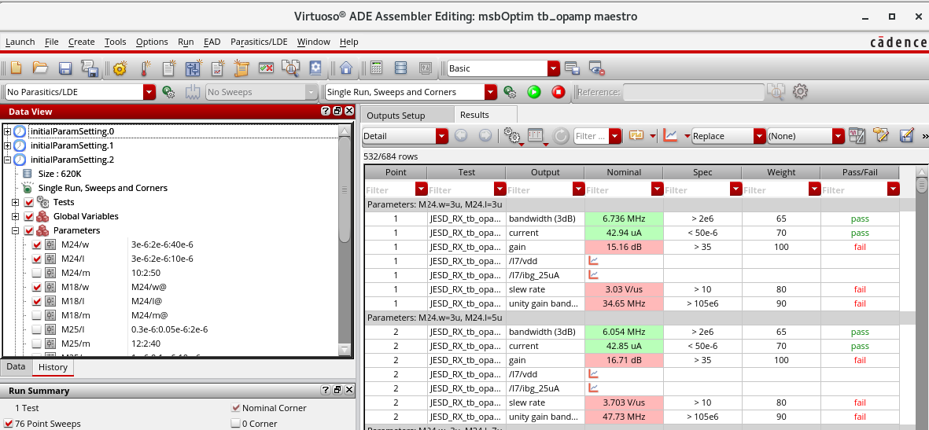
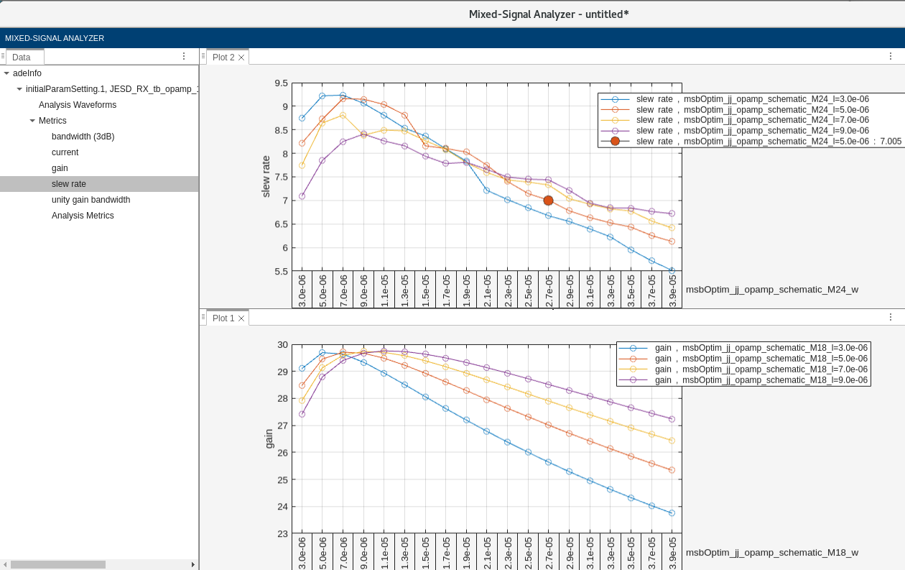
The Mixed-Signal Analyzer App/API
App and API for analyzing Virtuoso ADE simulation data
Extends Virtuoso ADE-MATLAB Integration option (ID95252)
Provides flexible trend chart
and report generation
Use MATLAB as calculator
Allows round-trip automation
Runs on Linux or Windows
Maestro
MATLAB
Notes:
It’s a bi-directional connection or interface between MATLAB and Cadence.
Data flows from Cadence to MATLAB and MATLAB to Cadence
Control signals from MATLAB to Cadence

Slide 3
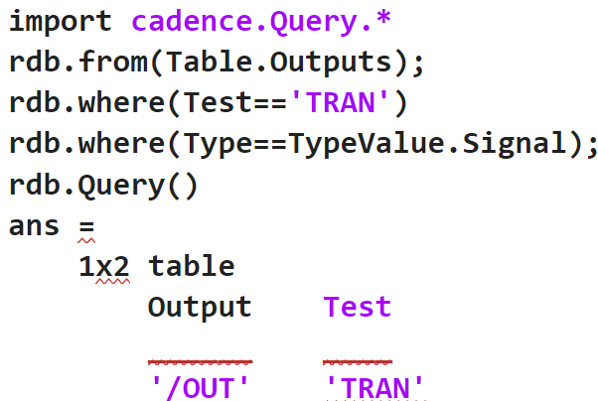
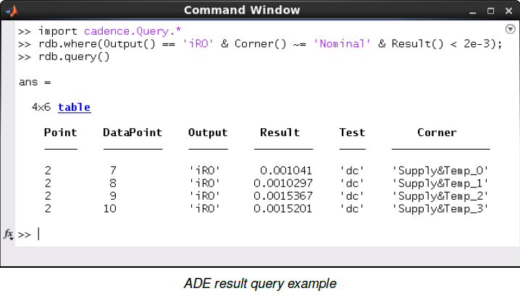
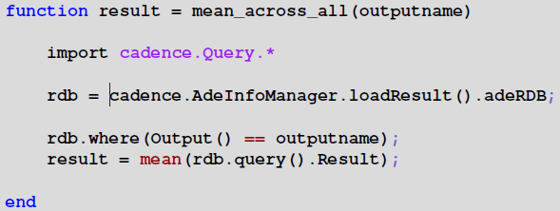
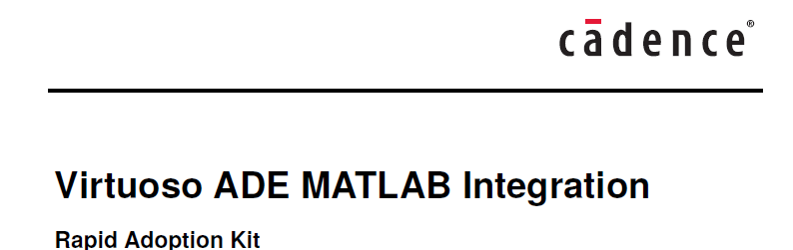
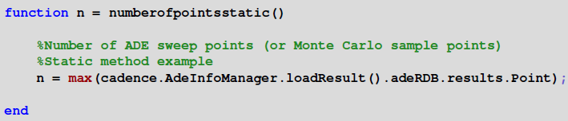
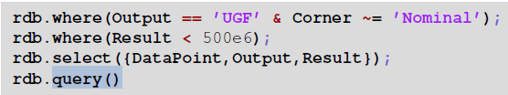
Virtuoso ADE - MATLAB Integration Option (ID95252)
Notes:
What lies beneath…the foundation of MSA
Requires having a live-connection to ADE, thus, cannot use Windows.
Requires programming/relational database/structured query skills
You write code in MATLAB but it’s not your grandfather’s MATLAB…
Does not allow saving of the entire simulation data set to a file(s). You download/query/plot one variable at a time.
The Virtuoso ADE MATLAB Integration option communicates with a relational database as that’s how the Cadence simulation data is stored. You’ll see references to adeRDB in many places when using the API. Thus the MATLAB code utilizes structured queries to access said data. If you’re already familiar with database query languages, then this will be relatively easy to pick up. If you’re not, then this “MATLAB code” is going to look a foreign at first. In any case, this is one of the reasons the Mixed-Signal Analyzer app exists, namely, to make it easier to get started bringing in the data to MATLAB and visualizing it. Underneath the app however, we are using this API.

Slide 4
Two Ways to Work…
Interactive – point-n-click in the Mixed-Signal Analyzer app
Programmatic – write MATLAB scripts to automate post-processing including optimization

Slide 5
Look at Interactive Flow…

Slide 6
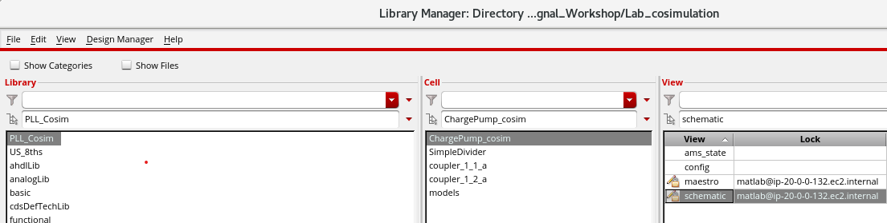
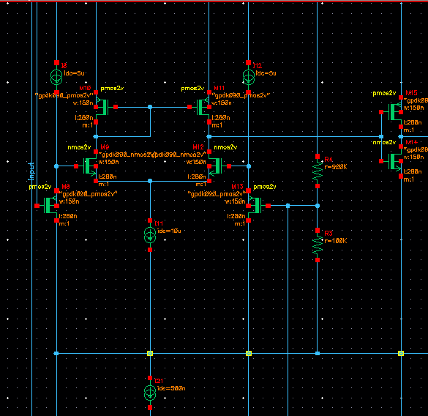
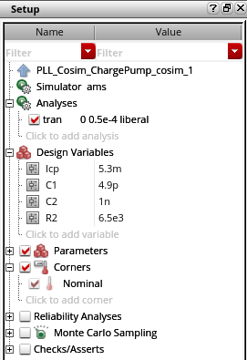
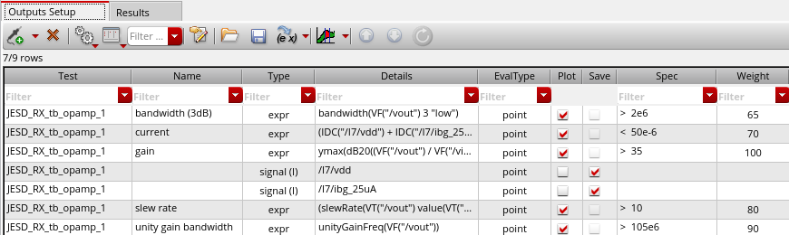
Start with your design in Cadence

Slide 7
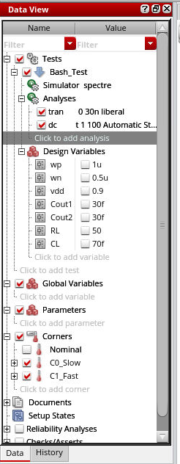


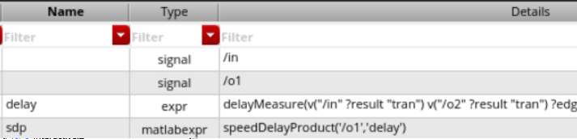
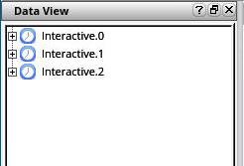
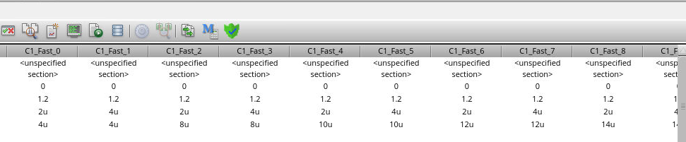
After simulation, find M on Results tab
Start MATLAB to create adeInfo object
Results
Notes:
Look for the blue capital “M” in the Baskerville Old Face font.

Slide 8
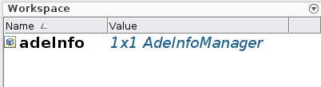
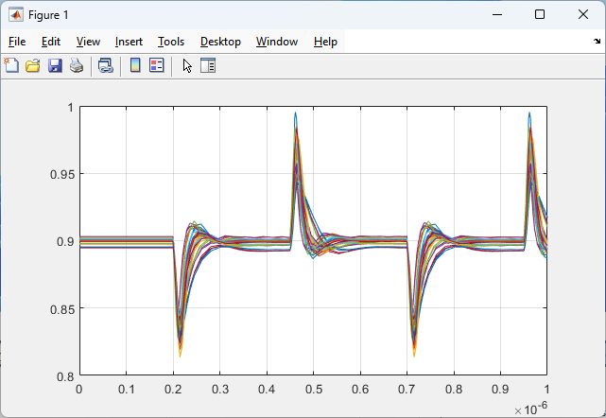
adeInfo as a pointer…
** adeInfo is access point for all Cadence interactive runs
dr = adeDataReader;
wd = getWaveData(dr, 'tran, /ldo_out')
for i=1:height(wd)
plot(wd.XValues{i},wd.YValues{i}); grid on;
hold on;
end
>> dr.WaveInfo
ans =
6x1 cell array
{'dc,/ldo_out' }
{'dc,/I_load' }
{'stb,/ldo_out' }
{'stb,/I_load' }
{'tran,/ldo_out'}
{'tran,/I_load' }
dr =
adeDataReader with properties:
InputSource: "adeInfo"
MetricsInfo: [50x13 table]
TrendChartFields: {11x1 cell}
WaveInfo: {6x1 cell}

Slide 9
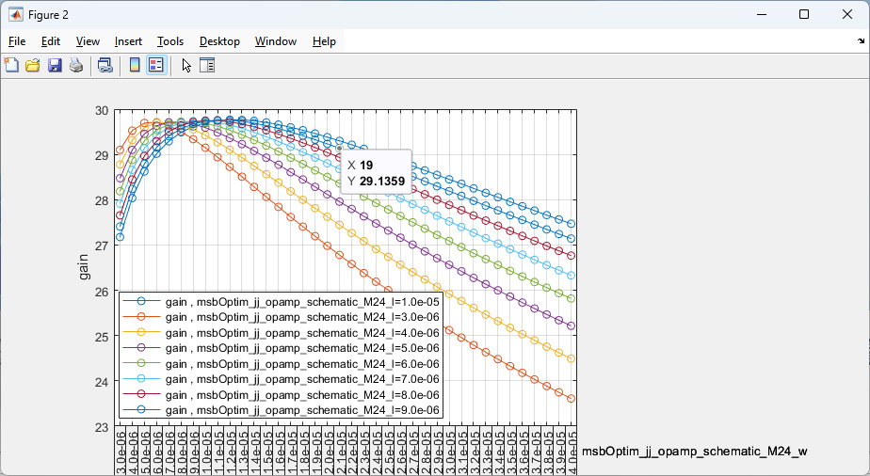
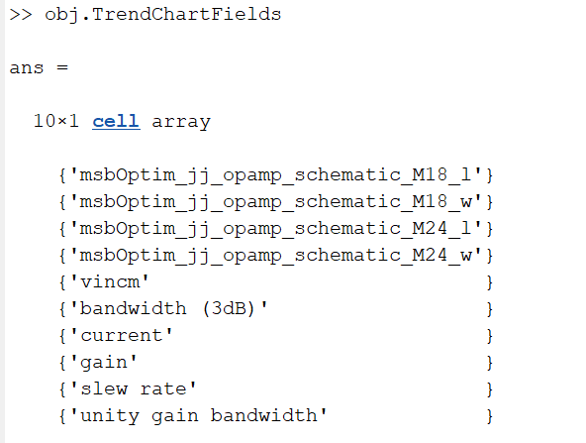
Read Metric Data and Plot Custom TrendChart in MATLAB
obj=adeDataReader;
fig=trendChart(obj,Xaxis=obj.TrendChartFields(4),…
Yaxis=obj.TrendChartFields{8},…
Legend=obj.TrendChartFields{3})

Slide 10
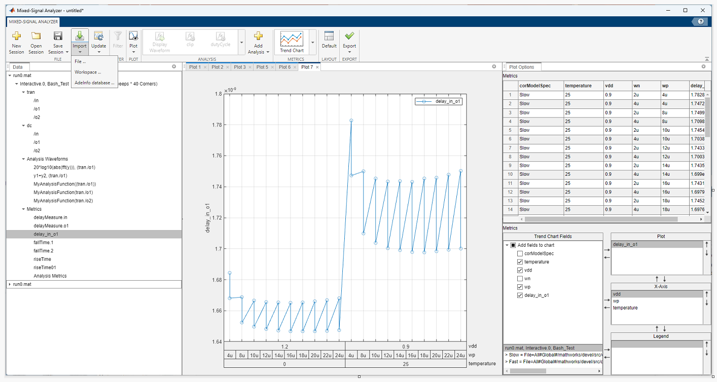
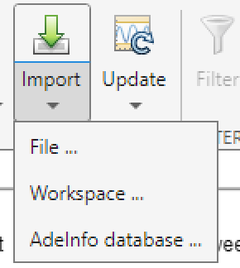
The Mixed-Signal Analyzer App
>> mixedSignalAnalyzer
Notes:
It’s a Cadence post-processing app at this point. There are plans to generalize it going forward.

Slide 11
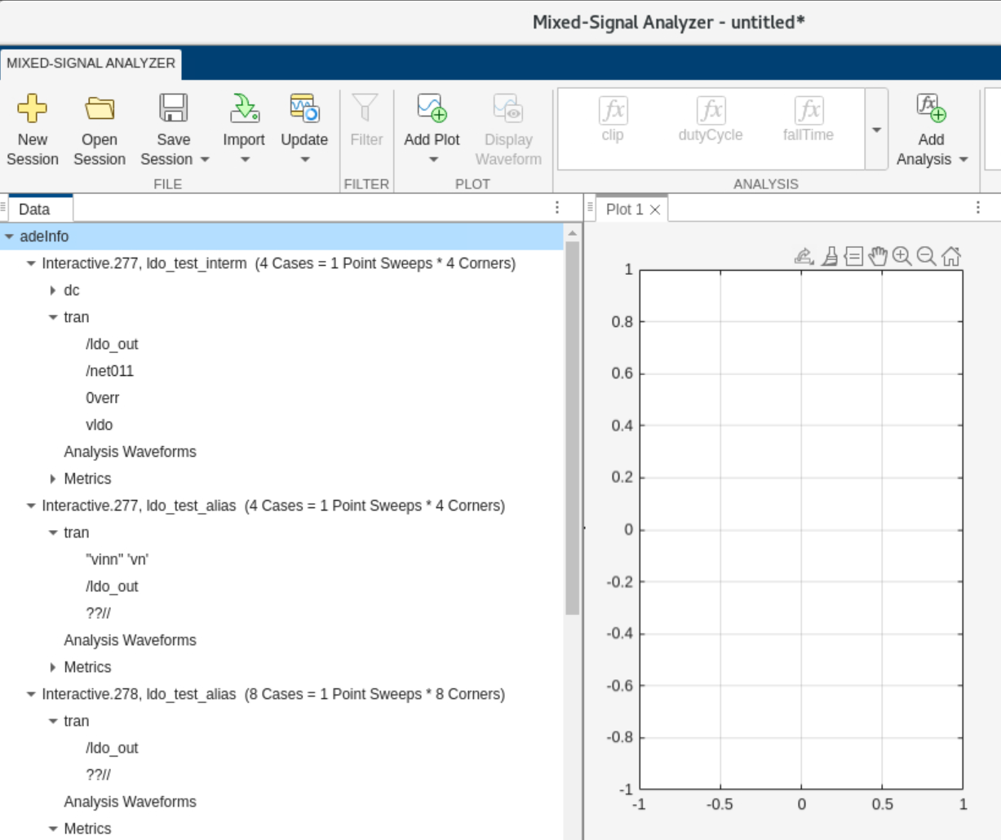
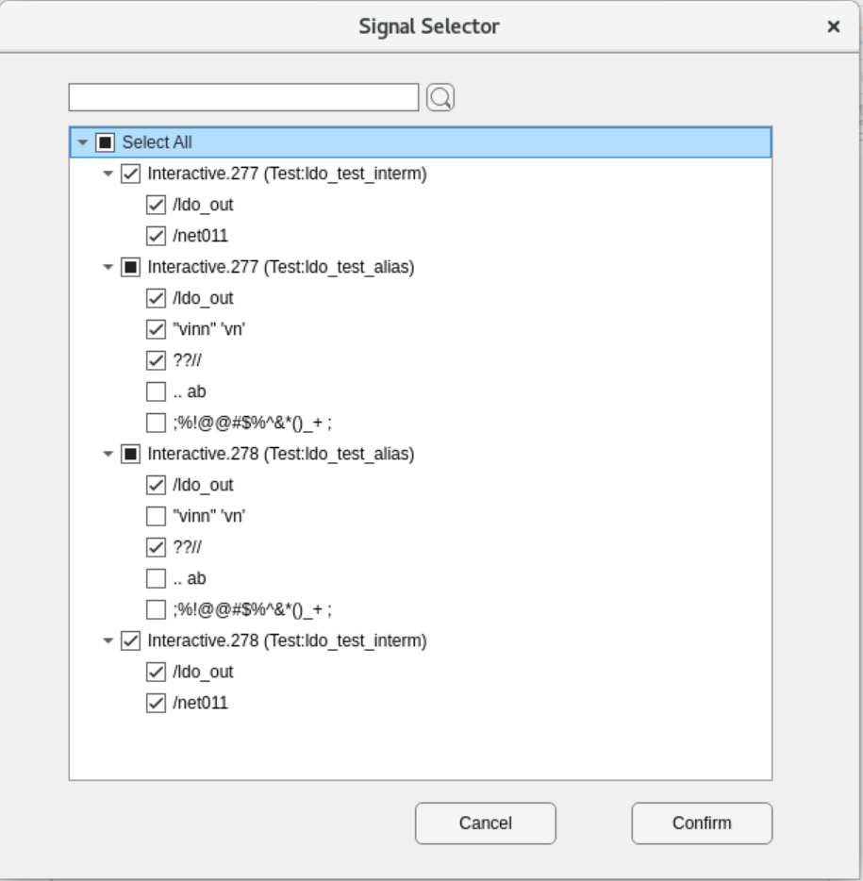
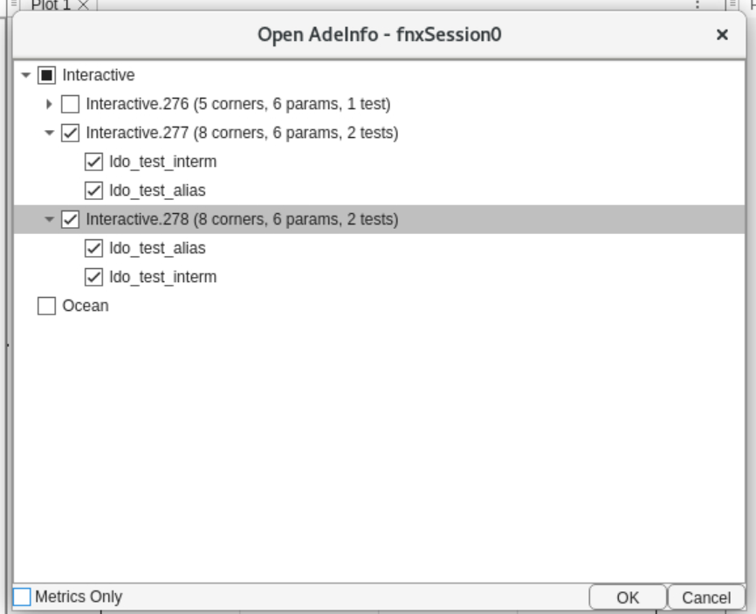
Selectively import only the waveforms you want…
Avoid necessity of long import times…
RFAIN Documents Bash Workflows to Try

Slide 12
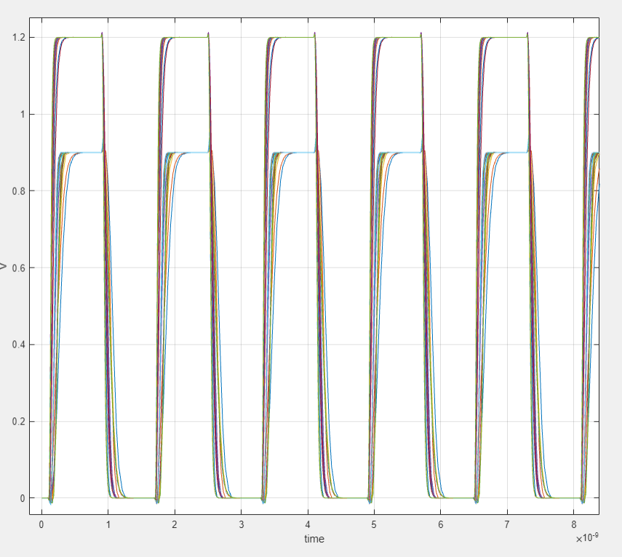
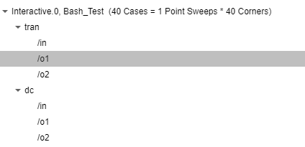

View TRAN, AC, DC, and STB Simulation Results
1. Select Signal
Data Pane
2. Hit Display…

Slide 13
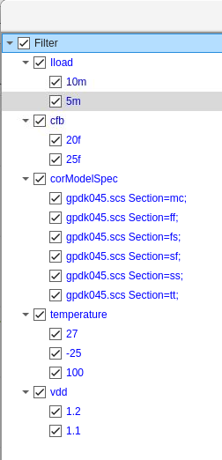
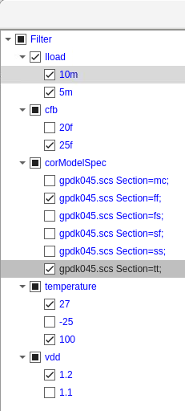
Filter Your Display Waveforms over Corners
Hierarchically select
data of interest
Notes:
Showing 25 of 40 corners in screen capture above.

Slide 14
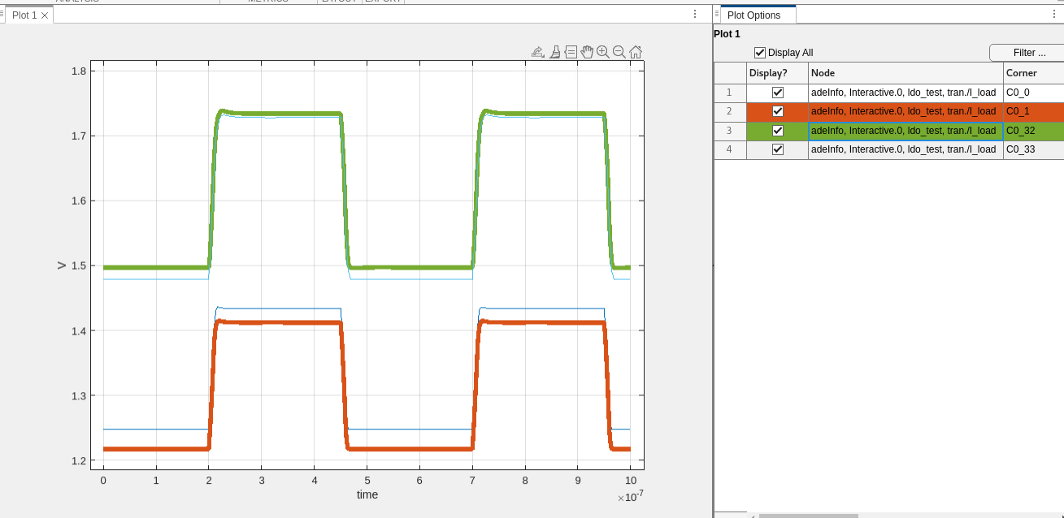
Cross-probe to match waveforms with corners
Works bi-directionally

Slide 15
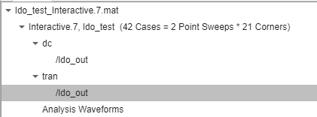
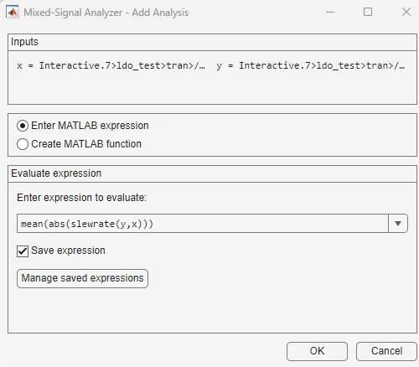
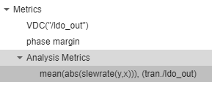


Create new Metrics or Waveforms using MATLAB
1. Select Signal(s)
3. Enter MATLAB Expression
>> mean(abs(slewrate(y,x)))
4. Select & Display
2. Add Analysis

Slide 16
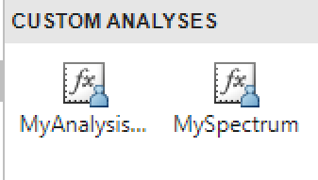

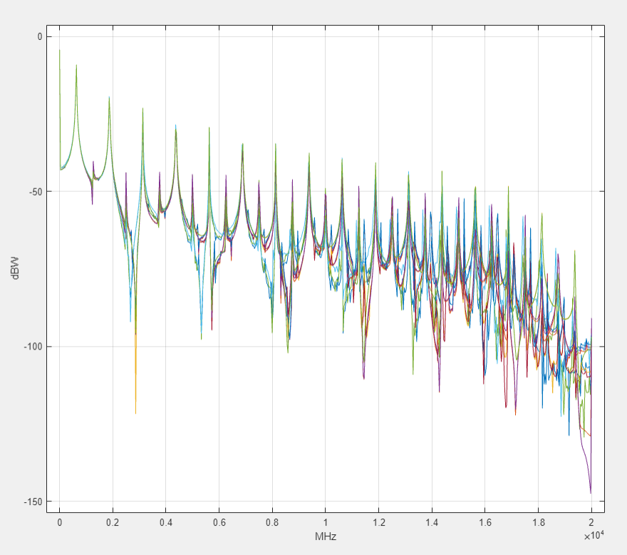
Add Your Own MATLAB Analysis Functions to App
1. Write analysis function
2. Add it to the list
3. Select Signal
4. Select analysis
function [Xout, Yout, NameValuePairs] = MySpectrum(x, y, dialogAnswers)
arguments
x {mustBeNumeric, mustBeVector};
y {mustBeNumeric, mustBeVector};
dialogAnswers.Prompt1 {mustBeNonzeroLengthText} = '0'; % Sample Rate:
end
Xout = x;
Yout = y;
NameValuePairs={'xUnit','Freq','xScale','Log','xlabel','MHz','ylabel','dBW'};
% Begin custom code.
Fs = str2num(dialogAnswers.Prompt1);
yr = resample(y,x,Fs);
yrf = fft(yr);
N = length(yr);
yrf = 10*log10(yrf.*conj(yrf)/N^2);
Nf = N/2 + 1;
yrf = yrf(1:Nf);
fvec = [0:Fs/length(yr):Fs - Fs/length(yr)];
fvec = fvec(1:Nf)/1e6; % display in MHz units
Xout = fvec;
Yout = yrf;
end
5. Display results
Custom analysis functions are stored in your prefdir
Notes:
>> prefdir
Windows: C:\Users\kschutz\AppData\Roaming\MathWorks\MATLAB\R2023b\msblks\+msaCustom
Linux: /home/matlab/.matlab/R2023b/msblks/+msaCustom

Slide 17

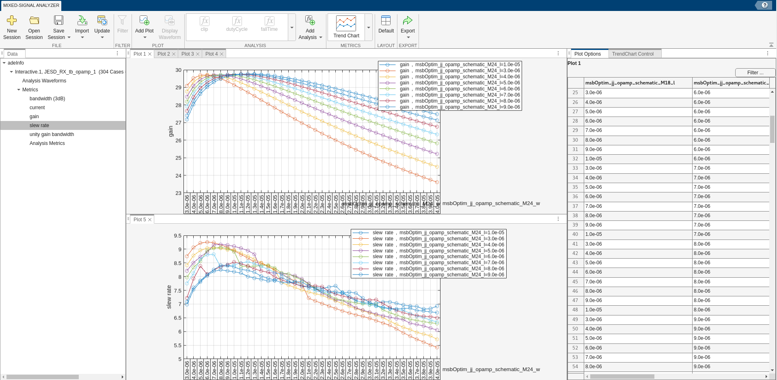
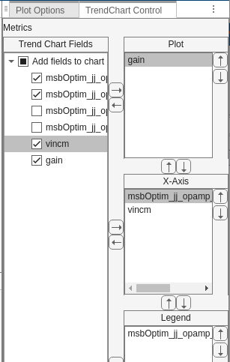
Interactive Trend Chart Analysis via App
>> adeInfo
Select Waveforms, Metrics
Plot Area
Customize Trend Chart

Slide 18
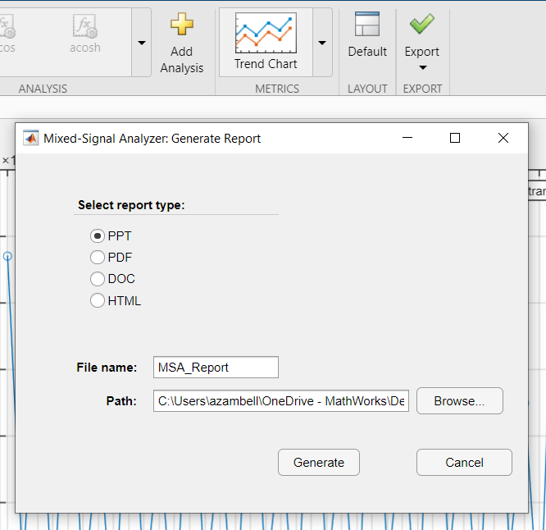
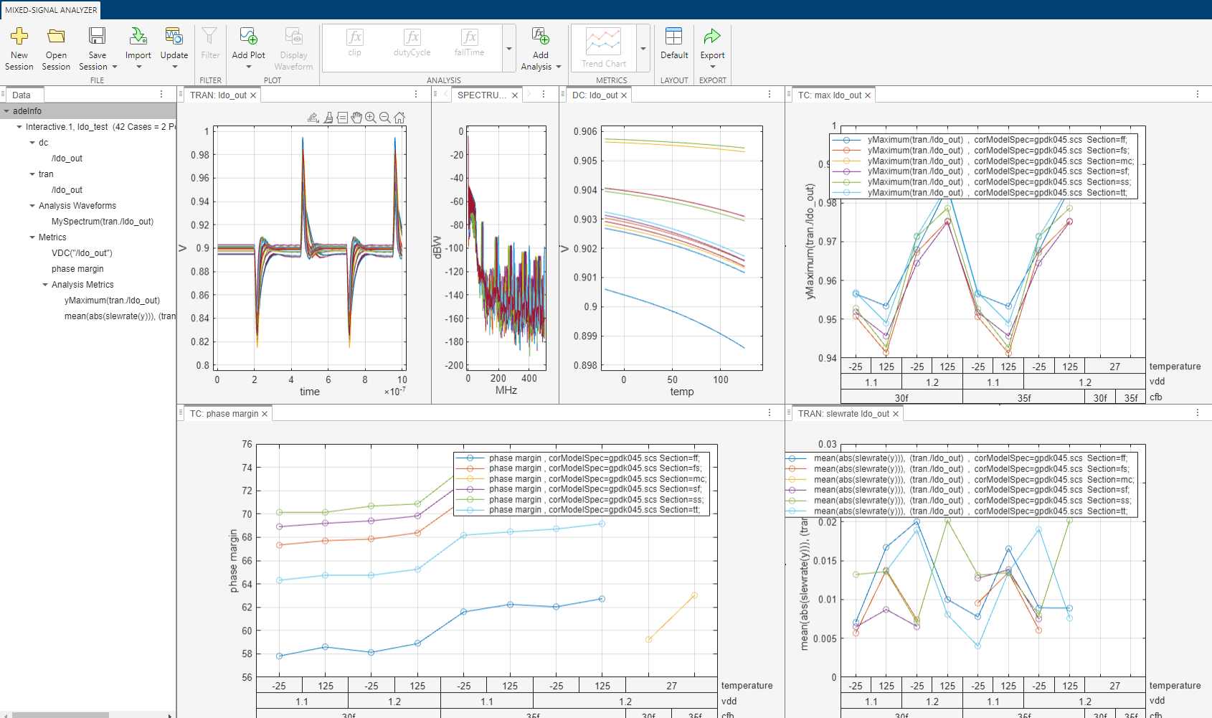
Generate Reports
Export
Report Type
LDO_Report.pdf
Notes:
The next feature is the ease in which reports are created. This can be done in the Mixed-Signal Analyzer app by clicking the Export button. You have the choice of PowerPoint, PDF, Word Document, or HTML.
But wait, there’s one more feature I want to mention! What if you had another set of data and you want to create a similar report by plotting the same charts and graphs?
<click 1>
This can be done with the Update button. By using the Update button, you can choose another dataset to import. Then what will happen is that all the plots that were originally created with the first dataset will be re-plotted with the second dataset. The two charts are plotting the same metric. In this case it’s a trend chart of a delay. But the chart on the left is the original dataset and the chart on the right is the new dataset. Same delay metric but with a different dataset and all done without having to recreate the chart from scratch. Now imagine doing this for multiple charts and graphs and for multiple datasets. Think of how much time it will save not having to recreate everything repeatedly? In a matter of minutes, you can create several reports all showing the same plots but for different datasets just by using the Update button.

Slide 19
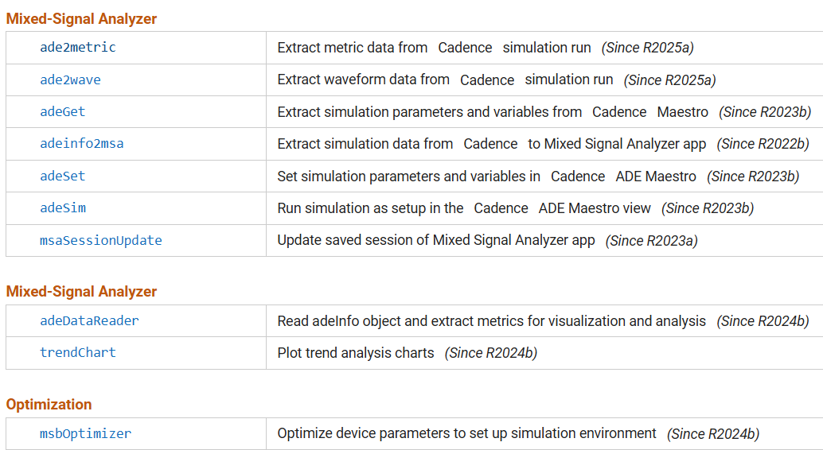
Command-Line API functionality

Slide 20
Read tran data directly into MATLAB and plot
adeInfo.loadResult('history','Interactive.2’)
dr = adeDataReader;
wd = getWaveData(dr, 'tran, /ldo_out')
for i=1:height(wd)
plot(wd.XValues{i},wd.YValues{i}); grid on;
hold on;
end
dr =
adeDataReader with properties:
InputSource: "adeInfo"
MetricsInfo: [50x13 table]
TrendChartFields: {11x1 cell}
WaveInfo: {6x1 cell}
>> dr.WaveInfo
6x1 cell array
{'dc,/ldo_out' }
{'dc,/I_load' }
{'stb,/ldo_out' }
{'stb,/I_load' }
{'tran,/ldo_out'}
{'tran,/I_load' }
a.WaveInfo{5} = ‘tran,/ldo_out’
Notes:
You can skip the adeInfo.loadResult step if you want to user whatever the current active history is in Cadence.
This step is the equivalent in Cadence of “Load Setup to Active”
Use a = adeDataReader('ldo_test_Interactive.6.mat’) if reading from a previously saved .mat file.

Slide 21
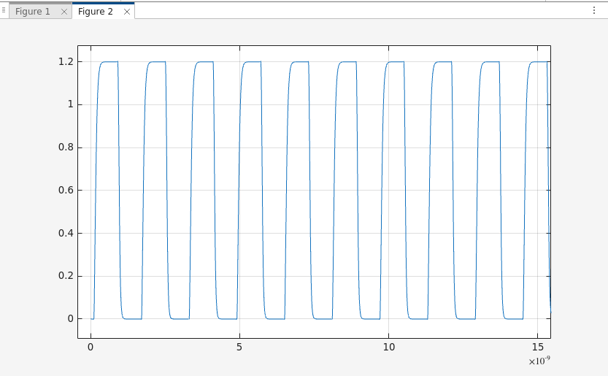
Using ade2wave
>> ade2wave('/o1')
ans =
24x6 table
modelFiles RL temperature wn wp wave
___________ ___ ___________ _____ _______ _______
{'Fast.sp'} 160 -40 1e-06 1e-06 1x1 cadence.Waveform
{'Fast.sp'} 160 -40 1e-06 1.2e-05 1x1 cadence.Waveform
{'Fast.sp'} 160 -40 1e-05 1e-06 1x1 cadence.Waveform
{'Fast.sp'} 160 -40 1e-05 1.2e-05 1x1 cadence.Waveform
{'Fast.sp'} 160 0 1e-06 1e-06 1x1 cadence.Waveform
{'Fast.sp'} 160 0 1e-06 1.2e-05 1x1 cadence.Waveform
{'Fast.sp'} 160 0 1e-05 1e-06 1x1 cadence.Waveform
: : : : : :
{'Slow.sp'} 160 100 1e-05 1.6e-05 1x1 cadence.Waveform
{'Slow.sp'} 160 100 2e-05 8e-06 1x1 cadence.Waveform
{'Slow.sp'} 160 100 2e-05 1.6e-05 1x1 cadence.Waveform
{'Slow.sp'} 170 100 1e-05 8e-06 1x1 cadence.Waveform
{'Slow.sp'} 170 100 1e-05 1.6e-05 1x1 cadence.Waveform
{'Slow.sp'} 170 100 2e-05 8e-06 1x1 cadence.Waveform
{'Slow.sp'} 170 100 2e-05 1.6e-05 1x1 cadence.Waveform
tvec = ade2wave('/o1').wave.x;
o1_volts = ade2wave('/o1').wave.y;
figure;plot(tvec,o1_volts);grid on

Slide 22
Using adeDataReader and getWaveData on ‘tran’ data
obj = adeDataReader;
waveData = getWaveData(obj, 'tran, /o1');
tvec = waveData.XValues{1};
o1_volts = waveData.YValues{1};
figure;plot(tvec,o1_volts);grid on;
obj =
adeDataReader with properties:
InputSource: "adeInfo"
MetricsInfo: [24x9 table]
TrendChartFields: {7x1 cell}
WaveInfo: {9x1 cell}
>> waveData = getWaveData(obj, 'tran, /o1')
24x14 table
XValues YValues XLabels YLabels XUnits YUnits XScales YScales type corModelSpec RL temp wn wp
{2990x1 } {2990x1} time V s V linear linear tran Fast.sp 160 -40 1e-06 1e-06
{3529x1} {3529x1} time V s V linear linear tran Fast.sp 160 -40 1e-06 1.2e-05
{3778x1} {3778x1} time V s V linear linear tran Fast.sp 160 -40 1e-05 1e-06
{4104x1} {4104x1} time V s V linear linear tran Fast.sp 160 -40 1e-05 1.2e-05
{2831x1} {2831x1} time V s V linear linear tran Fast.sp 160 0 1e-06 1e-06
{3465x1} {3465x1} time V s V linear linear tran Fast.sp 160 0 1e-06 1.2e-05
{3668x1} {3668x1} time V s V linear linear tran Fast.sp 160 0 1e-05 1e-06

Slide 23
Structure of the wave data
>> waveData = getWaveData(obj, 'tran, /o1')
waveData =
24x14 table
XValues YValues XLabels YLabels XUnits YUnits XScales YScales type corModelSpec RL temperature wn wp
_______________ _______________ _______ _______ ______ ______ _______ _______ ____ ____________ ___ ___________ _____ _______
{2990x1 double} {2990x1 double} time V s V linear linear tran Fast.sp 160 -40 1e-06 1e-06
{3529x1 double} {3529x1 double} time V s V linear linear tran Fast.sp 160 -40 1e-06 1.2e-05
{3778x1 double} {3778x1 double} time V s V linear linear tran Fast.sp 160 -40 1e-05 1e-06
{4104x1 double} {4104x1 double} time V s V linear linear tran Fast.sp 160 -40 1e-05 1.2e-05
{2831x1 double} {2831x1 double} time V s V linear linear tran Fast.sp 160 0 1e-06 1e-06
{3465x1 double} {3465x1 double} time V s V linear linear tran Fast.sp 160 0 1e-06 1.2e-05
{3668x1 double} {3668x1 double} time V s V linear linear tran Fast.sp 160 0 1e-05 1e-06
: : : : : : : : : : : : : :

Slide 24
Programmatic Trend Chart Analysis via MATLAB Script
obj=adeDataReader(‘interactive_1.mat’);
fig=trendChart(obj,Xaxis=obj.TrendChartFields(4),…
Yaxis=obj.TrendChartFields{8},…
Legend=obj.TrendChartFields{3})
Notes:
You can either point and click your way to a trendChart or you can script your way there. Both ways have reason to exist.
Here I’m focusing on trendCharts but we also have many other types of analysis we could perform be in spectral analysis, eyeDiagram or jitter analysis, audio analysis, machine/deep learning, etc.
While this slide focues on metrics, the same thing applies to post-processing waveform data as well.

Slide 25
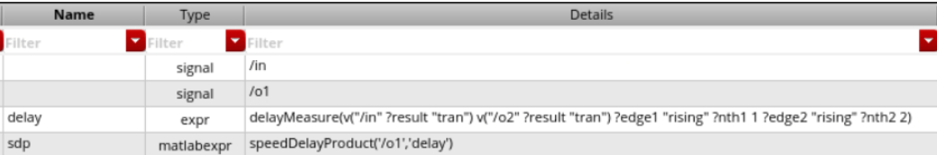
Embed MATLAB Directly into Virtuoso ADE
function sdp = speedDelayProduct(netname,metric)
[x,y]=ade2wave(netname);
slewRate=abs(mean(slewrate(y,x)));
delay=ade2metric(metric);
sdp=slewRate*delay;
The user never sees MATLAB, runs in background…

Slide 26
To chart multiple x-axis categories…use a cell array of strings
fig=trendChart(obj,Xaxis={obj.TrendChartFields(3),...
obj.TrendChartFields(5),...
obj.TrendChartFields(6)},...
Yaxis=obj.TrendChartFields{7},...
Legend=obj.TrendChartFields{2})

Slide 27
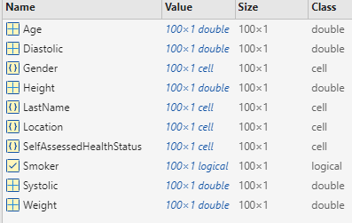
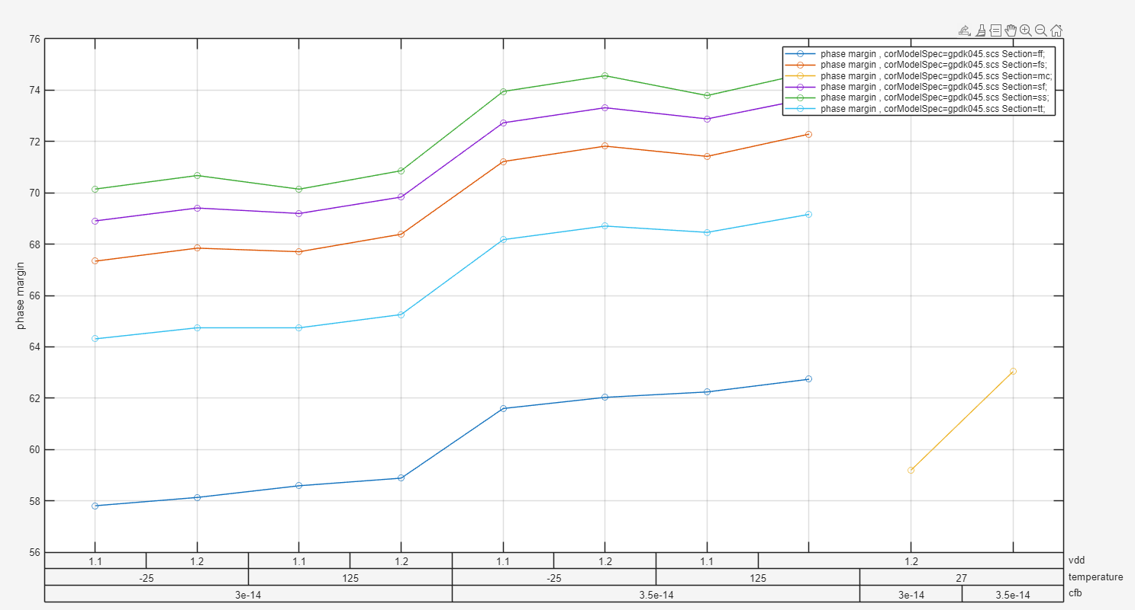
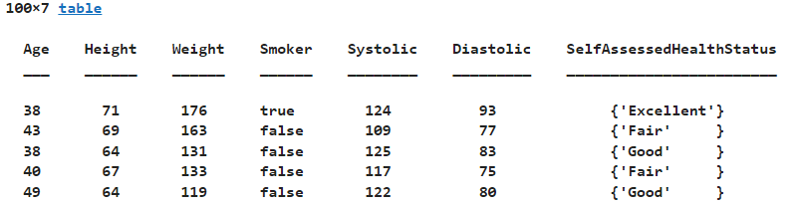
trendChart function Applied to any MATLAB Table
load patients
fig=trendChart(T,Yaxis={'Systolic','Diastolic'},Xaxis={'SelfAssessedHealthStatus','Age','Weight'})
T = table(Age,Height,Weight,Smoker,Systolic,Diastolic,SelfAssessedHealthStatus)

Slide 28
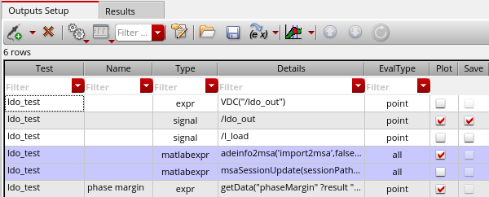
Automate Saves and Updates within ADE
Calling MATLAB from
Outputs Setup
adeinfo2msa('metricsOnly','false','import2msa',false);
Save data to .mat file at end of run automatically
Default file name is concatenation of test name with interactive run name.
Notes:
adeinfo2msa('import2msa',false,'metricsOnly’,true)
adeinfo2msa('import2msa',false,'metricsOnly',false,runName='Interactive.4',fileName=‘IR4.mat’)
% Or, automate filename creation using time/date stamp as one option
fn = sprintf('msa_data_%s.mat',datestr(now,'mm_dd_yyyy_HH_MM'));
adeinfo2msa('metricsOnly','false','import2msa',false,'filename',fn);

Slide 29
Roundtrip automation between MATLAB and Cadence
% get or set global variables or parameters
>> adeGet(varName = 'vdd’)
ans = '0.9 1.2’
>> adeGet('paramName','msbOptim/jj_opamp/schematic/M24/w')
ans =
'2.04e-05 3.89e-05 1.12e-05 2.97e-05 6.6e-06 2.51e-05 1.58e-05 3.43e-05 8.9e-06 2.74e-05 1.81e-05 3.66e-05 1.35e-05 3.2e-05 4.3e-06 2.28e-05'
>> adeSet(varName = 'RL',varValue = '150 160’)
Automate parameter sweeps and analysis from MATLAB
RL_array = [100 110;120 130;140 150; 160 170];
Nsims = 4;
delay = NaN.*ones(24,Nsims);
for k = 1:Nsims
adeSet(varName = 'RL',varValue = num2str(RL_array(k,:)))
adeSim;
delay(:,k) = ade2metric('delay');
end

Slide 30
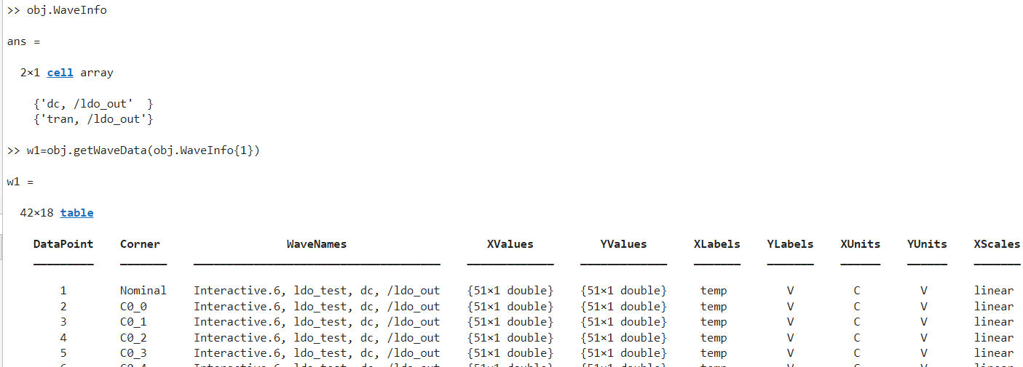
Filtering Data #1

Slide 31
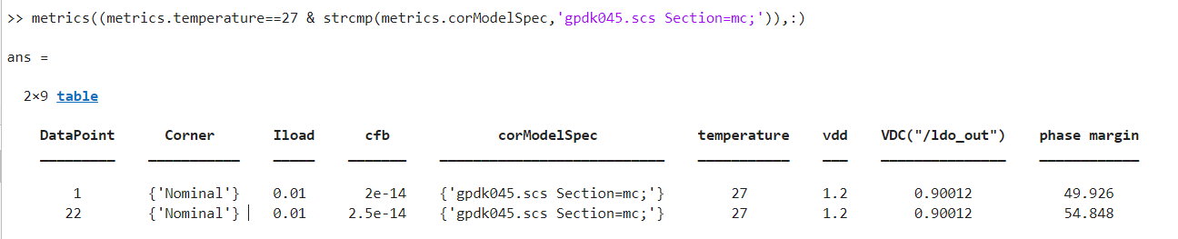
Filtering Data #2

Slide 32
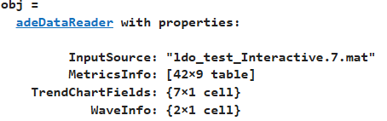
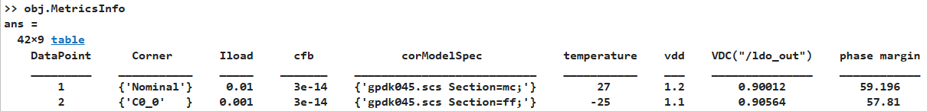

Filtering Data
obj=adeDataReader('ldo_test_Interactive.7.mat’);
metrics = obj.MetricsInfo;
metrics((metrics.temperature==-25),:)
metrics((metrics.temperature==-25 & strcmp(metrics.corModelSpec,'gpdk045.scs Section=sf;')),:)

Slide 33
Automating Design Optimization

Slide 34

The problem: Optimize transistor parameters for given LDO design

Slide 35

Might Start with Manual Data Exploration…
Understand IC sensitivity
Identify major trends
Define the metric that matters
Example: 304 simulations subset
Trends visualization and analysis

Slide 36


The optimization problem…
Optimize w, l, and m on 9 transistors
against 7 specifications
Approach: surrogate optimization
Outputs
Metrics
loadReg
Max Voltage Error
Phase Margin
Gain Margin
Phase Margin Frequency
Gain Margin Frequency
Max Loop Gain
Notes:
Outputs/metrics/objectives/constraints/Goals/specifications

Slide 37



MATLAB to Control Cadence® Virtuoso Design and Simulation
one time
adeInfo
adeGet
Met Spec
Or MaxSim?
Yes
Set solution,
Back annotate
No
surrogateopt, adeSet, adeSim
Parameters
Metrics
Load Reg < 40e-3
Max Voltage Error < 300e-3
Phase Margin > 60
An intelligently guided parameter sweep…
…
…
Notes:
This block diagram is functionally what we do but not literally when it comes to the code.
Think of it as an intelligently guided parameter sweep as opposed to a brute-force one.

Slide 38


Parameter Setup: Group as Parametric Set
Select all parameters to be
Optimized and select
Group as Parametric Set
Virtuoso Video Diary: What Are Parametric Sets? - Analog/Custom Design - Cadence Blogs - Cadence Community
Notes:
Parametric sets allow Cadence to sweep the parameters by ordinal position as opposed to sweeping all possible combinations of parameter values.
This greatly cuts down on the number of simulations run.

Slide 39



Optimization setup on the MATLAB side…
1. loadMaestroState(adeInfo.adeSession,"initialParamSetting","All","overwrite");
2. m = msbOptimizer();
3.[Solution, Metrics] = m.optimizeDesign('MaxNumberSims’,128,'NumParallelSims',16)
4. [Solution, Metrics] = m.optimizeDesign('MaxNumberSims’,128,'NumParallelSims',16,'UseCheckPoint',true)
13 minutes &
96 points later
Best Solution
Progress
Indicator
Best Metrics

Slide 40
Using Checkpoints
First Pass
>> [bestSolution, bestMetrics] = m.optimizeDesign('MaxNumberSims',48,'NumParallelSims',16)
Above generates myCheckPoint.mat file
Second Pass
>> [bestSolution, bestMetrics] = m.optimizeDesign('MaxNumberSims',48,'NumParallelSims',16,'UseCheckPoint',true)
First pass results
Second pass results
Name | Metrics | Specs | Units
loadReg | 26.7e-3 | < 40e-3 | V/A
maxerr | 275.3e-3 | < 300e-3 | V
Phase Margin | 64.32 | > 60 | degree
Gain Margin | 18.72 | > 10 | dB
Phase Margin Frequency | 4.78e6 | > 5e6 | Hz
MaxLoopGain | 58.5 | > 55 | dB
GainMargin Frequency | 31.96e6 | > 20e6 | Hz
Name | Metrics | Specs | Units
loadReg | 26.7e-3 | < 40e-3 | V/A
maxerr | 275.3e-3 | < 300e-3 | V
Phase Margin | 64.32 | > 60 | degree
Gain Margin | 18.72 | > 10 | dB
Phase Margin Frequency | 5.44e6 | > 5e6 | Hz
MaxLoopGain | 58.5 | > 55 | dB
GainMargin Frequency | 31.96e6 | > 20e6 | Hz

Slide 41
Using Checkpoints
First Pass
>> [bestSolution, bestMetrics] = m.optimizeDesign('MaxNumberSims',48,'NumParallelSims',16)
Above generates myCheckPoint.mat file
Second Pass
>> [bestSolution, bestMetrics] = m.optimizeDesign('MaxNumberSims',48,'NumParallelSims',16,'UseCheckPoint',true)
First pass results
Second pass results
Name | Metrics | Specs | Units
loadReg | 26.7e-3 | < 40e-3 | V/A
maxerr | 275.3e-3 | < 300e-3 | V
Phase Margin | 64.32 | > 60 | degree
Gain Margin | 18.72 | > 10 | dB
Phase Margin Frequency | 4.78e6 | > 5e6 | Hz
MaxLoopGain | 58.5 | > 55 | dB
GainMargin Frequency | 31.96e6 | > 20e6 | Hz
Name | Metrics | Specs | Units
loadReg | 26.7e-3 | < 40e-3 | V/A
maxerr | 275.3e-3 | < 300e-3 | V
Phase Margin | 64.32 | > 60 | degree
Gain Margin | 18.72 | > 10 | dB
Phase Margin Frequency | 5.44e6 | > 5e6 | Hz
MaxLoopGain | 58.5 | > 55 | dB
GainMargin Frequency | 31.96e6 | > 20e6 | Hz
Progress indicator plot
>> setFinalSolution((bestSolution1.Name)', num2cell(bestSolution1.Value'))

Slide 42

Under the Results tab in Cadence…
Each simulation consisted of 16 transistor parameter combinations
13 minutes
96 points
Best Parameter Set
First simulation with all passes…
6 iterations (16 simulations each)
Parameters value set by surrogate optimizer
Best Metrics

Slide 43

LDO Circuit Optimization Example in documentation
https://www.mathworks.com/help/releases/R2026a/msblks/ug/optimize-transistor-sizes-of-ldo.html
https://www.mathworks.com/help/releases/R2026a/msblks/ug/optimize-eye-height-in-serdes-system-model.html

Slide 44







Surrogate Optimization Methods
Use on optimization problems that are expensive to evaluate
  Simulations, differential equations
  Uses fewer function evaluations than other Global Optimization solvers
  Does not rely on gradients: works on smooth and nonsmooth problems
Construct Surrogate
Search for Minimum
Reset

Slide 45



Related Product Examples and Videos
https://www.youtube.com/playlist?list=PLn8PRpmsu08pn3Uml_lc-pfzrgWzfpeAA
https://www.youtube.com/playlist?list=PLn8PRpmsu08rTyRA_aTqQOgY_Vyp81ydw
https://www.mathworks.com/help/releases/R2024a/msblks/examples.html
Round-trip automation of Cadence Virtuoso and MATLAB for circuit optimization.
https://www.mathworks.com/videos/optimization-of-mixed-signal-ics-with-matlab-1713549171445.html

Slide 46
Summary
Get Virtuoso ADE simulation data into MATLAB quickly
Take advantage of built-in toolboxes for machine learning, signal processing, curve fitting, systemID, and optimization
Use MATLAB as a control and command center to set variables in Cadence, run simulations, and plot results…with a few lines of code
Work interactively or scripted

