Slide 1
Mixed-Signal Verification workflows with
Cadence and MathWorks
Kerry Schutz, Application Engineer

Slide 2

Mathworks Product Family
SoC
Blockset
Signal
Antenna
Toolboxes
More Toolboxes
Phase-Array
Coders
Parallel
Wavelet
SI
Toolbox
Robotics
PLC
Instrument
Control
5G
Physical
Modeling
HDL Coder
SerDes
Toolbox
DAQ
Stats and Mach Learn
Finance
RF
CurveFit
RF
Hydraulic
HDL Verifier
Audio
WLAN
Mixed-Signal
Blockset
Deploy
Mechanical
GPU
Production
Server
StateFlow
SimEvents
Vision
LTE
StateFlow
Optim
Image
Electrical
Embedded
Comms
SL Compiler
Aerospace
DeepLearn
Fixed
Point
Fluid
Simulink
Simulink
Compiler
DSP
SysID
Symbolic
MATLAB
PDE
MATLAB
Compiler
AutoDrive
Notes:
This is about ½ of our current product portfolio. Many others in the Finance, BioPharma, and Controls space are not listed.

Slide 3
Questions were trying to answer…
How can I maximize the re-use of my behavioral model in my implementation?
How can I assess the quality of my behavioral model?
How can I improve the quality of my behavioral model?

Slide 4
What is a “behavioral model”?
A higher-level more abstract description of a system that captures essential behaviors but lacks implementation detail
Involves a mixture of languages and features:
  Mixture of continuous and discrete-time
  Mixture of RF and baseband
  Mixture of languages: Verilog-A, System Verilog, C, MATLAB, Simulink, and more
  Larger in scope, e.g. Transmitter → Channel → Receiver (with loops between them)
  State-machines interacting with all of the above
Purpose: Design space exploration and optimization
Notes:
What is a behavioral model…as contrasted against a circuit-level model…
An example would be a behavioral model of an audio or RF amplifier. An amplifier ideally takes a voltage in and produces an output voltage that is K times larger.
So, mathematically, it would be y = K*x. Contrast that with the actual circuit implementation or model of that amplifier which could be a very detailed transistor circuit with differential input stages, current mirrors, buffering, impedance matching, etc and have all sorts of impairments. One could approximate the actual circuit using a behavioral model that included mathematical and empirical descriptions (not circuit-level) of the amplifier to include not just the gain K but also non-linearities in the form of a curve-fitted equation or a LUT, additive noise, slew-rate and bandwidth limiting, propagation delay, or maybe we have measured s-parameters on the circuit and we used a rationalfit on those parameters to model the actual circuit that way. In any case, the behavioral model is not a 1-to-1 match necessarily with the circuit architecture but it still captures the essential I/O behaviors that most impact system performance.
Another behavioral model example that is easy to grasp is an ADC. You could have a behavioral model of an ADC at various levels of abstraction. The simplest behavioral ADC model would be an ideal quantizer. Adding more detail, you add a sample-n-hold + quantizer. Adding a little more detail, you’d include saturation. Next adding impairments, you’d add INL/DNL, i.e. non-linearities in the transfer curve of the ADC. Adding more detail, you’d include bandwidth and/or slew-rate limiting. Adding more detail yet, you would add jitter of the appropriate type to the sampling clock. And then after that you could add ADC architecture specific impairments. A SAR ADC would have different impairments from a delta-sigma based architecture, different from a FLASH ADC. But in all of the above ADC behavioral models, you’d most likely never model a single transistor or reference a PDK. The behavioral model would be lacking that level of detail. Said behavioral model should only be “good enough” to design trade-offs at the system-level and of course it should run significantly faster than the transistor level version.
It’s a widely used term with no single agreed upon definition
Mixture of languages and features: a Franken Model of sorts
Sometimes people will use system-level model and behavioral model interchangeably that’s okay as long as everyone understands what the other person is saying for the application in question. A system-level model though is typically a behavioral model that is larger in scope.
If you were for example to connect many behavioral DUTs together, you’d end up with a system-level model. For example, you could have a behavioral model of a variable-gain amplifier. If you were to connect this Bmod to the Bmod for the CTLE, AGC, and DFE/CDR, then you’d have a system-level model of the Receiver.

Slide 5
Mixed-Signal Design and Verification Challenges
Difficult design trade-offs
SPECIFICATION
Limited analog design abstractions
DIGITAL DESIGN
ANALOG DESIGN
Limited analog/digital links
IMPLEMENTATION
IMPLEMENTATION
Specification isolated from verification
VHDL, Verilog
Spice-like
TEST & VERIFICATION
Slow design iterations
Disconnected teams
PROTOTYPE / INTEGRATION
Notes:
This is really a WHAT-the-current-state is and WHY-it-can-be-a-problem SLIDE
The design of mixed-signal systems and ICs is very complex, because it requires different expertise, and it involves multiple design teams using multiple tools, often disconnected.
The complexity of mixed-signal design is not only due to spanning both analog and digital design flows and requiring tight communications between the two. But it is amplified by complex requirements pushing the limits of the silicon processes, requiring multiple design iterations and complex verification scenarios.
But you all are probably far too familiar with all of these challenges ….

Slide 6


System-Level Design and Analysis Leads to Continuous Verification
Rapid design construction
SPECIFICATION
Easier analog modeling
ANALOG & DIGITAL DESIGN
Multi-domain simulation
Today
Integrated specification
TEST & VERIFICATION
IMPLEMENTATION
IMPLEMENTATION
VHDL, Verilog
Spice-like
Rapid design iterations
Improved team communication
PROTOTYPE / INTEGRATION
Notes:
This is a better-integrated version of the previous workflow
The MathWorks products have helped mixed-signal IC designers for many years, by focusing on system-level modeling and by providing tools for rapidly simulating analog and digital systems in closed feedback loops.
You can model mixed-signal systems at the behavioral level, integrate them with digital signal processing algorithms and control logic.
You can refine the models at different level of abstractions and use the most expressive description: at the signal level, using spice-like components, using fixed-point integer arithmetic, state machines, and others.
Modeling your mixed-signal systems earlier in the design flow provides a better understanding of how the system works, it facilitates tradeoffs and architecture exploration, and simplifies verification effort with model and testbench re-use.

Slide 7
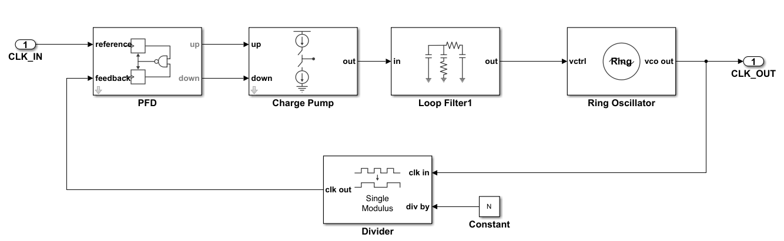
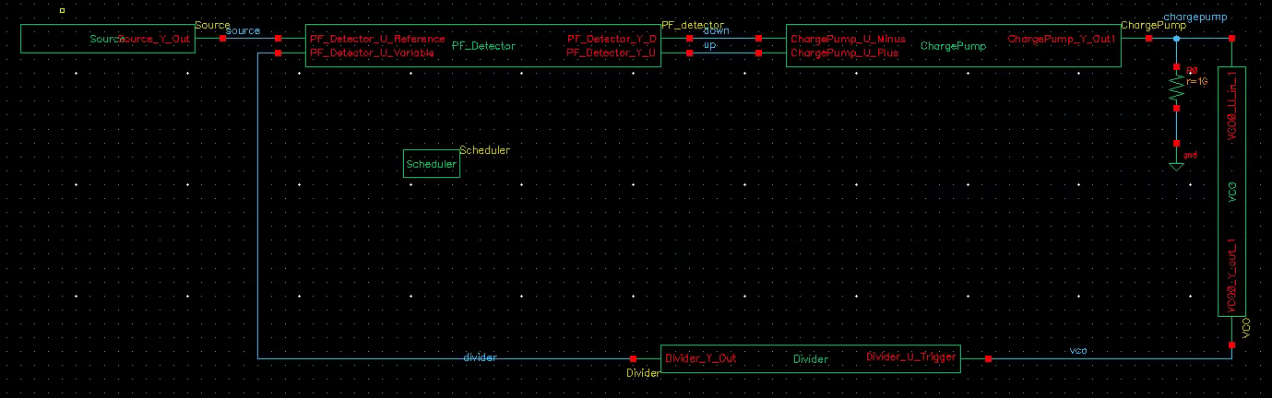
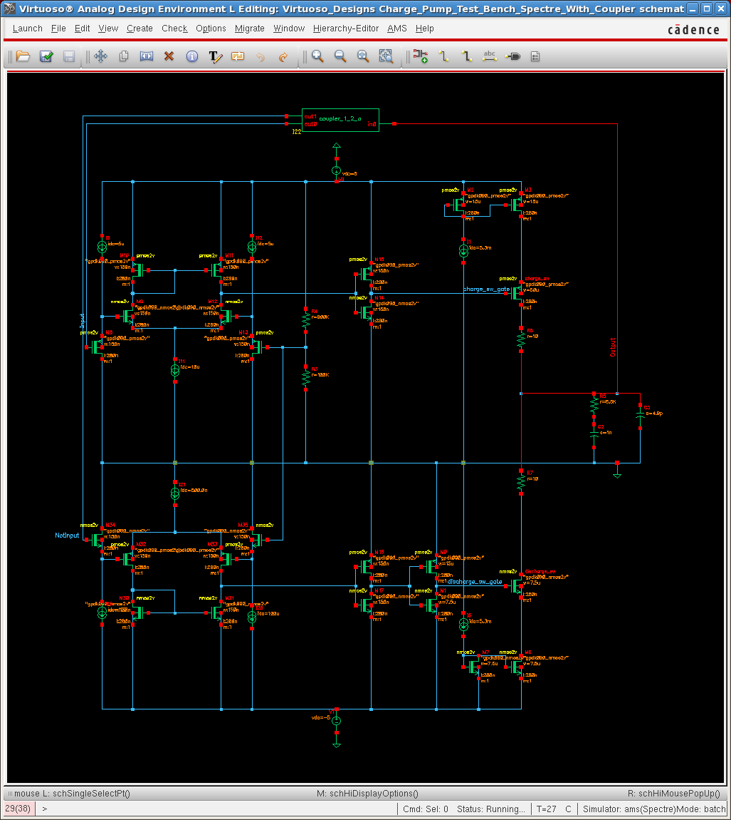
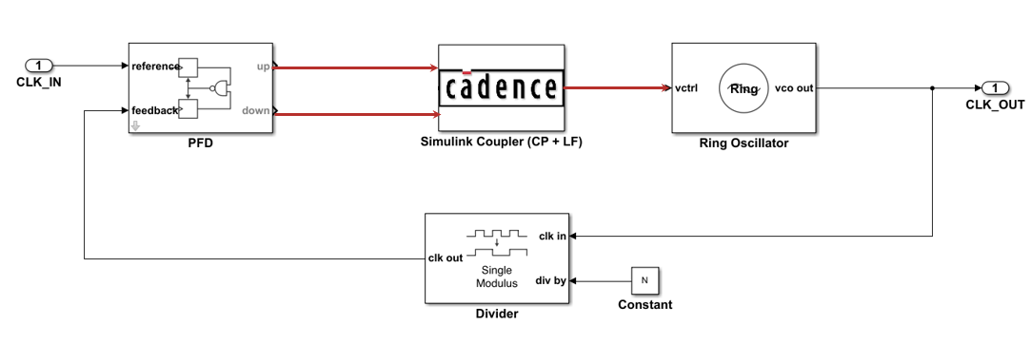
Connecting Models to Implementation: Two Workflows
Cadence Virtuoso
Generate SV DPI-C
#1
Simulink
Cadence Virtuoso
#2
run lock-step
Simulink

Slide 8
Cosimulation between Cadence Spectre and Simulink
A Hello-World Example
Kerry Schutz

Slide 9
Cosimulation between Cadence Spectre and Simulink

Slide 10
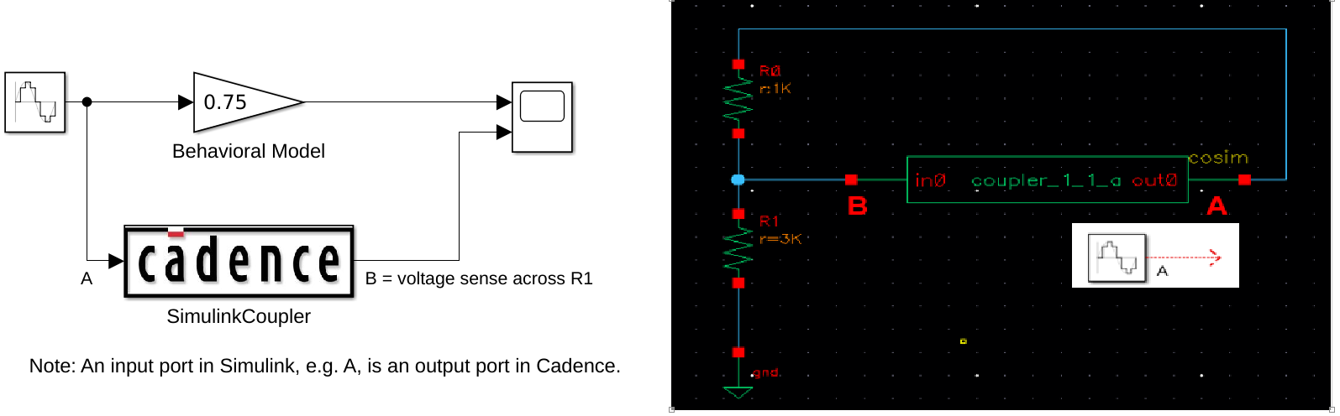
Our Hello-World Co-simulation Example
Simulink is running
lock-step
Spectre is running
Main Goal: Show the process of setting up a design for co-simulation

Slide 11
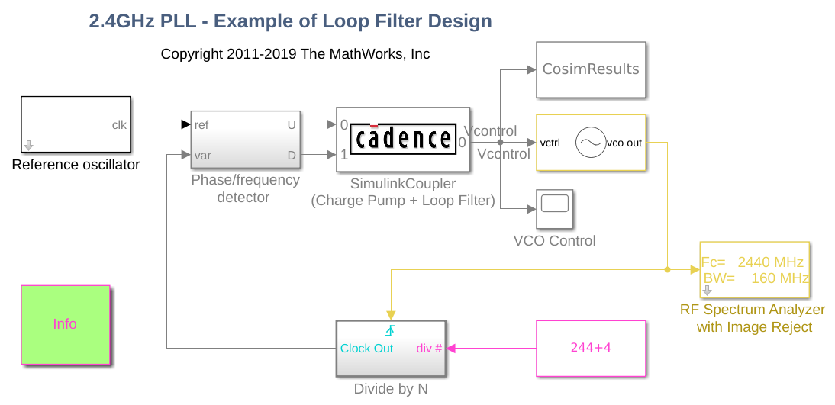
Co-simulation Scales to Larger Designs

Slide 12

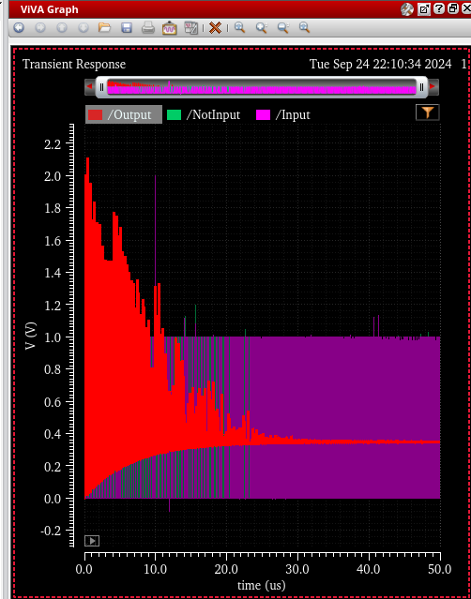
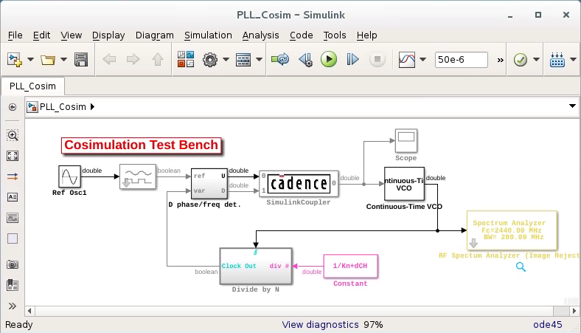
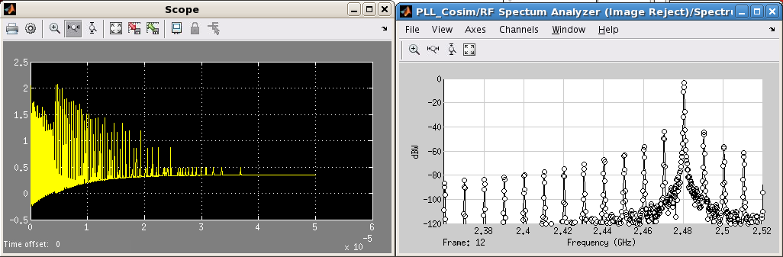
Scales to Larger Designs…continued
Spectre engine
Simulink engine
Notes:
Requires the insertion of a coupler block on both sides, Cadence and Simulink.

Slide 13
Why Co-simulate?
1. Bring transistor-level detail into behavioral (Simulink) simulation.
Validate behavioral model, not a substitute.
2. Re-use Simulink testbench to drive Cadence simulation
3. Bring behavioral (Simulink) description into a transistor-level simulation.
Transistor-level version might not be available yet.
Most
common

Slide 14
But…co-simulation is not a panacea
Powerful but misunderstood, under-utilized, and challenging
Slower than pure behavioral models. Fidelity comes at a price.
A temporary means to verify or improve behavioral model.
Tedious to configure initially
Only one coupler block per co-simulation

Slide 15

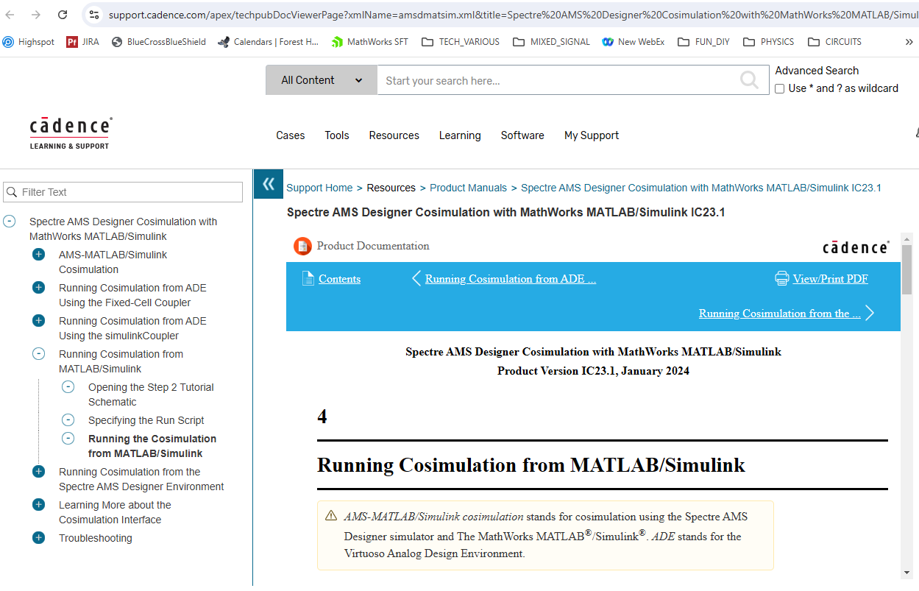
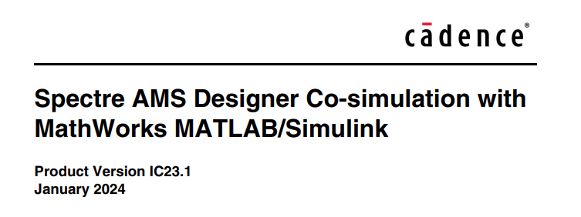
Getting more support…
Cadence introduced this capability circa 2007
Full doc on cadence.com support portal: https://www.cadence.com/en_US/home/support/cadence-online-support.html
Download amsdMatSim.pdf, 103 pages
Notes:
This capability has been around for quite some time, over 17 years now.
To get the complete documentation on co-simulation, you’ll need to go through the Cadence online support portal where I’ve shared the US link above. It’s probably slightly different for International audiences.
Keep in mind this was a capability developed entirely by Cadence. We are Mathworks are doing our best to raise awareness of the capability and make it easier to get started but the real expert is Cadence. Mathworks cannot support it in any official capability. Our support people as an example are largely unaware of it. We cannot modify it, bug fix, feature add, look at the source code, none of that. If you have detailed questions on its operation or have trouble getting it to function, work with your Cadence support person.

Slide 16
Cadence Contact with Co-simulation Expertise
Ashish Patni
pashish@cadence.com

Slide 17
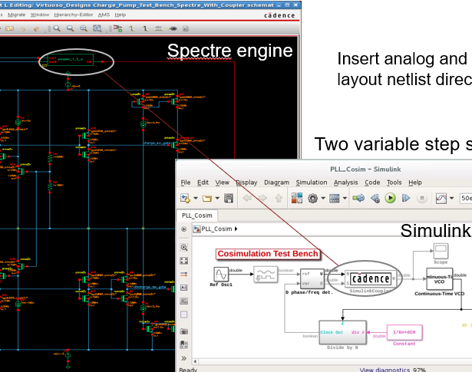
Step-by-Step Thru an Example
Co-simulation requires configuration
in both Cadence and Simulink
** Small version differences may exist **

Slide 18
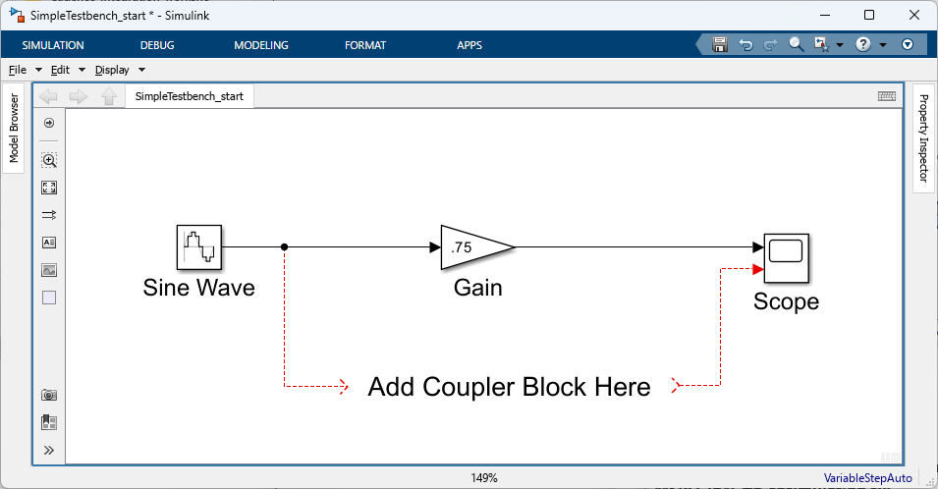
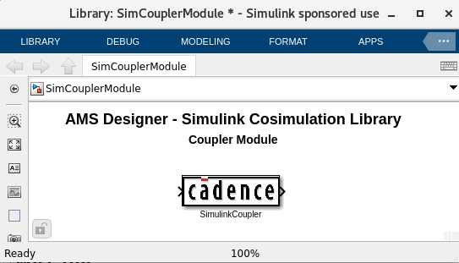
Start on Simulink side…
>> which SimCouplerModule
/home/matlab/cadence/installs/XCELIUM2209/
tools.lnx86/affirma_ams/
etc/matlab/SimCouplerModule.slx
>> SimCouplerModule
Behavioral DUT
A common challenge is finding the Simulink Coupler block…

Slide 19

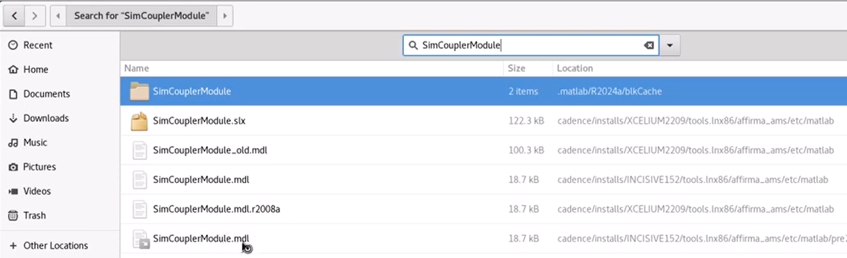
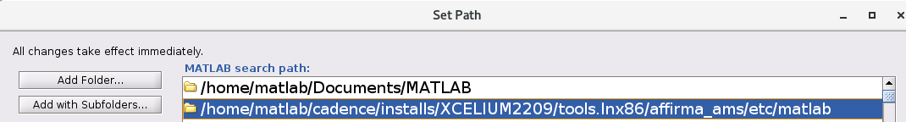
If SimCouplerModule is not on MATLAB path…
You have to find it first…
Add to your MATLAB path: >> pathtool
Verify: >> which SimCouplerModule
Notes:
You may only have a .mdl file, which is the older Simulink file format. Here I had already save-as’d the older mdl version of the library file to the newer .slx file format. Both mdl and slx formats are supported however.

Slide 20
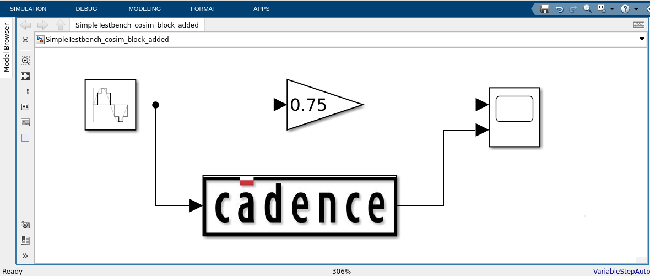
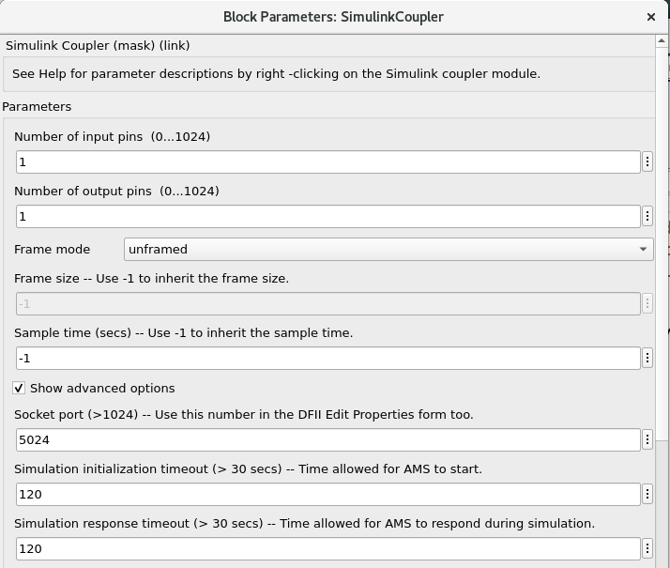
Connect coupler block and configure its settings
Most important settings
Number inputs
Number outputs
Socket port #

Slide 21
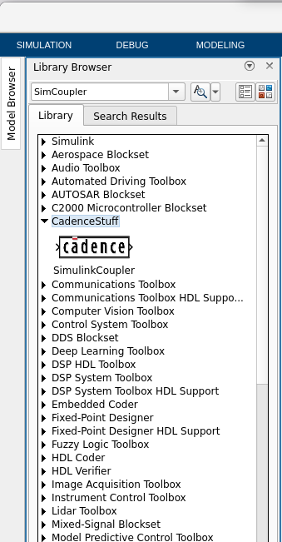
Recommended but optional…
Add Coupler block to Simulink Library Browser
Create slblocks.m and place on MATLAB path where library resides
function blkStruct = slblocks
% This function specifies that the library
% should appear in the Library Browser
% and be cached in the browser repository
Browser.Library = 'SimCouplerModule';
Browser.Name = 'CadenceStuff';
blkStruct.Browser = Browser;
Makes finding coupler block much easier in the future…
Notes:
It’s very hard to remember to looks for a block/library called “SimCouplerModule”.

Slide 22
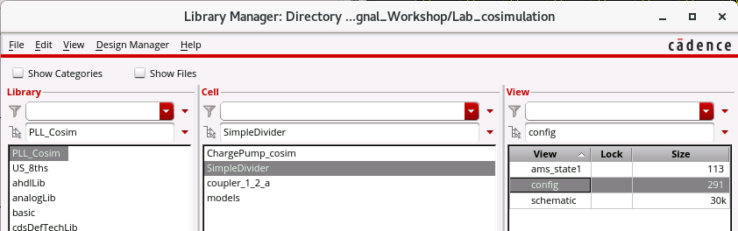
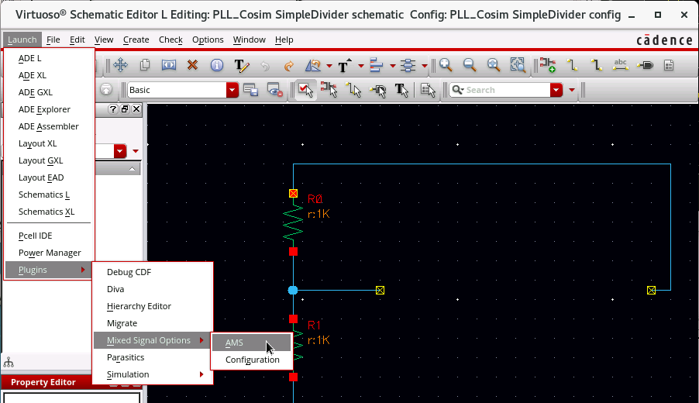
Configure Cadence side: Open Config View, Launch AMS plug-in
Open project in config view
Two additional menus are created in schematic editor:
- Hierarchy-Editor
- AMS

Slide 23
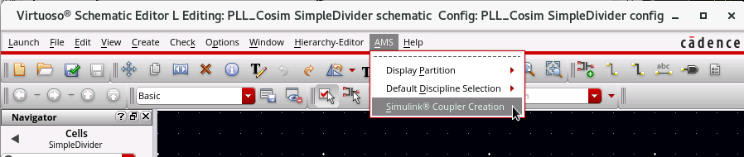
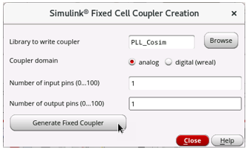
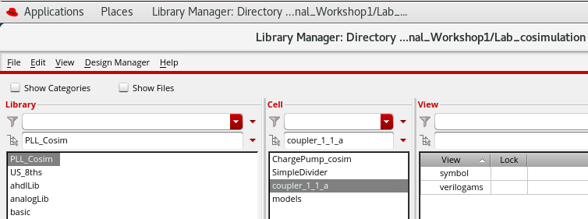
Generate Coupler
(1) Select AMS/Simulink Coupler Creation
(2) Specify number of I/O’s, Generate.
(3) Confirm creation of new cell, e.g. coupler_1_1_a

Slide 24
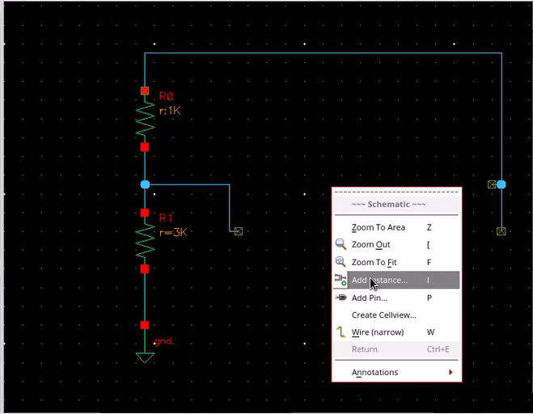
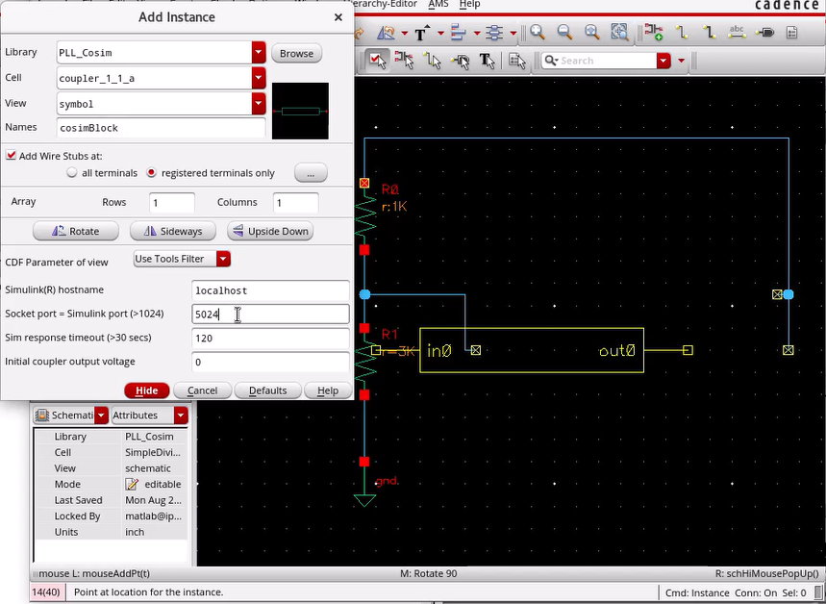
Instantiate coupler…
(1) Right click to instantiate Instance…
(2) Set Socket port #. Connect coupler block.

Slide 25
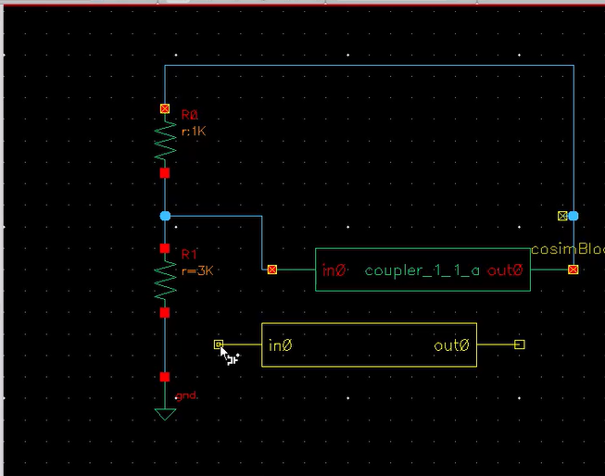
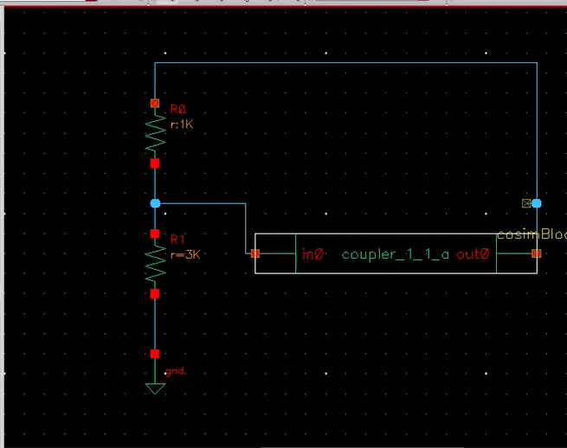
Connect coupler…
Hit Esc to prevent instantiation of subsequent coupler blocks…only 1 allowed

Slide 26
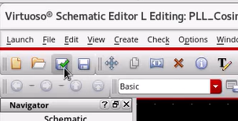
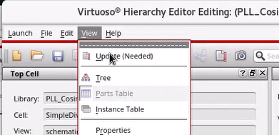
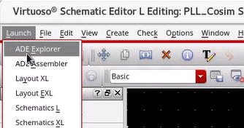
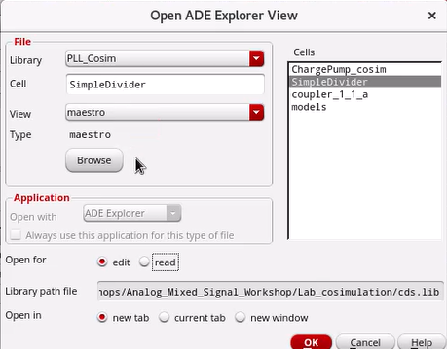
Launch ADE Explorer
1. Check Save: from Schematic
2. View/Update: from Hierarchy Editor
3. Launch ADE Explorer
3. Choose Cell = SimpleDivider, not coupler.
Choose “new view” to create a
new maestro view if you don’t already have one

Slide 27
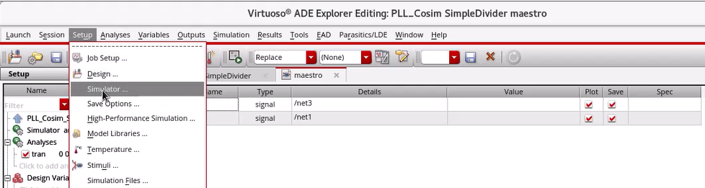
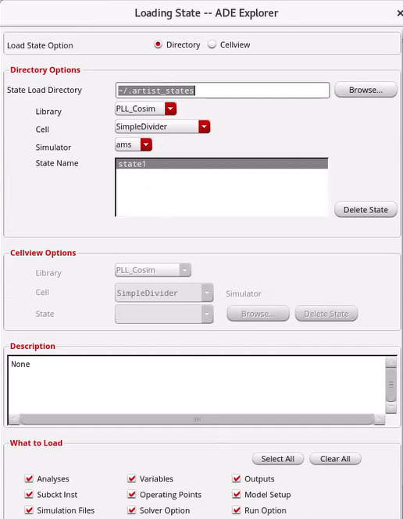
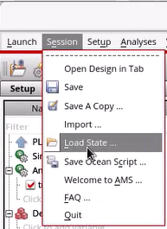
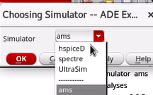
In ADE Explorer, Choose Simulator and Load State.
(1) Choose Setup/Simulator/ams
(2) Load State: ams/state1

Slide 28
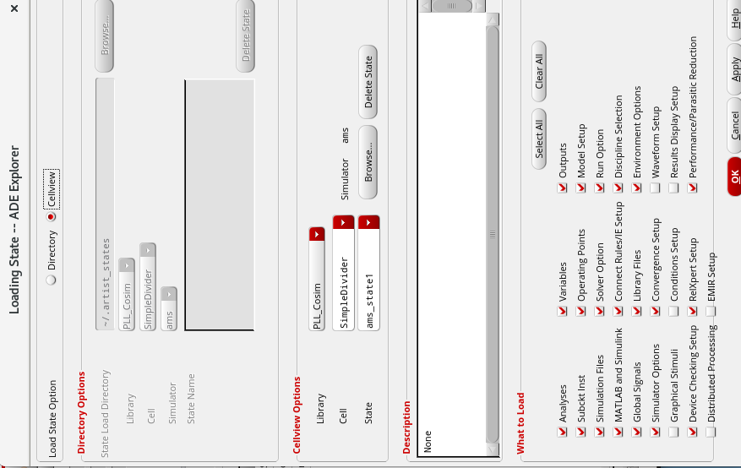
Alternatively: When it comes to loading “state”, use Cellview instead of Directory…

Slide 29
Checking redhat version from Linux command line
cat /etc/redhat-release
Red Hat Enterprise Linux release 8.10 (Ootpa)
Get version of Cadence Spectre
spectre -W

Slide 30

Using MATLAB-Drive to share files between Windows and Linux
Must install MATLAB-Connector to both sides, Windows and Linux:
See the instructions here:
https://www.mathworks.com/help/matlab/matlab_env/install-matlab-drive.html
From within MATLAB — Click the MATLAB Drive button in the Current Folder toolbar.
If the MATLAB Drive button is not on the Current Folder toolbar,
you can add it by right-clicking the toolbar and selecting Customize.
Then, in the MATLAB Toolbar Preferences Controls section,
select Access MATLAB Drive files on this computer and click OK.
MATLAB adds the button to the toolbar.
The part highlighted in red is subtle to find. Essentially, right click in this very thin strip of the MATLAB Command window and you “should” get the “Customize” menu option.

Slide 31
Resetting MATLAB Connector: occasionally necessary
From: Nina Cruz <support@mathworks.com>
Sent: Tuesday, October 15, 2024 2:22 PM
To: Kerry Schutz <kschutz@mathworks.com>
Subject: Re: MATLAB Drive takes a long time to sync [ ref:!00Di00Ha1u.!500UU0Igoin:ref ]
Hello Kerry,
Thank you for your patience. To further investigate this MATLAB Drive issue, our Development team has requested the following information:
Please try stopping MATLAB Connector and restarting it. Does the slow syncing issue persist after restarting MATLAB Connector?
  To stop MATLAB Connector, you can open the Task Manager from the Windows Start menu. Then, right click on the task called "MATLAB Connector", and click "End Task".
  You can then restart MATLAB Connector by opening it from the Windows Start menu.
Please zip the logs located in %LOCALAPPDATA%\MathWorks\ServiceHost\logs and send me the zip file containing the logs.
Please let me know if you have any questions on the above steps. I look forward to hearing from you!

Slide 32
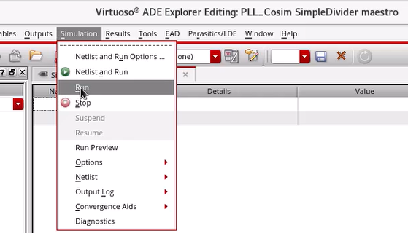
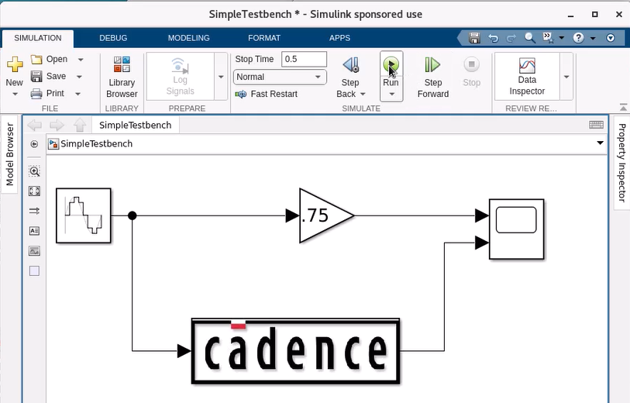
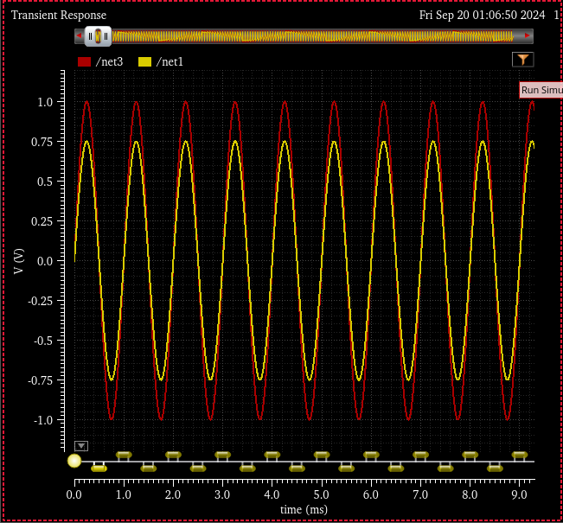
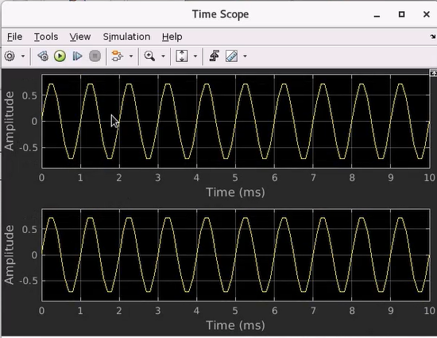
Press run in both environments, analyze results
Select Simulation/Run in ADE Explorer
Hit Run button in Simulink
Notes:
It doesn’t matter where you press run first…

Slide 33
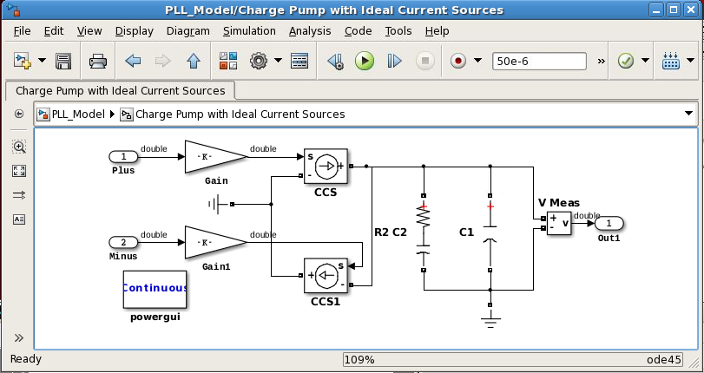
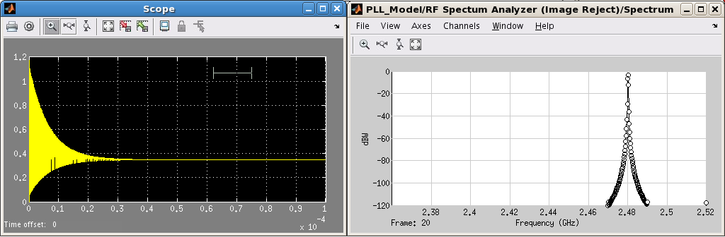
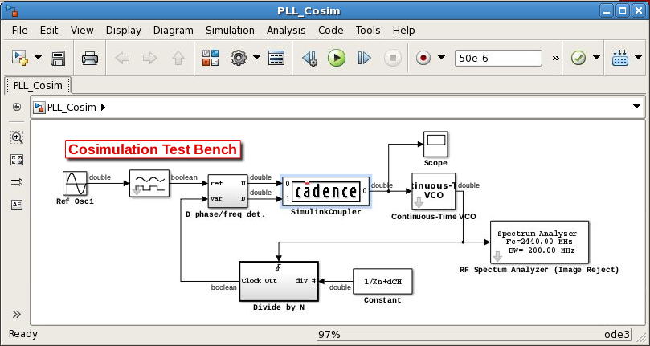
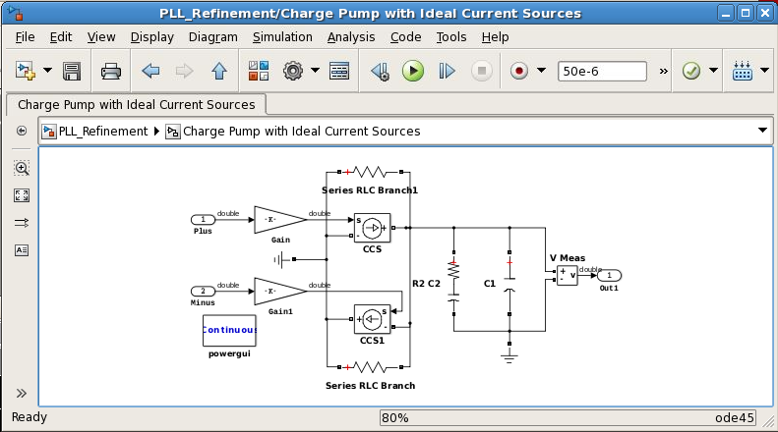
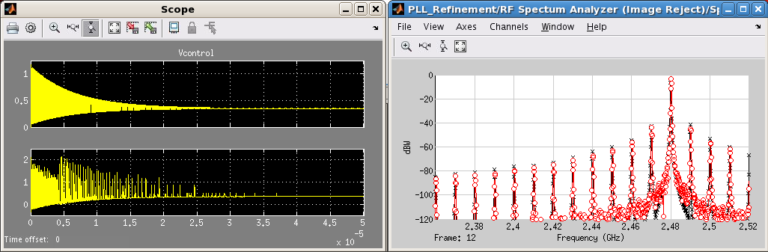
I ran a co-simulation, then what?
1. Ideal behavioral model
2. Co-simulation model
3. Elaborated behavioral model
“Compromise
model”
Notes:
After co-sim, step 2, what next?
The answer is step 3: ascertain a measure of closeness and then elaborate as needed to improve your behavioral to better align with the co-simulation.
That’s a case-by-case decision…what is good enough? Typically, you get as close as you can with incurring a significant simulation performance penalty. It really all depends on what questions you are trying to answer using your system-level model, how extensive use you’ll make of it, how much faith you’ll put in it.
1 and 3 do not use co-simulation
2 uses co-sim
1 runs fastest, 3 is second fastest, and 2 is the slowest by far but is the most realistic.
The idea is to get 2 to match 3 as close as possible in accuracy
The idea is to get 2 to match 1 as close as possible in speed.
The matching process of 3 to 2 is case-by-case..Elaborating circuit/block diagram using first principles, SysID, Surrogate Models, Curve Fitting, N-D LUTs, etc.

Slide 34
Summary on Spectre-Simulink Cosimulation
Powerful technique synchronizing two variable-time step simulation engines
Brings transistor-level detail into behavioral (Simulink) simulation.
Validate and elaborate your behavioral model, not a substitute.
Tedious but doable to configure initially
Alternative techniques like SV DPI-C code generation may serve your purpose better (not covered here)
Notes:
It’s a powerful technique…
It brings transistor-level detail…
It serves to validate and provides a means by which you can elaborate…
It’s tedious to setup initially…
Alternative techniques may serve your purpose better…

Slide 35
YouTube Videos
On Cadence Spectre to Simulink co-simulation
https://www.youtube.com/watch?v=Ea9KB5WP8DA&list=PLn8PRpmsu08rTyRA_aTqQOgY_Vyp81ydw&index=1&pp=iAQB
On Cadence to MATLAB Post-Processing
https://www.youtube.com/watch?v=PbQMFqLIzpY&list=PLn8PRpmsu08rTyRA_aTqQOgY_Vyp81ydw&index=11
https://www.youtube.com/watch?v=KfZNZZm8GXY&list=PLn8PRpmsu08rTyRA_aTqQOgY_Vyp81ydw&index=10
https://www.mathworks.com/videos/optimization-of-mixed-signal-ics-with-matlab-1713549171445.html

Slide 36
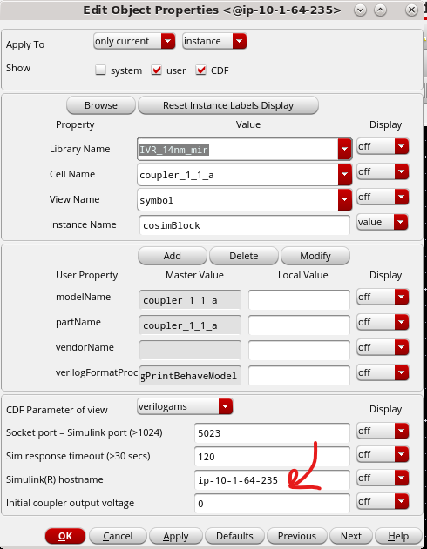
Possible Problem and Resolution…Two Different Servers
The issue is resolved. The problem was that our Matlab and Cadence sessions were open on two different servers. We made a change in the Cadence environment as shown in the attached screenshot.
We changed the hostname to the server name that MATLAB was being launched. That resolved the connection issue and simulation ran correctly.
Must run Cadence and MATLAB on same server, can’t kick off MATLAB on a compute farm and Cadence running somewhere else.
Make sure the SimCoupler you’re using is correct. There may be many versions in your Cadence install like old 32 bit versions which won’t work and the error message won’t tell you much.
Notes:
From Mir Mohammad at Claros, Sep 2025

Slide 37
Debugging Co-sim pointers from Draper Labs
From: Black, Dan <d.black@draper.com>
Sent: Friday, October 24, 2025 4:21 PM
To: Kerry Schutz <kschutz@mathworks.com>
Subject: RE: [EXTERNAL] Re: Are we on for today's AMS session at 3pm?
Hi Kerry,
I sincerely appreciate the support. I took a closer look based on your feedback and was able to get this working. Below is a description of some of the issues I ran into. I wanted to share in case this is helpful for supporting others in the future.
I was originally referencing a SimCouplerModule downloaded from Cadence along with the documentation referenced in your slides. Unfortunately, this included only the SimCoupler.mexglx compiled code for 32-bit Linux. After reviewing your response, I searched my own Cadence installation files, and was able to find one in each version of the xcellium files, with a similar path as in your presentation. It took a couple of tries to find a version that would work, but ultimately I did find a newer version that had a SimCoupler.mexa64 file associated with it to run on my 64-bit system. This eliminated the error on the Simulink side. Just so you are aware, the Simulink models in the Cadence download are outdated, such that some of the elements in the model can not be found. This made me even more grateful for your simple “Hello World” example.
On the Cadence side, I had to load a newer version of Xcellium (that corresponded to the newer SimCouplerModule I had found). I also had to change the Maestro Job Setup to run locally instead of being kicked off to a compute farm so that it could find the correct socket.
After addressing each of these issues, I was able to get a version of your “Hello World” simulation running!
I realize that the issues I experienced were due either to my own oversight/misinterpretation, stale documentation from Cadence, or things specific to my system. Even so, I appreciate your support, and the willingness of Mathworks to take an interest in helping to debug cross-platform issues.
Many thanks, and have a great weekend!
Dan Black | Group Leader, Analog IC Design | D R ᴧ P E R
c: 480-939-4866 | d.black@draper.com

