Slide 1
Mixed-Signal System Design with MATLAB and Simulink
Kerry Schutz
Application Engineer

Slide 2
Agenda
Introduction to MathWorks tools for mixed-signal
  MATLAB vs Simulink platforms
Visual Tour of Simulink for Mixed-Signal
Top-Down Design of Mixed-Signal Systems
  Behavioral models of PLLs and ADCs
  Modeling impairments: phase noise, jitter, leakage, etc.
  Measurements and testbenches
Cadence-MATLAB Integration
  Post-Processing Cadence ADE simulations
  Co-simulation with Cadence Spectre
  Generating SystemVerilog DPI-C

Slide 3

Subset of Mathworks Tools
SoC
Blockset
Signal
Antenna
Toolboxes
More Toolboxes
Phase-Array
Coders
Parallel
Wavelet
SI
Toolbox
Robotics
PLC
Instrument
Control
5G
Physical
Modeling
HDL Coder
SerDes
Toolbox
DAQ
Stats and Mach Learn
Finance
RF
CurveFit
RF
Hydraulic
HDL Verifier
Audio
WLAN
Mixed-Signal
Blockset
Deploy
Mechanical
GPU
Production
Server
StateFlow
SimEvents
Vision
LTE
StateFlow
Optim
Image
Electrical
Embedded
Comms
SL Compiler
Aerospace
DeepLearn
Fixed
Point
Fluid
Simulink
Simulink
Compiler
DSP
SysID
Symbolic
MATLAB
PDE
MATLAB
Compiler
AutoDrive
Notes:
This is about ½ of our current product portfolio. Many others in the Finance, BioPharma, and Controls space are not listed.

Slide 4
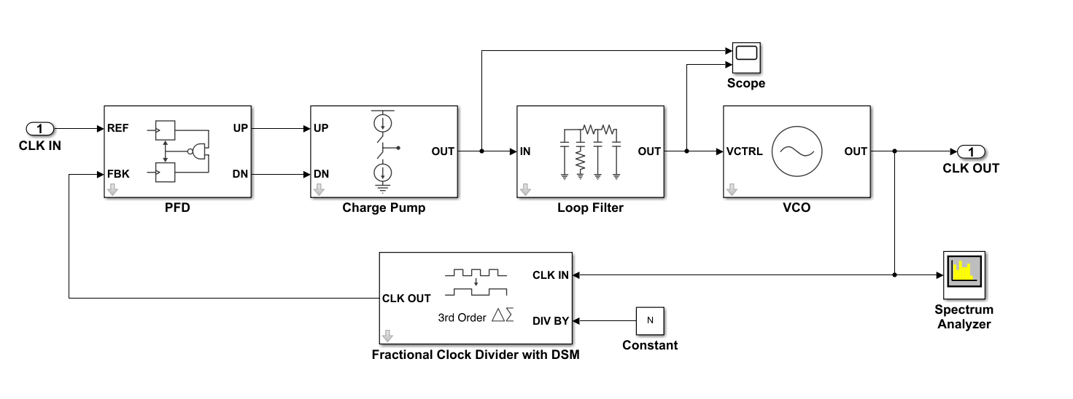
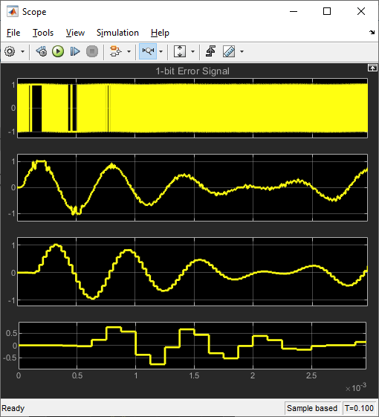
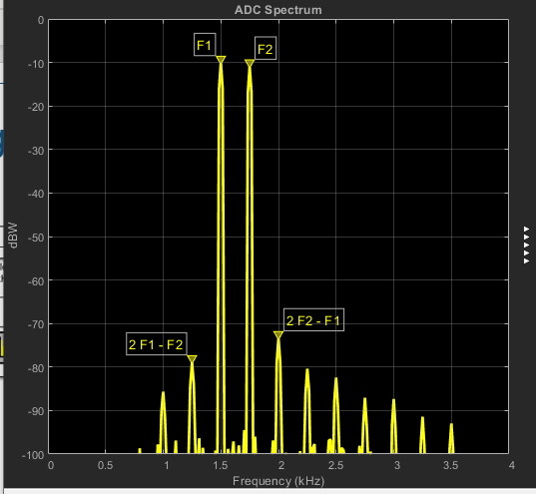
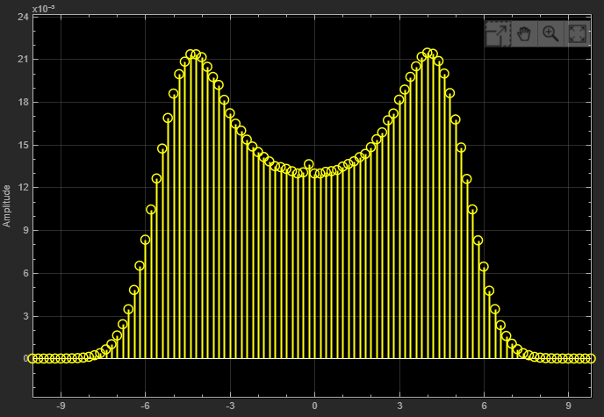
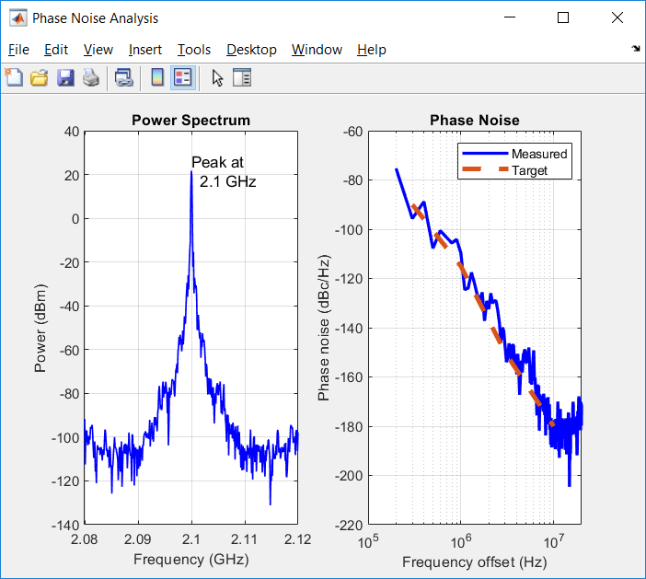
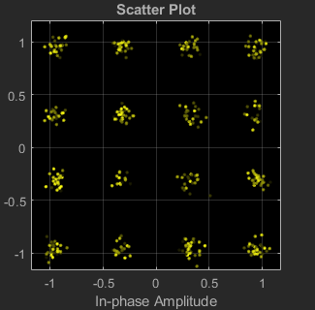
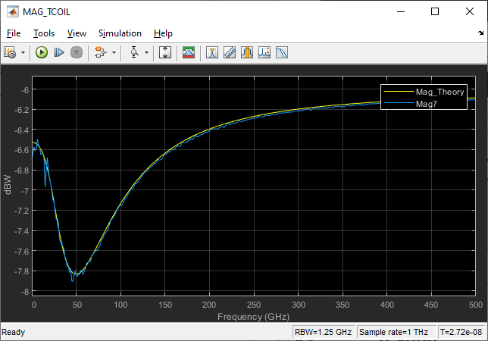
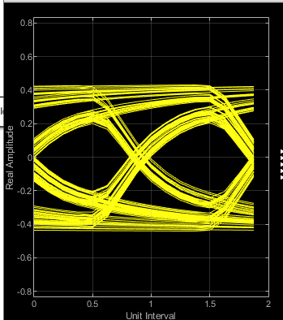
Simulink: A multi-domain simulation platform
Hierarchical block diagram
  Built-in notion of time and concurrency
Digital, analog/mixed signal & event driven
Visualize Signals
Co-simulate: Analog and Digital
Integrated with MATLAB
NOT a Graphical Wrapper for MATLAB
Time-domain
Oscilloscopes
Spectrum Analyzers
Histograms
Spectrum
Post-processing
in MATLAB
Eye Diagrams
Constellations
Network Analyzers
Notes:
What is Simulink? It’s VISIO block diagram with a clock, differential equations solvers, scopes, and a run button. It’s a mixed-signal simulator. It’s a combination of behavioral Verilog and behavioral SPICE, i.e. mixed-signal.
On MATLAB and Mixed-Signal…
For modeling and simulation purposes, our analog and mixed-signal flow is based on the Simulink platform which includes the Simulink solvers and schedulers.
We do not offer a MATLAB-based mixed-signal tool. This also implies by definition there is no way to convert a Simulink model to a MATLAB code representation.
Such a think is technically possible but it would be exceedingly tedious to reproduce all of Simulink’s functionality in MATLAB form, variable-step ODE solvers, multi-rate schedulers, etc.
Simulink is well-integrated with MATLAB however and integrated in 4 ways in particular.
Use MATLAB variables as parameters and input signals in your model.
Use MATLAB scripts/functions to programmatically construct or configure your model.
3. Use MATLAB to post-process logged simulation data.
4. Use MATLAB to implement algorithms in your model (run-time).

Slide 5
When is Simulink Applicable?
Having a notion of time is important
Conveying system-level architecture is important
Managing & Communicating complexity is important
  multi-domain: analog, digital, RF, audio, image, electrical, mechanical
  fixed-point, multi-rate, feedback, pipelining, state-machine heavy
  requirements traceability
Code generation is important: C or Verilog
You’re an analog designer who works better with pictures than code.
Notes:
It’s important for modeling hardware at the system-level

Slide 6
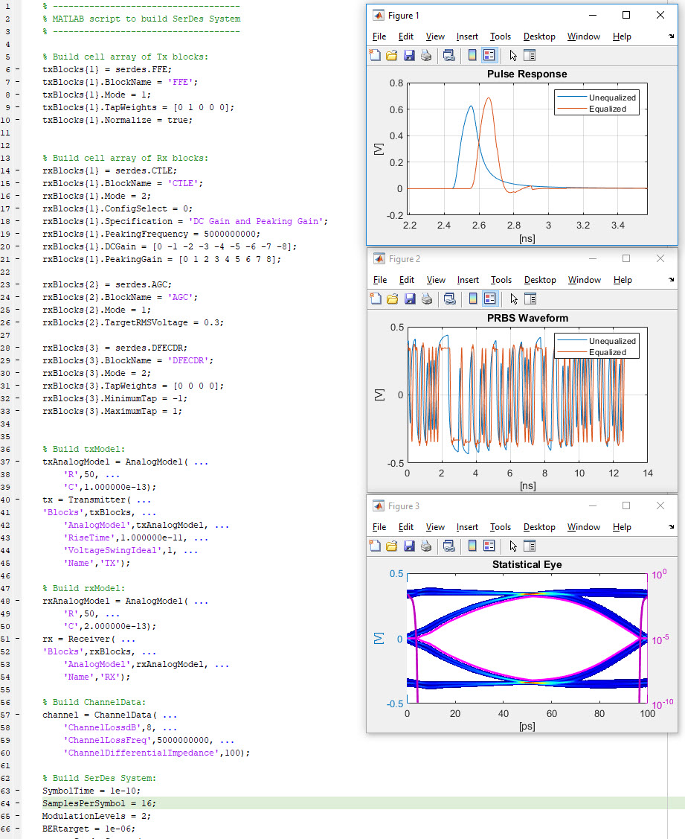
MATLAB: Always in the Picture
The leading environment for technical computing
  It’s a programming language
  Numeric computation
  Data analysis and visualization
  Industry-standard language
  for algorithm development
  A toolbox for about everything
  Easy for non computer scientists but advanced to satisfy them
Notes:
6
We are not leaving MATLAB behind in the dust…
Can always use the line: A programming language for engineers, by engineers, to do engineering.
MATLAB, our first core product, is the leading environment for technical computing. It is also the foundation of The MathWorks product family.
People apply MATLAB to a broad range of applications, including signal processing, control system analysis, image processing, and just general data analysis. That’s one reason why MATLAB (is/can be) used so widely throughout (your organization/organizations like yours/your industry).
MATLAB addresses this range of applications by offering a core set of technical computing capabilities. These include:
* fast and robust numeric computation, with over 1000 algorithms geared to engineering and science
* Engineering graphics and visualization tools
* A high-level programming language that has become a de facto standard for developing and sharing algorithms
* add-on toolboxes, providing additional functions for specific areas, such as signal and image processing, control system design, statistics, symbolic math, and other areas
Optional elaboration:
When people describe MATLAB, they generally talk about it as one of two things
* An interactive, exploratory analysis and visualization environment
* A programming environment
In fact, it’s both. The math, graphics, and language can be applied in either way and these two modes can be mixed. You can use MATLAB as an exploratory environment, iteratively trying out math functions and plotting results until you’re satisfied with the resulting analysis. And you can use that same MATLAB language to develop functions and applications that you can reuse and share with others. The mode you use really depends on your style and your end goal. The benefit of this is that you can do your thinking and your programming in a single environment.

Slide 7
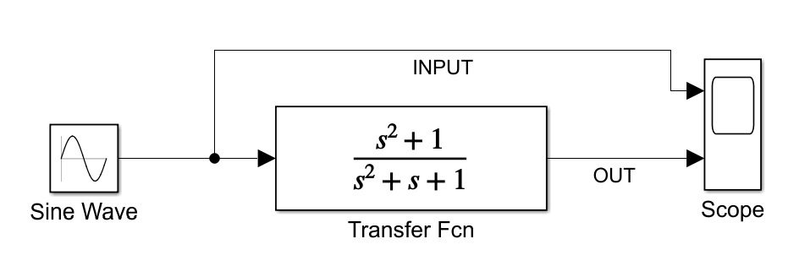
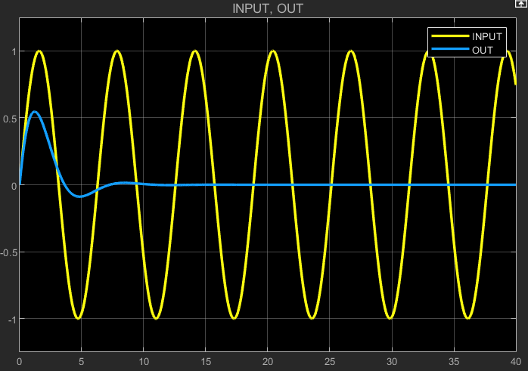
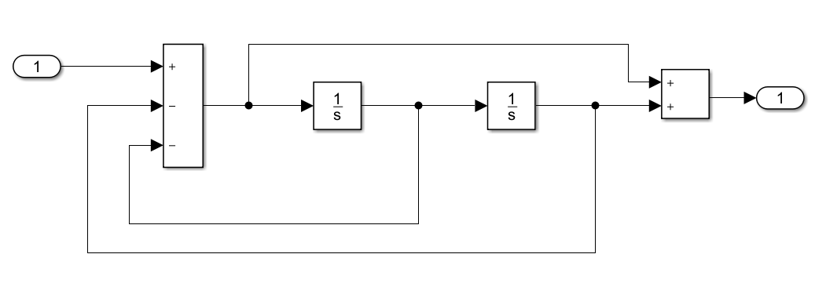
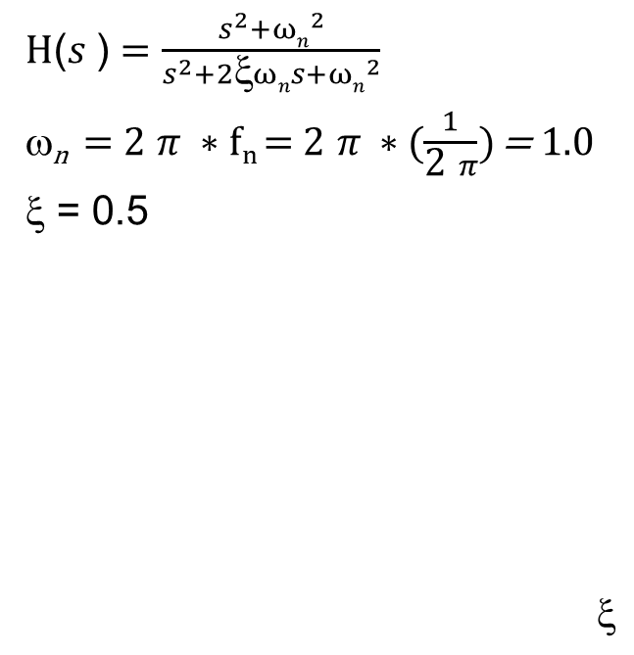
Simulink was analog on day 1, digital came later…
Leverages ODE variable-step solver
H($s$) $=\frac{s^{2}+{ωn}^{2}}{s^{2}+{2ξωns+ωn}^{2}}$
ω_{n} = 2 $π ∗fn \text{= 2} π ∗(\frac{1}{\text{2} π})$ = 1.0
$$ = 0.5
                $$$$
Why does the blue trace (output) go to zero?
Notes:
What does this transfer function represent? Answer = 1 rad/sec Notch Filter
Clue #1: There is a sine wave input and disappearing sine wave-ish on the output.
Clue #2: There is a zero at +/- j1 on the jw axis in the s-plane.
Therefore the frequency of the input sine wave is 1 rad/sec or 1/(2*pi) Hz.
We are looking at the transient response of a 1 rad/sec notch filter in response to a 1 rad/sec sine wave input.
Hint on answer to question in slide: The frequency of the sine wave can be determined by inspection of the transfer function without looking at the time axis on the scope.

Slide 8
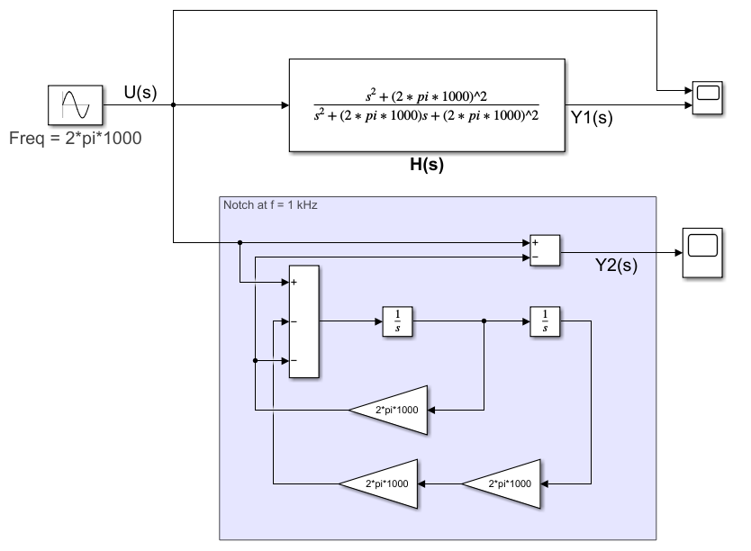
Easily generalized to any notch frequency, e.g. 1000 Hz
Or…Build Out of Primitives
Insert Impairments
Notes:
This is just a slightly more generalized version of the previous 1 rad/sec notch filter.

Slide 9
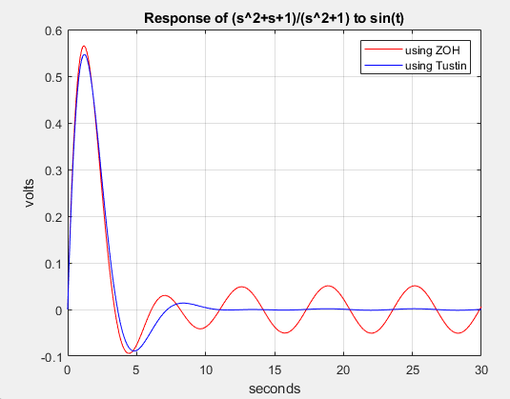
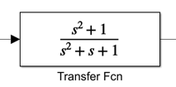
Modeling Alternative #1:
Convert to Discrete-Time and Run in MATLAB
sin(t)
hs = tf([1 0 1],[1 1 1]);
Ts = 0.1;
hzz = c2d(Hs,Ts,’zoh’); % default
hzt = c2d(hs,Ts,’tustin’,1);
tvec = [0:Ts:30];
ydz = lsim(hzz,sin(tvec),tvec);
ydt = lsim(hzt,sin(tvec),tvec);
plot(tvec,ydz,'r',tvec,ydt,'b');
0.9525 z^2 - 1.895 z + 0.9525
hzt(z) = -----------------------------------------
z^2 - 1.895 z + 0.9049
Sample time: 0.1 seconds
Notes:
Using LSIM, it first converts the DUT to discrete-time using c2d and then simulates using the overall system, excitation + system, using either a cascade of lower order sections or state-space to ensure stability.

Slide 10
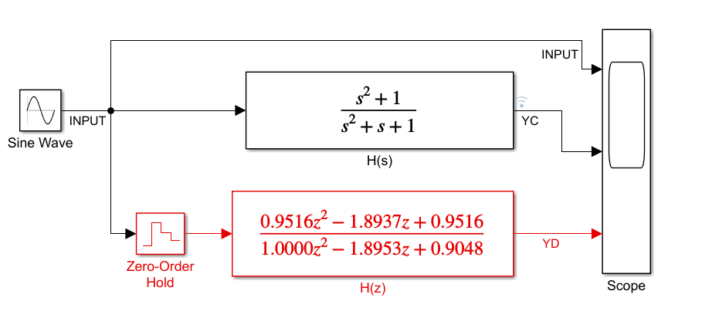
Exercise discretized version in Simulink…
Pick a sample time and convert to discrete-time, s to z transform.
s = tf('s');
hs = (s^2+1)/(s^2+s+1);
hz = c2d(hs,0.1,'matched’)
hz = 0.9516 z^2 - 1.894 z + 0.9516
----------------------------------------
z^2 - 1.895 z + 0.9048
Variable-step ODE solver
vs
Fixed-step discrete-time conversions
The discrete version…
requires greater care/testing
has accuracy issues at higher frequencies
is less intuitive
is harder to integrate into a larger system
is not one and done
Notes:
The discrete-time conversion approaches works well here but…
1. Requires care: You have to think about what sample time works and a conversion method, e.g. matched, zoh, Tustin, etc and then test it.
2. Has accuracy issues: You’ll likely select a sample time which errors on the conservative side, e.g. a little too small. This can slow down the simulation.
The variable-step solver preserves accuracy via error tolerances.
3. Less intuitive: If the actual system is a continuous-time system, it’s easier to think in terms of said s-plane poles and zeros as compared to the z-domain equivalent.
4. Hard to Integrate Into Larger System: What happens if you have 3 systems with 3 different bandwidths mixed with continuous, discrete, and asynchronous behaviors? Now you have to convert each one with its own individual sample time and then carefully integrate these rates when and wherever they cross paths in the system. This also requires careful planning and extra signal processing to handle this rate-stitching.
5. Is NOT one and done. If the DUT changes, you have to go thru the C2D conversion process each time. With native modeling as a continuous-time system, no such re-work is required.
Ultimately, you are either leveraging
(1) variable-step ODE solver technology OR
(2) fixed-step discrete-time conversion technology and then carefully stitching these fixed rates together.

Slide 11
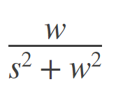
Alternative #2: Leverage variable-step solver technology in MATLAB but…
A non-trivial pursuit
Configure ODE solver
Factor in Laplace transform
of input sine wave:
Recall XferFcn to DiffEQ conversions
Set IC’s carefully
function system_ML()
global Omega
Omega=1;
Tfinal = 10; % simulation stop time
ICs = [1 0 0 0];
[T,Y] = ode45(@sin_system,[0 Tfinal],ICs);
Yout= Omega*Y(:,2) - Y(:,3);
plot(T,Yout);
title(‘Resp of (s^2+1)/(s^2+s+1) to sin(t)’);
function dy = sin_system(t,y)
% Construct DiffEQ including both
% sine excitation and system (s^2 + 1)/(s^2 + s +1)
% and express in SS format.
global Omega
dy = zeros(4,1);
dy(1) = -(Omega^2)*y(2); % state 1 excitation
dy(2) = y(1); % state 2 excitation
dy(3) = Omega*y(2)-y(3)-y(4); % state 3 system
dy(4) = y(3); % state 4 system
Notes:
Is any of the above easy or intuitive?
This only works for very simple systems.

Slide 12
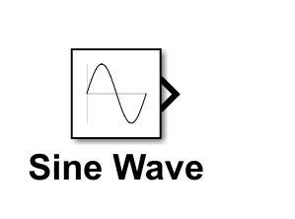

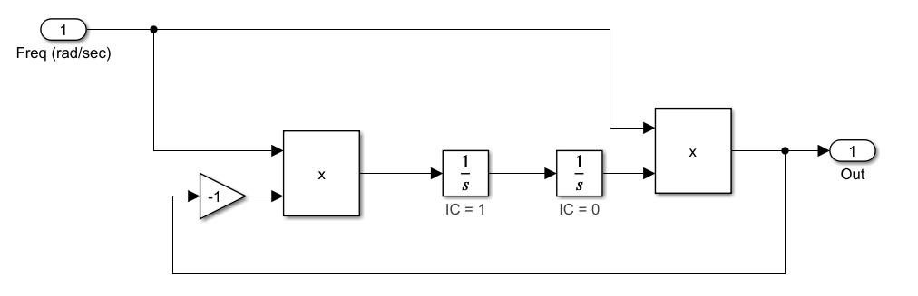
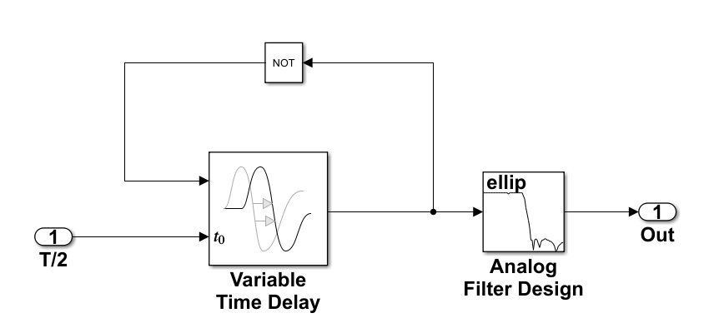
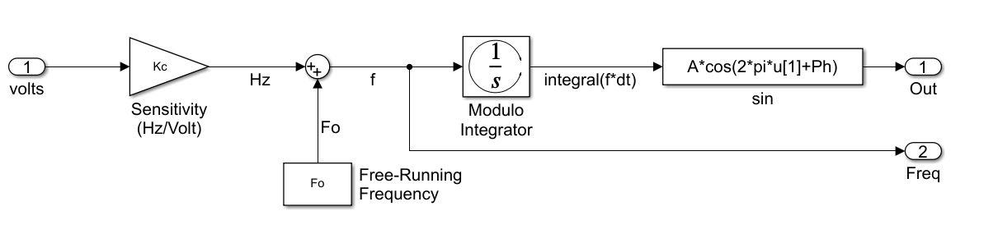
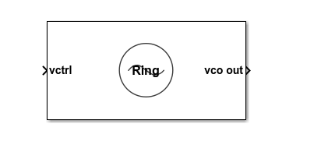
Tunable Behavioral Oscillators
f(t)
Just a few ways to model a tunable sinewave
Ring
Oscillator
Style
H(s) → h(t)
ω / (s^2+ ω^2) → sin(ω*t)
Library Blocks
VCO
Modulo phase accumulator
Notes:
This block diagram is based on the Laplace transform of the desired output, a sine wave, sin(w*t), where w = 2*pi*f.
The key to making this design work is
the initial condition on the integrators which
effectively serves as the only excitation to the
system.
The transfer function of a linear system is
always: TF(s) = (forward_gain)/(1 + loop_gain)
forward_gain = w/s
Loop_gain = w^2/s^2
Therefore, TF(s) = w*s/(s^2+w^2)
The output Y(s) = TF(s)*U(s) where U(s) is the
excitation. If the initial condition is 1 on the first integrator
That corresponds to a U(s) = 1/s.
Therefore…
Y(s) = w*s/(s^2+w^2)* (1/s) = w/(s^2+w^2) which via
Inverse Lapalce Transform corresponds to
y(t) = sin(w*t) in the time domain.

Slide 13
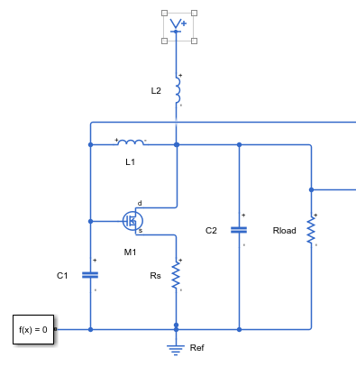
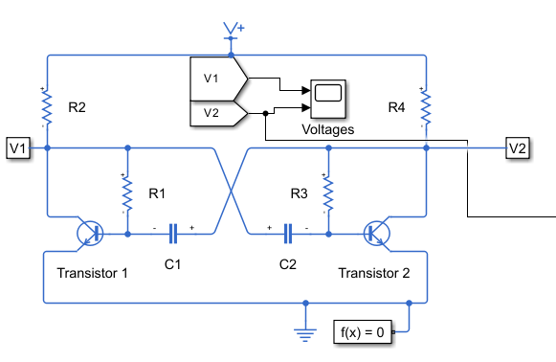
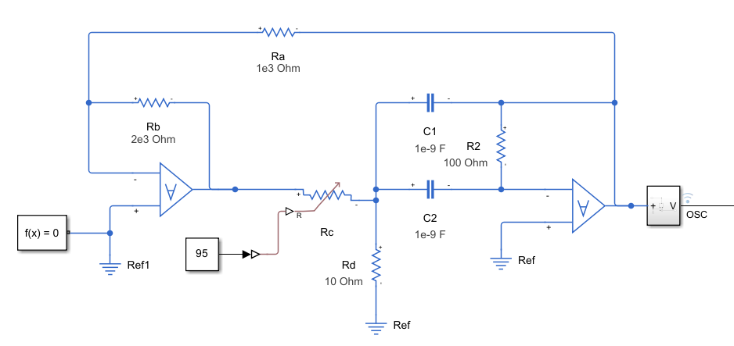
Many Ways to Model an Oscillator
Pierce
Relaxation Oscillator
Pierce Oscillator
Colpitts Oscillator
Friend Circuit Topology
Astable Multivibrator
Complex Differential Oscillator
Behavioral Ring Oscillator/Tank-Tuned
Multi-vibrator
Friend
Notes:
There is no shortage of ways to approach modeling and simulating a mixed-signal design in MATLAB and Simulink.
This slide shows a frequency domain analytical approach to PLL modeling and “simulation”
It’s only a simulation in the sense that you can back out a time-domain response from a Laplacian description.
Here we make use of control system TB to get the overall PLL transfer function. There are many alternative to arrive
At the same result including polynomial convolution in the frequency domain which is essentially what TF is doing here.

Slide 14
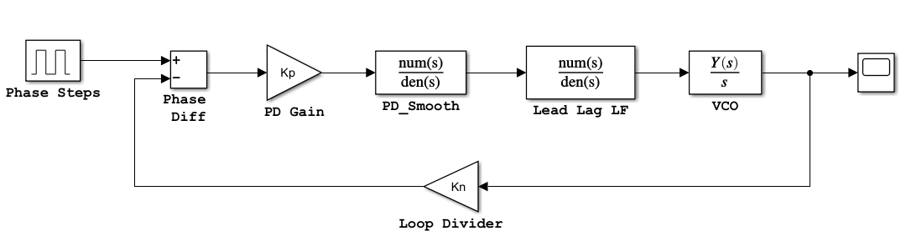
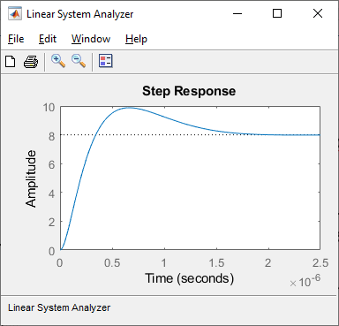
Many Ways to Analyze, Model, and Simulate a PLL
Frequency-domain/LTI analysis
CL_XFER =
22.6 s + 4e7
----------------------------------------------------
3.1e-14 s^3 + 6.2e-7 s^2 + 2.82 s + 5e6
VCO = tf(2*pi*40e6,[1 0]);
R1 = 132; R2 = 120;C = 4.7e-9;
num = [R2*C,1];
den = [R1*C,0];
LF =tf(num,den);
PD = tf(1/(2*pi),[5/100e6 1]);
DIV = tf(.125,1);
CL_XFER = feedback((PD*LF*VCO),DIV);
ltiview(‘step’,CL_XFER);
Notes:
There is no shortage of ways to approach modeling and simulating a mixed-signal design in MATLAB and Simulink.
This slide shows a frequency domain analytical approach to PLL modeling and “simulation”
It’s only a simulation in the sense that you can back out a time-domain response from a Laplacian description.
Here we make use of control system TB to get the overall PLL transfer function. There are many alternative to arrive
At the same result including polynomial convolution in the frequency domain which is essentially what TF is doing here.

Slide 15
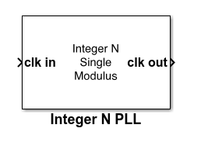
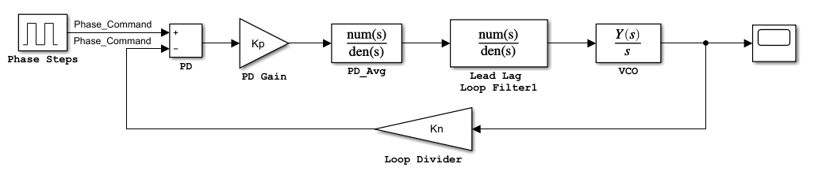
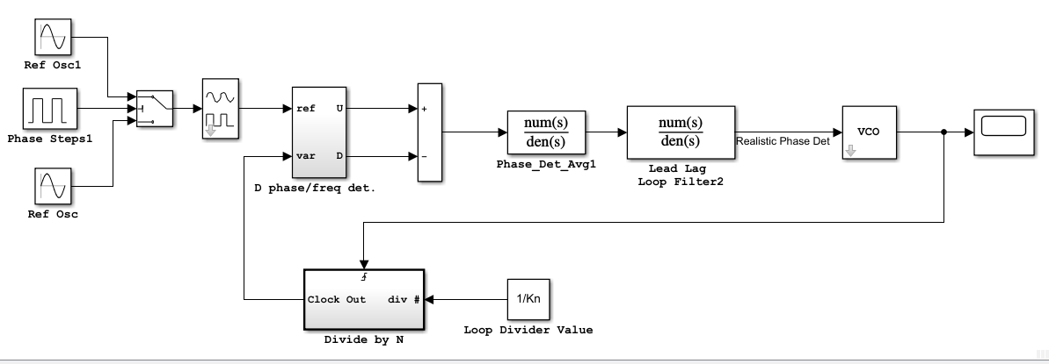
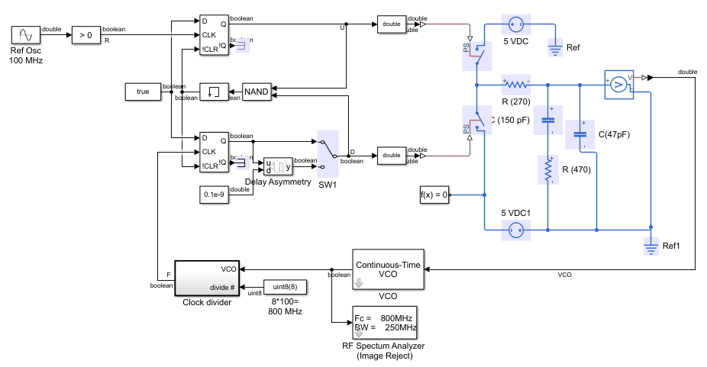
Many Ways Continued…
Library block - editable
Phase domain
Time domain with circuit descriptions
Time domain
Notes:
This slide shows moving the analytical model to Simulink for time-domain simulation. While you can simulate mixed-signal designs in MATLAB as well by discretizing the entire design based on some over-sampling factor, there are advantages in using an mixed-signal simulation environment with time management built-in.
While this phase domain model should yield exact results with the previous Control System analysis, you can do more with a time-domain implementation of a phase-domain model. It’s easy for example to add arbitrary time delays at any node. It’s easy to add non-linearities. And it’s easy to integrate within a larger system-level model where this PLL is just one component.
Not shown here but you could also write MATLAB code to simulate the PLL in the time or phase domains but this can get tedious and/or inefficient when it comes to describing more complex analog mixed-signal behaviors.

Slide 16
Simulink as a Platform: A Visual Tour

Slide 17
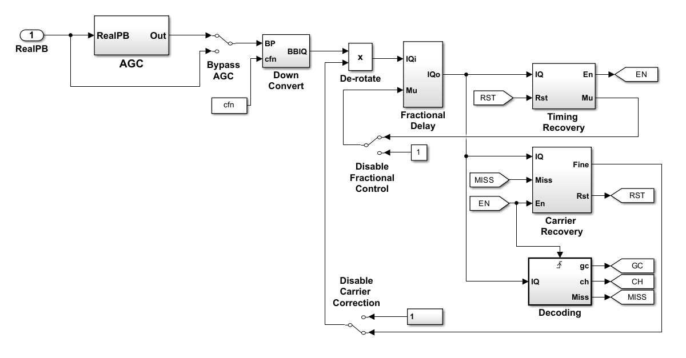
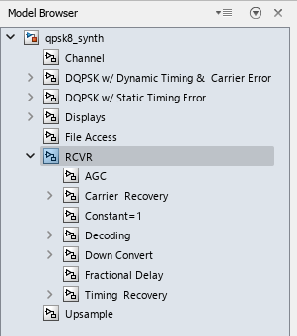
Can You Draw Me a Picture?
Concurrence
By Construction
2 inputs/2 outputs
DQPSK Receiver
You can quickly ascertain
Design scope
Feedback points
Concurrent & Sequential
Interfaces & Relationships
Asynchronous Behaviors
And much more…
Notes:
By visual inspection you can quickly ascertain…a bunch of stuff as listed.
This slide is mostly about the connectivity of the model, relationships between the various parts.
With the model browser you can quickly get a feel for the scope of the design, what are the major section of the design and how deep they are.
Are there 2 or 3 levels of hierarchy or 20 or 30? It’s hard to do this in pure text, even with a smart editor.
You can quickly see where feedback occurs in the design, e.g. from mu out on the timing recovery block to the mu in on the fractional delay block.
And from the Fine output on the carrier recovery block back to the input of the de-rotation multiplier.
Ascertaining feedback in text/code is a pain. You have to trace variable names and/or parameter lists and that’s tedious, error prone.
It’s easy to distinguish between sequential behavior and concurrent behavior (serial vs parallel) at a glance.
Trying to extract parallelism in text is not easy. Everything sort of looks sequential in text. This line executes and then this line executes.
You can see triggered and enabled behaviors via triggered and enabled symbols. Here’s a level triggered event on EN but you could also have
Both neg and pos edge triggered events.
Hard to zoom out like this and see relationships with text code.
You have to create a block diagram anyway for documentation purposes. Why shouldn’t that documentation:
1. be in sync with the actual simulation model?
2. be the same as the actual simulation model?
Feedback is very hard to discern and debug in textual languages. It’s easy when described graphically.
The designed can be partitioned easily in a graphical environment making hot swaps of one implementation for a second easier.

Slide 18
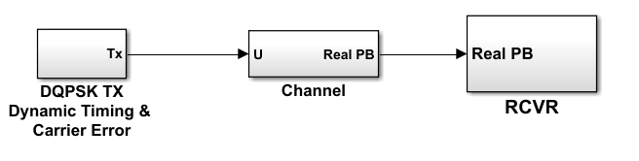
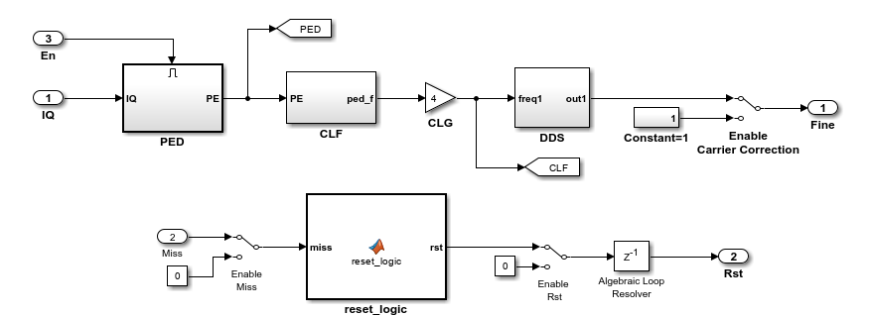
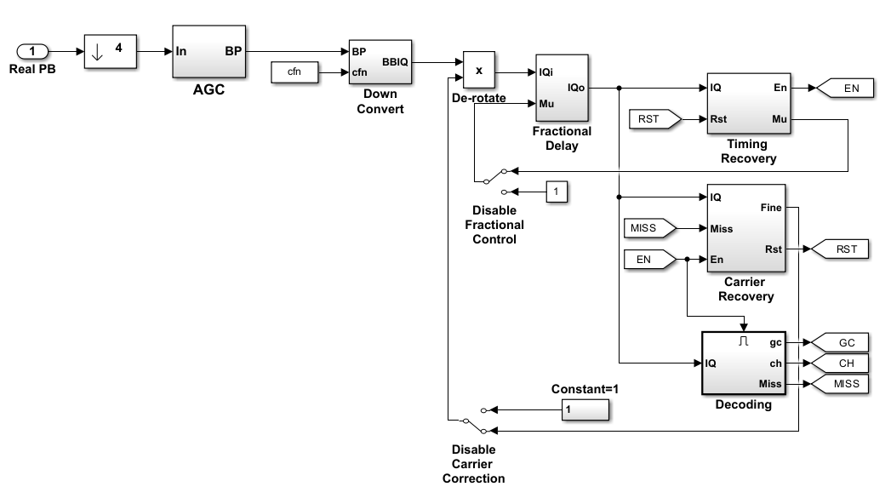
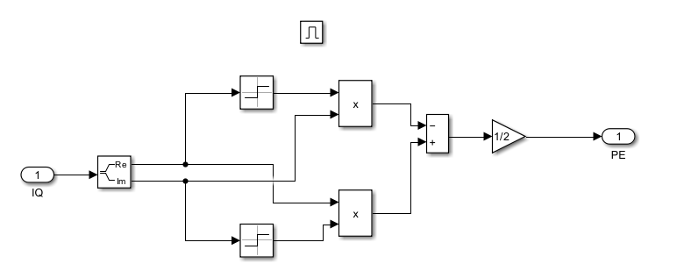
Navigate Design Hierarchy Intuitively

Slide 19
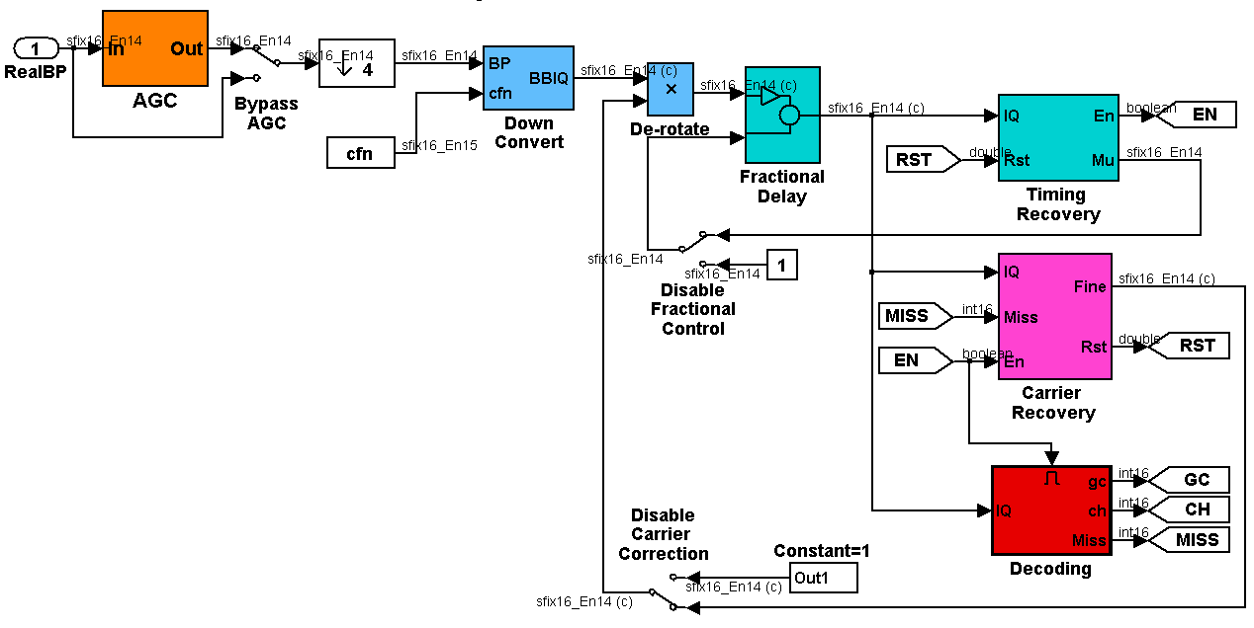
Visualize Data Type Propagation
sfix16_En14
double
boolean
int16

Slide 20
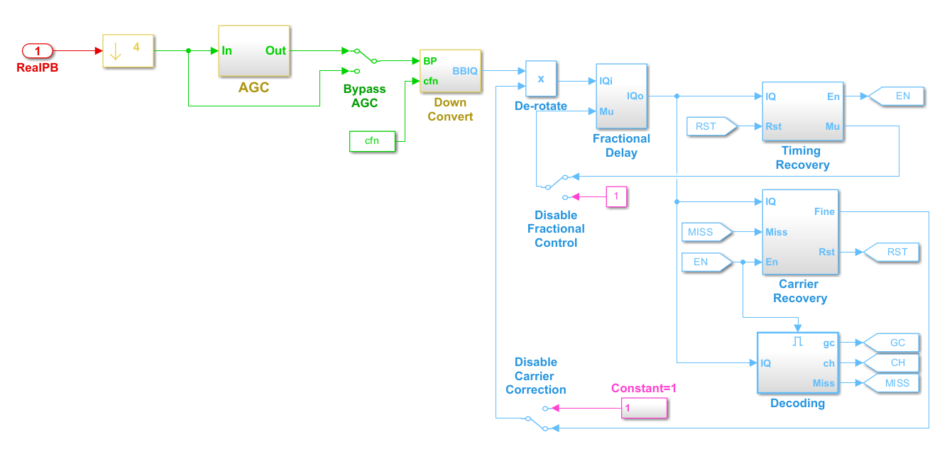
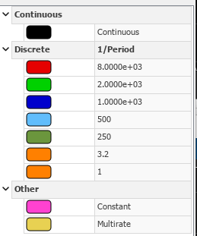
Visualize Sample Rates
Different colors on signal lines denote different sample rates
Timing Legend
Notes:
You could have a black rate in this model. That means continuous-time.
You could also have a grey rate meaning continuous-time but triggered (asynchronous).

Slide 21
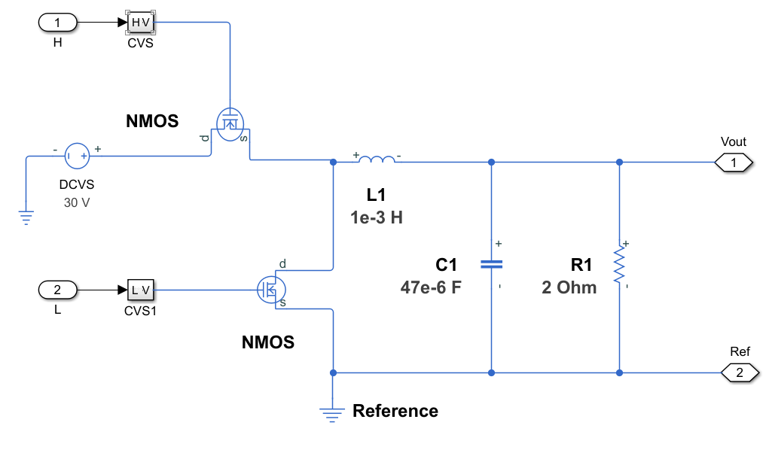
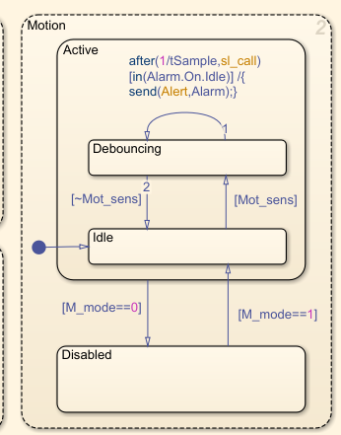
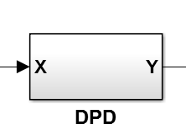
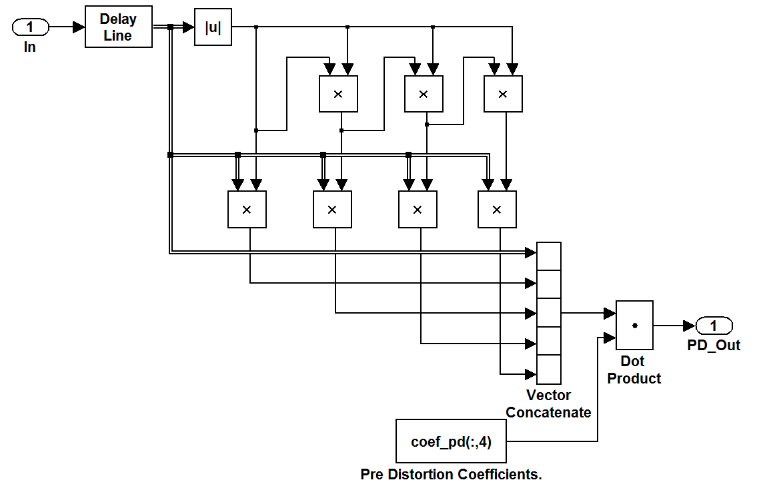
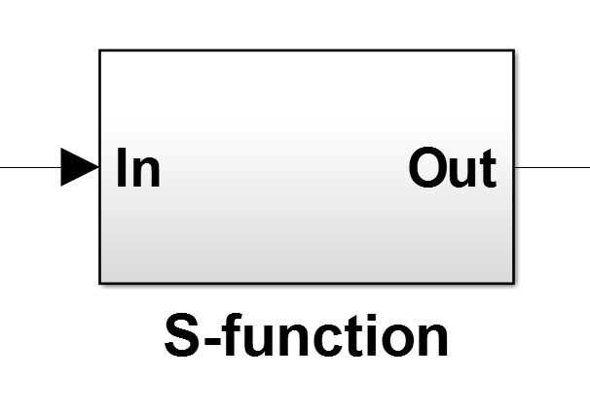
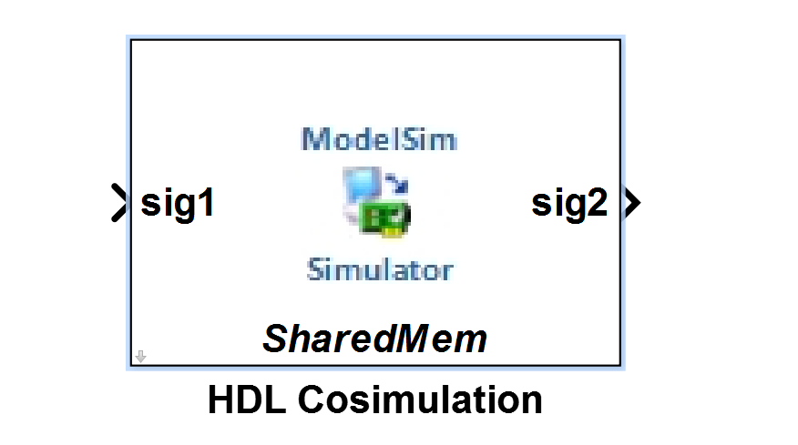
Subsystems Take on Many Forms
circuit
Statechart
DUT
MATLAB Code
function y = evalMP_func(x, coef, degree, memorylen) %#codegen
persistent pipe
if isempty(pipe)
pipe = complex(zeros(memorylen, 1));
end
pipe(1:end-1) = pipe(2:end);
pipe(end) = x;
X = complex(zeros(1,degree*memorylen));
for deg = 1:degree
X(1,(deg-1)*memorylen+(1:memorylen)) = (pipe.*(abs(pipe).^(deg-1))).';
end
y = X*coef;
more primitive
blocks
Verilog
C
code
Notes:
Not shown here are statecharts…yet another option

Slide 22
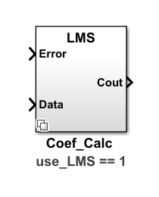
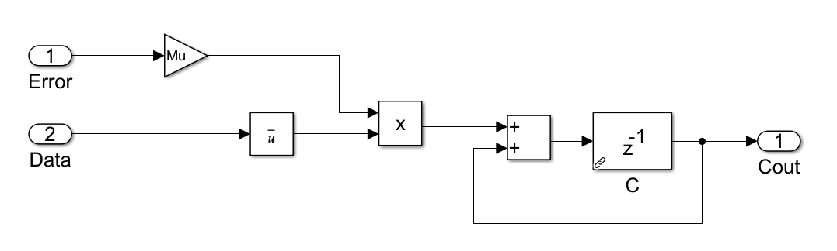
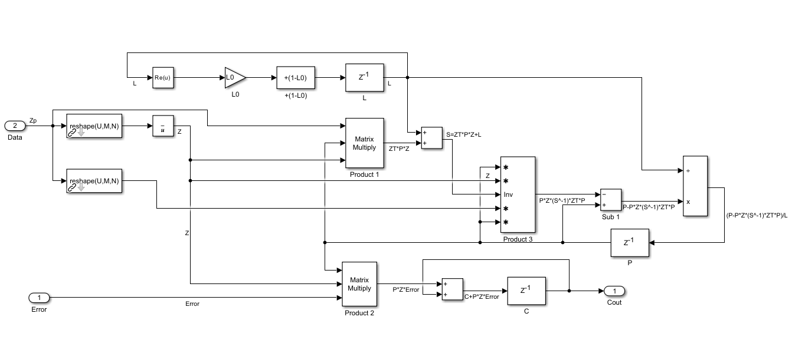

Variant Subsystems: One block, multiple personalities
LMS-based
Right-click to select
subsystem variant
RLS-based

Slide 23




Variant Subsystems: Fidelity-Level Change
Right-click to select
subsystem variant
Variant #1
Variant #2
Notes:
Instead of feeding back a the 1 bit error signal as in the conventional sigma-delta ADC, it feeds the error forward to the next modulator.
The first mod converts the analog signal and subsequent mods convert the quantization noise, Qn. The quantization errors of all but the last
Mod are digitally cancelled yielding a noise-shaping function of order equal to the number of mods.
Advantages: guaranteed stability, limited signal swing at output of integrator, pipelining of the SC integrators.
Disadvantages: S/N is more sensitive to analog component accuracy. Specifically the xfer function of the SC integrator must be close to ideal,
1/(1-z^-1).

Slide 24



The model is also a GUI
Throw switches
Change gains
Notes:
The model is not just an executable but also something you can tweak both before and while running.
Structural (switches) and computational elements of your model can be automatic GUI elements.
You can tweak gains and throw switches while the model is running to see the effect.

Slide 25


Can Model Multi-rate and/or Asynchronous Behaviors
fastest
slowest
Generates data with
arbitrary timing

Slide 26



Modeling State-Machines: 3 options
Hardware Style
Application: clock throttling
logic for CPU
generally preferred…
Software Style
write MATLAB code using if-then or
switch-case constructs
Statechart Style
Notes:
Using Explicit Gates, Flops, Counters, Comparators

Slide 27


Example: Hysterisis modeling
Stateflow
function state = hysterisis(u)
persistent x;
if isempty(x)
x = 0;
end
if (x == 0)
if (u > 5)
x = 1;
end
else
if (u < -5)
x = 0;
end
end
state = x;
Built-in state tracer and animation
MATLAB code
Logic operators
Notes:
Keep in mind this state chart interfaces easily with the rest of your Simulink model. Stateflow is not an island or walled garden tool.
It also can generate C or Verilog as well.
This is a simple example but it illustrates the value of Stateflow. Statecharts are the natural way to describe finite state machines and flow-charts.
The alternative approaches are not as intuitive.
Formerly, the statechart approach would have been something people only did for documentation. But with stateflow, the documentation is the executable. The executable is the documentation.
You can still add comments and annotate the stateflow model as well.
Yes, the value of Stateflow only becomes more evident, not less, as the complexity of the state-machine grows.
Then there is animation and state-tracing, all built-in with Stateflow. These are things either not available or you’d have to go to great lengths to program in with other approaches.

Slide 28





Delays Are Easier
A 4 Tap Oversampled FIR Filter
Fixed delay use-case
Variable delay options
Continuous-time
Discrete-time
Notes:
The z to the -10 block is a fixed delay operation. The input u(n) maps to the output y(n) = u(n-10). That shift value never changes over the course of the simulation.
There are also variable delay operators as well.
I’m going to make the bold assertion that even working with simple delays elements is much easier in Simulink.
They work like a textbook example without the need to work with circular buffers, pseudo-pointers, and modulo operators.

Slide 29

Same Thing in MATLAB Code
function y = fir_oversampled(u, OSR)
%% Initialize state memory for 4 states at 128 samples per bit max
persistent buff;
persistent firptr;
persistent coef;
if isempty(buff)
buff = zeros(4*128,1);
firptr = 1;
coef = [.2 .3 .3 .2];
end
y = u;
%% Loop through input to update state buffer and compute output
for idx = 1:numel(u)
buff(firptr) = u(idx);
y(idx) = coef*buff(mod(firptr-[0:3]*OSR-1,OSR*4)+1);
firptr = mod(mod(firptr-1,OSR*4)+1,OSR*4)+1;
end
easier to understand version
firptr = firptr + 1;
if (firptr > OSR*4)
firptr = 1;
end
Notes:
Yes, this is actual customer MATLAB code…shown with permission.

Slide 30



Mixed-Signal Blockset
Design and Simulate Analog and Mixed-Signal Systems
Plus…
MATLAB app for
post-processing
Virtuoso data
Time-domain simulation of continuous and discrete time systems
Simulink Libraries for PLL and ADC design
  Architecture white-box models for top-down design
  Building blocks including impairments
  Measurement blocks and testbenches for verification
Open and closed-loop linear analysis
Measurement testbenches
Phase noise analysis
Building blocks including impairments
White-box architectural models
Notes:
A new product for a long standing Mathworks market, mixed-signal

Slide 31





Mixed-Signal Blockset: Architectural Models
Model PLL and ADCs using architectural models
Integer-N PLLs
Fractional-N PLLs
Flash, SAR ADCs
Delta-Sigma Modulators
Strong emphasis
On Visibility

Slide 32




Mixed-Signal Blockset: Architectural Models
Model AMS behavior and impairments using your specs
Perform open and closed-loop PLL analysis
analyze
simulate
configure

Slide 33


Block Category #1: DUT Blocks
Device-Under-Test blocks including impairments
  Finite rise and fall time
  Leakage, imbalance
  Phase noise

Slide 34

Category #2: Measurements and Testbenches
Validate the performance of your ADC and PLL
ADC DC measurements INL, DNL, …
ADC AC measurements SINAD, SNR, ENOB, Noise, …
Aperture jitter
PLL lock time and frequency
PLL phase noise profile
Eye Measurements
  Height, width, area
  Contours, Bathtubs
  COM, VEC
Jitter Measurements
  RJ, DJ, SJ, DCD, TIE

Slide 35
Jitter Generation and Measurement
Generation
Measurement
stimulus1 = serdes.Stimulus(...
'SampleInterval',dt,...
'SymbolTime',SymbolTime,...
'Specification','Random Symbols',...
'DCD',InjectedDCD,...
'Dj',InjectedDj,...
'Rj',InjectedRj,...
'Sj',InjectedSj,...
'SjFrequency',InjectedSjFrequency,...
'MapToVoltage',symbolVoltages,...
'JitterSeed',123,...
'PAMnSeed',1431655765,...
'OutputJitter',1,...
'Modulation',Modulation);
for k = 1:nSamples
[yj(k)jval(k)] = step(stimulus1);
end
If input consists of time steps and voltages
J = jitter(t,y,"SymbolTime",1/symbol_rate)
J = TJrms: 28.1808e-012
TJpkpk: 200.1527e-012
RJrms: 24.7945e-012
DJrms: 0.0000e+000
DJpkpk: 0.0000e+000
DDJrms: 0.0000e+000
DDJpkpk: 311.9148e-015
SJa: 1.1732e-012
SJf: 536.3770e+006
SJp: -1.1158e+000
DCDrms: 85.5861e-015
DCDpkpk: 171.1700e-015
ISIrms: 25.5831e-015
ISIpkpk: 140.7448e-015
pn= phaseNoiseMeasure(fvec,power_spectrum,rbw,FreqOffsets,'on','Phase noise', PNTarget)
[fvec,pn] = msblks.utilities.phaseNoiseTimeDomain(zct, RBW, FreqOffsets);
[Jrms_rad,Jrms_deg,Jrms_s] = phaseNoiseToJitter(fvec,pn,'Frequency',2.1e9)

Slide 36

eyeDiagramSI
eyeDiagram = eyeDiagramSI;
eyeDiagram.SymbolTime = SymbolTime;
eyeDiagram.SampleInterval = SymbolTime / OSR;
eyeDiagram.Modulation = 2;
eyeDiagram(y);
figure;plot(eyeDiagram);
ax = gca; ax.ColorScale = ‘log’;
EyeDiagramSI Methods
bathtub | eyeLinearity
com | eyeWidth
eyeAmplitude | Falltime
eyeArea | Risetime
eyeCrossingSI | plot
eyeHeight | vec
eyeLevels | slice

Slide 37


ADC Blocks and Examples

Slide 38



Cyclic ADC using switched-cap multiplying DAC
Cyclic ADC Testbench
ADC Cell
Switched Capacitor Sample/Hold/Amplify (Multiplying DAC)

Slide 39
SAR ADC built from charged-scaled DAC

Slide 40


12 bit SAR ADC with Circuit-Level DAC
Sample & Hold
SAR FSM
Circuit-Level
DAC
Compares Ideal vs Circuit-Level DAC
Implements SAR logic using state-chart
Two rates: Sample and Bit Rate
Ideal
DAC

Slide 41


Code Search State-Machine in Stateflow format

Slide 42


12 bit 4 Stage Split Array Charge-Scaling 2’s Complement DAC
http://inst.eecs.berkeley.edu/~ee247/fa06/lectures/L15_f06.pdf, page 38

Slide 43




Inside Each Array Element
Set capacitance and impairments at mask level
Switches with On resistance
Open conductance

Slide 44

3rd Order Sigma-Delta ADC: behavioral vs circuit-level
Variant #1
Variant #2
Uses No Feedback between Mods
Compares Behavioral vs Circuit-Level Modulators
Simulates Gain/Pole Error in Integrators
Simulates Imperfect 1-bit Quantizer
Uses Multi-stage, Multi-rate Decimation Filtering
Compares Fixed Point vs Floating Point
M. Rebeschini, N. van Bavel, P. Rakers, R. Greene, J. Caldwell, J. Haug, "A high-resolution CMOS sigma-delta A/D converter with 320 kHz output rate",
IEEE International Symposium on Circuits and Systems, 1989, pages 246-249.
Notes:
Instead of feeding back a the 1 bit error signal as in the conventional sigma-delta ADC, it feeds the error forward to the next modulator.
The first mod converts the analog signal and subsequent mods convert the quantization noise, Qn. The quantization errors of all but the last
Mod are digitally cancelled yielding a noise-shaping function of order equal to the number of mods.
Advantages: guaranteed stability, limited signal swing at output of integrator, pipelining of the SC integrators.
Disadvantages: S/N is more sensitive to analog component accuracy. Specifically the xfer function of the SC integrator must be close to ideal,
1/(1-z^-1).

Slide 45

Many Ways to Model a PLL
Phase domain
Time domain with circuit descriptions
Time domain
Notes:
This slide shows moving the analytical model to Simulink for time-domain simulation. While you can simulate mixed-signal designs in MATLAB as well by discretizing the entire design based on some over-sampling factor, there are advantages in using an mixed-signal simulation environment with time management built-in.
While this phase domain model should yield exact results with the previous Control System analysis, you can do more with a time-domain implementation of a phase-domain model. It’s easy for example to add arbitrary time delays at any node. It’s easy to add non-linearities. And it’s easy to integrate within a larger system-level model where this PLL is just one component.
Not shown here but you could also write MATLAB code to simulate the PLL in the time or phase domains but this can get tedious and/or inefficient when it comes to describing more complex analog mixed-signal behaviors.

Slide 46




PLL Blocks and Examples

Slide 47
Fractional-N PLL

Slide 48



10 MHz to 101 MHz Fractional-N PLL: 10.1x
Close-in phase noise
More apparent

Slide 49


Comparing Different Orders of Sigma-Delta Modulation
2nd order sigma-delta structure
2nd order sigma-delta is better than 1st but…
surprisingly, 4th order is NOT better than 2nd

Slide 50
Frequency Multiplying
Delay-Locked Loop

Slide 51

Frequency Multiplying Delay-Locked Loop
Frequency multiply 100 kHz to 1 MHz, 10x
Replaces VCO with Variable-Time Delay Element
Equalizes spacing of 10 out-clocks over 1 in-clock when SEL = 1
If var leads ref → U-D < 0 → delay increased → var phz decreased
A Low-Power Multiplying DLL for Low-Jitter Multigigahertz Clock Generation in Highly Integrated Digital Chips
IEEE JOURNAL OF SOLID-STATE CIRCUITS, VOL. 37, NO. 12, DECEMBER 2002
Notes:
U pulses mean go UP in frequency or phase
D pulses mean go DOWN in frequency or phase

Slide 52

Normal DLL Adaption, from ~0 delay to target delay = 0.5e-6 sec
DLL only adapts when SEL = 1 and betweens +edge gated by CLK_IN and CLK_OUT
The 10 clk_out pulses per 1 CLK_IN cycle dilate to distribute
themselves equally over the CLK_IN period. The delay adapts (increases)
during the time when SEL = 1. The delay is frozen when SEL = 0.
Note that effectively only D (down) pulses in blue are occurring in this case.
Notes:
This DLL as currently designed only moves from a high frequency to a low frequency. It has problems going in the other direction as noted on subsequent slide.

Slide 53

Digital PLL Example
https://www.mathworks.com/help/msblks/ug/digital-phase-locked-loop.html

Slide 54
Switched-Mode Power Supply Modeling

Slide 55



Model a Buck Converter using Simulink and Simscape Electrical

Slide 56

For Automation: Programmatically Control Simulink
Open Model
Configure Model
Run Model
Log Results
Post Process
Analyze
Plot
Generate Reports
Parameter Sweep Can Be Dynamic
Interleave Simulation and Analysis To
Perform Intelligent Sweeps or Calibrations
https://www.mathworks.com/help/releases/R2020b/simulink/programmatic-modeling.html
Notes:
Here I broke the analysis out as a separate step after all of the simulations were complete.
But it’s just as easy incorporate analysis into the simulation loop to intelligently narrow down your solution space to save precious simulation time.

Slide 57

Link to Mixed-Signal System Design playlist
And on YouTube…
https://www.youtube.com/playlist?list=PLn8PRpmsu08rTyRA_aTqQOgY_Vyp81ydw

Slide 58
Cadence-Mathworks Integration

Slide 59
MathWorks-Cadence Integration
Analog: between Simulink and AMS Designer
Co-simulation
Code-generation
Data post-processing
Debugging
Validation of behavioral models
Digital: between MATLAB/Simulink and Xcelium
Synthesizable: VHDL, Verilog, or SystemVerilog
IC Implementation
Testbench generation
Behavioral: real-number SystemVerilog (uses DPI-C)
File: import data files in MATLAB for post-processing
Result analysis (statistical)
Model fitting
ADE Explorer & Assembler: Invoke MATLAB functions

Slide 60


The Mixed-Signal Analyzer App/API
App and API for analyzing Virtuoso ADE simulation data
Extends Virtuoso ADE-MATLAB Integration option (ID95252)
Provides flexible trend chart
and report generation
Use MATLAB as calculator
Allows round-trip automation
Runs on Linux or Windows
Maestro
MATLAB
Notes:
It’s a bi-directional connection or interface between MATLAB and Cadence.
Data flows from Cadence to MATLAB and MATLAB to Cadence
Control signals from MATLAB to Cadence

Slide 61






Virtuoso ADE - MATLAB Integration Option (ID95252)
Notes:
What lies beneath…the foundation of MSA
Requires having a live-connection to ADE, thus, cannot use Windows.
Requires programming/relational database/structured query skills
You write code in MATLAB but it’s not your grandfather’s MATLAB…
Does not allow saving of the entire simulation data set to a file(s). You download/query/plot one variable at a time.
The Virtuoso ADE MATLAB Integration option communicates with a relational database as that’s how the Cadence simulation data is stored. You’ll see references to adeRDB in many places when using the API. Thus the MATLAB code utilizes structured queries to access said data. If you’re already familiar with database query languages, then this will be relatively easy to pick up. If you’re not, then this “MATLAB code” is going to look a foreign at first. In any case, this is one of the reasons the Mixed-Signal Analyzer app exists, namely, to make it easier to get started bringing in the data to MATLAB and visualizing it. Underneath the app however, we are using this API.

Slide 62



Point-n-click access to Cadence data
>> adeInfo
Select Waveforms, Metrics
Plot Area
Customize Trend Chart

Slide 63


Programmatic Access via MATLAB Script
>> adeInfo;
DR = adeDataReader; % adeDataReader(‘interactive_1.mat’);
fig=trendChart(DR,Xaxis=DR.TrendChartFields(4),…
Yaxis=DR.TrendChartFields{8},…
Legend=DR.TrendChartFields{3})
Notes:
You can either point and click your way to a trendChart or you can script your way there. Both ways have reason to exist.
Here I’m focusing on trendCharts but we also have many other types of analysis we could perform be in spectral analysis, eyeDiagram or jitter analysis, audio analysis, machine/deep learning, etc.
While this slide focues on metrics, the same thing applies to post-processing waveform data as well.

Slide 64



MATLAB to Control Cadence® Virtuoso Design and Simulation
one time
adeInfo
adeGet
Met Spec
Or MaxSim?
Yes
Set solution,
Back annotate
No
surrogateopt, adeSet, adeSim
Parameters
Metrics
Load Reg < 40e-3
Max Voltage Error < 300e-3
Phase Margin > 60
An intelligently guided parameter sweep…
…
…
Notes:
This block diagram is functionally what we do but not literally when it comes to the code.
Think of it as an intelligently guided parameter sweep as opposed to a brute-force one.

Slide 65


Cadence Integration
Analog: between Simulink and AMS Designer
Co-simulation
Code-generation
Post-processing
Debugging
Validation of behavioral models
Digital: between MATLAB/Simulink and Incisive
Synthesizable: VHDL or Verilog
IC Implementation
Testbench generation
Behavioral: real-number SystemVerilog (uses DPI-C)
File: import data files in MATLAB for post-processing
Result analysis (statistical)
Model fitting
ADE Explorer & Assembler: Invoke MATLAB functions

Slide 66



SystemVerilog DPI-C Component Generation
Make the Simulink model / MATLAB code compliant with C code generation
Generate C code
Automatically wrap the C code using the DPI-C interface
Import, build and simulate SV model in your IC design tool
1. Simulate
3. SystemVerilog wrapper
4. IC Design Tool
2. C Code

Slide 67
Agenda
Mixed-Signal and Serdes Design using MATLAB and Simulink Mixed-signal engineers use MATLAB and in particular Simulink for behavioral modeling of mixed-signal systems such as PLLs, ADCs, high-speed serial communications, and power conversion. Behavioral simulations allow one to explore a broader design space before committing to detailed transistor-level simulations. Mixing analog and digital behaviors is natural in Simulink as it was designed for this purpose. Further, Simulink is well integrated with MATLAB for automation and post-processing. During this session we will introduce Simulink as a simulation framework and then begin walking through a number of live examples. Data Converter Modeling – Model jitter, non-linearities, timing mismatches, fixed-point effects, and pole/zero mismatches for various architectures such as Interleaved, SAR, Cyclic, and Sigma-Delta Converters PLL Modeling – Investigate effect of imperfect phase detectors, charge pumps, jitter, and phase noise for various architectures such as Integer N, Fractional N, Delay-Locked Loops, and Digital PLLs Cadence-to-MATLAB Integration – Streamline the post-processing of your Virtuoso based simulations Import, analyze, visualize Cadence Virtuoso data in MATLAB Create custom trend charts of your metrics Automate analysis and report generation Optimize design parameters in Cadence SerDes Toolbox overview with IBIS-AMI model creation Design and verify SerDes systems or high-speed memory Simulate in both statistical and time domain Explore equalization configurations (CTLE, DFE, etc.) to improve performance Assess metrics such as eye height, eye width, eye diagrams and impulse responses Generate dual IBIS-AMI models for statistical and time domain analysis

Slide 68
Agenda
Mixed-Signal Design withMATLAB and Simulink Mixed-signal engineers use MATLAB and in particular Simulink for behavioral modeling of mixed-signal systems such as PLLs, ADCs, high-speed serial communications, and power conversion. Behavioral simulations allow one to explore a broader design space before committing to detailed transistor-level simulations. Mixing analog and digital behaviors is natural in Simulink as it was designed for this purpose. Further, Simulink is well integrated with MATLAB for automation and post-processing. During this session we will introduce Simulink as a simulation framework and then begin walking through a number of live examples. Data Converter Modeling – Model jitter, non-linearities, timing mismatches, fixed-point effects, and pole/zero mismatches for various architectures such as Interleaved, SAR, Cyclic, and Sigma-Delta Converters PLL Modeling – Investigate effect of imperfect phase detectors, charge pumps, jitter, and phase noise for various architectures such as Integer N, Fractional N, Delay-Locked Loops, and Digital PLLs Cadence-to-MATLAB Integration – Streamline the post-processing of your Virtuoso based simulations Import, analyze, visualize Cadence Virtuoso data in MATLAB Create custom trend charts of your metrics Automate analysis and report generation Optimize design parameters in Cadence

Slide 69
Accelerating Mixed-Signal Design with Simulink and Cadence Integration
Join us for this 90 minute session on behavioral modeling of mixed-signal systems. Behavioral models allow simulation speed vs fidelity tradeoffs not possible with SPICE. This allow faster and more complete design space exploration at the system-level. Mixing continuous-time, discrete-time, asynchronous, and multi-rate behaviors is natural in Simulink as it was designed for this purpose. In addition to modeling and simulation, we’ll show how to quickly bring Cadence waveforms and metrics into MATLAB for post-processing further streamlining analog mixed-signal workflows. Attending this session, you’ll come away with a much better grasp of where Mathworks tools fit in mixed-signal design and how they can help you.
Simulink as a Platform for Mixed-Signal
Reinforcement via examples such as PLLs, data converters, and power conversion.
Cadence to MATLAB streamlined
  Import, analyze, visualize Cadence Virtuoso data in MATLAB
  Create custom trend charts of your metrics
  Automate analysis and report generation
  Optimize design parameters in Cadence

