Slide 1
Mathworks-Cadence Integration for Mixed-Signal
Kerry Schutz
Application Engineer

Slide 2


Cadence Integration
Analog: between Simulink and AMS Designer
Co-simulation
Code-generation
Post-processing
Debugging
Validation of behavioral models
Digital: between MATLAB/Simulink and Incisive
Synthesizable: VHDL or Verilog
IC Implementation
Testbench generation
Behavioral: real-number SystemVerilog (uses DPI-C)
File: import data files in MATLAB for post-processing
Result analysis (statistical)
Model fitting
ADE Explorer & Assembler: Invoke MATLAB functions

Slide 3
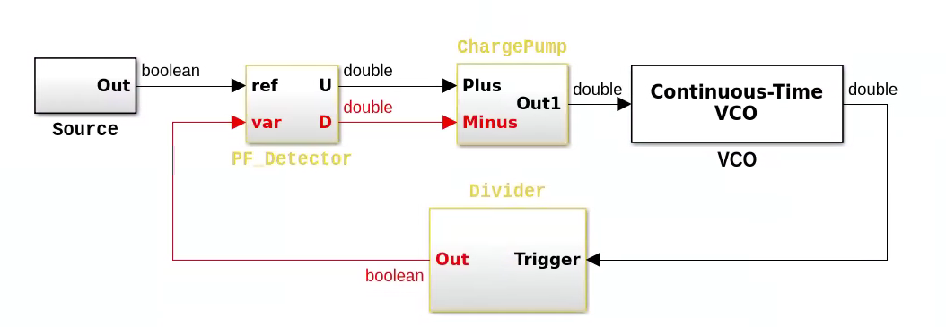
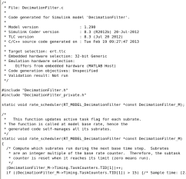
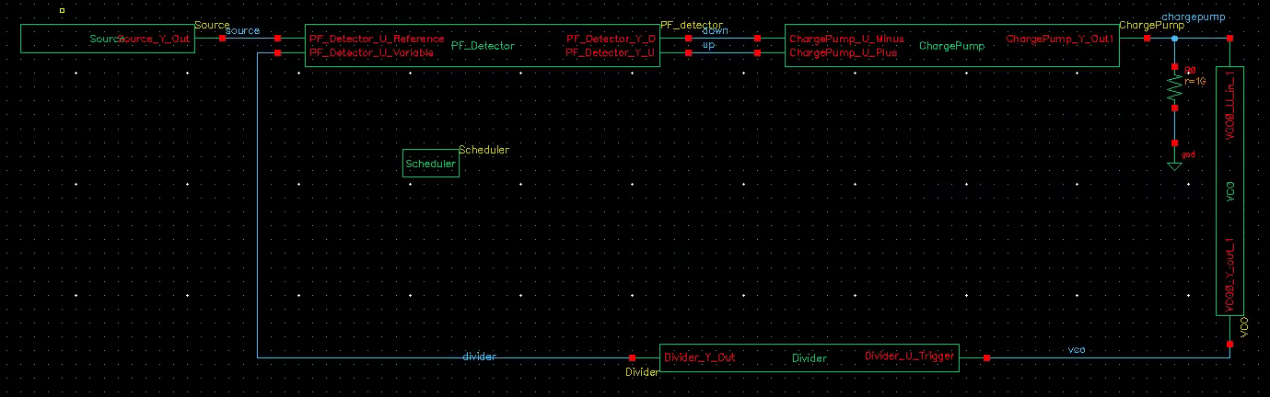
SystemVerilog DPI-C Component Generation
Make the Simulink model / MATLAB code compliant with C code generation
Generate C code
Automatically wrap the C code using the DPI-C interface
Import, build and simulate SV model in your IC design tool
1. Simulate
3. SystemVerilog wrapper
4. IC Design Tool
2. C Code

Slide 4
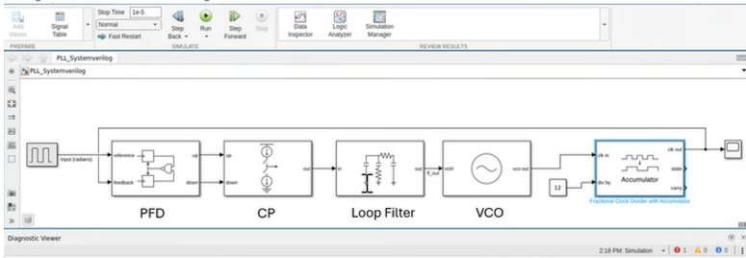
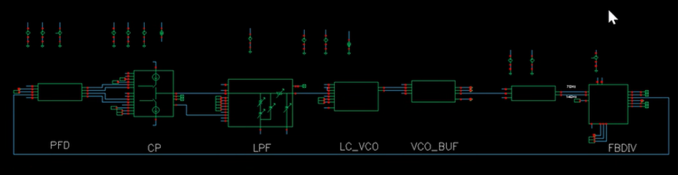
Why Generate SV-DPIC?

Slide 5
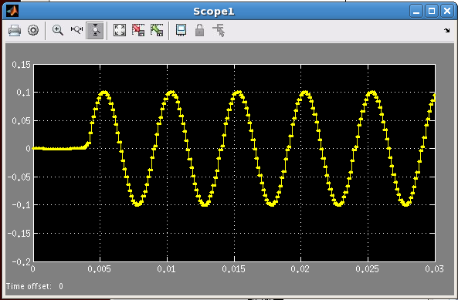
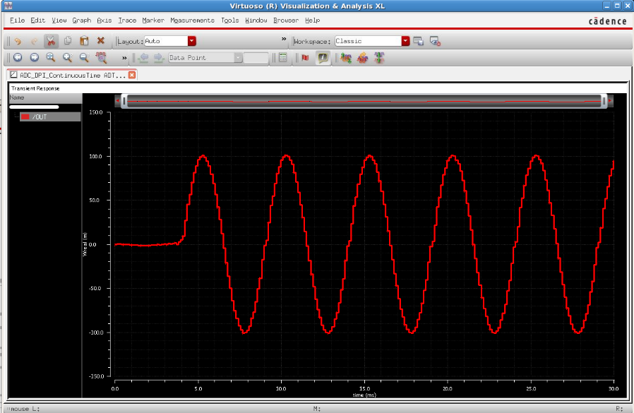
Benefits of C Code Generation and DPI-C Export
Fast simulation using the native SystemVerilog API
IC design tool independent
Leverages mature C code generation technology to provide real-number models
Most suitable for testbench generation and IC verification (regression tests)
Support discrete and continuous time signals
Supports code generation from MATLAB and Simulink
Simulink/MATLAB
IC Design Tool

Slide 6

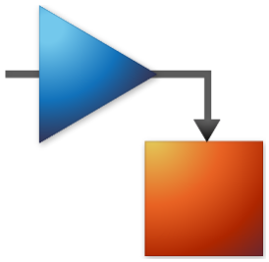
SystemVerilog Component Generation from MATLAB/SIMULINK
Function_dpi.sv
Function.m
Function_dpi.c
Function.c
Simulink

Slide 7
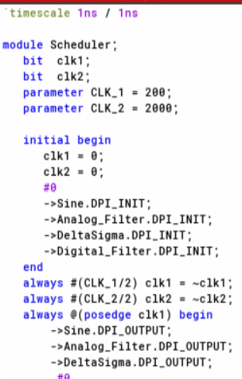
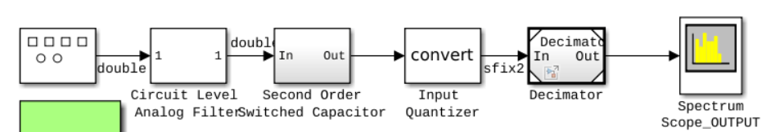
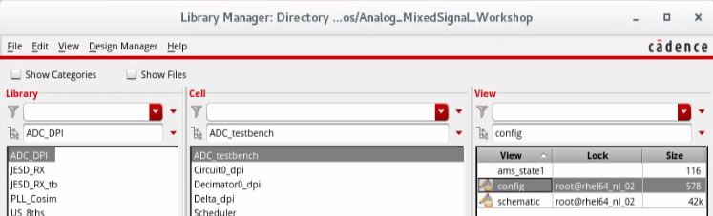
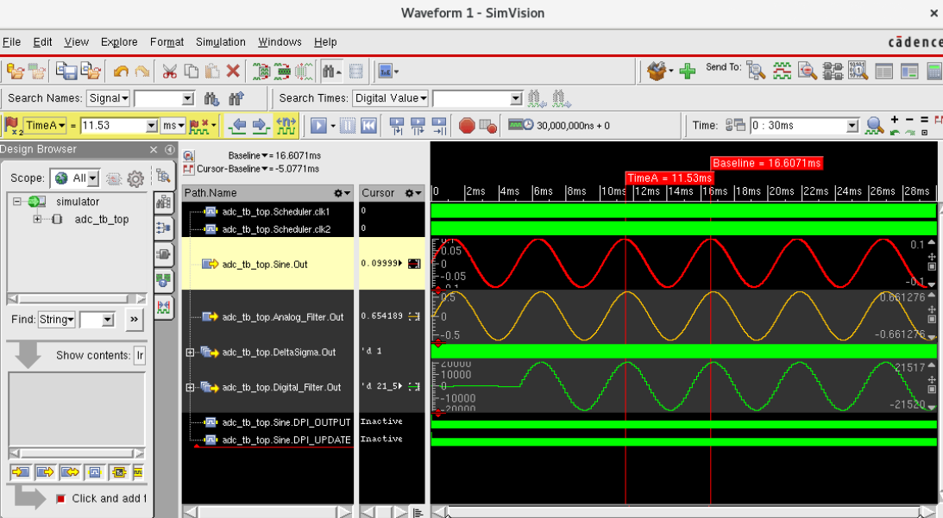
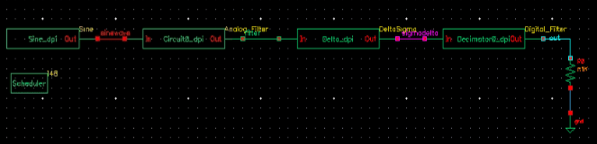
See step-by-step example in doc
SystemVerilog Module Generation for Delta-Sigma ADC model
Notes:
SystemVerilog Module Generation
https://www.mathworks.com/help/releases/R2026b/msblks/ug/system-verilog-module-genreation.html

Slide 8
Useful Getting Started Links
Overview on SystemVerilog DPI component generation from MATLAB. The key function is dpigen.
https://www.mathworks.com/help/releases/R2026b/hdlverifier/gs/systemverilog-dpi-component-generation.html
Getting Started Example for MATLAB-based SystemVerilog DPI Generation
https://www.mathworks.com/help/releases/R2026b/hdlverifier/ug/getting-started-with-matlab-based-systemverilog-dpi-component-generation.html
DPI Component Generation with Simulink
https://www.mathworks.com/help/releases/R2026b/hdlverifier/ug/dpi-c-generation-overview.html
ADC-based tutorial example of generating SystemVerilog DPI from blocks in a Simulink model and instantiating SV inside EDA tool.
https://www.mathworks.com/help/releases/R2026b/msblks/ug/system-verilog-module-genreation.html

Slide 9
Some Details …

Slide 10
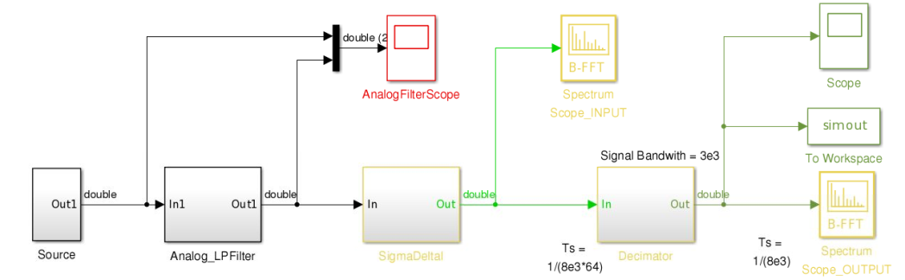
Mixed-Signal ADC Model
Sine Wave Signal Source
First Order
Sigma Delta
Analog
Low Pass Filter
Digital
Decimator Filter

Slide 11
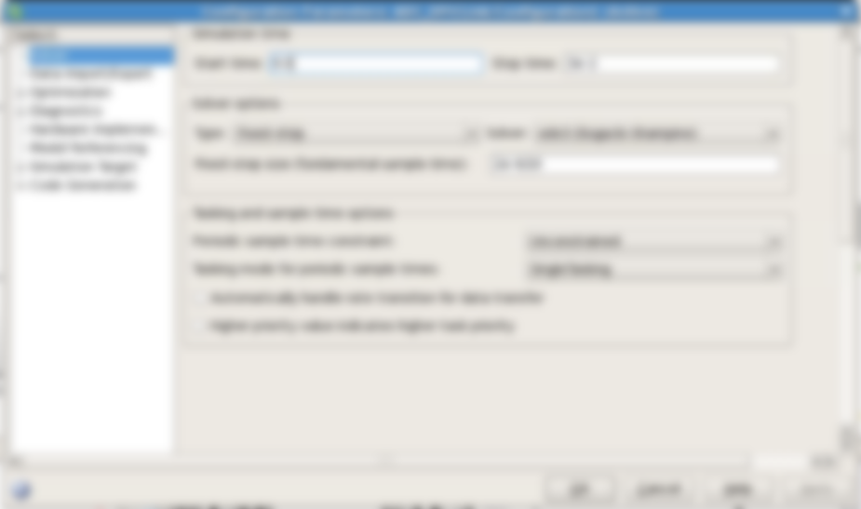
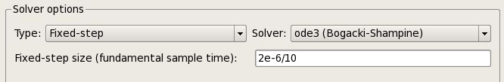
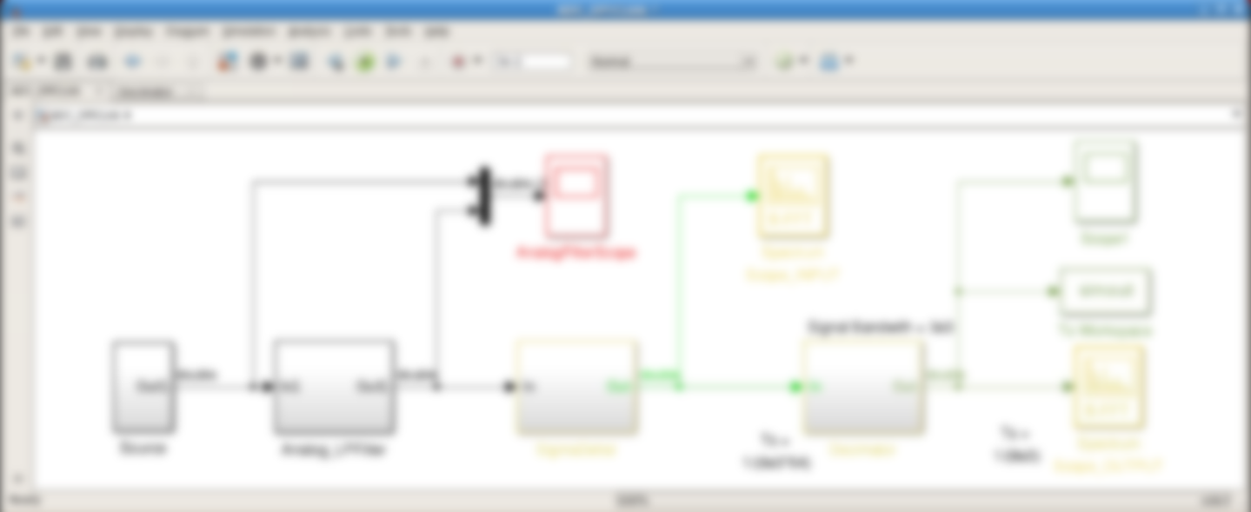
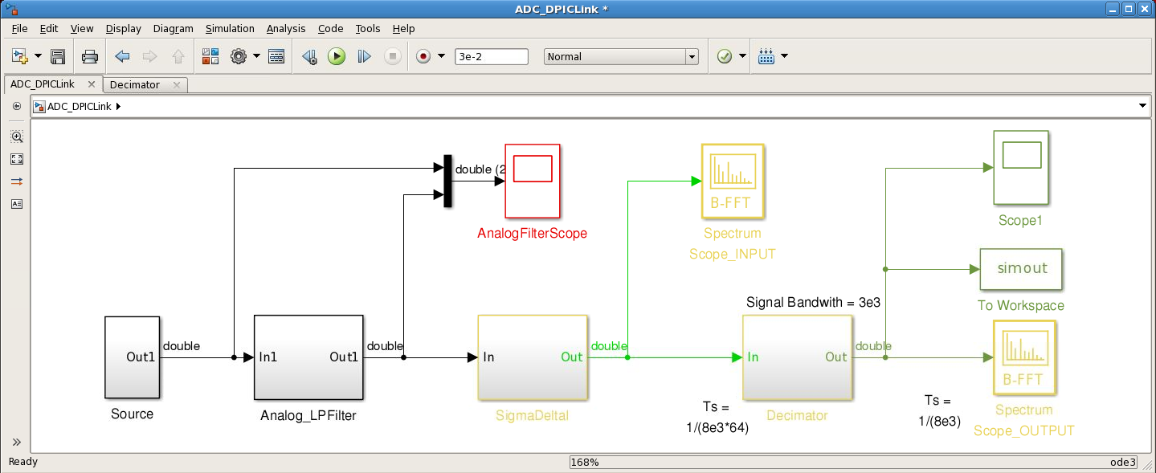
Export of Mixed-Signal Models
Continuous time signals
Discrete time solver

Slide 12
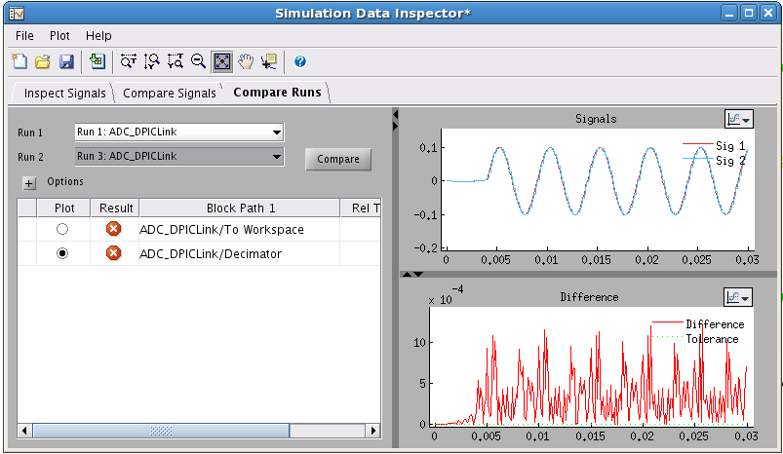
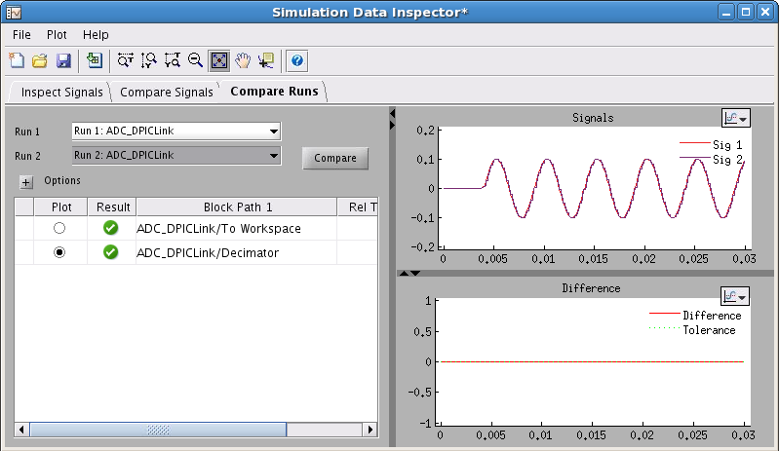

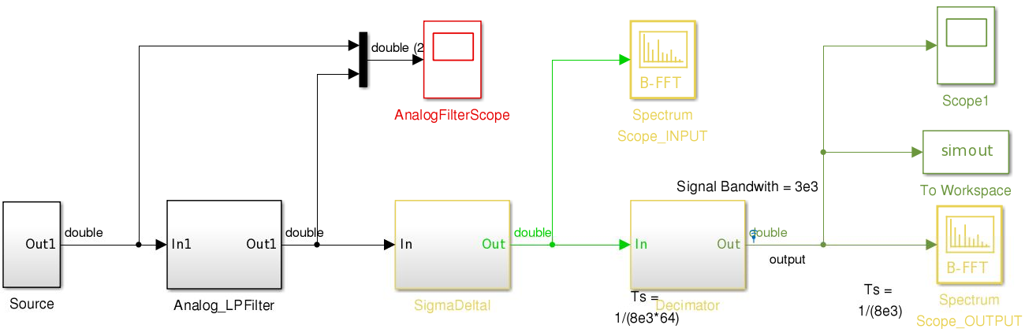
From Variable to Fixed Time Step Solver
Chose a fixed sample time that it is small enough to give correct results
Tradeoff accuracy and simulation time
Large time step
Small time step

Slide 13
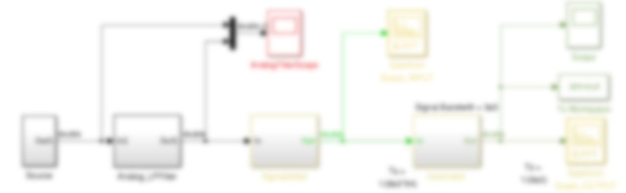

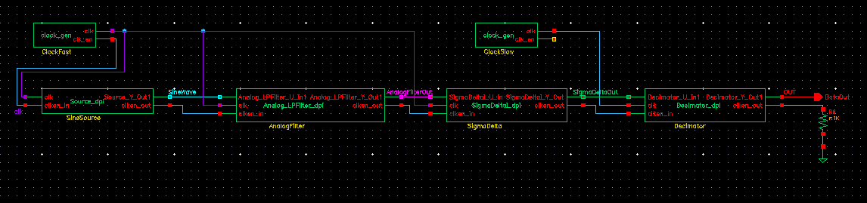
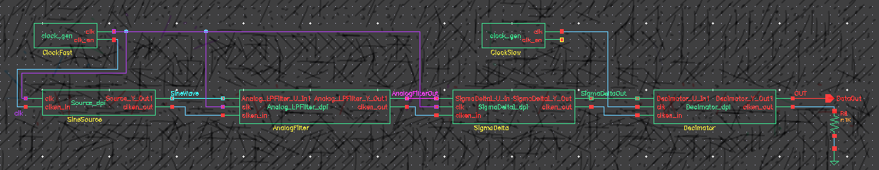
Clocks in SystemVerilog Determine the Scheduling of the Execution
Simulink handles multi-rate systems automatically
Simulink supports model generation for hierarchical subsystems or individual components
Need to define multi-rate clocks to schedule the SystemVerilog execution when different rate components are generated
Fast Rate
Slow Rate
Fast Clock
Slow Clock

Slide 14
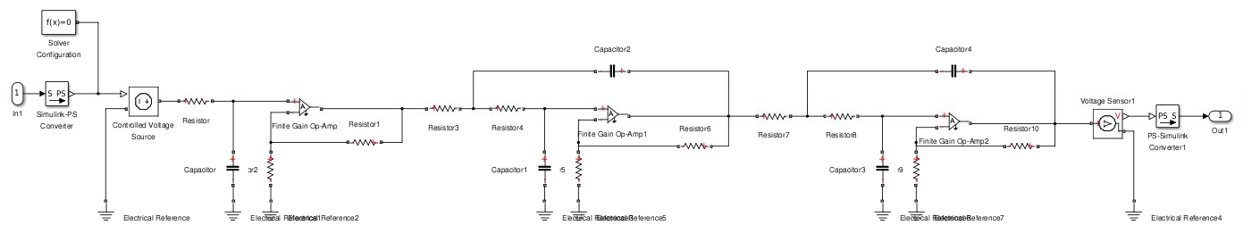
Model Analog Circuits with Simscape
Model analog electronics with Simscape
Generate a SystemVerilog component for simulation in the IC Design Tools

Slide 15
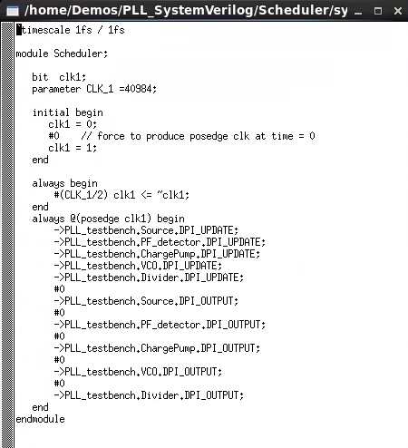
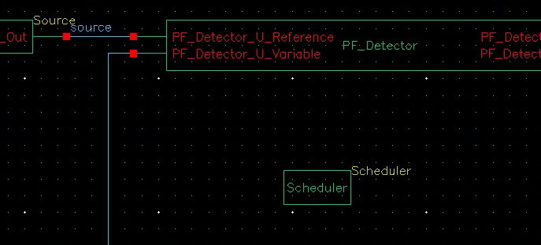
Schedule the Execution of the SystemVerilog Modules
Simulink handles multi-rate systems automatically
You need to define a scheduler to control the SystemVerilog execution
Slow Clock

Slide 16
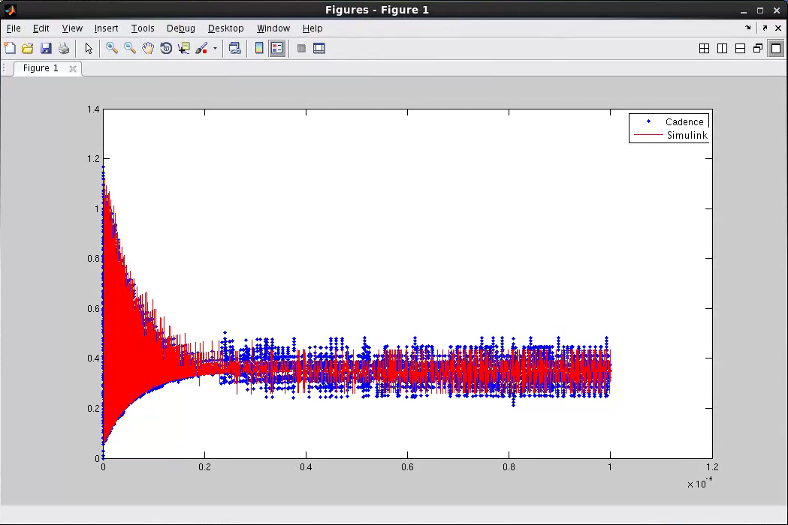
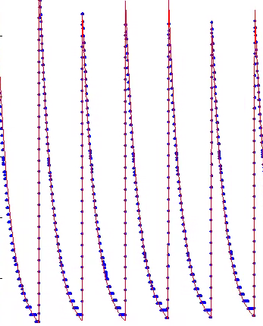
SystemVerilog Discretizes Time
Discrete sample times in Simulink are integer multiple of an arbitrary fundamental sample time
In SystemVerilog all sample times are integer multiple of 1fs (or a reference discrete sample time)

Slide 17
SystemVerilog Component Generation from MATLAB
Function_dpi.sv
Function_dpi.c
Function.m
Function.c

Slide 18
SystemVerilog Component Verification from MATLAB
Testbench
Testbench.sv
Function.m
Function_dpi.sv
Pass / Fail

Slide 19
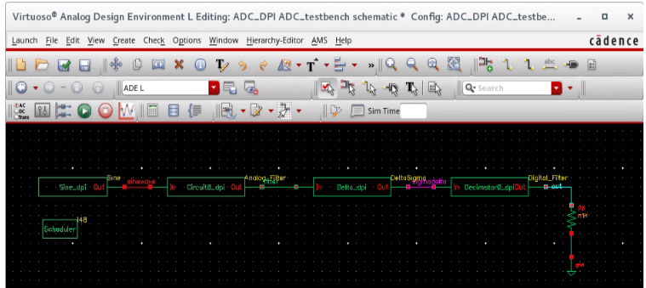
SV-DPIC Tutorial Example: Delta-Sigma ADC
https://www.mathworks.com/help/releases/R2026a/msblks/ug/system-verilog-module-genreation.html

