Slide 1
Kruskal’s Algorithm
By Kevin Schwaar

Slide 2
Finding the Minimal Spanning Tree
Finds the shortest (smallest weight) path that connects all nodes in a graph.
Start with a list of edges
Add the shortest path without creating a cycle.
Make sure all the nodes are connected.

Slide 3
My Implementation
Create Vertices
Create Edges
Sort Edges
Kruskal’s Algorithm
Algorithm
Choose edge to insert
Check for cycles
Insert Edge
Check for completion

Slide 4
A
B
2
Complete!
4
8
6
C
D
10

Slide 5
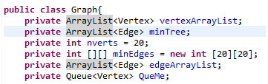
Things to implement
Graphs
Vertices (Nodes)
Edges
ArrayList
Sorting function
Queue
Breadth First Search

Slide 6
Sorting
if(edgeArrayList.get(i).getWeight()>edgeArrayList.get(j).getWeight()){
Edge temp=edgeArrayList.get(i);
edgeArrayList.set(i,edgeArrayList.get(j));
edgeArrayList.set(j,temp);
}

Slide 7


Slide 8
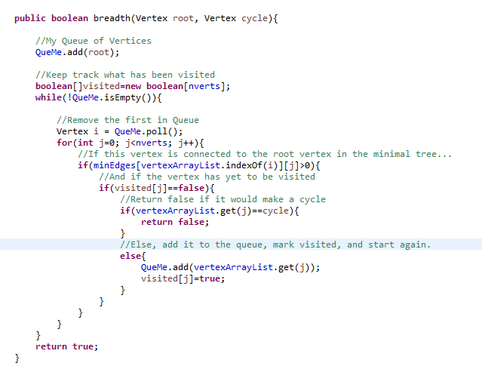

Slide 9
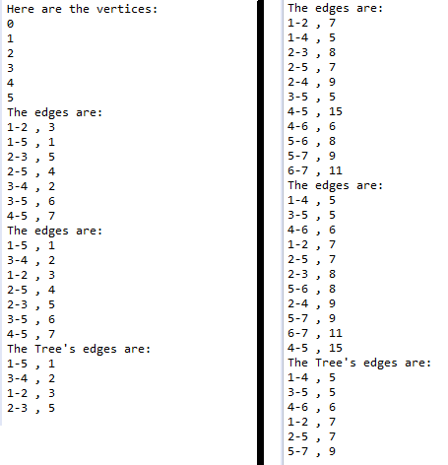
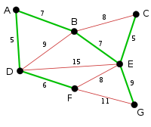
"Kruskal's Algorithm." Wikipedia. Wikimedia Foundation, n.d. Web. 12 Apr. 2016.

Slide 10
Keep in Mind /Other Facts
Cycle Checking can be done with depth first search as well as breadth first
Efficiency is O(E logE). (1)
Most of the memory is going to be taken up by the vertices and the objects they hold.
Other algorithms to find minimal spanning tree include
Prim’s algorithm
Reverse-delete algorithm
Boruvka’s algorithm
(1) Weiss, Mark Allen. Data Structures and Algorithm Analysis in Java. Second ed. Boston: Peason Addison-Wesley, 2007. Print.

