Slide 1

EV40-F Wiring by K. Ferhat Celik
We support you when your ideas start elevating

Slide 2

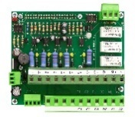
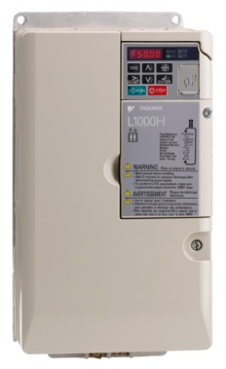
EV40-F Layout
Interface card
Down travel: mechanical
EV40
Pressure sensor
Lift controller
Up travel via Yaskawa drive
EV40 Valve
EV40
OPEN loop control
L1000H
Pump
Motor
Temp. sensor

Slide 3
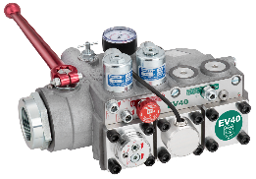
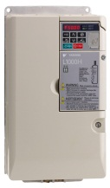
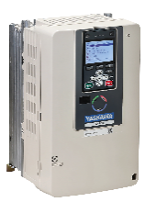
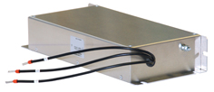
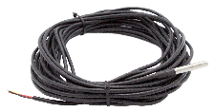
What is received in an EV40-F package?
EV40 package: EV40L or EV40GA package
An EV40 valve with integrated pressure sensor
A Yaskawa Drive, either with
a L1000H drive (comes together with an external line filter)
or with a GA700 drive (having a built-in line filter)
The interface card (Pro-Hydro)
A digital temperature sensor
EV40 User Manual
EV40 valve with an integrated pressure sensor
L1000H Drive
GA700 Drive
Line filter
Interface card
The package does not include an AC reactor !
Digital Temp. sensor
Either a standard YASKAWA GA700 (EV40GA package) or L1000H drive (EV40L package) is delivered in the EV40 package. The package includes an interface card (Pro-Hydro) that contains the hydraulic software. There is no AC reactor delivered in the EV40 package. L1000H drive comes with an external line filter in the package whereas, the GA700 drive comes with a built-in line filter.

Slide 4
YASKAWA Drives for the EV40-F system
EV40 Package
kW size | L1000H |  | GA700
 | Drive Code | Line Filter | Drive Code
3 | LC4V0007BAA-0011 | FS23639-15-07 | GA70C40009BBAA-BA
4 | LC4V0009BAA-0011 |  | GA70C40012BBAA-BA
5.5 | LC4V0015FAA-0011 | FS23639-30-07 | GA70C40018BBAA-BA
7.5 | LC4F0018BAC-9120 | FB-40025A | GA70C40023BBAA-BA
11 | LC4F0024BAC-9120 | FB-40044A | GA70C40031BBAA-BA
15 | LC4F0031BAC-9120 |  | GA70C40038BBAA-BA
18.5 | LC4F0039BAC-9120 |  | GA70C40044BBAA-BA
22 | LC4F0045BAC-9120 | FB-40060A | GA70C40060BBAA-BA
30 | LC4F0060BAC-9120 |  | GA70C40075BBAA-BA
37 | LC4F0075BAC-9120 | FB-40105A | GA70C40089BBAA-BA
45 | LC4F0091BAC-9120 |  | GA70C40103BBAA-BA
55 | LC4F0112CAC-9120 | FB-40170A | GA70C40140BBAA-BA
75 | LC4F0150CAC-9120 |  | GA70C4168BBAA-BA
Interface card
Digital Temp. sensor
Line filter
GA700
L1000H
EV40L package
EV40GA package

Slide 5



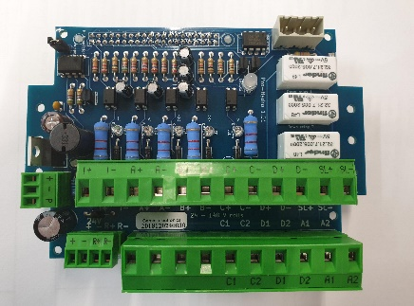


EV40 (Pro-Hydro) cards
There two types of Pro-Hydro cards:
High Voltage
45V to 230V
Borad colour: Green
Pro-Hydro cards are delivered according to the coil voltage.
Low Voltage
24V to 110V
Board colour: Blue
Check whether voltage range of the interface card matches with the elevator controller !

Slide 6
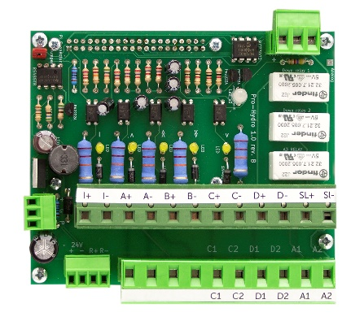
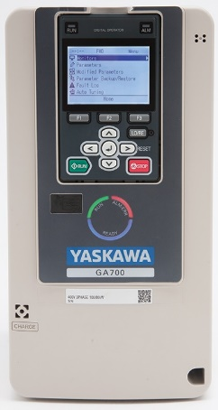
Supply power and motor connections
Pro-Hydro card
Place the drive either in the existing controller cabinet or in a separate cabinet together with the Pro-Hydro card. Do the mains and motor connections (See page 15 of EV40 Manual).
High voltage card
45V – 230V
Low voltage card
24V – 110V
Mains
D C
EV40
EV40
Motor contactors
Make sure that signal voltage from the controller is the same as the coil voltage on the valve and matches with the Pro-Hydro card voltage range!
MOTOR

Slide 7
Wiring of input signals
Connect the signalling wires to the input terminals on the Pro-Hydro card (See page 18 of EV40 Manual).
Inspection signal
UP: I & A
DOWN : I & D
Signalling voltage from the controller should be same than the coil voltage on the valve!
Input terminals
If DC current is used, CHECK for polarity (+,-)!
A
B C D
Mains
D C
EV40
EV40
Motor contactors
Pressure sensor
DO NOT give inspection and full speed travel signals at the same time!
MOTOR
UP signalling is shown in BLUE colour
DOWN signalling is shown in RED colour

Slide 8

Input terminals wiring
The voltage of the signals from the controller should match with the Pro-Hydro card voltage range.
+ - T
Signalling sequence: The elevator controller sends signals (energy) to the input terminals for travels.
For an up direction travel, A & B terminals are used.
If only A signal is given, elevator travels only at slow (levelling) speed.
If A & B signals are given at the same time, elevator accelerates to full speed and travel at full speed.
To decelerate into slow speed B signal is removed. To stop at the floor A signal is removed.
If only B signal is given, elevators does nothing.
Status LED
Up & down travel signals
Travel LEDs
Ins. A B C D
I+ I- A+ A- B+ B- C+ C- D+ D- SL+ SL-
P - +
+ -
24V R+ R-
The same sequence is applied for the down travel but in this case, signals are sent to the D & C terminals by the elevator controller.
For full down speed D & C signals are given.
To decelerate into slow speed C signal is removed
To stop at floor D signal is removed.
To provide soft stop, controller runs the motor approximately 1s longer after the A signal is removed.
Verification of signalling can be done by checking the lighting sequence of “Travel LEDs” on the Pro-Hydro card.

Slide 9
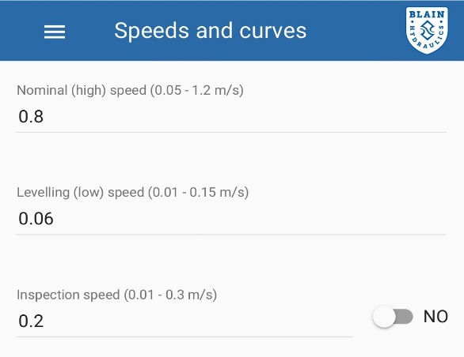
Input terminals wiring
INSPECTION SIGNAL: Inspection signal wiring is done to the terminal “I+/I-”. Inspection signal can be chosen to be a NO or NC circuit. After doing the wiring NO/NC selection can be done via the smart phone application. The default setting is NC.
The voltage of the inspection signal should match with the Pro-Hydro card voltage range.
+ - T
Status LED
Travel LEDs
Ins. A B C D
I+ I- A+ A- B+ B- C+ C- D+ D- SL+ SL-
P - +
+ -
24V R+ R-
Inspection signal wiring
UP INSPECTION TRAVEL: Elevator controller sends signals to I and A terminals
DOWN INSPECTION TRAVEL: Elevator controller sends signals to I and D terminals.
SL+/SL- wiring is only used for UCM (Unintended Car Movement) safety when there is a UCM valve in the system. The UCM safety valve is not compulsory in the US market.

Slide 10
Output terminal wiring
The voltage of the signals from the controller should match with the Pro-Hydro card voltage range.
Inspection signal
Output terminals
Connect the D and C coils to the output terminals on the Pro-Hydro card (See Page 16 of EV40 manual)
A
B C D
Mains
D C
EV40
EV40
Motor contactors
Pressure sensor
MOTOR

Slide 11
Wiring of the sensors
Inspection signal
Connect pressure & temperature sensors (See page 16 of EV40 Manual).
A
B C D
Mains
D C
EV40
EV40
Motor contactors
Pressure sensor
MOTOR
Temp. sensor

Slide 12

Wiring of the sensors and the output coils
Power GND Signal
Temperature
sensor connection
+ - T
PRESSURE SENSOR: The sensor is built-in on the EV40 valve. Connect the open end to the Pro-Hydro card.
TEMPERATURE SENSOR: The sensor with 3m long cable is delivered in the EV40 package. Connect the cable to the Pro-Hydro card.
Power
P - +
Pressure sensor connection
Signal
+ -
24V R+ R-
C
D
UCM wiring is only done when there is an UCM valve connected to the EV40 valve.
UCM
Coils for EV40 valve

Slide 13
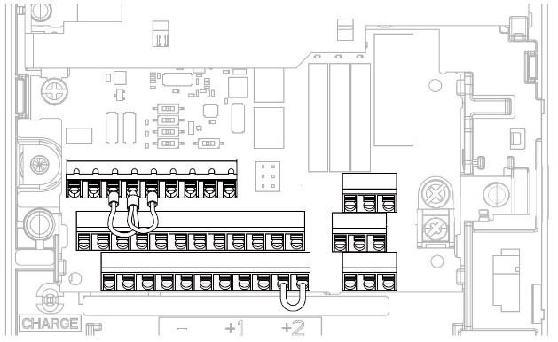
Wiring for the drive
GA700 drive
D+ D-
SN SC
Remove the wire bridge between SN & SC on the drive (See page 17 of EV40 Manual).
A
B C D
Do the wirings between the drive and the Pro-Hydro card (pages 17 & 18).
Mains
D C
EV40
EV40
Motor contactors
Pressure sensor
MOTOR
Temp. sensor

Slide 14
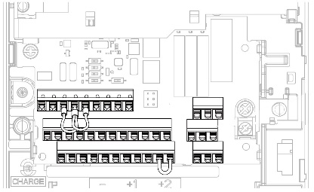
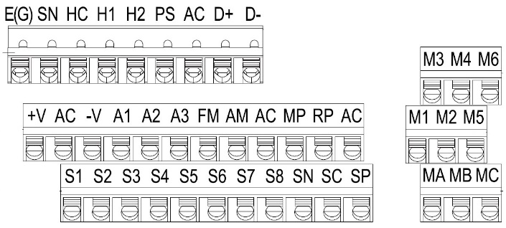
Wiring for GA700 drive
YASKAWA GA700 drive
GA700 Drive: The data communication wiring is done between D+ and R+; D- and R-.
Supply power wiring is done between SP (+) and 24V+; SN (-) and 24V-
+ - T
Pro-Hydro card
I+ I- A+ A- B+ B- C+ C- D+ D- SL+ SL-
P - +
24V
+ - R+ R-
C1 C2 D1 D2 A1 A2
24V+ 24V- R+ R-
If 24VDC external power supply is used for the Pro-Hydro card, pay attention for the polarity. High current may damage the Pro-Hydro card!

Slide 15
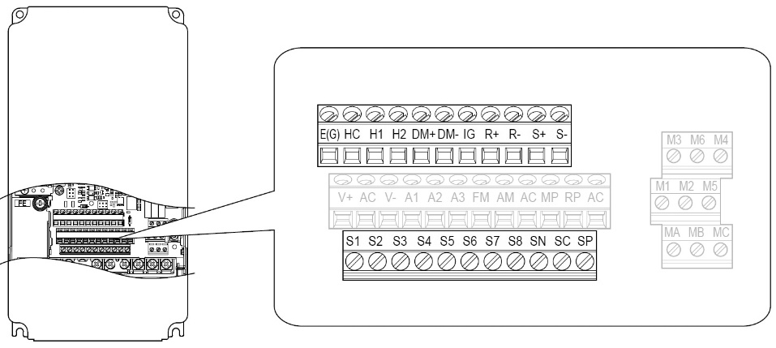
Wiring for L1000H drive
L1000H Drive: The data communication wiring is done between R+/S+ and R+; R-/S- and R-.
The supply power wiring is done between SP (+) and 24V+; SN (-) and 24V-
YASKAWA
L1000H drive
R-
R+
to Pro-Hydro card
24V+
24V-
If 24VDC external power supply is used for the Pro-Hydro card pay attention for the polarity. High current may damage the Pro-Hydro card!

Slide 16
Drive initialization & Wi-Fi connection
After completing the wiring of the EV40 system, drive initialization is necessary to provide communication between the Pro-Hydro card and the drive. For that do the followings (see page 20 of EV40 Manual);
Make sure that A1-01 (Access level selection) is set to 2 (Advance level)
Verify H5-01 (Modbus communication address) is set to “1F”
Change H5-02 (Communication speed) to “8” (115.2kbps)
Power the drive off and on again to activate the setting (wait 3 minutes before repowering). This will allow the Pro-Hydro card to communicate with the drive
Verify that 10 seconds after re-powering the drive the diagnostic LED on the Pro-Hydro card starts blinking green at 1 second intervals – See Section 5 when LED blinks RED.
Wi-Fi off
+ - T
To provide Wi-Fi communication with a mobile telephone, remove the Wi-Fi jumper connection. Place the jumper back after completing the set-up to prevent unauthorized access.
Wi-Fi
Jumper
Status LED
Travel LEDs
Ins. A B C D
Verification of signalling can be done by checking the lighting sequence of “Travel LEDs” on the Pro-Hydro card.
Wi-Fi on
I+ I- A+ A- B+ B- C+ C- D+ D- SL+ SL-
P - +
+ -
C1 C2 D1 D2 A1 A2
24V R+ R-

Slide 17
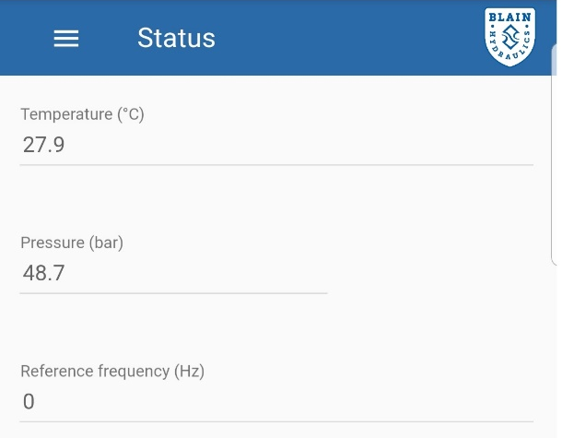
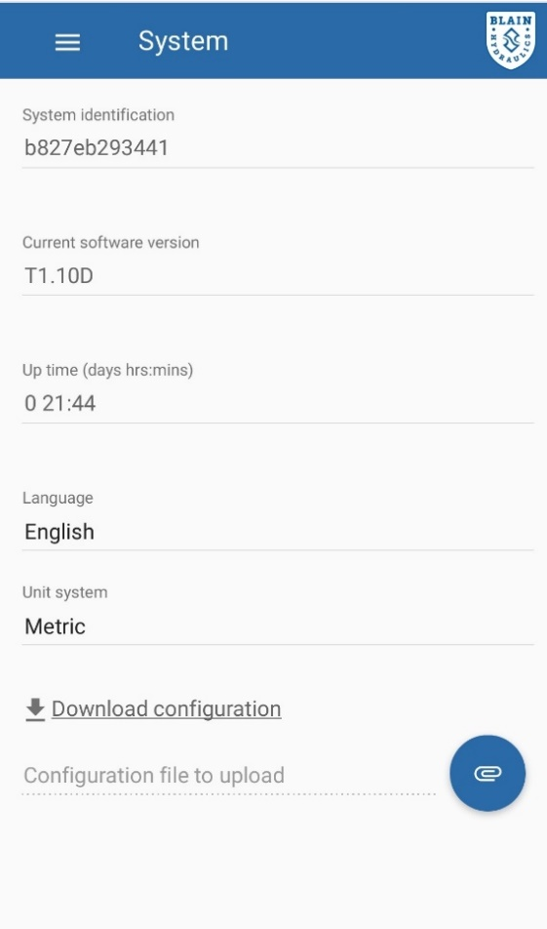
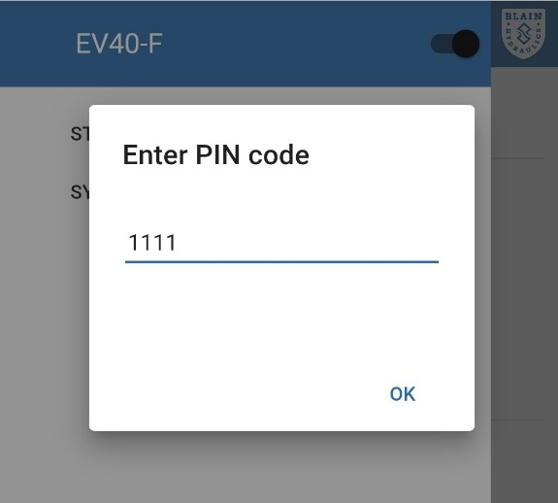
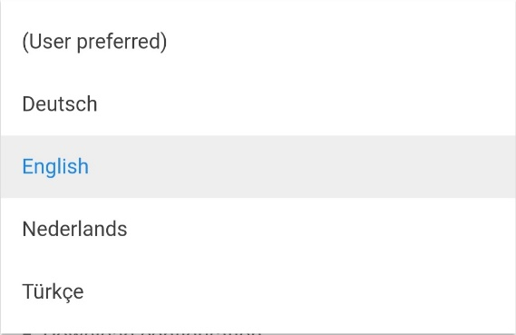

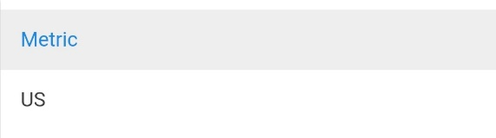
Connect your telephone to do your set up!
Entering pin code
Selecting language & unit system

Slide 18
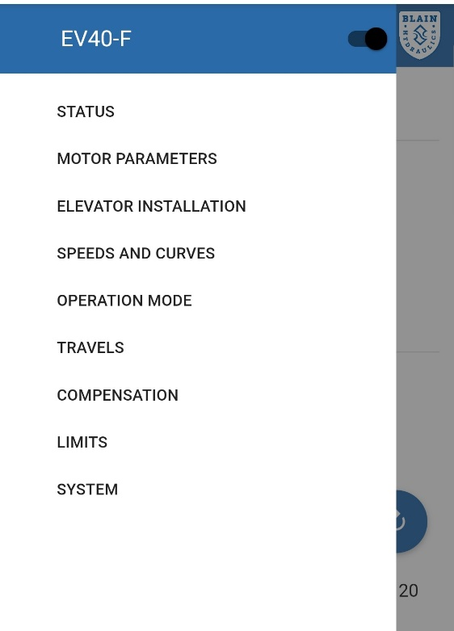
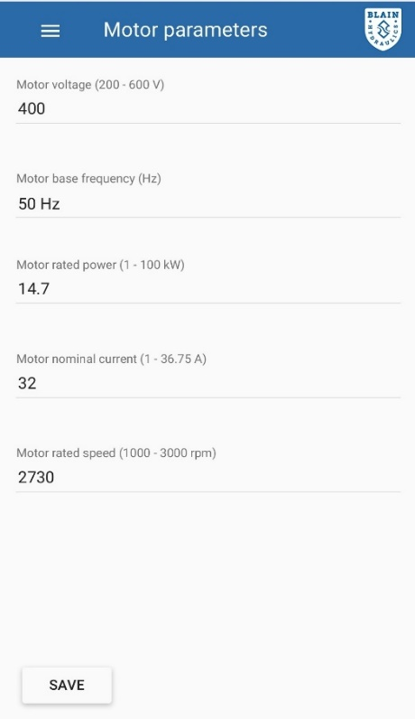
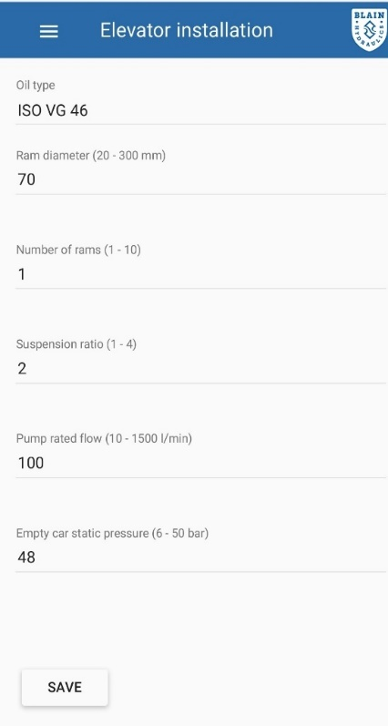
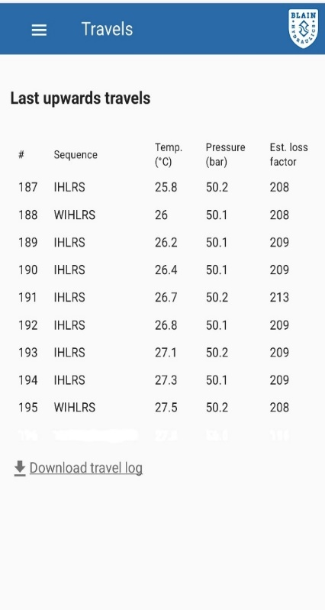
Connect your telephone to do your set up!
Main menu
Entering lift data

Slide 19
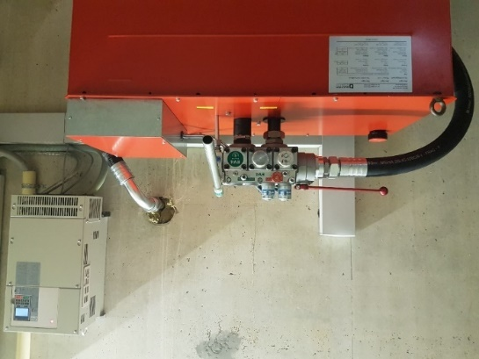
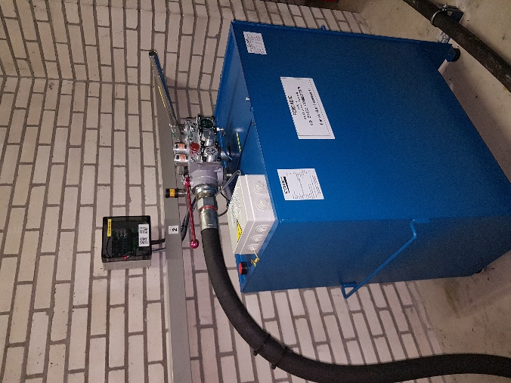
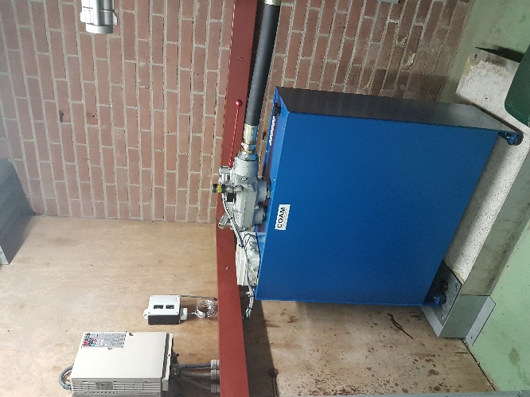
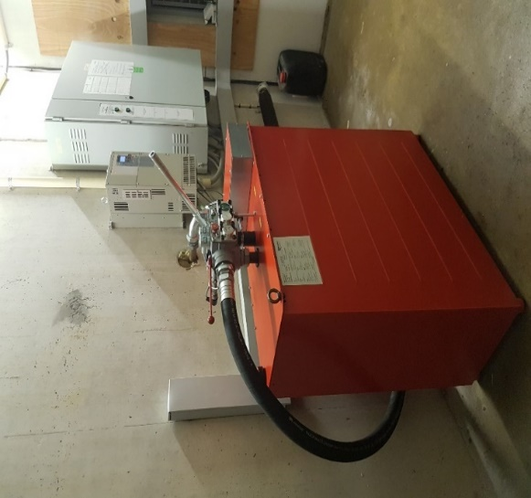
EV40-F Applications

Slide 20

Thank you
Questions!

