Slide 1

Quantitative Cell and Molecular Biology (CM508A)
Kristin Scott
Python Basics
https://github.com/kscott94/qBio

Slide 2


Itinerary
Section I: Introduction
Section II: Getting Started
Section III: (Exercise) Operation Fancy Calculator
Section IV: (Exercise) Python Basics
Section IV: (Project) Primer Design

Slide 3

Section I: Introduction

Slide 4
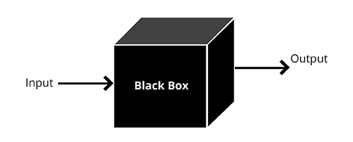
Algorithm
5
x²
25

Slide 5
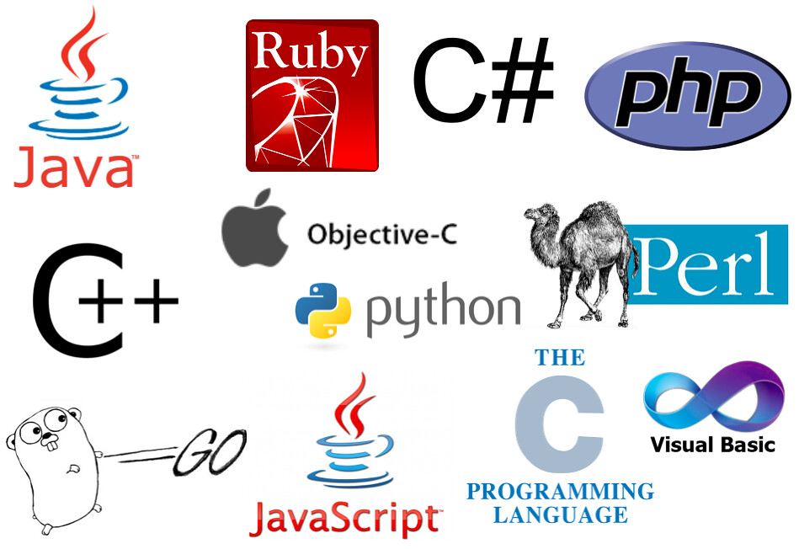

Slide 6
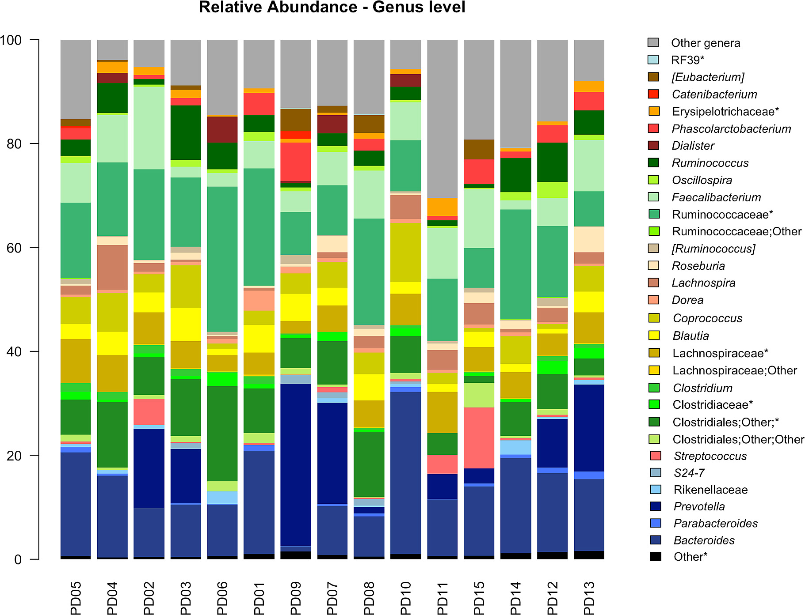
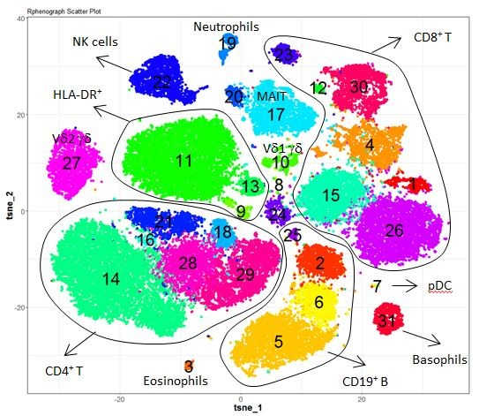
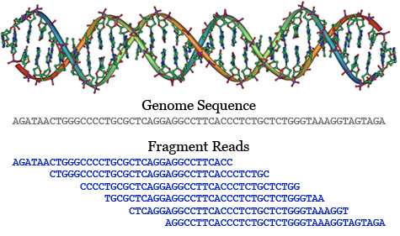
As a Biologist, why learn to code?
Big Data
Automation
Statistical analysis
Data visualization

Slide 7
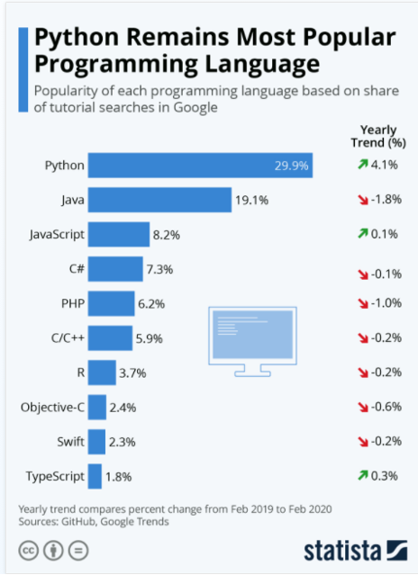
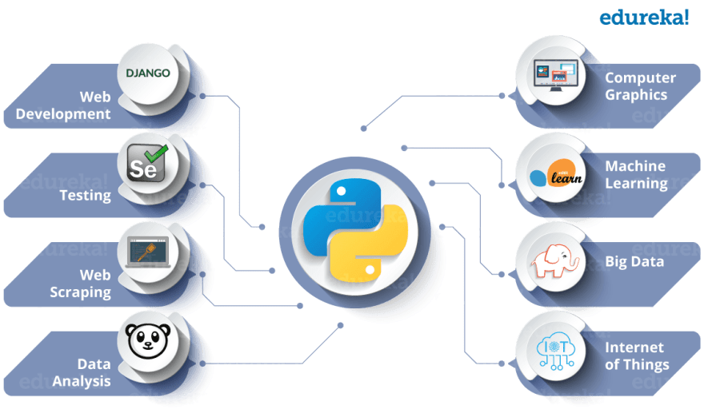
Why Python?
Plethora of Packages!
Easy syntax!

Slide 8
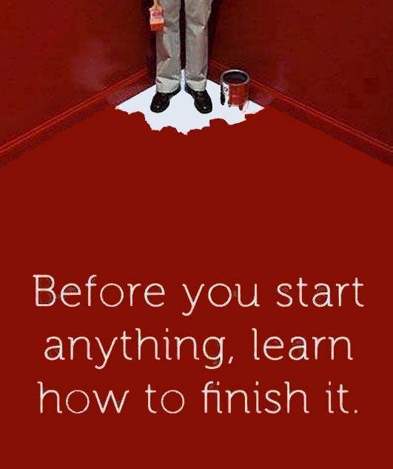
Section II: Getting started

Slide 9
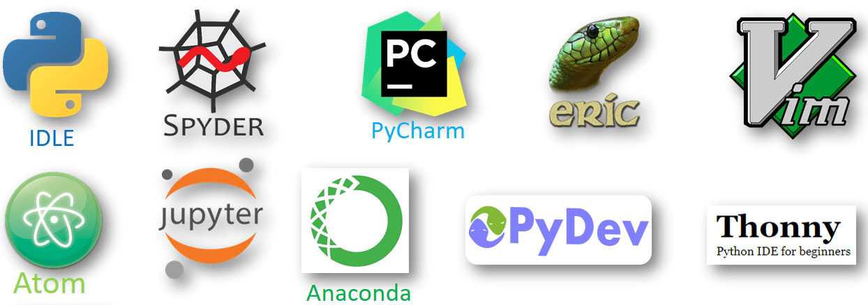
Integrative Development Environment (IDE)
Where you write your code
Suggests edits/corrections
Organize your projects

Slide 10
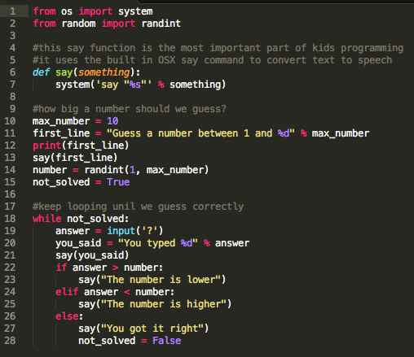
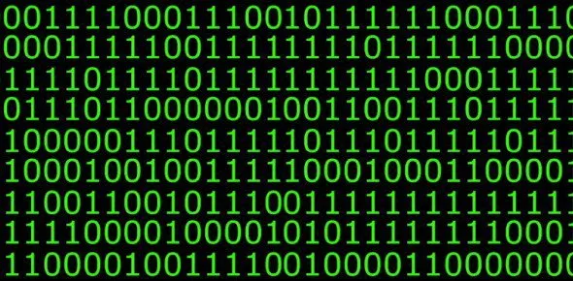
Computer Speak

Slide 11
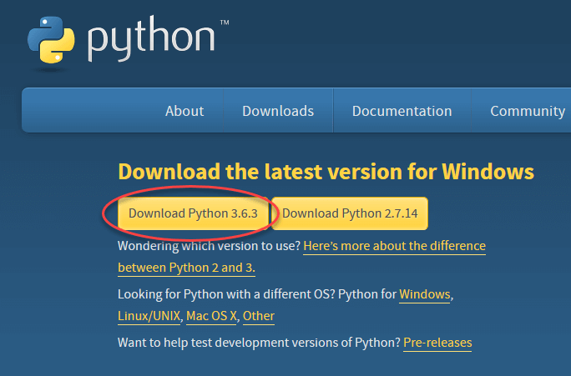
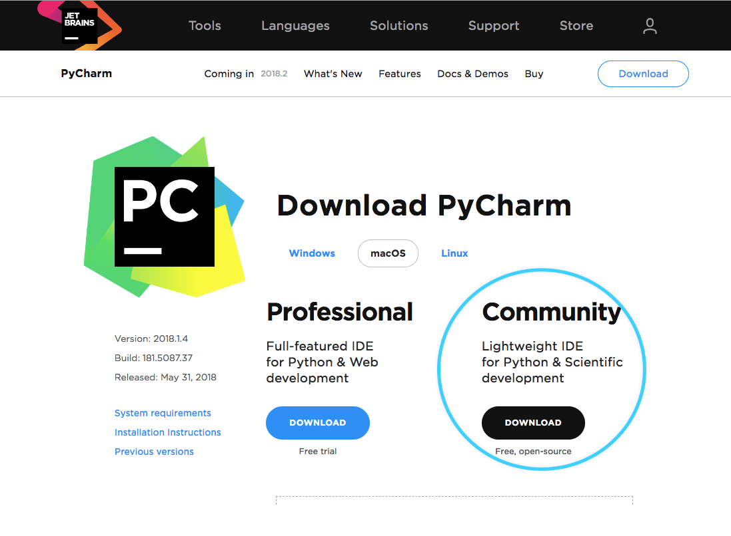
Step 1: Download python
Step 1: Download an IDE

Slide 12
<Pycharm Tour>

Slide 13
“ Computers are stupid, so you have to be smart ” – Ann Hess
Be explicit
Logical flow
  The computer reads your code top to bottom

Slide 14
Writing Code
Console
>>> start_here
One line at a time
Can’t go back and change code
Executed scripts print to console
Script
Multiple lines can be written, then all executed at once
script_name.py

Slide 15
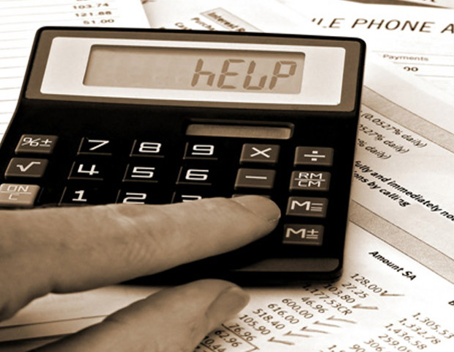
Section III:
(Exercise)
Operation Fancy Calculator

Slide 16
Operators
+
Addition
Subtraction
Division
Multiplication
Power (10**2 = 100)
Modulo – The remainder of division (13 % 5 =?)
-
/
*
**
%

Slide 17
Comparison and Logic Operators
< , >
==
!=
<=
>=
Greater/less than
Is equal to
Is not equal to (≠)
Less than or equal to (≤)
Greater than or equal to (≥)
Ask multiple questions: and / or
Data type: Boolean
True/False

Slide 18

Section IV: (Exercise) Python Basics

Slide 19
Data Camp
Introduction to Python
  Basics
  Lists
  Functions & Packages
Intermediate Python
  Loops
  Dictionaries
  Pandas
  Matplotlib

Slide 20
variables
A Python variable is a symbolic name that is a reference to a value. You assigne values to variables.
Notes:
No spaces!!
Use underscores instead
No special characters
Can’t start with a number
All lowercase
  - CamalCase
variable_name = object
my_integer = 8
my_float = 3.14
my_string = “atgggtactgtg”

Slide 21
Functions
Functions are "self contained" modules of code that accomplish a specific task. Functions usually "take in" data, process it, and "return" a result.
function_name(argument)
function_name(arg1, arg2, ..., argn)
print(“hello world!”)
Output : hello world!
type(“hello world!”)
Output: <class 'str'>
Packages: Code written by others
import package_name
package_name.function(args)
eg.
import math
math.sqrt(100)

Slide 22
<demo>

Slide 23
Data Structures
A data structure is a data organization, management, and storage format that enables access and modification. A data structure is a collection of values, the relationships among them, and the functions or operations that can be applied to those values.
Strings
Lists
Tuples
Dictionaries
Sets

Slide 24
Lists
Lists are a common data structure to hold an ordered sequence of elements.
list_name = [ ]
item1, item2, …, item(n)
names = [“Linda”, “Steven”, “John”, “Carry”]
# list of string
numbers = [3, 5, 1, 22]
# list of numbers

Slide 25
Lists
Each element can be accessed by an index. Note that Python indexes start with 0 (not 1)
list_name = [ item1, item2, …, itemn]
>>> list_name[1]
item2
>>> list_name[0]
item1

Slide 26
String indexing
Like lists, a string can be accessed through indexing as well.
my_name = “Kristin Scott”
>>> my_name[0]
K
>>> my_name[1]
r

Slide 27
Indexing
You can also output a range of positions instead of single positions.
seq = “atggctacg”
>>> seq[0:3]
atg
>>> seq[3:6]
gcta
You can also query from the end!
>>> seq[-1]
g
>>> seq[-5:-1]
ctac
>>> seq[-5:9]
ctacg

Slide 28
<demo>

Slide 29
Making Functions
Base python might not have the function you need, and you may not be able to find a package that does what you want.
def is the workhorse of python
def function_name(arg1, arg2, …, argn):
instructions
return object

Slide 30
<demo>

Slide 31
for-loops
A for loop is used for iterating over a data structure (list, a tuple, a dictionary, a set, or a string, or even a single string).
item_ls = [item1, item2, item3]
instruction

Slide 32
for-loops
item_ls = [item1, item2, item3]
for item in item_ls:
“do something here”
for animal in animal_ls:
print(animal)
for tamagotchi in animal_ls:
print(tamagotchi)

Slide 33
<demo>

Slide 34
Assignment
In your python notebook, complete the code at lines that start with
    ### IND
Feel free to work individually or in groups
Ask questions!

Slide 35
Project
Design primers for three genes
There are many ways to accomplish this task.
  Think creatively
  Make a game plan
  Experiment with different code
  Go big if you are feeling it

Slide 36
Installation managers
An installation manager is downloadable software that allows you to install packages.
  R does not require an installation manager.
    >>> Install.packages(“package_name”)
The package will be installed in a directory (folder) on your computer where your python interpreter will be able to access it.
An installation manager will also handles installing other software required to run the package (dependencies).

Slide 37

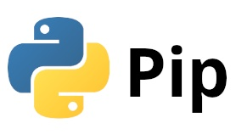
Installation managers
Python requires an installation manager to install packages.
Once you have an installation manager, you will be able to install packages in PyCharm, or via the commandline.

