Slide 1

Analytical CRM Development for a Bank
FROM: Dayasagar H

Slide 2
Data Overview
RowNumber: The row number in the dataset, likely used for reference or indexing.
CustomerId: A unique identifier for each customer.
CreditScore: A numerical representation of the customer's creditworthiness.
Credit score:
Excellent: 800–850
Very Good: 740–799
Good: 670–739
Fair: 580–669
Poor: 300–579
GeographyID: A numerical identifier that likely corresponds to a geographical location, such as a country or region.
GenderID: A numerical identifier for the customer's gender, where for example, '1' could represent male and '2' could represent female.

Slide 3
Age: The age of the customer.
Tenure: The number of years the customer has been with the bank.
Balance: Current balance in the customer's account.
NumOfProducts: refers to the number of products that a customer has purchased through the bank.
HasCrCard: denotes whether or not a customer has a credit card. This column is also relevant, since people with a credit card are less likely to leave the bank.
1 represents credit card holder
0 represents non credit card holder
IsActiveMember: active customers are less likely to leave the bank (as per the criteria defined by the bank for identifying the activeness).
1 represents Active Member
0 represents Inactive Member

Slide 4
Estimated Salary: as with balance, people with lower salaries are more likely to leave the bank compared to those with higher salaries.
Exited: whether or not the customer left the bank.
0 represents Retain
1 represents Exit
Bank DOJ: date when the Customer associated/joined with the bank.

Slide 5
Customer Churn and its impact on business
Customer churn, the rate at which customers stop using a company's products or services, is a crucial metric for banks.
It directly impacts revenue and profitability.
In this presentation, we will analyze our bank's customer churn rates, focusing on gender, recent years, customers with credit cards, number of products used, credit score-wise churn count, and geography-wise churn count.
Our goal is to identify factors contributing to churn and propose strategies to improve customer retention and satisfaction.

Slide 6
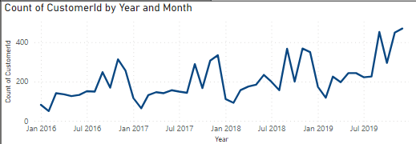
Churn Churn Rate Trends
Analysis:
It can be seen that there is an significant increase in the customers in year 2017 and saw a sudden decline in starting of 2018 as well as in Jan 2019.
Recommendation:
Monitor closely for emerging trends.
Implement targeted strategies for stability.

Slide 7
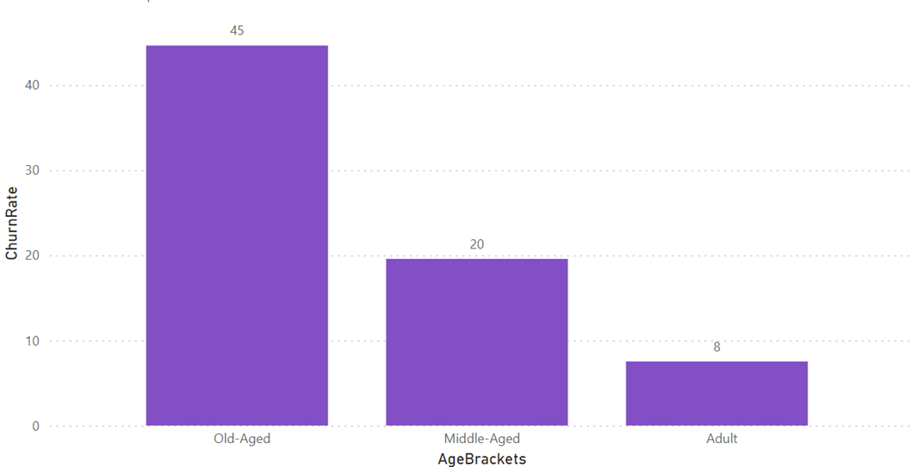
Churn Analysis by Age
Analysis:
Age Group Old Aged(45 Churn Rate):
High churn rate suggests potential dissatisfaction or unmet needs.
Reasons could include lack of personalized services or better offers from competitors.
Recommend further investigation into specific pain points or service gaps.
Age Group Middle Aged (20 Churn Rate):
Significant churn rate indicating possible issues.
Factors may include retirement planning or changing financial priorities.
Tailor retention strategies based on understanding their financial needs and concerns.

Slide 8
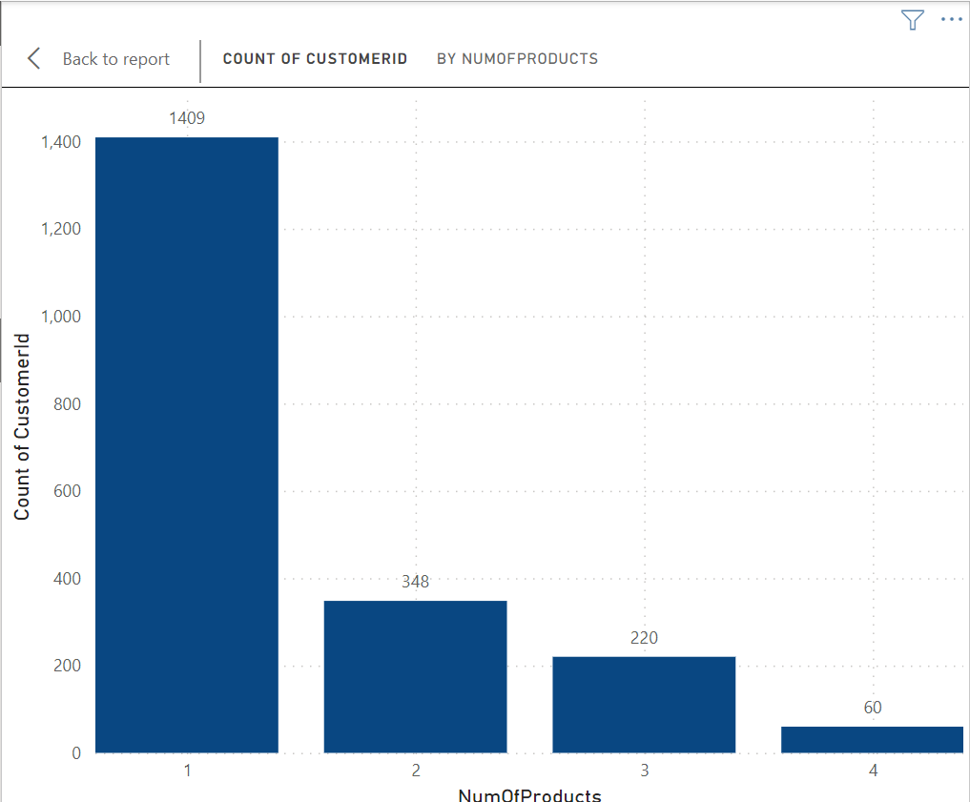
Churn Analysis by Number of Products.
Key Points:
Customers using 1 product have highest churn count (1409).
Churn count decreases as the number of products used increases. Suggest product bundling to incentivize multiple product usage
Analysis:
Single-product customers may churn due to limited banking needs or perceived value.
Multiple-product users are more loyal, indicating a need to encourage product diversification.

Slide 9
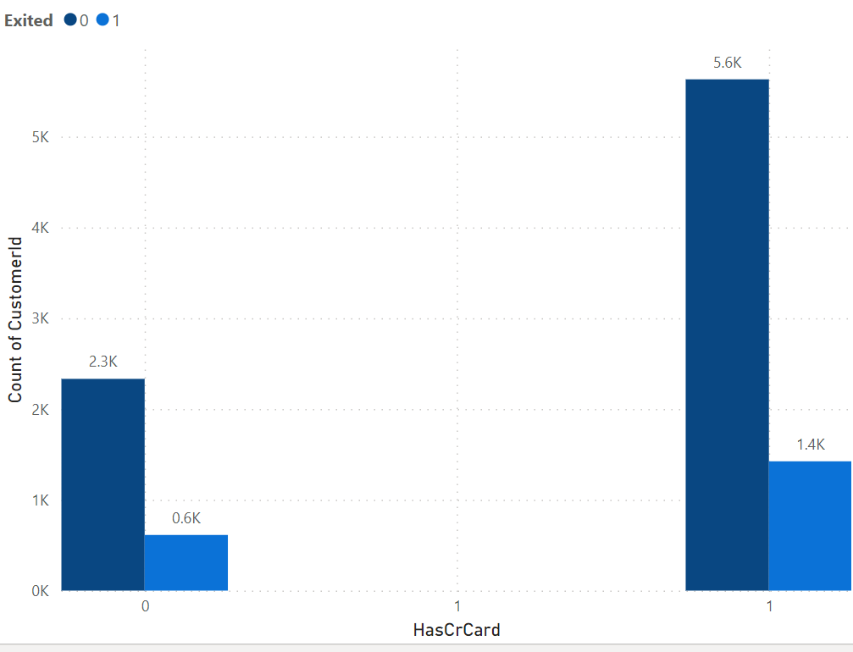
Credit Card on Customer Churn
The Bar chart shows customers by credit card status and churned/exited status.
6K of credit card holders have exited or churned.
1K of non-credit card holders have churned.
Credit card ownership significantly impacts customer retention rates.

Slide 10
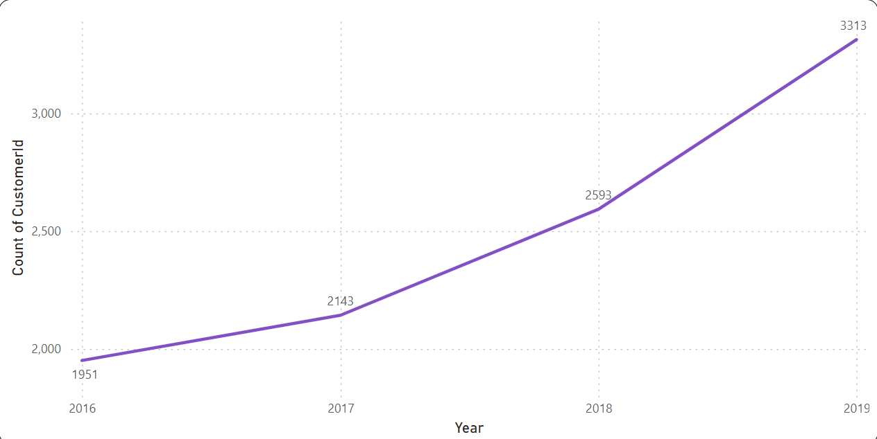
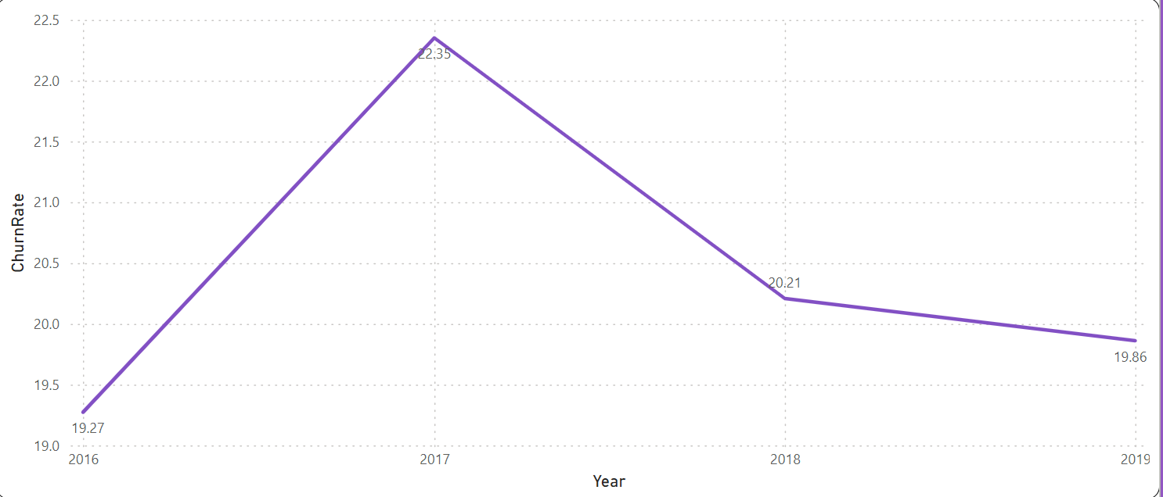
Customer Joining over Years
Churn Rate over Years
Analysis:
The increase in new customers joining the bank each year is a positive trend, indicating potential growth opportunities.
However, the constant churn rate suggests that while new customers are joining, the bank is struggling to retain them.
Analysis:
Fluctuations in churn rates occurred, but overall, the rate has stabilized.
Minor increase in 2017, but stabilized in subsequent years.

Slide 11
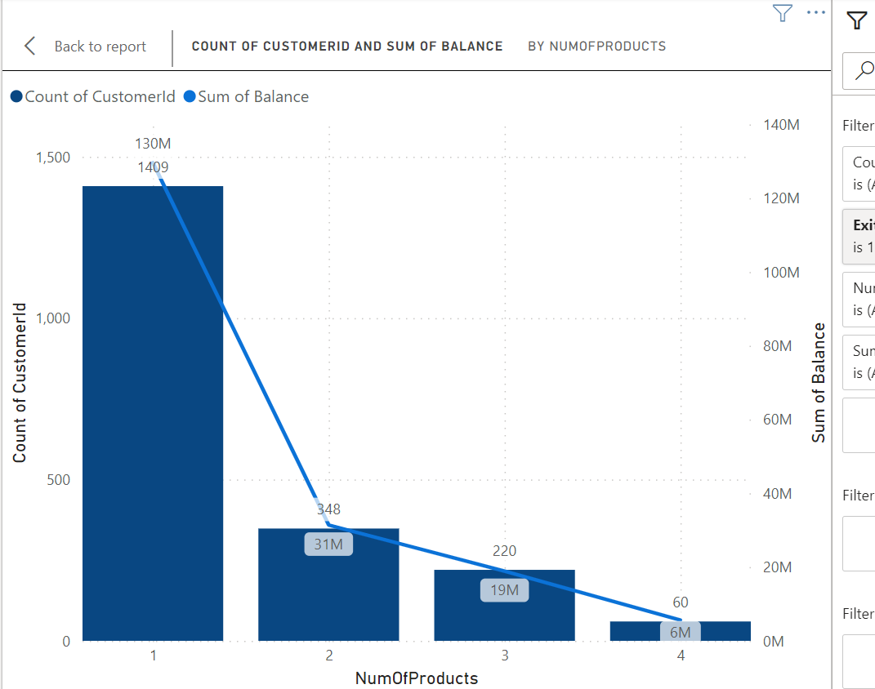
Account balance And Number of products
Analysis:
Customers with higher product usage tend to have higher total account balances.
Customers using 1 product contribute significantly to the total account balance.
Recommendation:
Encourage customers to use multiple products to increase overall account balances.
Offer incentives or rewards for customers who adopt additional banking products.

Slide 12
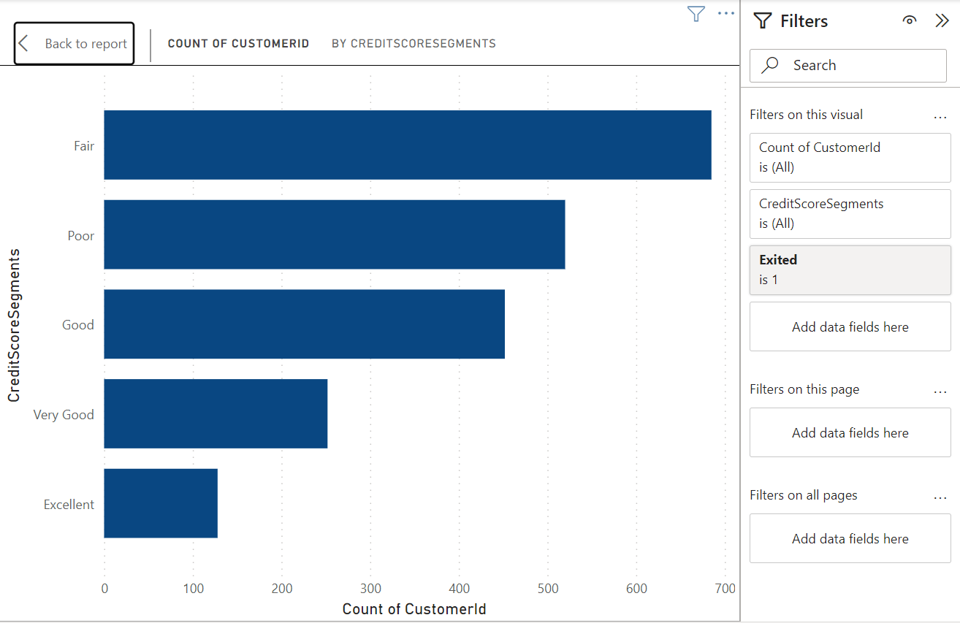
Credit Score Wise Count Of Customers Exited.
Analysis:
Customers with higher credit scores tend to have lower churn rates.
The highest churn count is observed in the credit score group Fair, followed by Poor.
Recommendation:
Focus retention efforts on customers in the credit score groups Fair and Poor.
Provide targeted offers or incentives to encourage loyalty and reduce churn in these segments.

Slide 13
Suggestions:
Targeted Marketing and Communication: Develop campaigns focused on their financial goals.Highlight services like retirement planning and investment options.
Customer Loyalty Programs: Implement programs rewarding long-term customers.
Product Bundling and Cross-Selling: Create bundled offerings to encourage multiple product usage.
Personalized Offers and Services: Offer tailored product bundles and exclusive discounts.
Improved Customer Service:Enhance support for older customers.Train reps to address their unique concerns.

Slide 14
Strategies to Reduce Churn
Reason of Churn:
Lack of engagement.
Poor customer service.
Competitive offers.
Strategies to Reduce Churn:
Improve customer engagement.
Enhance customer service.
Competitive product offerings.
Financial education.

Slide 15
Recommendation:
Implement targeted strategies to reduce churn, such as personalized engagement programs, enhanced customer service, and competitive offerings.
By improving customer retention, the bank can capitalize on the increasing trend of customers joining and achieve sustainable growth

Slide 16
Conclusion
The bank has experienced a consistent churn rate over the years, despite a steady increase in customer acquisition.
Customers with lower credit scores and those using fewer products are more likely to churn.
Age groups Old and Middle have the highest churn rates, indicating specific retention challenges.
Improving customer engagement, enhancing customer service, and offering competitive products/services are key strategies to reduce churn.
Targeted marketing and personalized offers can help retain customers in critical age and credit score groups.
Overall, by focusing on customer engagement, service enhancement, and targeted strategies for specific customer segments, the bank can reduce churn, improve customer retention, and foster long-term customer loyalty.

Slide 17
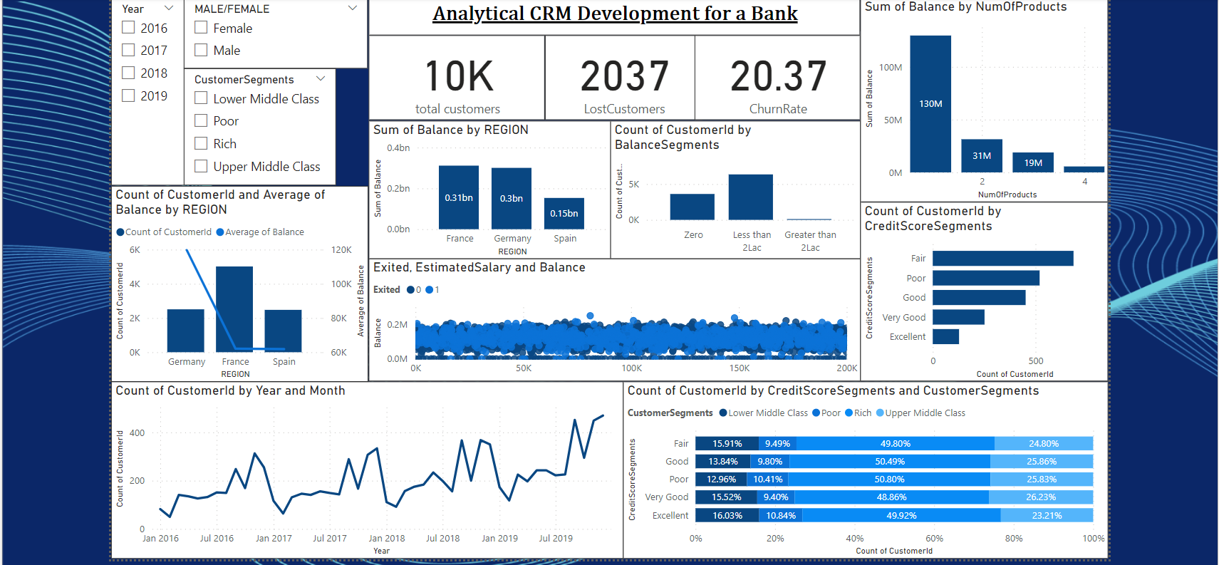
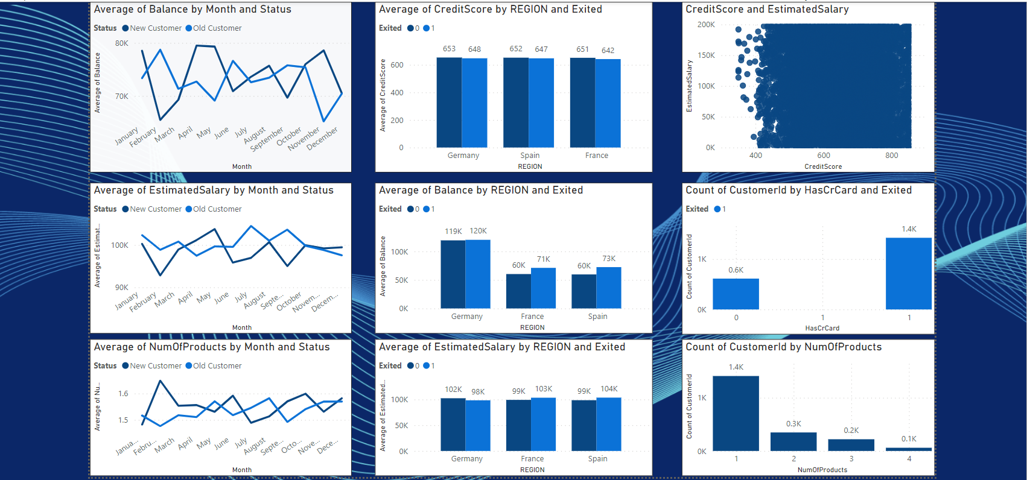
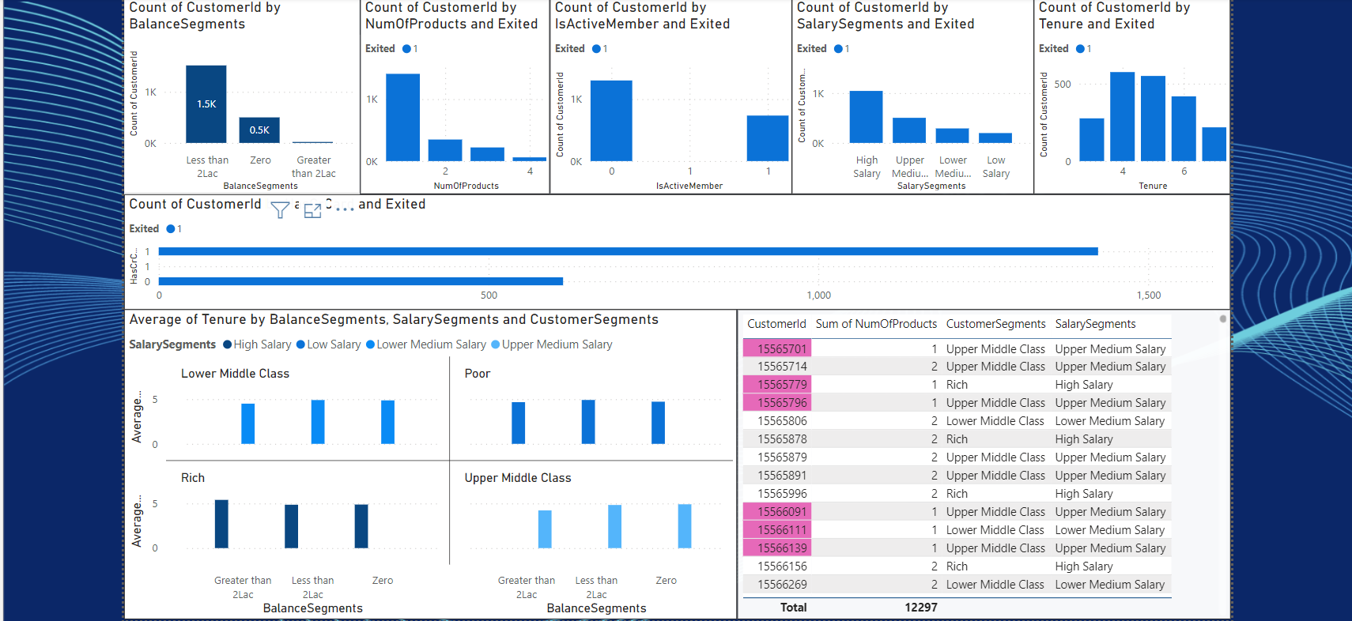
Dashboard

