Slide 1
Teach Yourself: HTML, CSS, and JavaScript – All in One Chapter 6: Working with Fonts, Text Blocks, Lists, and Tables
Introduction to Web Programming I CIS375/MFC215 Slides by Jim Gerland Instructor

Slide 2
Chapter 6: Working with Fonts, Text Blocks, Lists, and Tables
What You’ll Learn in This Chapter:
How to use boldface, italics, and special text formatting
How to tweak the font
How to use special characters
How to align text on a page
How to use the three types of HTML lists
How to place lists within lists
How to create simple tables
How to control the size of tables
How to align content and span rows and columns within tables
How to use CSS columns

Slide 3
Chapter 6: Working with Fonts, Text Blocks, Lists, and Tables
What You’ll Learn in This Chapter:
In the early days of the Web, text was displayed in only one font and one size. However, a combination of HTML and CSS now makes it possible to control the appearance of text (font type, size, color) and how it is aligned and displayed on a web page. In this chapter you’ll learn how to change the visual display of the font—its font family, size, and weight—and how to incorporate boldface, italics, superscripts, subscripts, and strikethrough text into your pages. You will also learn how to change typefaces and font sizes. Then, after becoming conversant in these textual aspects, you’ll learn the basics of text alignment and some advanced text tips and tricks, such as the use of lists. Because lists are so common, HTML provides tags that automatically indent text and add numbers, bullets, or other symbols in front of each listed item. You’ll learn how to format different types of lists, which are part of the many ways to display content in your website. Finally, you’ll learn how to build HTML tables that you can use to control the spacing, layout, and appearance of tabular data in your web content. Although you can achieve similar results using CSS, there are definitely times when a table is the best way to present information in rows and columns. You also see in this chapter how designers had to use tables for page layout in the past—and how to avoid ever doing that in the future.

Slide 4
Working with Special Characters
Before we rush headlong into font changes, let’s talk for a minute about special characters within fonts. Most fonts include special characters for European languages, such as the accented é in café. You’ll also find a few mathematical symbols and special punctuation marks, such as the circular • bullet.
Note: When viewing other designers’ web content, you might notice methods of marking up text that are different from those this book teaches. Some telltale signs of the old way of formatting text include the use of the <b></b> tag pair to indicate when a word should be bolded, the <i></i> tag pair to indicate when a word should be in italics, and the <font></font> tag pair to specify font family, size, and other attributes. However, this method is being phased out of HTML, and CSS is considerably more powerful.
You can insert these special characters at any point in an HTML document using the appropriate codes in Table 6.1. You’ll find an even more extensive list of codes for multiple character sets at the following URL: https://en.wikipedia.org/wiki/List_of_XML_and_HTML_character_entity_references

Slide 5
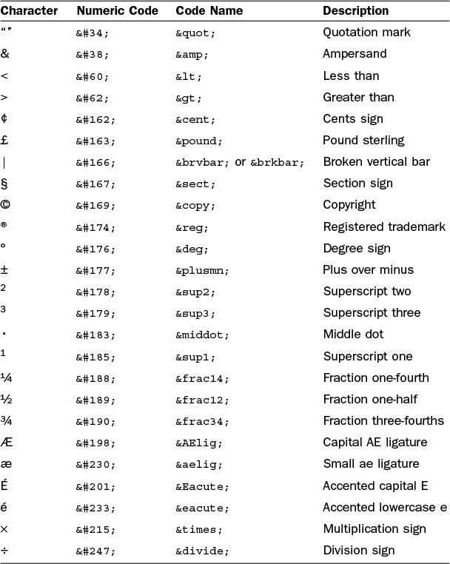
Working with Special Characters

Slide 6
Working with Special Characters
For example, you can produce the word café using either of the following methods: caf&eacute; caf&#233;
Tip: Looking for the copyright (©) and registered trademark (®) symbols? Those codes are &copy; and &reg;, respectively.
To create an unregistered trademark (™) symbol, use &trade;.
Although you can specify character entities by number, each symbol also has a mnemonic name that is often easier to remember.
HTML uses a special code known as a character entity to represent special characters such as © and ®. Character entities are always specified starting with & and ending with ;. The table on the previous lists the most commonly used character entities, although HTML supports many more.
This table also includes codes for the angle brackets, quotation, and ampersand. You must use those codes if you want these symbols to appear on your pages; otherwise, the web browser interprets them as HTML commands.

Slide 7
Working with Special Characters
<!DOCTYPE html> <html lang="en"> <head> <title>Punctuation Lines</title> <style type="text/css"> section { margin-bottom: 20px; } </style> </head> <body> <section> Q: What should you do when a British banker picks a fight with you?<br /> A: &pound; some &cent;&cent; into him. </section> <section> Q: What do you call it when a judge takes part of a law off the books?<br /> A: &sect; violence. </section> <section> Q: What did the football coach get from the locker room vending machine in the middle of the game?<br /> A: A &frac14; back at &frac12; time. </section> <section> Q: How hot did it get when the police detective interrogated the mathematician?<br /> A: x&sup3;&deg; </section> <section> Q: What does a punctilious plagiarist do?<br /> A: &copy; </section> </body> </html>

Slide 8
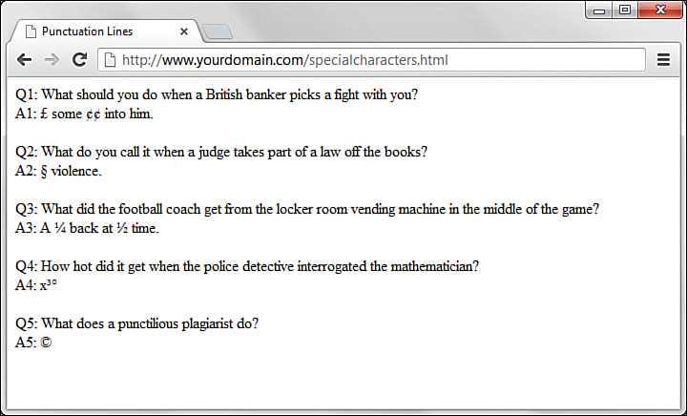
Working with Special Characters

Slide 9
Boldface, Italics, and Special Text Formatting
Way back in the age of the typewriter, we were content with a plain-text display and with using an occasional underline to show emphasis. Today, boldface and italic text have become de rigueur in all paper communication. Naturally, you can add bold and italic text to your web content as well. Several tags and style rules make text formatting possible.
Note: Although you want to use styles wherever possible to affect presentation, an alternative to style rules when it comes to bold and italic text involves the <strong></strong> and <em></em> tag pairs. The <strong> tag does the same thing as the <b> tag in most browsers, whereas the <em> tag acts just like the tag <i> by formatting text as italics. Of course, you can style these tags however you’d like, but those are the defaults.
The <strong> and <em> tags are considered an improvement over <b> and <i> because they imply only that the text should receive special emphasis; they don’t dictate exactly how that effect should be achieved. In other words, a browser doesn’t necessarily have to interpret <strong> as meaning bold or <em> as meaning italic. This makes <strong> and <em> more fitting in HTML5 because they add meaning to text, along with affecting how the text should be displayed.
The old-school approach—discussed briefly here because invariably you will see it in the source code of many websites, if you choose to look—to adding bold and italic formatting to text involves the <b></b> and <i></i> tag pairs. For boldface text, you wrap the <b> and </b> tags around your text. Similarly, to make any text appear in italics, you enclose it in <i> and </i> tags. Although this approach still works fine in browsers, it isn’t as flexible or powerful as the CSS style rules for text formatting and should be avoided.
Part III, “Advanced Web Page Design with CSS,” covers CSS style rules in more depth, but a little foreshadowing is appropriate here just so that you understand some basic text formatting options. The font-weight style rule enables you to set the weight, or boldness, of a font using a style rule. Standard settings for font-weight include normal, bold, bolder, and lighter (with normal being the default). Italic text is controlled via the font-style rule, which you can set to normal, italic, or oblique. You can specify style rules together as well if you want to apply more than one rule: <p style="font-weight:bold; font-style:italic">This paragraph is bold and italic!</p>

Slide 10
Boldface, Italics, and Special Text Formatting
In this example, both style rules are specified in the style attribute of the <p> tag. The key to using multiple style rules is that they must be separated by a semicolon (;).
You aren’t limited to using font styles in paragraphs, however. The following code shows how to italicize text in a bulleted list: <ul> <li style="font-style: italic;">Important Stuff</li> <li style="font-style: italic'">Critical Information</li> <li style="font-style: italic;">Highly Sensitive Material</li> <li>Nothing All That Useful</li> </ul>
You can also use the font-weight style rule within headings, but a heavier font usually doesn’t have an effect on headings because they are already bold by default.
Caution: In the past, a <u> tag was useful in creating underlined text, but you don’t want to use it now, for a couple of reasons. First, users expect underlined text to be a link, so they might get confused if you underline text that isn’t a link. Second, the <u> tag is obsolete, which means that it has been phased out of the HTML language (as has the <strike> tag). Both tags are still supported in web browsers and likely will be for quite a while, but using CSS is the preferred approach to creating underlined and strikethrough text.

Slide 11
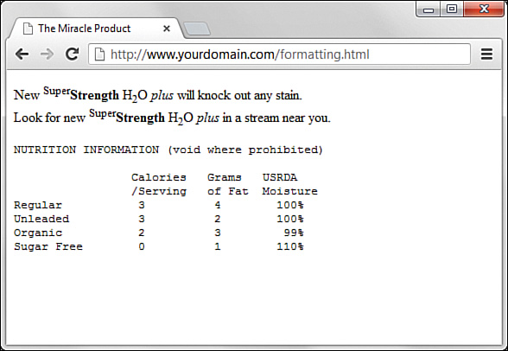
Boldface, Italics, and Special Text Formatting
Although using CSS enables you to apply richer formatting, there are a few other HTML5 tags that are good for adding special formatting to text when you don’t necessarily need to be as specific as CSS enables you to be. Following are some of these tags.
<sup></sup> — Superscript text
<sub></sub> — Subscript text
<em></em> — Emphasized (typically italic) text
<strong></strong> — Strong (typically boldface) text
<pre></pre> — Monospaced text, preserving spaces and line breaks

Slide 12
Boldface, Italics, and Special Text Formatting
<!DOCTYPE html> <html lang="en"> <head> <title>The Miracle Product</title> </head> <body> <p>New <sup>Super</sup><strong>Strength</strong> H<sub>2</sub>O <em>plus</em> will knock out any stain.<br/>Look for new <sup>Super</sup><strong>Strength</strong> H<sub>2</sub>O <em>plus</em> in a stream near you.</p> <pre> NUTRITION INFORMATION (void where prohibited) Calories Grams USRDA /Serving of Fat Moisture Regular 3 4 100% Unleaded 3 2 100% Organic 2 3 99% Sugar Free 0 1 110% </pre> </body> </html>

Slide 13
Boldface, Italics, and Special Text Formatting
The <pre> tag causes text to appear in the monospaced font—and does something else unique and useful. As you learned in Chapter 2, “Structuring an HTML Document,” multiple spaces and line breaks are normally ignored in HTML files, but <pre> causes exact spacing and line breaks to be preserved. For example, without <pre>, the text in the output would look like the following: calories grams usrda /serving of fat moisture regular 3 4 100% unleaded 3 2 100% organic 2 3 99% sugar free 0 1 110%
Even if you added <br /> tags at the end of every line, the columns wouldn’t line up properly. However, when you put <pre> at the beginning and </pre> at the end, the columns line up properly because the exact spaces are kept—no <br /> tags are needed. The <pre> tag gives you a quick and easy way to preserve the alignment of any monospaced text files you might want to transfer to a web page with minimum effort.
CSS provides you with more robust methods for lining up text (and doing anything with text, actually), and you’ll learn more about them throughout Part III.

Slide 14
Tweaking the Font
Sometimes you want a bit more control over the size and appearance of your text than just some boldface or italics. Before I get into the appropriate way to tinker with the font using CSS, let’s briefly look at how things were done before CSS—you might still find examples of this method when you look at the source code for other websites. Remember, just because these older methods are in use doesn’t mean you should follow suit.
Before style sheets entered the picture, the now-phased-out <font> tag was used to control the fonts in web page text.
For example, the following HTML was once used to change the size and color of some text on a page: <font size="5" color="purple">This text will be big and purple.</font>
Note: I cannot stress enough that the <font> tag is deprecated and should not to be used! It is used here for illustrative and historical purposes only.
As you can see, the size and color attributes of the <font> tag made it possible to alter the font of the text without too much effort. Although this approach worked fine, it was replaced with a far superior approach to font formatting, thanks to CSS style rules. Following are a few of the main style rules used to control fonts:
font-family — Sets the family (typeface) of the font
font-size — Sets the size of the font
color — Sets the color of the font
The font-family style rule enables you to set the typeface used to display text. You can and usually should specify more than one value for this style (separated by commas) so that if the first font isn’t available on a user’s system, the browser can try an alternative.

Slide 15
Tweaking the Font
Note: You’ll learn more about controlling the color of the text on your pages in Chapter 8, “Working with Colors, Images, and Multimedia.” That chapter also shows you how to create your own custom colors and how to control the color of text links.
Providing alternative font families is important because each user potentially has a different set of fonts installed, at least beyond a core set of common basic fonts (Arial, Times New Roman, and so forth). By providing a list of alternative fonts, you have a better chance of your pages gracefully falling back on a known font when your ideal font isn’t found.
Following is an example of the font-family style used to set the typeface for a paragraph of text: <p style="font-family:arial, sans-serif, 'times roman'">
This example has several interesting parts. First, arial is specified as the primary font. Capitalization does not affect the font family, so arial is no different from Arial or ARIAL. Another interesting point about this code is how single quotes are used around the times roman font name because it has a space in it. However, because 'times roman' appears after the generic specification of sans-serif, it is unlikely that 'times roman' would be used. Because sans-serif is in the second position, it says to the browser “if Arial is not on this machine, use the default sans-serif font.”
Note: You’ll learn about hexadecimal colors in Chapter 8. For now, just understand that the color style rule enables you to specify exact colors beyond just using green, blue, orange, and so forth.
The font-size and color style rules are also commonly used to control the size and color of fonts. The font-size style can be set to a predefined size (such as small, medium, or large), or you can set it to a specific point size (such as 12pt or 14pt). The color style can be set to a predefined color (such as white, black, blue, red, or green), or you can set it to a specific hexadecimal color (such as #ffb499). Following is a better version of the previous paragraph example, and with the font size and color specified: <p style="font-family: arial, 'times roman', sans-serif; font-size:14pt; color: green;">

Slide 16
Tweaking the Font
<!DOCTYPE html> <html lang="en"> <head> <title>R&eacute;sum&eacute; for Jane Doe</title> <style type="text/css"> body { font-family: Verdana, sans-serif; font-size: 12px; } header { text-align: center; } h1 { font-family:Georgia, serif; font-size: 28px; text-align: center; } p.contactinfo { font-size: 14px; } p.categorylabel { font-size: 12px; font-weight: bold; text-transform: uppercase; }

Slide 17
Tweaking the Font
div.indented { margin-left: 25px; } </style> </head> <body> <header> <h1>Jane Doe</h1> <p class="contactinfo">1234 Main Street, Sometown, CA 93829<br/> tel: 555-555-1212, e-mail: jane@doe.com</p> </header> <section> <p class="categorylabel">Summary of Qualifications</p> <ul> <li>Highly skilled and dedicated professional offering a solid background in whatever it is you need.</li> <li>Provide comprehensive direction for whatever it is that will get me a job.</li> <li>Computer proficient in a wide range of industry-related computer programs and equipment. Any industry.</li> </ul> </section>

Slide 18
Tweaking the Font
<section> <p class="categorylabel">Professional Experience</p> <div class="indented"> <p><strong>Operations Manager, Super Awesome Company, Some City, CA [Sept 2002 – present]</strong></p> <ul> <li>Direct all departmental operations</li> <li>Coordinate work with internal and external resources</li> <li>Generally in charge of everything</li> </ul> <p><strong>Project Manager, Less Awesome Company, Some City, CA [May 2000 – Sept 2002]</strong></p> <ul> <li>Direct all departmental operations</li> <li>Coordinate work with internal and external resources</li> <li>Generally in charge of everything</li> </ul> </div> </section>

Slide 19
Tweaking the Font
</section> <section> <p class="categorylabel">Education</p> <ul> <li>MBA, MyState University, May 2002</li> <li>B.A, Business Administration, MyState University,May 2000</li> </ul> </section> <section> <p class="categorylabel">References</p> <ul> <li>Available upon request.</li> </ul> </section> </body> </html>
Using CSS, which organizes sets of styles into classes—as you learned in Chapter 3, “Understanding Cascading Style Sheets”—you can see how text formatting is applied to different areas of this content. If you look closely at the definition of the div.indented class, you will see the use of the margin-left style. This style, which you will learn more about in Part III, applies a certain amount of space (25 pixels, in this example) to the left of the element. That space accounts for the indentation shown in the screen shot on the next slide.

Slide 20
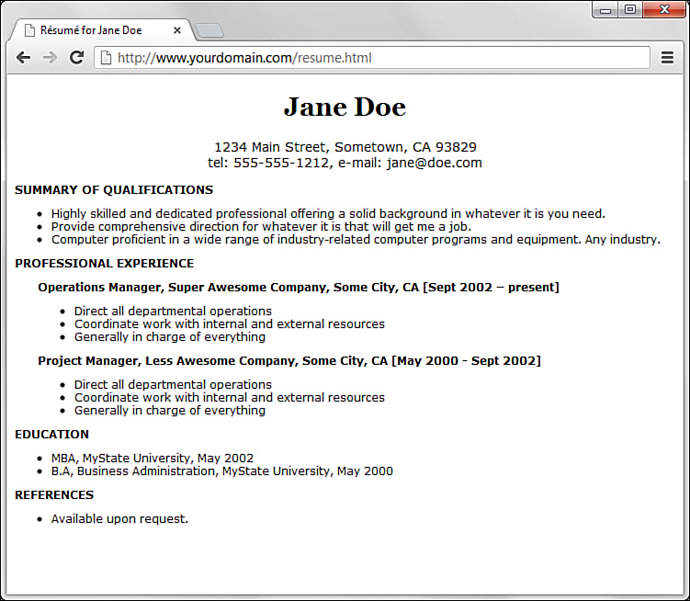
Tweaking the Font

Slide 21
Using Web Fonts
In the preceding section, you saw uses of font families that we’re pretty sure reside on everyone’s computers. That is, you can be assured that most computers would render Arial or Times New Roman, or have a go-to default font for serif and sans-serif, if that’s what your stylesheet calls for. But with the inclusion of the @font-face feature in CSS3, you can wield even greater design power over the content you place online.
In brief, the @font-face feature enables you to define fonts for use in your HTML5 markup so that they are displayed to users regardless of whether they have those fonts installed on their computer (and chances are incredibly great that users do not have your selected fancy font on their own computer). The definition of the font can be local (to your web server, if you care to include font files there) or remote (you can link to locations where many fonts are stored).
In your stylesheet, to define a new font for use throughout your page(s), you can simply use the following structure: @font-face { font-family: 'some_name_goes_here';- src: url('some_location_of_the_font_file'); }

Slide 22
Using Web Fonts
Note: If you look at the Google link location, you can see that it is Google’s @font-face definition already done for us. Specifically, it says: @font-face { font-family: 'Cherry Swash'; font-style: normal; font-weight: 400; src: local('Cherry Swash'), local('CherrySwash-Regular'), url(http://themes.googleusercontent.com/static/fonts/cherryswash/v1/HqOk7C7J1TZ5i3L- ejF0vnhCUOGz7vYGh680lGh-uXM.woff) format('woff'); } @font-face { font-family: 'Cherry Swash'; font-style: normal; font-weight: 700; src: local('Cherry Swash Bold'), local('CherrySwash-Bold'), url(http://themes.googleusercontent.com/static/fonts/cherryswash/v1/-CfyMyQqfucZPQNB0nvYyHl4twXkwp3_u9ZoePkT564.woff) format('woff'); }

Slide 23
Using Web Fonts
After it’s defined, you can refer to the font-family as you would anywhere else in your stylesheet, such as here: h1 { font-family: 'some_name_goes_here'; font-size: 28px; text-align: center; }
But where do you get fonts, you might ask? You can obtain fonts from many locations—some free, others not. A widely popular location is Google Web Fonts (http://www.google.com/fonts), not only because the fonts are free but also because Google is widely recognized as providing a stable platform, which is important if your web typography relies on a font that’s sitting on someone else’s web server. Some other reliable pay sites for obtaining fonts are TypeKit (typekit.com/) and Fontspring (www.fontspring.com). Pay sites aren’t necessarily bad—artists have to make money, too.
Let’s modify the previous code to include a Google Web Font for the h1 element. If you go to www.google.com/fonts and select a font you like, Google gives you code to include in your HTML and CSS. I’ve selected a font called Cherry Swash, and Google has advised me to include the following in my HTML template, in the <head> section: <link href='http://fonts.googleapis.com/css?family=Cherry+Swash:400,700' rel='stylesheet' type='text/css' />
Now that my code knows where to look for the font, we just refer to it: h1 { font-family:'Cherry Swash'; font-size:28px; text-align:center; }

Slide 24
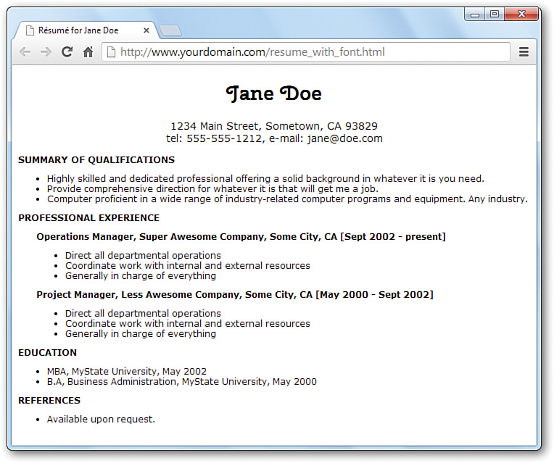
Using Web Fonts

Slide 25
Aligning Text on a Page
It’s easy to take for granted the fact that most paragraphs are automatically aligned to the left when you’re reading information on the Web. However, there certainly are situations in which you might choose to align content to the right or even the center of a page. HTML gives you the option to align a single HTML block-level element, such as text contained within a <p></p> or <div></div> tag pair. Before we get into the details of aligning block elements, however, let’s briefly note how attributes work.
Using Attributes
Attributes provide additional information related to an HTML tag. Attributes are special code words used inside an HTML tag to control exactly what the tag does. They are very important in even the simplest bit of web content, so it’s important that you are comfortable using them.
Attributes invoke the use of styles, classes, or IDs that are applied to particular tags. If you define a particular class or ID in a style sheet—as you learned in Chapter 3—then you can invoke that class or ID using class="someclass" or id="someid" within the tag itself. When the browser renders the content for display, it will look to the style sheet to determine exactly how the content will appear according to the associated style definitions. Similarly, you can use the style attribute to include style information for a particular element without connecting the element to an actual style sheet—this is the inline style format you learned about in Chapter 3.
In the following example, each paragraph could be left-aligned: <p style="text-align: left;">Text goes here.</p> <p class="leftAlignStyle">Text goes here.</p> <p id="firstLeftAlign">Text goes here.</p>
In the first paragraph, the style appears directly in the style attribute—this is useful for debugging or for short-term formatting tests, but not so much for ongoing maintenance of your web content. In the second paragraph, the paragraph will be left-aligned if the style sheet entry for the leftAlignStyle class includes the text-align statement; remember, using a class means that other tags can reuse the class. Similarly, the third paragraph will be left-aligned if the style sheet entry for the firstLeftAlign id includes the text-align statement; remember, using an id means that these styles can be applied to only the one identified tag.

Slide 26
Aligning Block-Level Elements
To align text in a block-level element such as <p> to the right margin without creating a separate class or ID in a style sheet, simply place style="text-align: right;" inside the <p> tag at the beginning of the paragraph (or define it in a class or an id). Similarly, to center the text in the element, use <p style="text-align: center;">. To align text in a paragraph to the left, use <p style="text-align: left;">.
The text-align part of the style attribute is referred to as a style rule, which means that it is setting a particular style aspect of an HTML element. You can use many style rules to carefully control the formatting of web content.
Note: Every attribute and style rule in HTML has a default value that is assumed when you don’t set the attribute yourself. In the case of the text-align style rule of the <p> tag, the default value is left, so using the bare-bones <p> tag has the same effect as using <p style="text-align: left;">. Learning the default values for common style rules is an important part of becoming a good web page developer.
The text-align style rule is not reserved for just the <p> tag. In fact, you can use the text-align style rule with any block-level element, which includes semantic elements such as <section> and <header>, as well as <h1>, <h2>, the other heading-level tags, and the <div> tag, among others. The <div> tag is especially handy because it can encompass other block-level elements and thus allow you to control the alignment of large portions of your web content all at once. The div in the <div> tag is for division.
The next listing demonstrates the style attribute and text-align style rule with different block-level elements.

Slide 27
Aligning Block-Level Elements
<!DOCTYPE html> <html lang="en"> <head> <title>Bohemia</title> </head> <body> <section style="text-align: center;"> <header> <h1>Bohemia</h1> <h2>by Dorothy Parker</h2> </header> </section> <section> <p style="text-align: left;">Authors and actors and artists and such<br /> Never know nothing, and never know much.<br /> Sculptors and singers and those of their kidney<br /> Tell their affairs from Seattle to Sydney.</p> <p style="text-align: center;">Playwrights and poets and such horses' necks<br /> Start off from anywhere, end up at sex.<br /> Diarists, critics, and similar roe<br /> Never say nothing, and never say no.</p> <p style="text-align: right;">People Who Do Things exceed my endurance;<br /> God, for a man that solicits insurance!</p> </section> </body> </html>

Slide 28
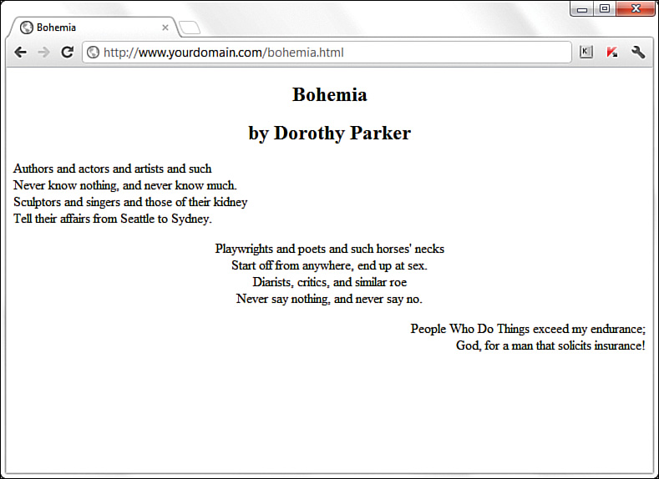
Aligning Block-Level Elements
The use of <section style="text-align: center;"> ensures that the content area, including the two headings, is centered. However, the inline styles applied to the individual paragraphs within the <section> override the setting and ensure that the text of the first paragraph is left-aligned, the second paragraph is centered, and the third paragraph is right-aligned.

Slide 29
The Three Types of HTML Lists
For clarity, it’s often useful to present information on a web page as a list of items. There are three basic types of HTML lists. All three are shown the following slide and reveals the HTML used to construct them.
Ordered list — An indented list that has numbers or letters before each list item. The ordered list begins with the <ol> tag and ends with a closing </ol> tag. List items are enclosed in the <li></li> tag pair and line breaks appear automatically at each opening <li> tag. The entire list is indented.
Unordered list — An indented list that has a bullet or another symbol before each list item. The unordered list begins with the <ul> tag and closes with </ul>. As with the ordered list, its list items are enclosed in the <li></li> tag pair. A line break and symbol appear at each opening <li> tag, and the entire list is indented.
Definition list — A list of terms and their meanings. This type of list, which has no special number, letter, or symbol before each item, begins with <dl> and ends with </dl>. The <dt></dt> tag pair encloses each term and the <dd></dd> tag pair encloses each definition. Line breaks and indentations appear automatically.

Slide 30
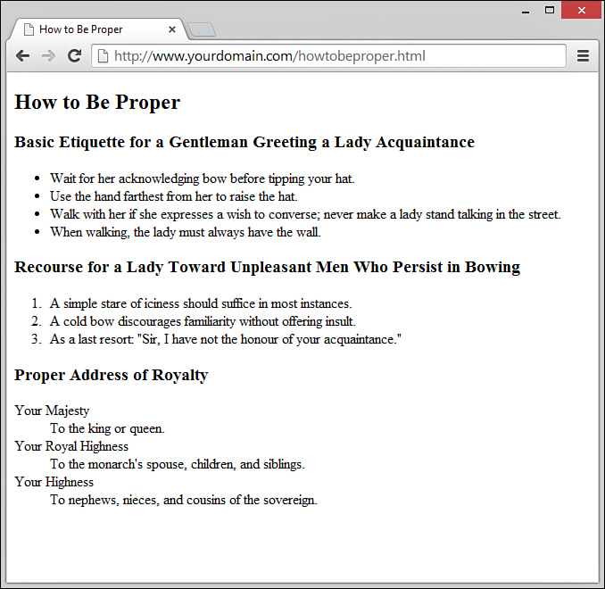
The Three Types of HTML Lists

Slide 31
The Three Types of HTML Lists
<!DOCTYPE html> <html lang="en"> <head> <title>How to Be Proper</title> </head> <body> <article> <header> <h1>How to Be Proper</h1> </header> <section> <header> <h1>Basic Etiquette for a Gentleman Greeting a Lady Acquaintance</h1> </header> <ul> <li>Wait for her acknowledging bow before tipping your hat.</li> <li>Use the hand farthest from her to raise the hat.</li> <li>Walk with her if she expresses a wish to converse; never make a lady stand talking in the street.</li> <li>When walking, the lady must always have the wall.</li> </ul> </section> <section> <header> <h1>Recourse for a Lady Toward Unpleasant Men Who Persist in Bowing</h1> </header> <ol> <li>A simple stare of iciness should suffice in most instances.</li> <li>A cold bow discourages familiarity without offering insult.</li> <li>As a last resort: "Sir, I have not the honour of your acquaintance."</li> </ol> </section> <section> <header> <h1>Proper Address of Royalty</h1> </header> <dl> <dt>Your Majesty</dt> <dd>To the king or queen.</dd> <dt>Your Royal Highness</dt> <dd>To the monarch's spouse, children, and siblings.</dd> <dt>Your Highness</dt> <dd>To nephews, nieces, and cousins of the sovereign.</dd> </dl> </section> </article> </body> </html>

Slide 32
The Three Types of HTML Lists
Note the use of semantic elements (<article>, <section>, and <header>) in the previous listing to provide a better sense of the content outline, including how the chunks of text relate to one another. Each of these elements could have their own styles applied to them, which would provide further visual separation of the elements.
Note: Remember that different web browsers can display web content quite differently. The HTML standard doesn’t specify exactly how web browsers should format lists, so users with older web browsers might not see exactly the same indentation you see. You can use CSS to gain precise control over list items, which you will learn about later in this chapter.

Slide 33
Placing Lists Within Lists
Although definition lists are officially supposed to be used for defining terms, many web page authors use them anywhere they’d like to see some indentation. In practice, you can indent any text simply by putting <dl><dd> at the beginning of it and </dd></dl> at the end and skipping over the <dt></dt> tag pair.
Because of the level of control over the display of your items that you have when using CSS, there is no need to use nested lists to achieve the visual appearance of indentation. Reserve your use of nested lists for when the content warrants it. In other words, use nested lists to show a hierarchy of information.
Note: Nesting refers to a tag that appears entirely within another tag. Nested tags are also referred to as child tags of the (parent) tag that contains them. It is a common (but not required) coding practice to indent nested tags so that you can easily see their relationship to the parent tag.
Ordered and unordered lists can be nested inside one another, down to as many levels as you want. In the listing, a complex indented outline is constructed from several unordered lists. Notice that the web browser automatically uses a different type of bullet for each of the first three levels of indentation, making the list very easy to read. This is common in modern browsers.

Slide 34
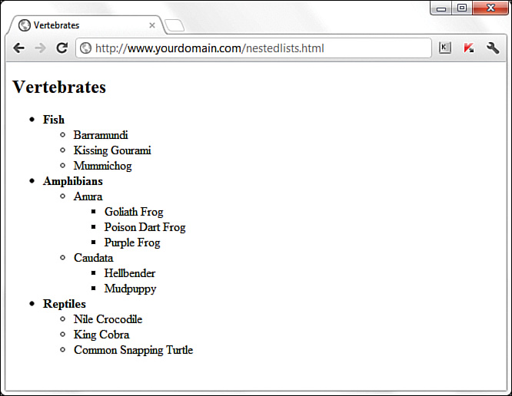
Placing Lists Within Lists

Slide 35
Placing Lists Within Lists
<!DOCTYPE html> <html lang="en"> <head> <title>Vertebrates</title> </head> <body> <section> <header> <h1>Vertebrates</h1> </header> <ul> <li><strong>Fish</strong> <ul> <li>Barramundi</li> <li>Kissing Gourami</li> <li>Mummichog</li> </ul> </li> <li><strong>Amphibians</strong> <ul> <li>Anura <ul> <li>Goliath Frog</li> <li>Poison Dart Frog</li> <li>Purple Frog</li> </ul> </li> <li>Caudata <ul> <li>Hellbender</li> <li>Mudpuppy</li> </ul> </li> </ul> </li> <li><strong>Reptiles</strong> <ul> <li>Nile Crocodile</li> <li>King Cobra</li> <li>Common Snapping Turtle</li> </ul> </li> </ul> </body> </html>

Slide 36
Placing Lists Within Lists
As the figure shows, a web browser normally uses a solid disc for the first-level bullet, a hollow circle for the second-level bullet, and a solid square for all deeper levels. However, you can explicitly choose which type of bullet to use for any level by using <ul style="list-style-type: disc;">, <ul style="list-style-type: circle;">, or <ul style="list-style-type: square;"> instead of <ul>, either inline or in a specific style sheet.
You can even change the bullet for any single point within an unordered list by using the list-style-type style rule in the <li> tag. For example, the following code displays a hollow circle in front of the words extra and super, and a solid square in front of the word special: <ul style="list-style-type: circle;"> <li>extra</li> <li>super</li> <li style="list-style-type: square;">special</li> </ul>
The list-style-type style rule also works with ordered lists, but instead of choosing a type of bullet, you choose the type of numbers or letters to place in front of each item. Listing 6.7 shows how to use Roman numerals (list-style-type:upper-roman), capital letters (list-style-type:upper-alpha), lowercase letters (list-style-type:lower-alpha), and ordinary numbers in a multilevel list

Slide 37
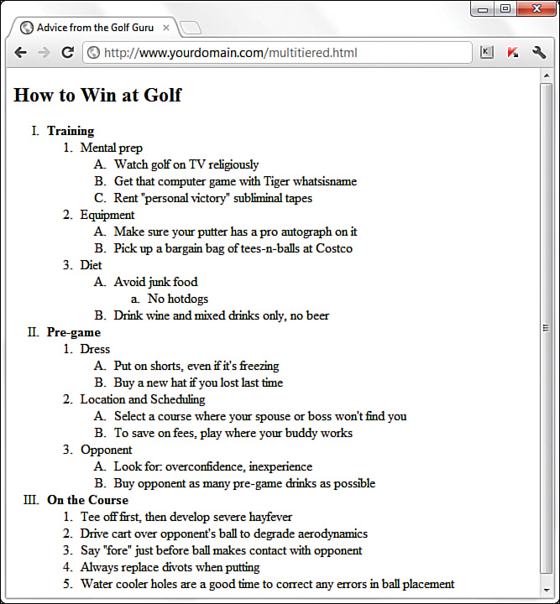
Placing Lists Within Lists

Slide 38
Placing Lists Within Lists
<!DOCTYPE html> <html lang="en"> <head> <title>Advice from the Golf Guru</title> </head> <body> <article> <header> <h1>How to Win at Golf</h1> </header> <ol style="list-style-type: upper-roman;"> <li><strong>Training</strong> <ol> <li>Mental prep <ol style="list-style-type: upper-alpha;"> <li>Watch golf on TV religiously</li> <li>Get that computer game with Tiger whatsisname</li> <li>Rent "personal victory" subliminal tapes</li> </ol> </li> <li>Equipment <ol style="list-style-type: upper-alpha;"> <li>Make sure your putter has a pro autograph on it</li> <li>Pick up a bargain bag of tees-n-balls at Costco</li> </ol> </li> <li>Diet <ol style="list-style-type: upper-alpha;"> <li>Avoid junk food <ol style="list-style-type: lower-alpha;"> <li>No hotdogs</li> </ol> </li> <li>Drink wine and mixed drinks only, no beer</li> </ol> </li> </ol> </li> <li><strong>Pre-game</strong> <ol> <li>Dress <ol style="list-style-type: upper-alpha;">
<li>Put on shorts, even if it's freezing</li> <li>Buy a new hat if you lost last time</li> </ol> </li> <li>Location and Scheduling <ol style="list-style-type: upper-alpha;"> <li>Select a course where your spouse or boss won't find you</li> <li>To save on fees, play where your buddy works</li> </ol> </li> <li>Opponent <ol style="list-style-type: upper-alpha;"> <li>Look for: overconfidence, inexperience</li> <li>Buy opponent as many pre-game drinks as possible</li> </ol> </li> </ol> </li> <li><strong>On the Course</strong> <ol> <li>Tee off first, then develop severe hayfever</li> <li>Drive cart over opponent's ball to degrade aerodynamics</li> <li>Say "fore" just before ball makes contact with opponent</li> <li>Always replace divots when putting</li> <li>Water cooler holes are a good time to correct any errors in Ball placement</li> </ol> </li> </ol> </article> </body> </html>

Slide 39
Summary
In this chapter, you learned how to make text appear as boldface or italic and how to code superscripts, subscripts, special symbols, and accented letters. You saw how to make the text line up properly in preformatted passages of monospaced text and how to control the size, color, and typeface of any section of text on a web page. You also learned that attributes are used to specify options and special behavior of many HTML tags, and you learned to use the style attribute with CSS style rules to affect the appearance of text. You also learned how to create and combine three basic types of HTML lists: ordered lists, unordered lists, and definition lists. Lists can be placed within other lists to create outlines and other complex arrangements of text.
Finally, you learned to arrange text and images into organized rows and columns called tables. You learned the basic tags for creating tables and several CSS properties for controlling the alignment, spacing, and appearance of tables. You also learned that tables are never to be used for layout purposes, but that you can achieve a multicolumn layout using CSS columns.

Slide 40
Creating a Simple Table
Another method for controlling the layout of information within your web pages is to display that information within a table. A table consists of rows of information with individual cells inside. To make tables, you have to start with a <table> tag. Of course, you end your tables with the </table> tag. CSS contains numerous properties that enable you to modify the table itself, such as the various border properties you learned about in previous chapters.
With the <table> tag in place, you next need the <tr> tag. The <tr> tag creates a table row, which contains one or more cells of information before the closing </tr>. To create these individual cells, use the <td> tag (<td> stands for table data). Place the table information between the <td> and </td> tags. A cell is a rectangular region that can contain any text, images, and HTML tags. Each row in a table consists of at least one cell. Multiple cells within a row form columns in a table.
One more basic tag is involved in building tables. The <th> tag works exactly like a <td> tag, except that <th> indicates that the cell is part of the heading of the table. Most web browsers automatically render the text in <th> cells as centered and boldface. However, if your browser does not automatically render this element with a built-in style, you have an element that you can style using CSS without using a class to differentiate among types of table data elements.

Slide 41
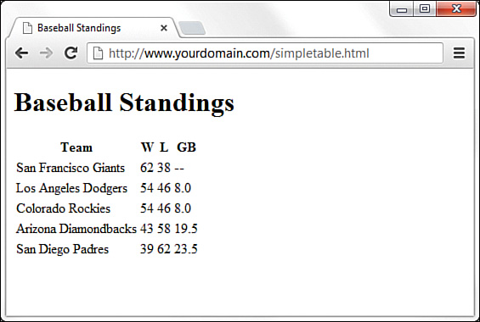
Creating a Simple Table
You can create as many cells as you want, but each row in a table should have the same number of columns as the other rows. The HTML creates a simple table using only the four table tags I’ve mentioned thus far.
Tip: You might find your HTML tables easier to read (and less prone to time-wasting errors) if you use spaces to indent <tr> and <td> tags. Remember, browsers ignore spaces when rendering HTML, so the layout of your code has no effect on the layout of the table that people will see.

Slide 42
Creating a Simple Table
<!DOCTYPE html> <html lang="en"> <head> <title>Baseball Standings</title> </head> <body> <h1>Baseball Standings</h1> <table> <tr> <th>Team</th> <th>W</th> <th>L</th> <th>GB</th> </tr> <tr> <td>San Francisco Giants</td> <td>54</td> <td>46</td> <td>8.0</td> </tr> <tr> <td>Los Angeles Dodgers</td> <td>62</td> <td>38</td> <td>—</td> </tr>
<tr> <td>Colorado Rockies</td> <td>54</td> <td>46</td> <td>8.0</td> </tr> <tr> <td>Arizona Diamondbacks</td> <td>43</td> <td>58</td> <td>19.5</td> </tr> <tr> <td>San Diego Padres</td> <td>39</td> <td>62</td> <td>23.5</td> </tr> </table> </body> </html>

Slide 43
Creating a Simple Table
The table in the example contains baseball standings, which are perfect for arranging in rows and columns—but they’re a little plain. For instance, this example doesn’t even have any borders! You’ll learn to jazz things up a bit in just a moment. The headings in the table show the Team, Wins (W), Losses (L), and Games Behind (GB) in the standings.
Adding the following stylesheet entries takes care of adding a basic border around the table and its cells: table, tr, th, td { border: 1px solid black; border-collapse: collapse; padding: 3px; }
You might wonder why you have to specify these styles for all four elements used to create the table instead of just the overall table element itself. Basically, this is because a table is made up of its elements, and each element can have these styles applied. The following figures demonstrate how the table would look with various elements styles or unstyled, to emphasize this point.
The next figure shows the output of the styles just listed. The border-collapse property, with a value of collapse, makes all the borders of the <table>, <tr>, and <th> or <td> elements collapse into one shared border. The padding adds a little breathing room to the content of the cells.

Slide 44
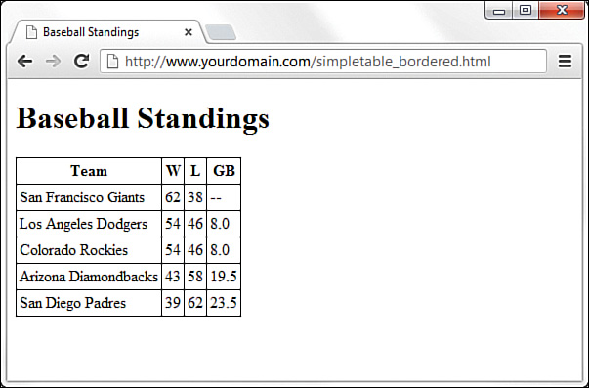
Creating a Simple Table

Slide 45
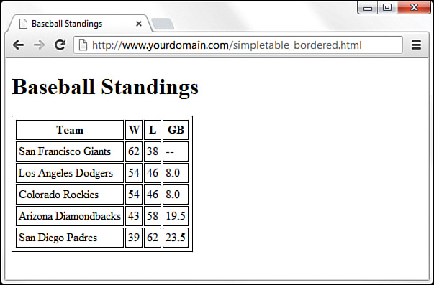
Creating a Simple Table
You can see what the table would look like without the border-collapse property specified (the default value then takes effect, which is separate, for separate borders).

Slide 46
Creating a Simple Table
Tip: You can employ three other useful but not required table-related tags when creating simple tables:
<thead></thead> — Wrap your header rows in this element to add more meaning to the grouping and also allow these header rows to be printed across all pages (if your table is that long). You can then style the <thead> element instead of individual <th> cells.
<tbody></tbody> — Wrap the rows that make up the “body” of this table (everything besides the header and the footer rows) in this element, to add more meaning to the grouping; you can then also style the <tbody> element as a whole instead of styling individual <td> cells.
<tfoot></tfoot> — Much like the <thead> element, use this to wrap your footer rows (if you have any) in this element, to add more meaning to the grouping and style it as a whole. An example of a footer row might be a summation of the data presented in the columns, such as financial totals.

Slide 47
Controlling Table Sizes
When a table width is not specified, the size of a table and its individual cells automatically expand to fit the data you place into it. However, you can control the width of the entire table by defining the width CSS property for the <table> element; you can also define the width of each cell through the width CSS property assigned to the <td> elements. The width property can be specified as either pixels, ems, or percentages.
To make the first cell of a table 20% of the total table width and the second cell 80% of the table width, you use the following property definitions: <table style="width: 100%;"> <tr> <td style="width: 20%;">skinny cell</td> <td style="width: 80%;">fat cell</td> </tr> </table>
Notice that the table is sized to 100%, which ensures that it fills the entire width of the browser window. When you use percentages instead of fixed pixel sizes, the table resizes automatically to fit any size browser window while maintaining the aesthetic balance you’re seeking. In this case, the two cells within the table are automatically resized to 20% and 80% of the total table width, respectively.
In the next listing, the simple table (plus the border-related styles) is expanded to show very precise control over table cell widths (plus, the border-related styles have been added).

Slide 48
Controlling Table Sizes
<!DOCTYPE html> <html lang="en"> <head> <title>Baseball Standings</title> <style type="text/css"> table, tr, th, td { border: 1px solid black; border-collapse: collapse; padding: 3px; } </style> </head> <body> <h1>Baseball Standings</h1> <table> <tr> <th style="width: 200px;">Team</th> <th style="width: 25px;">W</th> <th style="width: 25px;">L</th> <th style="width: 25px;">GB</th> </tr> <tr> <td>San Francisco Giants</td> <td>62</td> <td>38</td> <td>--</td>
</tr> <tr> <td>Los Angeles Dodgers</td> <td>54</td> <td>46</td> <td>8.0</td> </tr> <tr> <td>Colorado Rockies</td> <td>54</td> <td>46</td> <td>8.0</td> </tr> <tr> <td>Arizona Diamondbacks</td> <td>43</td> <td>58</td> <td>19.5</td> </tr> <tr> <td>San Diego Padres</td> <td>39</td> <td>62</td> <td>23.5</td> </tr> </table> </body> </html>

Slide 49
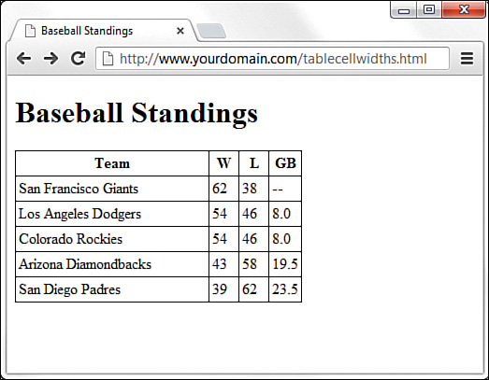
Controlling Table Sizes

Slide 50
Controlling Table Sizes
The addition of a specific width style for each <th> element in the first row defines the widths of the columns. The first column is defined as 200px wide, and the second, third, and fourth columns are each 25px wide. In You can see whitespace after the text in the first column, indicating that the specified width is indeed greater than the column width would have been had the table been allowed to render without explicit width indicators.
Also note that these widths are not repeated in the <td> elements in subsequent rows. Technically, you need to define the widths in only the first row; the remaining rows will follow suit because they are all part of the same table. However, if you had used another formatting style (such as a style to change font size or color), you would’ve had to repeat that style for each element that should have those display properties.

Slide 51
Alignment and Spanning Within Tables
By default, anything you place inside a table cell is aligned to the left and vertically centered. All the figures so far in this lesson have shown this default alignment. However, you can align the contents of table cells both horizontally and vertically with the text-align and vertical-align style properties.
You can apply these alignment attributes to any <tr>, <td>, or <th> tag. Alignment attributes assigned to a <tr> tag apply to all cells in that row. Depending on the size of your table, you can save yourself some time and effort by applying these attributes at the <tr> level and not in each <td> or <th> tag.
The HTML code in the next uses a combination of text alignment styles to apply a default alignment to a row, but it is overridden in a few individual cells.

Slide 52
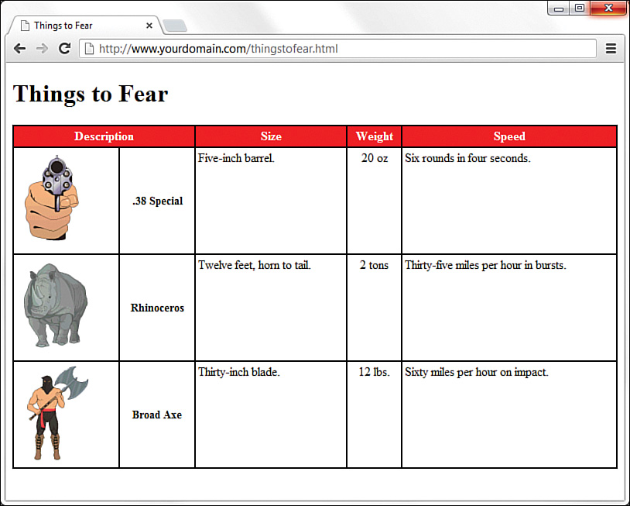
Alignment and Spanning Within Tables
<!DOCTYPE html> <html lang="en"> <head> <title>Things to Fear</title> <style type="text/css"> table { border: 2px solid black; border-collapse: collapse; padding: 3px; width: 100%; } tr, th, td { border: 2px solid black; border-collapse: collapse; padding: 3px; } thead { background-color: #ff0000; color: #ffffff;
} .aligntop { vertical-align:top; } .description { font-size: 14px; font-weight: bold; vertical-align: middle; text-align: center; } .weight { text-align: center; } </style> </head> <body> <h1>Things to Fear</h1>
<table> <thead> <tr> <th colspan="2">Description</th> <th>Size</th> <th>Weight</th> <th>Speed</th> </tr> </thead> <tr class="aligntop"> <td><img src="handgun.gif" alt=".38 Special"/></td> <td class="description">.38 Special</td> <td>Five-inch barrel.</td> <td class="weight">20 oz.</td> <td>Six rounds in four seconds.</td> </tr> <tr class="aligntop"> <td><img src="rhino.gif" alt="Rhinoceros" /></td> <td class="description">Rhinoceros</td> <td>Twelve feet, horn to tail.</td> <td class="weight">2 tons</td> <td>Thirty-five miles per hour in bursts.</td> </tr> <tr class="aligntop"> <td><img src="axeman.gif" alt="Broad Axe" /></td> <td class="description">Broad Axe</td> <td>Thirty-inch blade.</td> <td class="weight">12 lbs.</td> <td>Sixty miles per hour on impact.</td> </tr> </table> </body></html>

Slide 53
Alignment and Spanning Within Tables
Following are some of the more commonly used vertical-align style property values: top, middle, bottom, text-top, text-bottom, and baseline (for text). These property values give you plenty of flexibility in aligning table data vertically.

Slide 54
Alignment and Spanning Within Tables
Tip: Keeping the structure of rows and columns organized in your mind can be the most difficult part of creating tables with cells that span multiple columns or rows. The tiniest error can often throw the whole thing into disarray. You can save yourself time and frustration by sketching complicated tables on paper before you start writing the HTML to implement them.
Note: You often see alternating row colors in a table. For instance, one row might have a gray background, and the next row might have a white background. Alternating the row colors helps users read the content of your table more clearly, especially if the table is large.
At the top of the web page, a single cell (Description) spans two columns. This is accomplished with the colspan attribute in the <th> tag for that cell. As you might guess, you can also use the rowspan attribute to create a cell that spans more than one row.
Spanning is the process of forcing a cell to stretch across more than one row or column of a table. The colspan attribute causes a cell to span multiple columns; rowspan has the same effect on rows.
Additionally, text styles are defined in the stylesheet and applied to the cells in the Description column to create bold text that is both vertically aligned to the middle and horizontally aligned to the center of the cell.

Slide 55
Alignment and Spanning Within Tables
A few tricks in Listing 6.10 haven’t been explained yet. You can give an entire table—and each individual row or cell in a table—its own background, distinct from any background you might use on the web page itself. You can do this by placing the background-color or background-image style in the <table>, <tr>, <td>, <th>, <thead>, <tbody>, or <tfooter> tags (or assigning the value in the stylesheet for these elements), exactly as you would in the <body> tag. In Listing 6.10, only the top row has a background color; the stylesheet defines the <thead> element as one with a red background and white text in the cells in that row.
Similar to the background-color style property is the background-image property (not shown in this example), which is used to set an image for a table background. If you wanted to set the image leaves.gif as the background for a table, you would use background-image:url(leaves.gif) in the stylesheet entry for the <table> element. Notice that the image file is placed within parentheses and preceded by the word url, which indicates that you are describing where the image file is located.
Tweaking tables goes beyond just using style properties. As Listing 6.10 shows, you can control the space around the content of the cell, within its borders, by applying some padding to the cell. If you want to add some space between the borders of the cells themselves, you can use the border-spacing CSS property, which enables you to define the horizontal and vertical spacing like so: border-spacing: 2px 4px;
In the example, spacing is defined as 2 pixels of space between the horizontal borders, and 4 pixels of space between the vertical borders. If you use only one value, the value is applied to all four borders.

Slide 56
Page Layout with Tables: Don't Do It!
At the beginning of this chapter, I indicated that designers have used tables for page layout, as well as to display tabular information. You will still find many examples of table-based layouts if you peek at another designer’s source code. This method of design grew out of inconsistencies in browser support for CSS in the mid-1990s to early 2000s. Because all browsers supported tables, and in generally the same way, web designers latched on to the table-based method of content layout to achieve the same visual page display across all browsers. However, now that support for CSS is relatively similar across all major browsers, designers can follow the long-standing standards-based recommendation not to use tables for page layout.
The World Wide Web Consortium (W3C), the standards body that oversees the future of the web, has long promoted style sheets as the proper way to lay out pages (instead of using tables). Style sheets are ultimately much more powerful than tables, which is why the bulk of this book teaches you how to use style sheets for page layout.
The main reasons for avoiding using tables for layout include these:
Mixing presentation with content — One goal of CSS and standards-compliant web design is to separate the presentation layer from the content layer.
Creating unnecessarily difficult redesigns — To change a table-based layout, you have to change the table-based layout on every single page of your site (unless it is part of a complicated, dynamically driven site, in which case you have to undo all the dynamic pieces and remake them).
Addressing accessibility issues — Screen reading software looks to tables for content and often tries to read layout tables as content tables.
Rendering on mobile devices — Table layouts are often not flexible enough to scale downward to small screens (see Chapter 12, “Creating Fixed or Liquid Layouts”).
These are but a few of the issues in table-based web design. For a closer look at some of these issues, see the popular presentation “Why Tables for Layout Is Stupid,” at http://www.hotdesign.com/seybold/everything.html

Slide 57
Using CSS Columns
If you have a large amount of text-only information, you might want to present it much like a physical newspaper does: in columns. Over a hundred years of research have shown a correlation between the length of a line and reading speed, and indicated a “sweet spot,” or optimum length of a line that allows for a quick and enjoyable reading experience. The continued presence of this sweet spot—lines that are around 4 inches long—is why physical newspapers still present information in columns.
If you have a lot of information to present to readers, or if you simply want to mimic the aesthetic of a newspaper layout, you can use CSS columns. True, you could also use a table, because tables are made of rows and columns, but the preceding section explained some of the reasons to avoid a table-based layout. Also, columns aren’t just for text; you can put anything you want into defined columns, such as advertisements or related text in a sidebar.

Slide 58
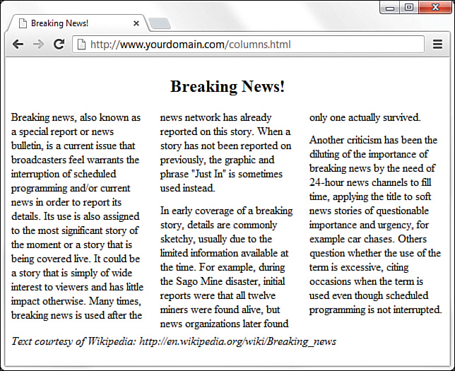
Using CSS Columns

Slide 59
Using CSS Columns
<!DOCTYPE html> <html lang="en"> <head> <title>Breaking News!</title> <style type="text/css"> article { -webkit-column-count: 3; -webkit-column-gap: 21px; -moz-column-count: 3; -moz-column-gap: 21px; column-count: 3; column-gap: 21px; } h1 { text-align: center; -webkit-column-span: all; -moz-column-span: all; column-span: all; } p { margin-top: 0px; margin-bottom: 12px; } footer { -webkit-column-span: all; -moz-column-span: all; column-span: all; } </style>
</head> <body> <article> <header> <h1>Breaking News!</h1> </header> <p>Breaking news, also known as a special report or news bulletin, is a current issue that broadcasters feel warrants the interruption of scheduled programming and/or current news in order to report its details. Its use is also assigned to the most significant story of he moment or a story that is being covered live. It could be a story that is simply of wide interest to viewers and has little impact otherwise. Many times, breaking news is used after the news network has already reported on this story. When a story has not been reported on previously, the graphic and phrase "Just In" is sometimes used instead.</p> <p>In early coverage of a breaking story, details are commonly sketchy, usually due to the limited information available at the time. For example, during the Sago Mine disaster, initial reports were that all twelve miners were found alive, but news organizations later found only one actually survived.</p> <p>Another criticism has been the diluting of the importance of breaking news by the need of 24-hour news channels to fill time, applying the title to soft news stories of questionable importance and urgency, for example car chases. Others question whether the use of the term is excessive, citing occasions when the term is used even though scheduled programming is not interrupted.</p> <footer> <em>Text courtesy of Wikipedia http://en.wikipedia.org/wiki/Breaking_news</em> </footer> </article> </body> </html>

Slide 60
Using CSS Columns
The code the previous listing is from a fake news article, so I’ve used the <article> element to hold all the content. Inside the <article> element is a <header> element that contains the “Breaking News!” heading (at the <h1> level), followed by three paragraphs of text and a <footer> element. All the styling is handled in the stylesheet at the beginning of the listing; styles are provided for four of the elements just named: <article>, <h1>, <p>, and <footer>.
Note: In the stylesheet, note that, for each column-related property in the stylesheet, I’ve added two additional entries with -webkit and -moz prefixes. Because browser support for column-related CSS is still a bit inconsistent, using the properties with these prefixes ensures that the properties will work in all browsers.
In the stylesheet, I’m applying the primary definition of the columns within the <article> element. I’ve used column-count to define three columns, and I’ve used column-gap to define the space between the columns as 21 pixels wide. Next, I’ve added a definition for the <h1> element, first to make the text align in the center of the page, and second to ensure that the text spans all the columns. I applied the same column-span property to the entry for the <footer> element, for the same reason.
After the entry for the <h1> element, I added some specific margins to the <p> element, namely, a top margin of 0 pixels and a bottom margin of 12 pixels. I could have left well enough alone and just allowed the <p> elements to display as the default style, but that would have created a margin at the top of each paragraph. “What’s the big deal?” you might ask, because it looks as though I’ve manually added space between the paragraphs anyway—and that’s true. However, I added the space after each paragraph and took away the space before each paragraph so that the first column doesn’t begin with a space and thus misalign the tops of each of the three columns.
You can even add vertical lines between columns. The stylesheet entries I added to achieve this appearance are shown here; note that they look remarkably similar to how you define borders (which you will learn about in the next chapter).

Slide 61
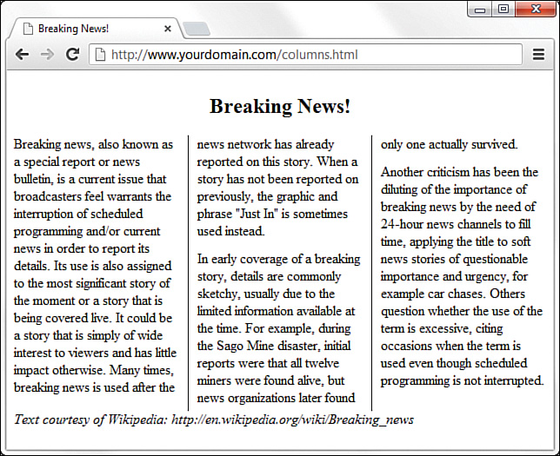
Using CSS Columns
Use this CSS code to add vertical lines between the columns:
-webkit-column-rule-width: 1px;
-moz-column-rule-width: 1px;
column-rule-width: 1px;
-webkit-column-rule-style: solid;
-moz-column-rule-style: solid;
column-rule-style: solid;
-webkit-column-rule-color: #000;
-moz-column-rule-color: #000;
column-rule-color: #000;

Slide 62
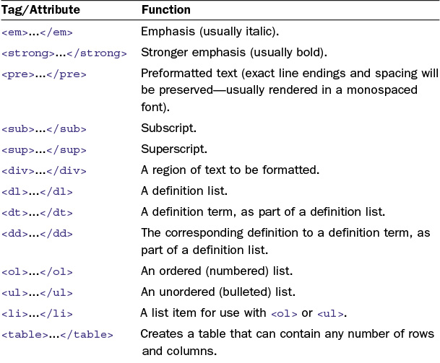
Summary

Slide 63
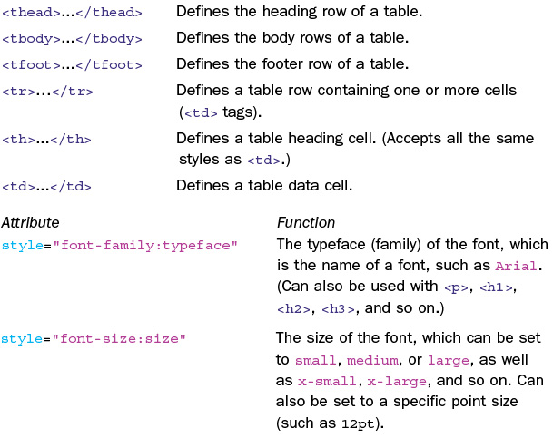
Summary

Slide 64
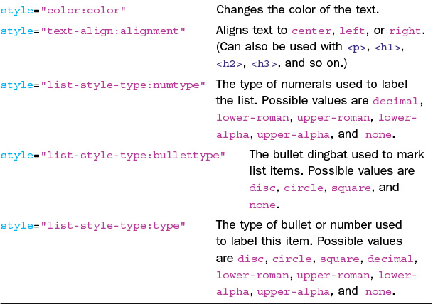
Summary

