Slide 1
Analysis of the Lightning Fee Market
Ken Sedgwick
Bonsai Software

Slide 2
What are Current Lightning
Network Fee Rates?

Slide 3
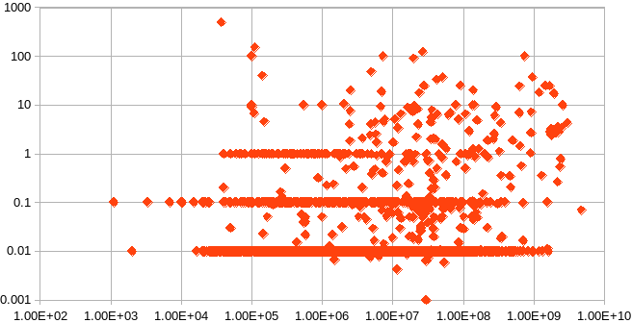
Node Fee Rate vs Node Capacity
Fee Rate (bps)
Node Capacity (sat)

Slide 4
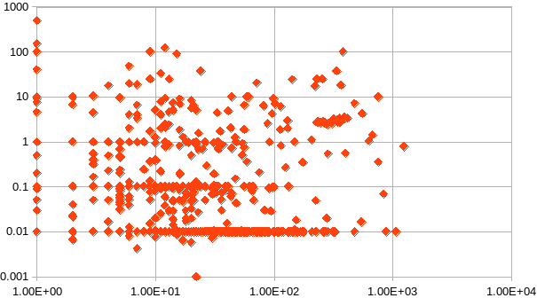
Node Fee Rate vs Node Channel Count
Fee Rate (bps)
Node Channel Count

Slide 5
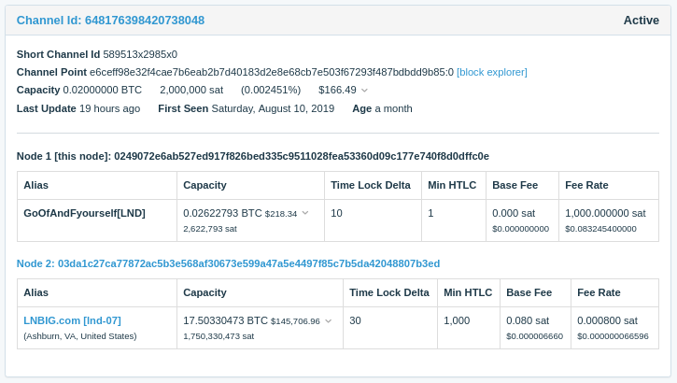
Wow, 100,000%!!

Slide 6
What are the Market Forces on Fee Rates?

Slide 7
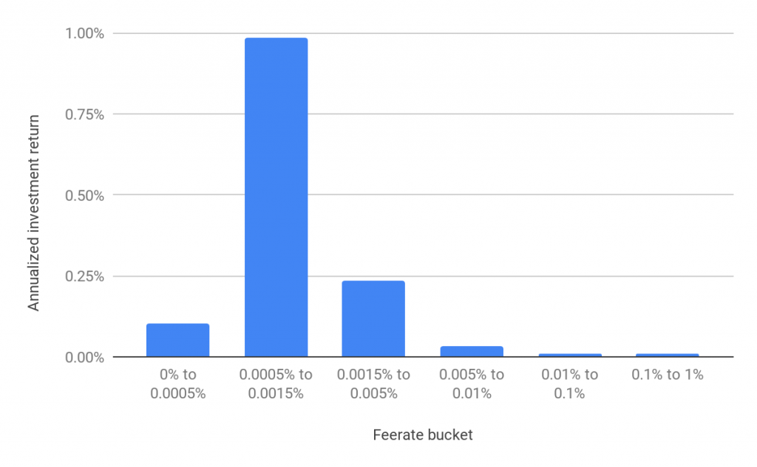
Profitability vs Lightning Fee Rate
0.1 bps
0.33 bps
0.75 bps
5 bps
50 bps
Source: BitMEX Research, “The Lightning Network (Part 2) – Routing Fee Economics”

Slide 8
Linear Payment Flows
Source
Route
Route
Sink

Slide 9
Linear Payment Flows
Source
Route
Route
Sink

Slide 10
Linear Payment Flows
Source
Route
Route
Sink

Slide 11
Methods to Refresh/Replenish Channels
Off-chain “looping” is likely to unbalance neighbors, no net “network” gain.
On-chain Mechanisms Work:
Close spent channel and open fresh channel
Loop-in and loop-out
Splicing

Slide 12
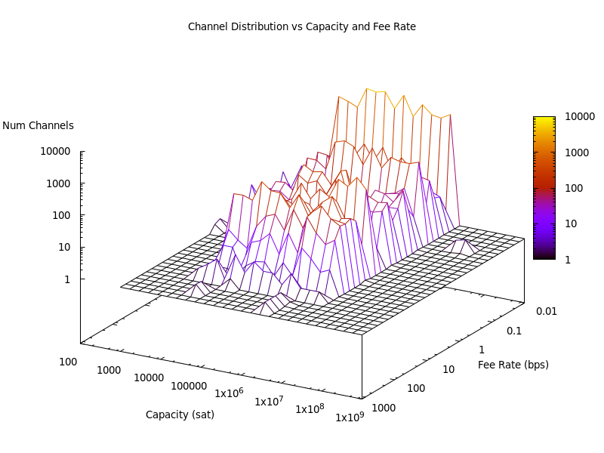

Slide 13
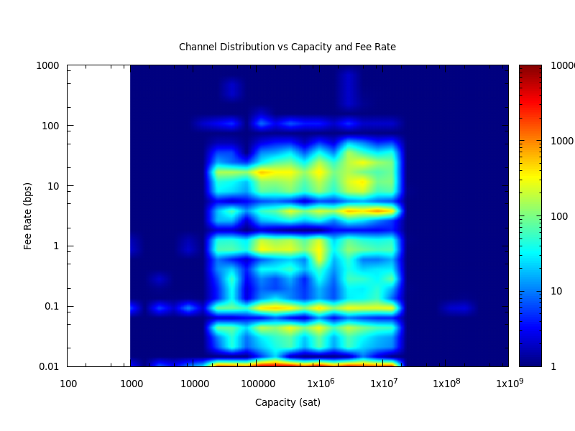

Slide 14
Break-even Fee Calculation
VSZ: Virtual size of funding transaction (150 vbyte)
BFR: Fee rate of on-chain bitcoin transaction (sats/vbyte)
CAP: Size of the created channel (sats)
LFR: Resulting break-even lightning fee rate (bps)
LFR = 10000 * BFR * VSZ / CAP

Slide 15
1
sat/vbyte
10
sat/vbyte
100
sat/vbyte

Slide 16
Observations
Larger channel sizes help
Fee rates of a few bps work

Slide 17
How does this compare to credit cards?
Square charges 275 bps (2.75%) of each swiped transaction
5 hops at 10 bps each is only 50 bps!

Slide 18
What Happens in the Future?

Slide 19
Things Get Better
As the network scales, more endpoints can both send and receive off-chain. Less dominated by “sources” and “sinks”.
Off-chain looping becomes viable; channels can be replenished without unbalancing neighbors.
Lightning Fee Rates Should Decrease

Slide 20
Conclusions
Many current lightning channels are not charging enough fees to cover on-chain replacement.
Lightning fee rates of a few basis points are achievable and sustainable.
As the network becomes larger loops will become more prevalent and fee rates can fall further.

Slide 21
Thanks!

Slide 22
What does Steady State Look Like?
“Modeling a Steady-State Lightning Network Economy” - Gregorio Guidi
“In particular, we have seen how the condition for having balanced income and expenses implies that the demand imbalance on the channels of the network flows around in “circuits”, and that letting the system evolve towards equilibrium (breaking the circuits) causes a spanning tree to emerge from the topology of the network.”

