Slide 1
3D BEC Polaron: Distribution Functions

Slide 2
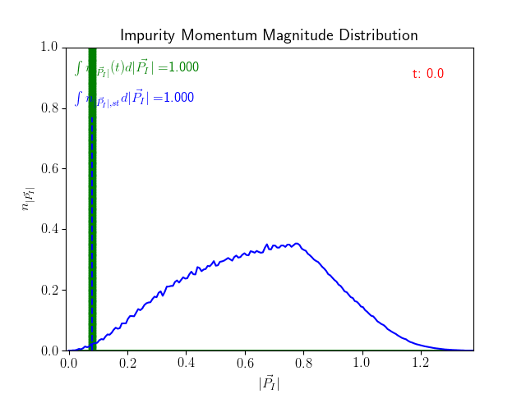
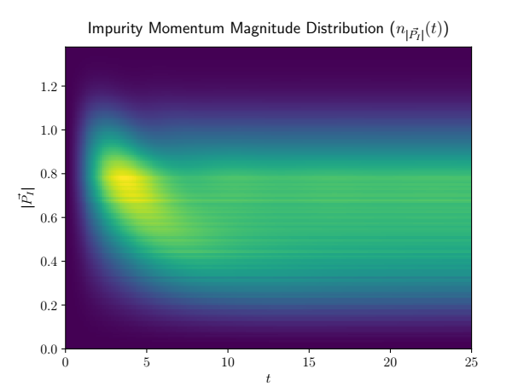
Impurity Momentum Magnitude Distribution

Slide 3
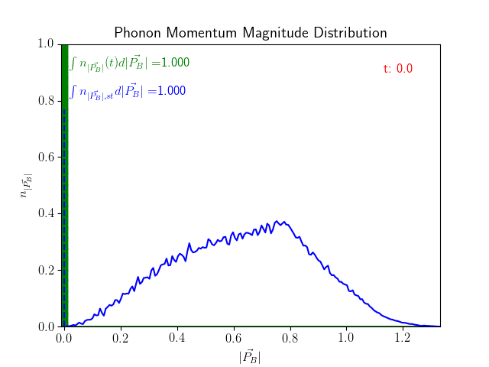
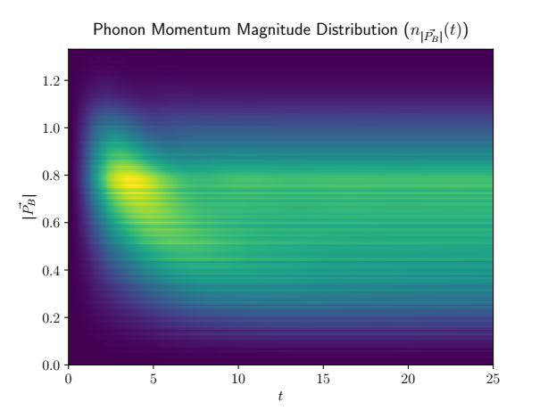
Phonon Momentum Magnitude Distribution

Slide 4
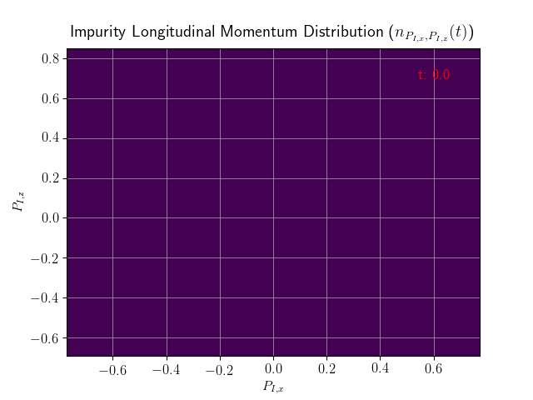
Impurity Momentum Slice Distributions

Slide 5
Phonon Momentum Slice Distributions

