Slide 1
Static and Dynamics Comparison

Slide 2
Parameters
P = 0.079 (~0)
aIBi = -2 (resonance at ~1)
|k| Cutoff: 2.72
gIB = -3.37
gBB = 1
mI = mB = 1
n0 = 1

Slide 3
Static Expressions

Slide 4
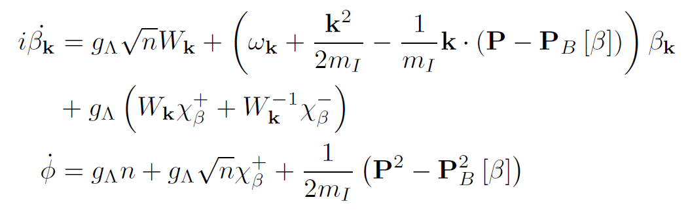
Equations of Motion
Real Time:
-1
Imaginary Time

Slide 5
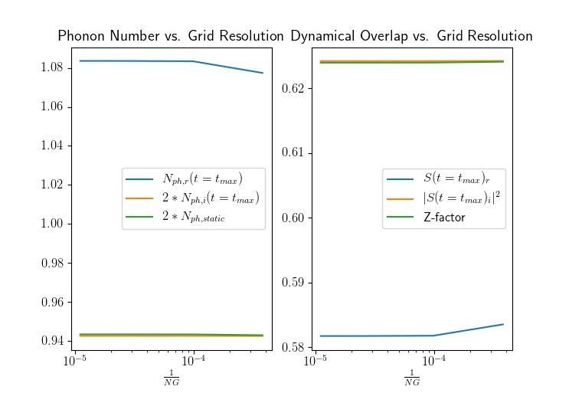
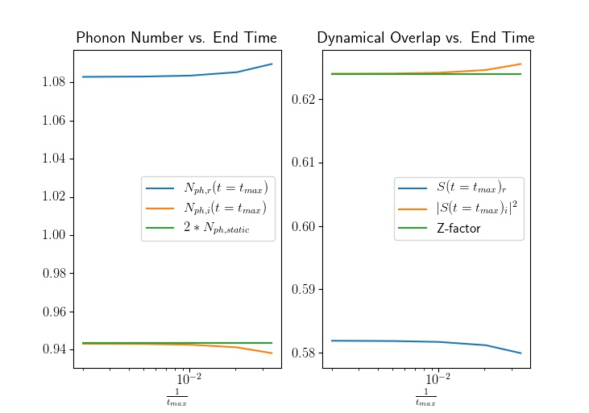
Real Time, Imaginary Time, Static Comparison
Y-axis scaling: auto

Slide 6
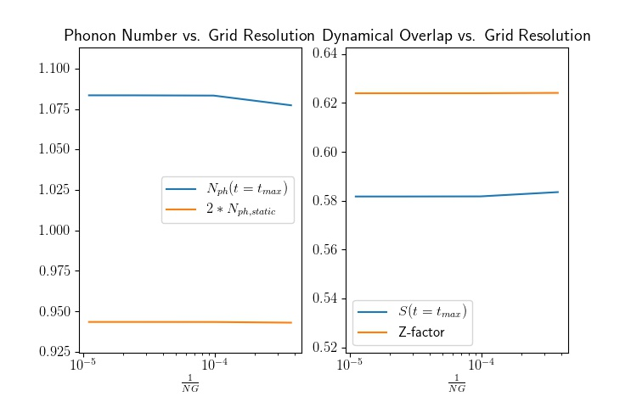
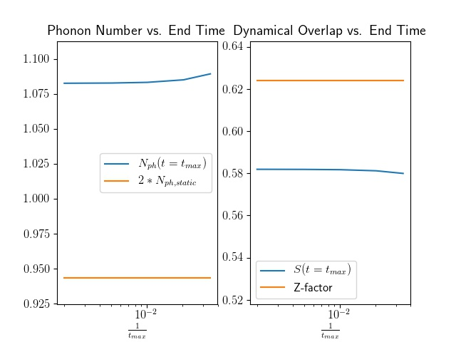
Real Time Dynamics vs. Static
Y-axis scaling: 20% range around static value

Slide 7
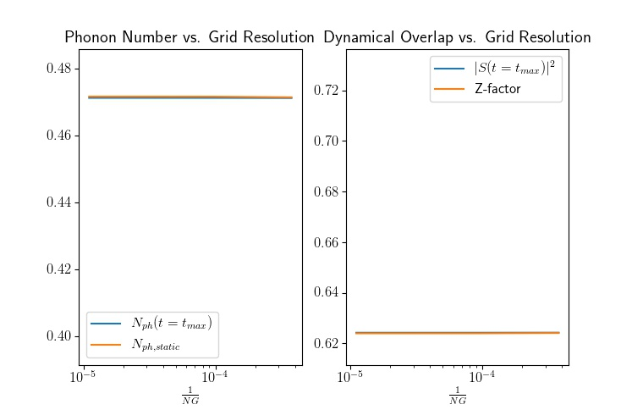
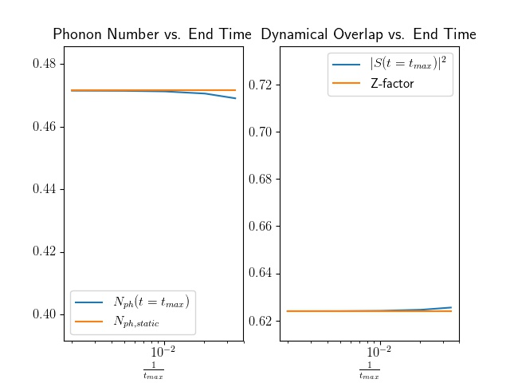
Imaginary Time Dynamics vs. Static
Y-axis scaling: 20% range around static value

Slide 8
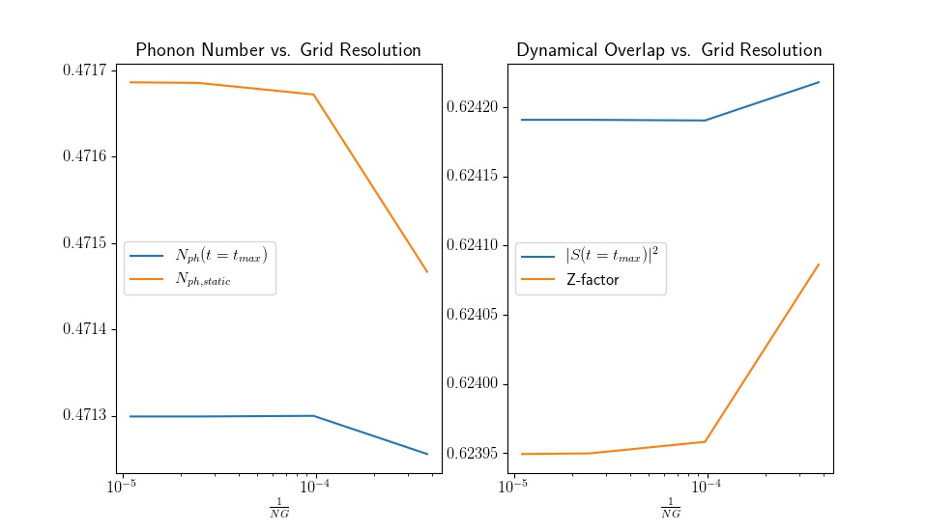
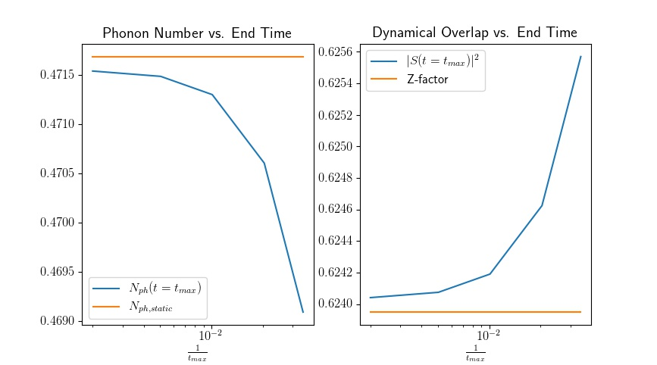
Imaginary Time Dynamics Zoom
Y-axis scaling: auto

