Slide 1
3D BEC Polaron Static and Quenched Dynamics Comparison

Slide 2
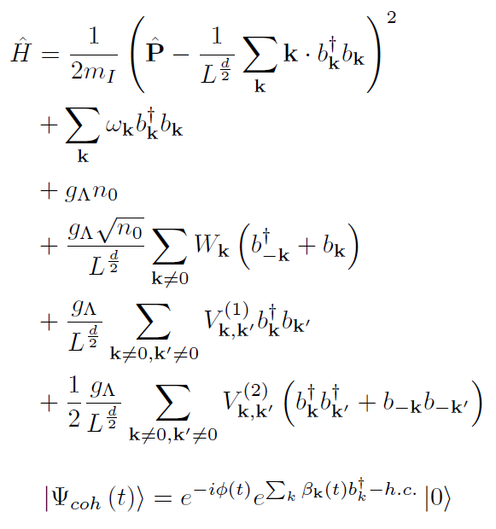
Hamiltonian and Variational Wavefunction

Slide 3
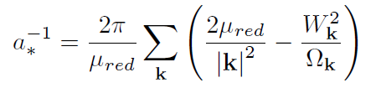
Static Expressions

Slide 4
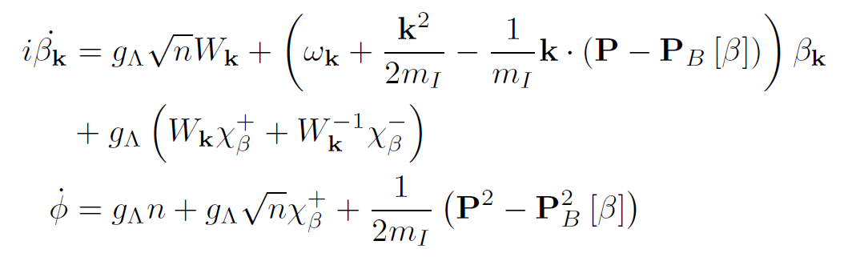
Equations of Motion
Real Time:
-1
Imaginary Time Evolution

Slide 5

Numerical ODE Approach
Solve system on a grid
Spherical coordinates (k, theta) – phi drops out
Cartesian coordinates (kx, ky, kz)
When comparing numerical results from different coordinate systems fix the total volume in k-space instead of cutoff to get a more accurate comparison
Static case
Self-consistently solve for and
Calculate coherence state amplitude
Calculate and
Dynamics
Start system at
Time-evolve with an ODE solver using the equations of motion with the update (and all quantities) calculated on the grid
Calculate and

Slide 6
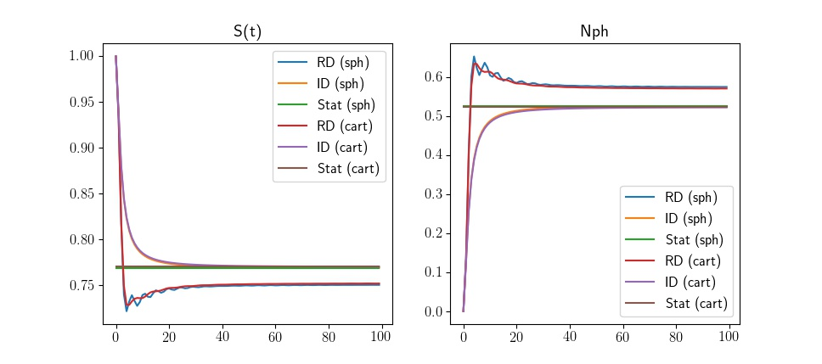
Real Time, Imaginary Time, Static Comparison for Spherical and Cartesian Coordinates
Notes:
Parameters:
P = 0.079 (~0)
aIBi = -2 (resonance at ~1)
|k| Cutoff Spherical: 0.97
|k| Cutoff Cartesian: 1.34
g_ΙΒ Σπηεριχαλ = -4.80
g_IB Cartesian = -4.83
gBB = 1
mI = mB = 1
n0 = 1

Slide 7
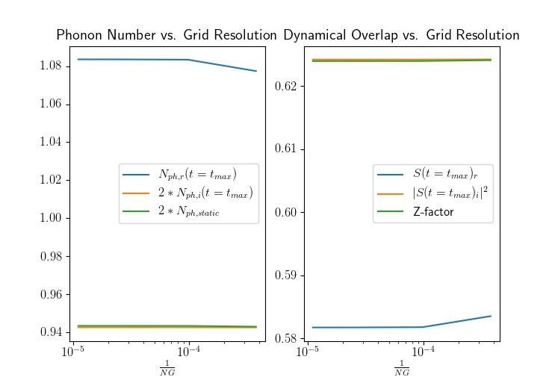
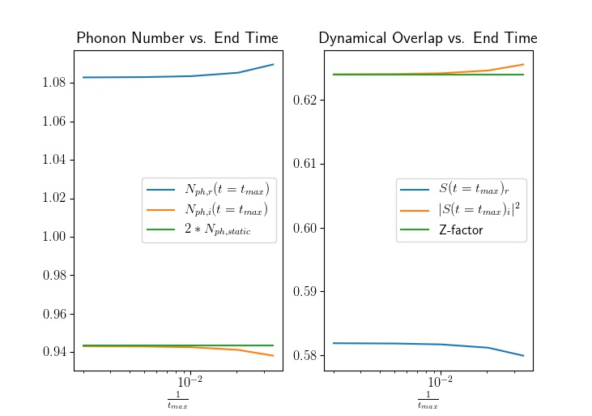
Real Time, Imaginary Time, Static Comparison for Better Grids and Longer Times
Spherical Coordinates
Notes:
Parameters:
P = 0.079 (~0)
aIBi = -2 (resonance at ~1)
|k| Cutoff: 2.72
g_Λ = -3.37
gBB = 1
mI = mB = 1
n0 = 1

