Slide 1
GIT-Basics 🤞

Slide 2
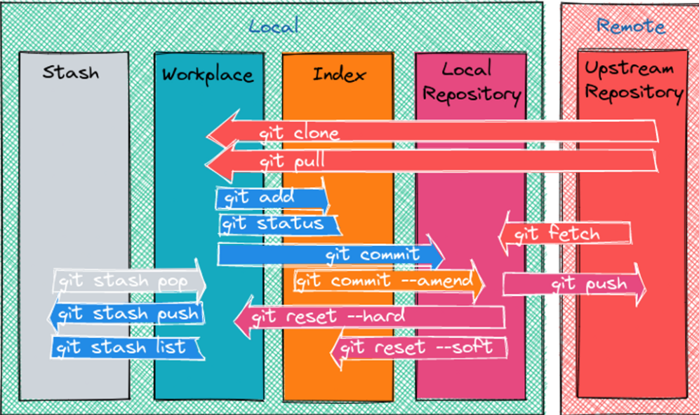
https://www.showwcase.com/article/18785/git-in-pictures

Slide 3
Why we use Git
It is used as version control tool or software
First of all
what is version control
In local I have task folder to monitor the daily status of task
In that I have day1 folder to show, what task done to my Trainer
in task1 folder I have text file eg: in that I have written the
Day 1 works completed is chest day
And next day I created another folder with the filename task2
Day 2works completed is lot day
Same like that task3
Day 3 works completed is leg day
4 th day what I have done is taken a leave so need to document that
Day 4 i created text file with empty to notify the leave day

Slide 4
On 5 th day the trainer ask to show the last day work
So I opened the 4 th day and show the progress of my work. I noticed that I didn’t do anything so it is empty.
Trainer ask you have not that workout.
So trainer think you have not done anything for the four days at that the time
I will show the 1st ,2nd day work because I keep the copy of thatin file to display but what here happens we have separate docs for each day
Consider the doc is of 300 gb we need each copy of that to monitor the day one works and day2 works.To keep copies we need more space in computer its bit costly
in version control what happens is we keep appending the task in single file itself
Day 1is chest day
Day2 is lot day
Day is leg day
in single txt file it will monitor the day 1 and day 2 of commits
Local we need seperate file to track the status daily we can’t able to do that in single file like version control. why because we can’t able to monitor that especially | Version control here we don’t need to Here single file it is enough, Monitor the day task also possible.

Slide 5
How can we find the github is connected with local
It can be find simply if the folder has .git file in local .It means the folder is connected with cloud git from local folders.
Download git software first
And the need configuration if you first time linking
git config --global user.name "Your Name"
git config --global user.email your.email@example.com
Step1:In Github create the branch for projects and then repo (folder name) in cloud
Step2:Create same folder name as repo(cloud) in local and open the folder in cmd
Step3:And then git clone to make a copy of the cloud folder or repo to local
Repo is cloud folder to store your docs or code
Git clone “main branch url” ---if use for one project it is enough
If u want to go for specifi branch
Git clone “main branch url”--branch=“branch_name” --- if use for multiple project

Slide 6
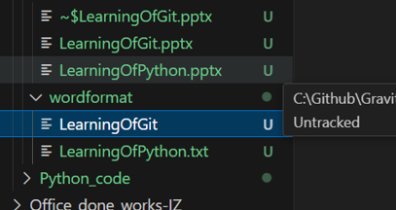
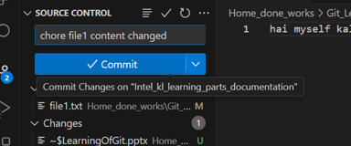
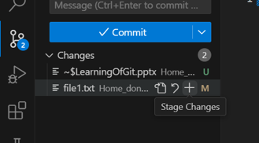
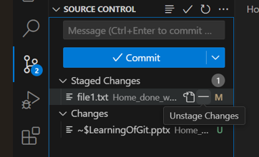
Step4: create files eg: myself created file1.txt
U-untracked what does it mean not staged
"Untracked" refers to files that are not being tracked by the version control system. These files are new and haven't been added to the staging area or committed to the repository.
Step5: Staging should be done. file1.txt was created in local and added some content & saved that content.
Step7: Staged changes only allowed for commits.
The box shows the commit Message after commit ,push can be done in different ways in vs code.
Step6: Unstaging what for unnecessary edits ,not to be reflect in the cloud git
so we unstage ,the staged changes
Goal: local saved content transfer to cloud git. Follow the step 5 ,7)
Detailed explanation in draw.io file

Slide 7
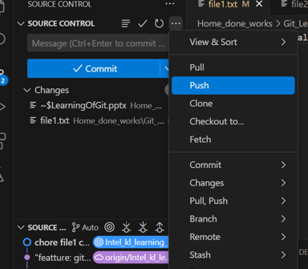
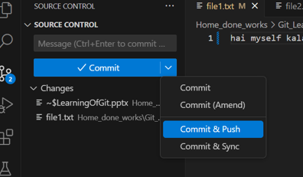
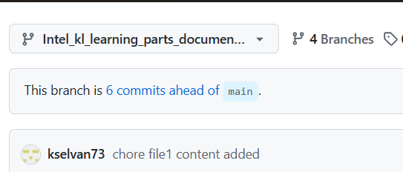
Ways: To push the contents in vs code
Note: git push works fine but sometimes it does not happens so what we need to do is
Git push origin branch name in cmd
origin means it takes the url of git cloned using .git
After the staged changes ,commit with message and at last push
Result is reflected in github you can able to see the commit message

Slide 8
To find the file are staged how can we check using
File1.txt is staged and commited
file2.txt is not staged and not commited
Git status --To check the file which are unstaged or untracked
Here we can see the file2.txt is unstaged
Next done the git add but not commited how can we track that is commited or not
Git add file2.txt here->file2.txt is staged but not commited then
Git status ->
Here we can find the file2.txt Is not commited (line after line)

Slide 9
Git diff
Show the modified with original one
Hai=original in file1.txt
Change the file1.txt to
hai rain
To see what changed – git diff
-hai
+hai rain
Before pushing to the main branch we need to take the pull from main
And push the changes in the main
If the not pulled means the recent changes of coworker in code (code misses)
If the change the same line what you need to change means first pull and push at the time if not pulled means it thows error firt pull and then push
Git pull given if coworker and you changed the same line in the code it throws merge confict that do be resolved with teammates and then push which is necessary .

Slide 10
Merge conflict
Line 10 -My line
Team mate code
Line 10=teammates line
First we have taken the pull from main to be the latest code to be dropped in main branch

Slide 11
Git stash
Our side in 10 line I added
The line is not necessary
Other side the same 10 th line
This line is necessary to adapt teammates
Our side :
Git handling (this all done in single branch)
Firstwe need to pull from others(because to get the changes)
Note:we don’t add,commit in our code first we taken the pull mistakenly
Here the error throws abort
Please commit your changes or unstash them if not necessary (we can retrieve later)
So we use stash cmd
Git stash– if not necessary I have given this
Git pull means from other side
This line is necessary to adapt teammates in our code merges.
If needed git add commit and push others code
If not needed means git stash pop cmd to retrieve the our changes before add and commit

Slide 12
Commands to learned😁
git clone “url of main branch”
git clone “url of main branch”--branch=“branch_name”
git branch
Git checkout–b “new branch name for creation”
git checkout “choose the branch name"
git add .
git reset staged_filename
git commit –m “commit message”
git push
git push origin branchname
Git pull

Slide 14
Git accomplished
😁

