Slide 1
BJSS Pair Programming
KSENIA GERMANOVICH
23 February 2023

Slide 2
Buying a house in the UK
Region
Scotland – Land Buildings Transaction Tax (LBTT)
England – Stamp Duty
Wales
Northern Ireland
Variables
Purchase price
First time buyer relief
Additional dwelling Supplement (ADS)
Linked transactions

Slide 3
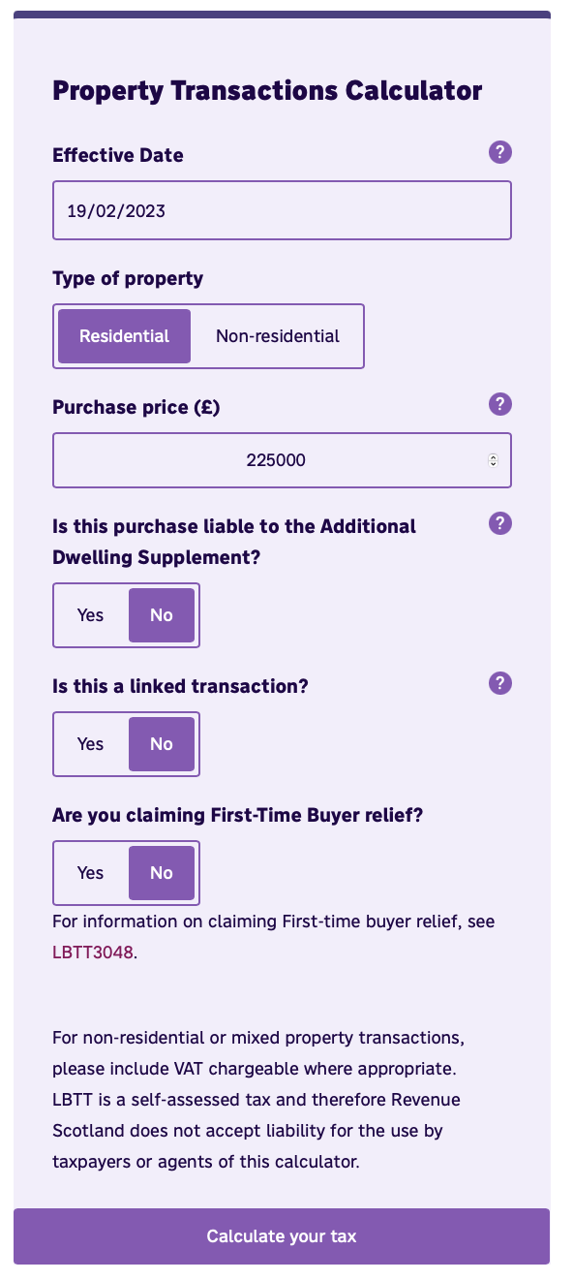
Land Buildings Transaction Tax (LBTT)
Tax on purchase of land or property purchased in Scotland, administered by Revenue Scotland since 2015 (replaced UK Stamp Duty)
Applies to purchase of residential and non-residential land or property, including the purchase of a new home
Tax payable at different rate on each portion of purchase price within specified ta bands
In addition to LBTT, the 6% Additional Dwelling Supplement may apply
Reliefs and exemptions
calculator

Slide 4
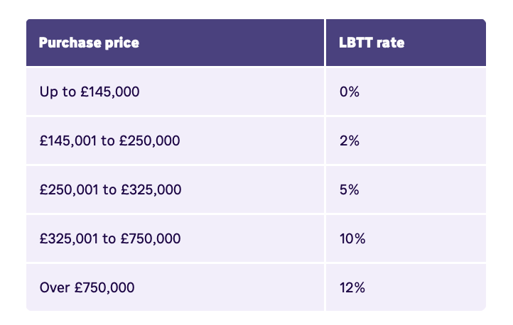
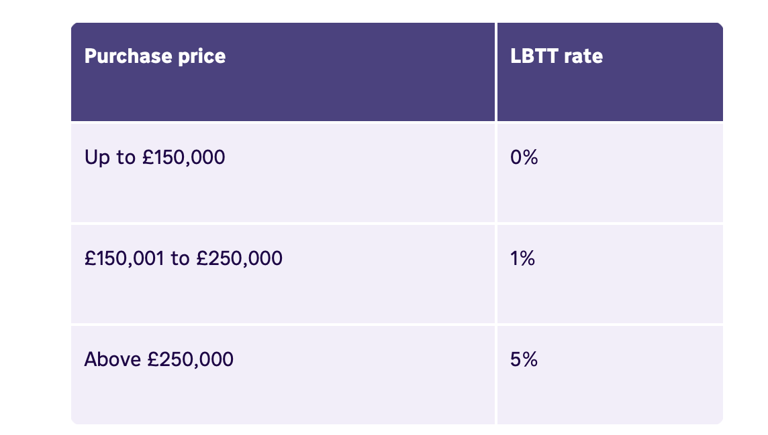
LBTT current bands
Residential property
Non-residential property rates
Notes:
To assist in keeping the functionality as simple as possible the unit tests do not need to cover all possible scenarios, simply that they pass for the scenario they cover in your code e.g., if you only have code which works for a certain price range of house then only this needs to be covered in the tests.
2. For the pair programming to be achievable in a small-time frame we ask you do not move far beyond this minimum e.g., adding a UI or other ancillary capabilities. The pair programming will focus on adding more logic to the LBTT calculation. Anything extra will be a wasted effort on your part or could get in the way of achieving the task.

Slide 5
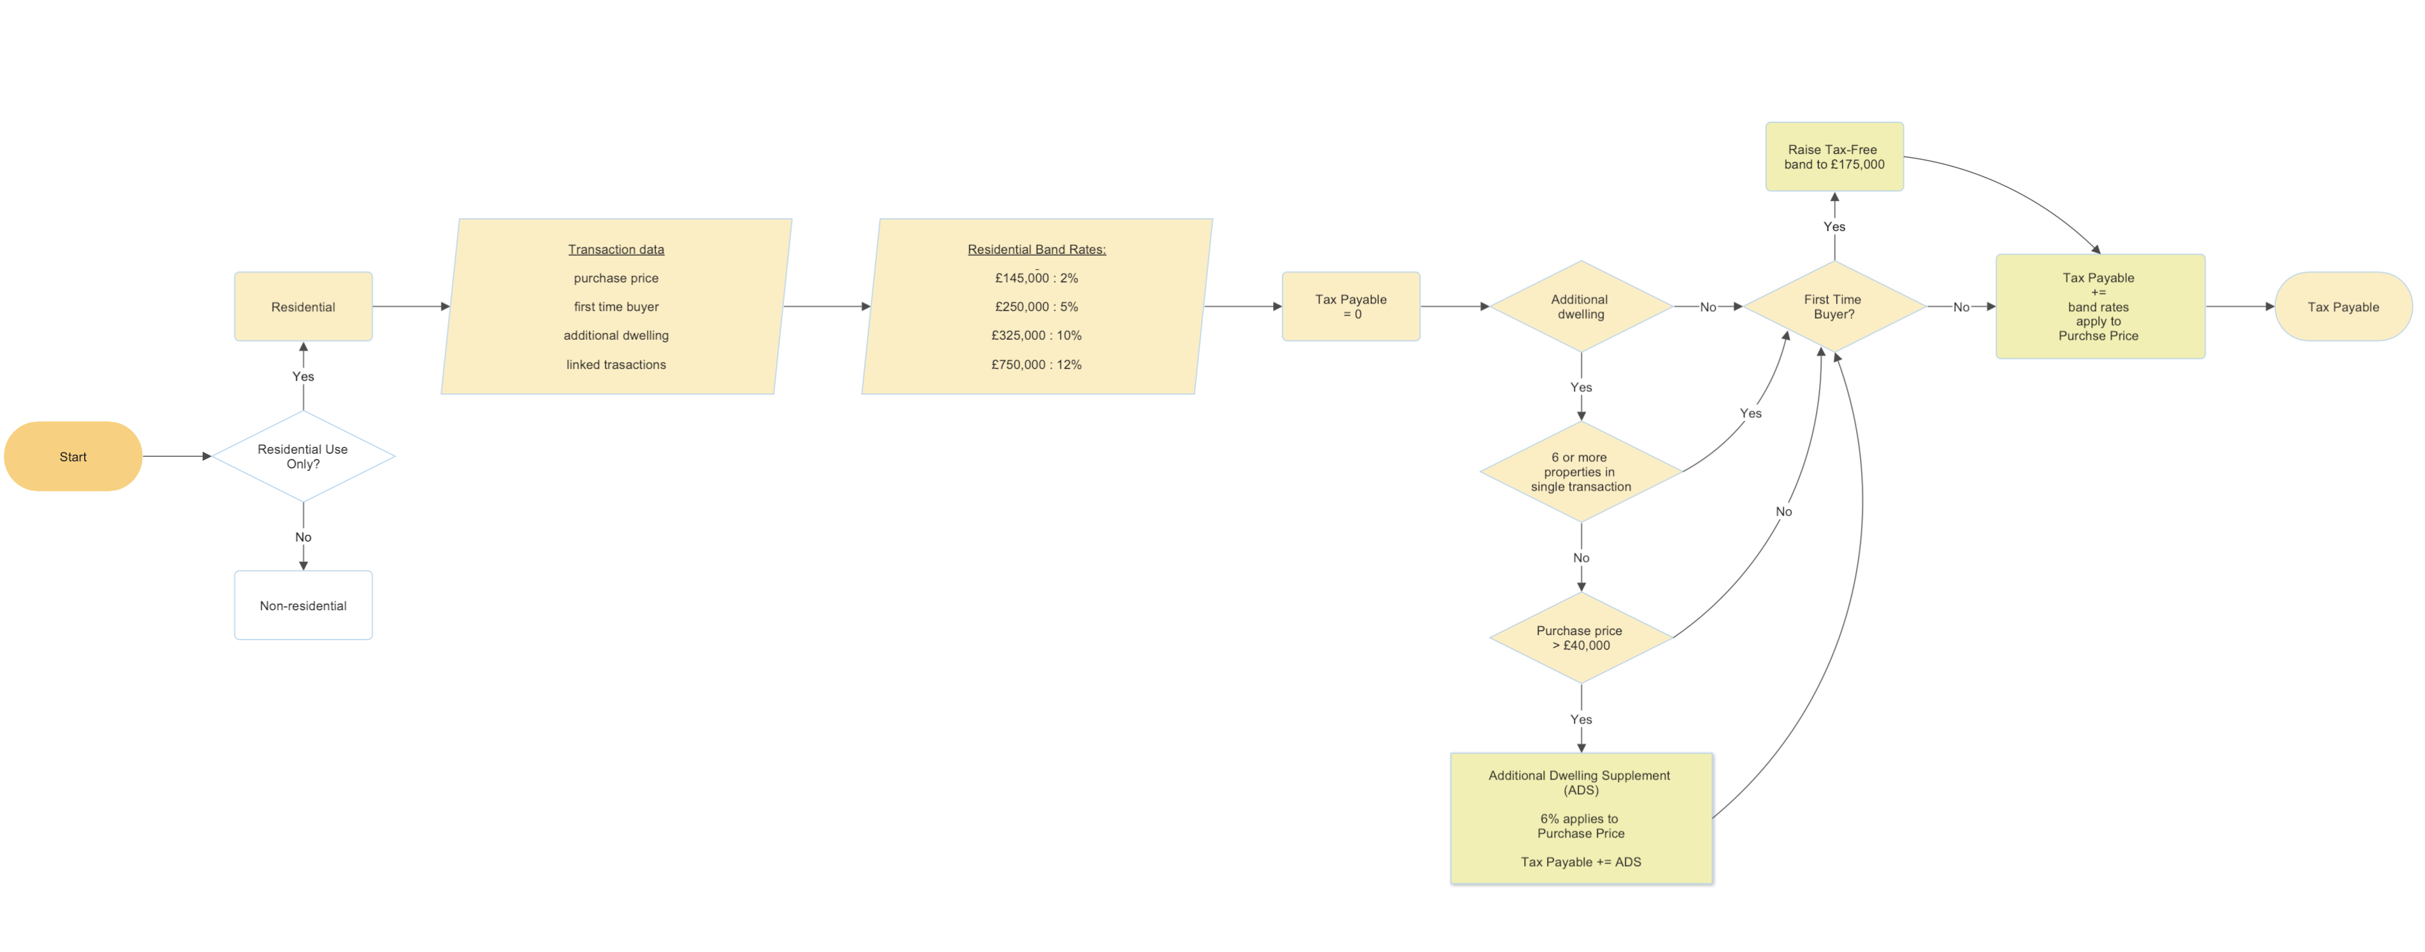
Land Buildings Transaction Tax - Residential
calculator

Slide 6
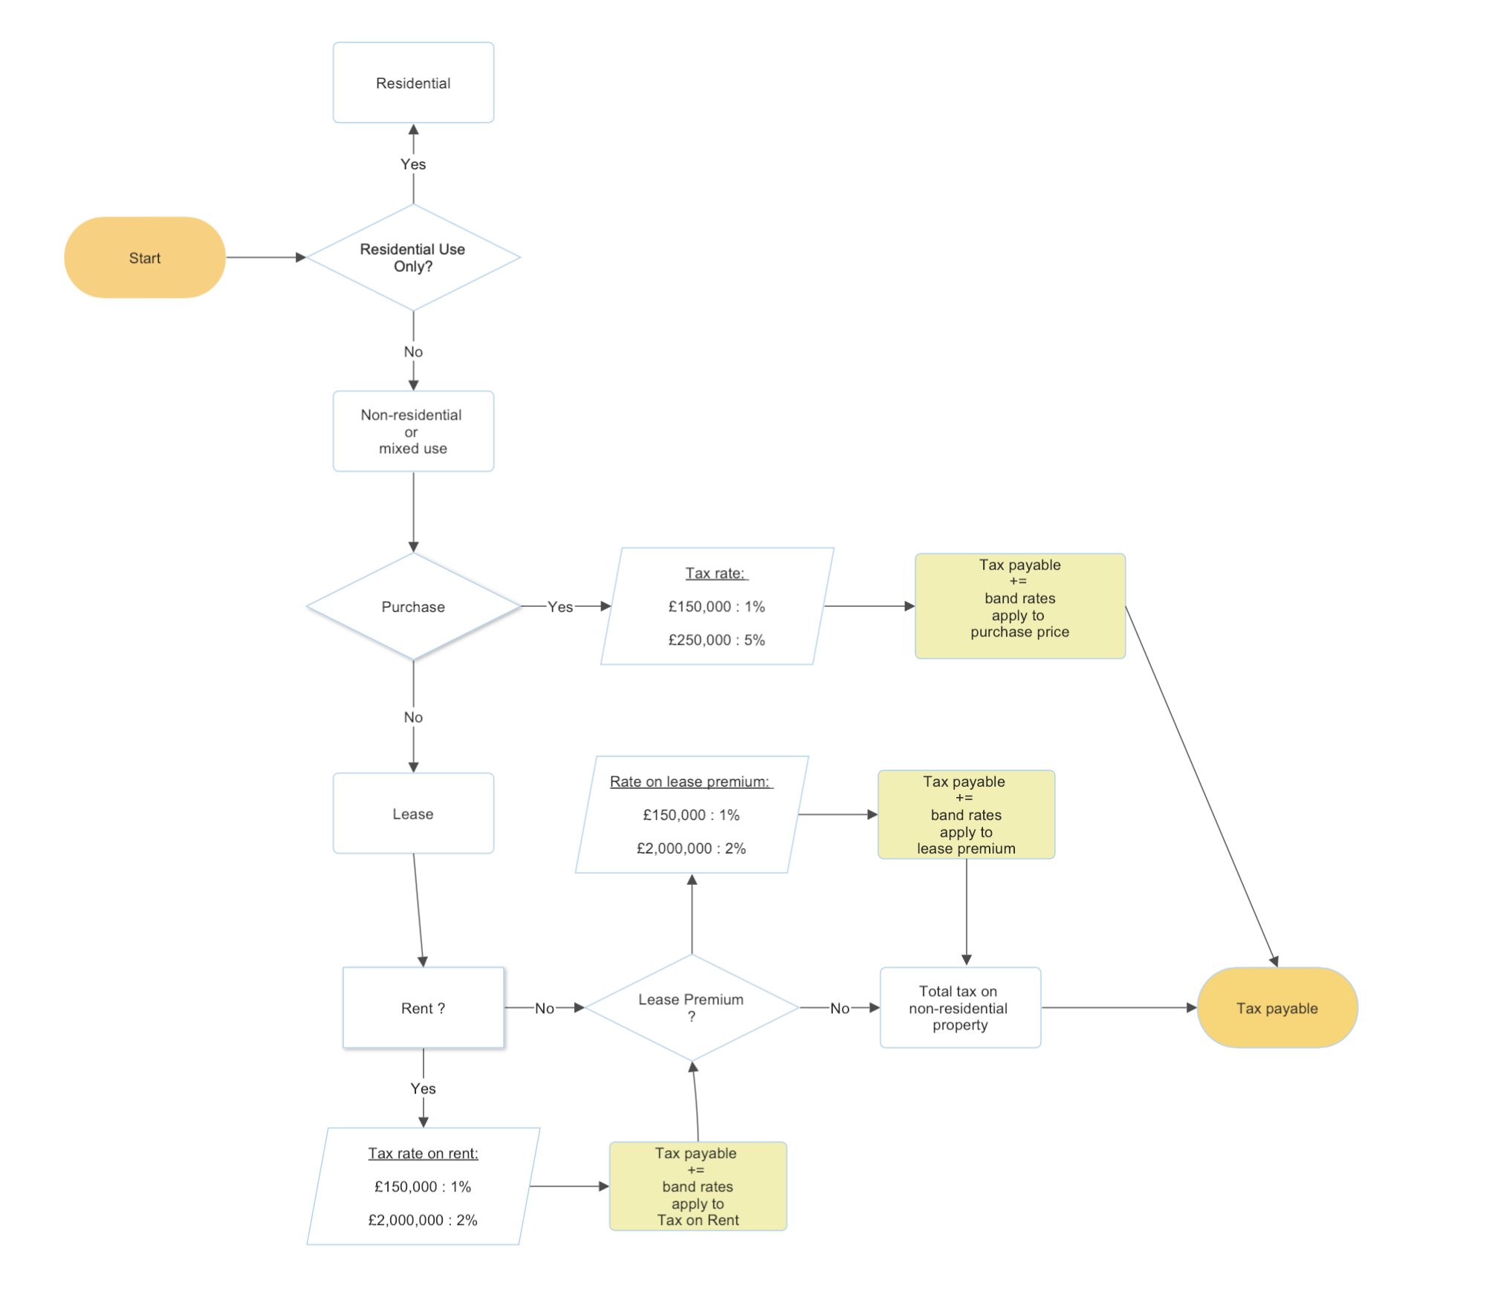
calculator
LBTT- Non-residential

Slide 7

Assumptions
Buyer owns a property and lives in it as main residence
→ no relief for first-time buyers
No business activity conducted from house (personal use)
→ residential LBTT rates
Buyer does not own any other properties
→ no Additional Dwelling Supplement
Buyer will only own one home as they sell current home
→ no Additional Dwelling Supplement
Notes:
understanding in unfamiliar business domains,

Slide 8
Notes:
Notes

Slide 9
Code requirements
At a minimum the code should:
Compile without errors
Include unit tests which are runnable (either via an IDE or command line)
Include unit tests which pass
Test runner
unittest – testing framework + test runner
Put tests into classes as methods
Use series of special assertion methods in unittest.TestCase class instead of built-in assert statements
nose or nose2
pytest test cases are a series of functions in a .py file starting with the name test_.
has some other great features:
Support for the built-in assert statement instead of using special self.assert*() methods
Support for filtering for test cases
Ability to rerun from the last failing test
An ecosystem of hundreds of plugins to extend the functionality

