Slide 1

Play Hard.
Play Smart.
Stay Uninjured.
Injury Prevention & Performance for Padel Players
righttrackphysio.com.cy

Slide 2
MEDICAL DISCLAIMER
This guide is for educational and informational purposes only.
It does not constitute medical advice, diagnosis, or treatment. Always consult a qualified healthcare professional before starting any new exercise programme or if you are experiencing pain or injury.
The authors accept no liability for any injury, loss, or damage arising from the use or misuse of the information provided.
If you are in pain, stop training and seek professional advice.
righttrackphysio.com.cy

Slide 3

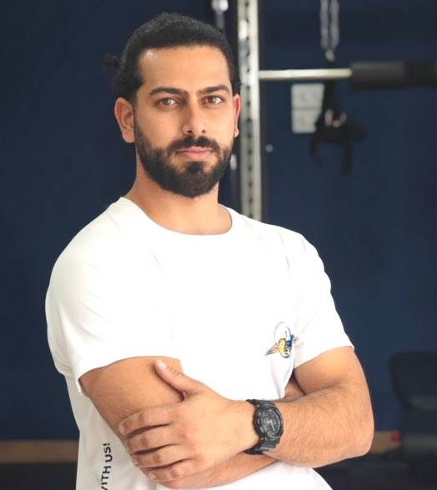





YOUR GUIDE
WHAT YOU'LL LEARN
Injury Patterns
Where & why padel players break down
[ Photo
Placeholder ]
Learn More
About Profile
Warm-Up Protocol
10-minute joint protection routine
Joint Protection
Shoulder, elbow, knee & ankle care
Recovery Strategy
Antonis Petri
Sleep, load, active recovery
Co-Founder & Lead Clinician
@ Right Track Physiotherapy
Red Flags
BSc Physiotherapy
Sports & Orthopaedic Rehab Specialist
When to stop playing immediately
righttrackphysio.com.cy
2

Slide 4
THE REALITY
What our survey revealed
87%
65%
50%
reported pain or injury
in the last 12 months
played through pain
without changing anything
skip warm-up
before playing
~70% of those who didn’t visit a physio said “it wasn’t serious enough”
Source: Right Track Padel Injury Survey, Cyprus 2026 (n=50+) — righttrackphysio.com.cy/blog
righttrackphysio.com.cy
3

Slide 5




AGENDA
What we will cover
01
02
03
04
How injuries
happen
Pre-game
warm-up
Joint
protection
Smart
Recovery
Injury patterns
in racket sports
Proper preparation
before playing
Shoulder, elbow,
knee, ankle
Recover like
a professional
righttrackphysio.com.cy
4

Slide 6
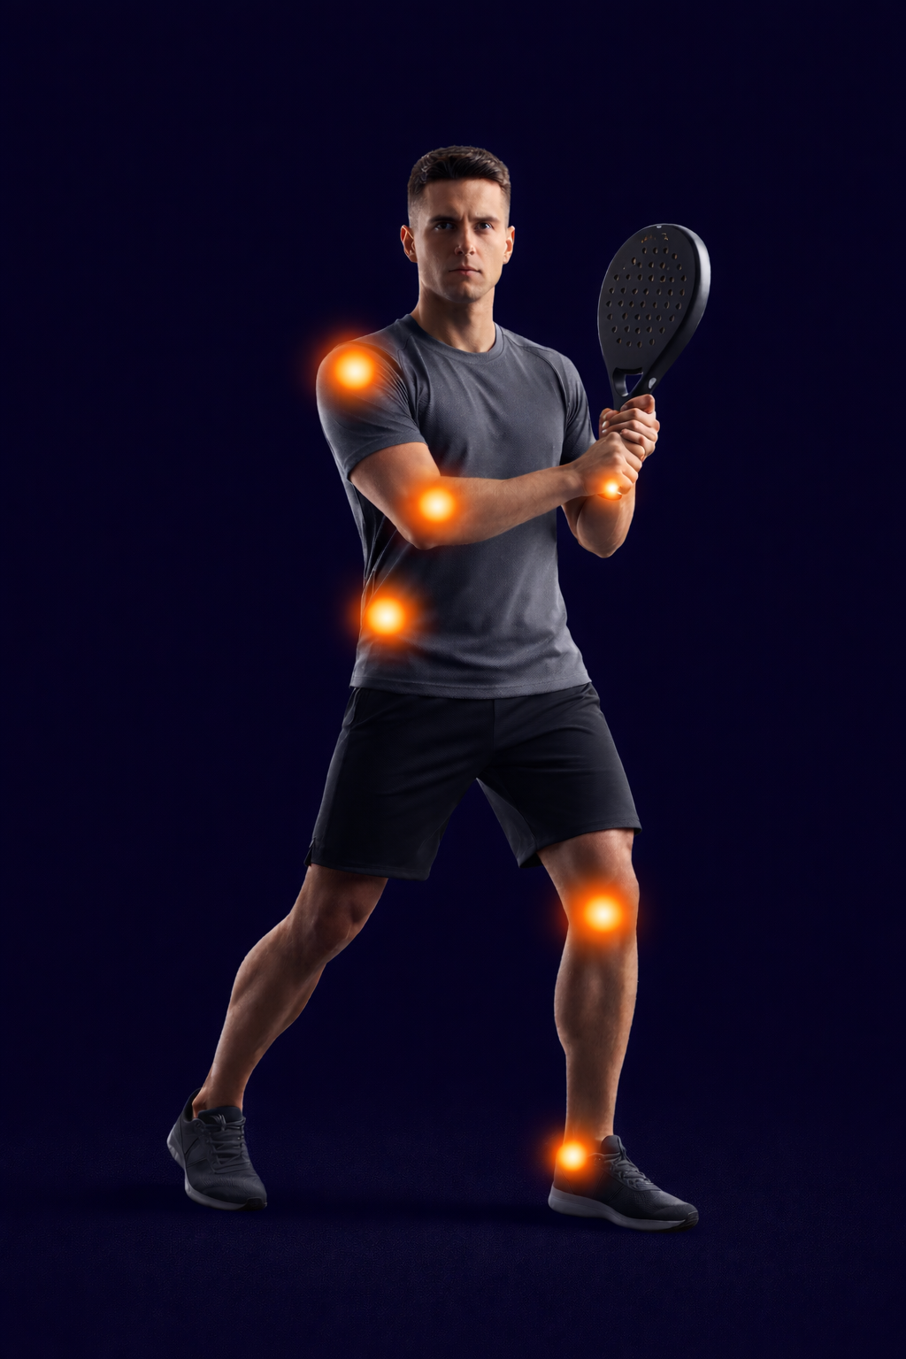
INJURY MAP
The 5 most common padel injuries
SHOULDER
Overhead smashes & serves
ELBOW
Vibration & grip strain (padel elbow)
WRIST
Off-center impacts & flicks
LOWER BACK
Rotation & low lunges
KNEE / ANKLE
Quick changes of direction
righttrackphysio.com.cy
5

Slide 7
MECHANISMS
How padel injuries happen
Overhead Smash
Vibration
Lateral Movement
Rotation
Shoulder impingement
& rotator cuff stress
Elbow & wrist
tendon overload
Knee & ankle
ligament stress
Lower back
disc & muscle strain
Repetitive overhead
motion under load
Off-center hits
transmit shock
Fast direction
changes on court
Trunk rotation
under fatigue
righttrackphysio.com.cy
6

Slide 8

WARNING
Red flags — when your body says stop
Performance Decline
Poor Sleep
Chronic Fatigue
Persistent Pain
Worse results
despite effort
Insomnia or excessive
fatigue despite rest
No recovery
with rest days
Pain > 7 days
without improvement
righttrackphysio.com.cy
7

Slide 9
WARM-UP PROTOCOL
10 minutes that save your joints
10
MINUTES
Before every
game or training.
PHASE 1
PHASE 2
5' Upper Body
5' Lower Body
→ Shoulder circles
→ Band pull-aparts
→ Wrist rotations
→ Scapular push-ups
→ Hip circles
→ Lateral lunges
→ Leg swings
→ Ankle mobility
righttrackphysio.com.cy
8

Slide 10
SHOULDER — ACTIVATION
4-step shoulder routine for padel
STEP 1
STEP 2
STEP 3
STEP 4
Band
Pull-Apart
External
Rotation
Wall
Slides
Push-Up
Plus
3 × 15 reps
3 × 12 reps
3 × 10 reps
3 × 10 reps
Scapular retraction
& rhomboid activation
Rotator cuff
strengthening
Scapular control
& range of motion
Serratus anterior
& stabilization
righttrackphysio.com.cy
9

Slide 11
ELBOW & WRIST
Protect against padel elbow
01
GRIP PRESSURE
Hold the racket at 4/10 pressure. Over-gripping is the #1 cause of elbow strain.
02
ECCENTRIC WRIST CURLS
3 × 15 reps with a light dumbbell. Slowly lower the weight. Strengthens the forearm tendons.
03
FOREARM STRETCHES
Extend your arm, pull fingers back gently. Hold 30 sec per side. Before and after every session.
righttrackphysio.com.cy
10

Slide 12
KNEE & ANKLE
4-step lower body routine
STEP 1
STEP 2
STEP 3
STEP 4
Lateral
Lunges
Single-Leg
Balance
Calf
Raises
Single-Leg
RDL
3 × 8/side
3 × 30 sec
3 × 15 reps
3 × 8/side
Hip mobility &
knee stability
Proprioception &
ankle control
Achilles tendon
strengthening
Balance, hip &
hamstring activation
righttrackphysio.com.cy
11

Slide 13



SMART RECOVERY
Recover like a professional
Sleep
Load Management
Active Recovery
SLEEP
LOAD
ACTIVE
7–9 hours / night
The #1 recovery factor
Non-negotiable
Progressive increase
No sudden spikes
Monitor how you feel
Light movement after play
Mobility & foam rolling
No passive rest
righttrackphysio.com.cy
12

Slide 14
MYTH BUSTING
What works and what doesn't
ICE
STRETCHING
✓ Reduces pain short-term
✓ Helps after acute injury
✗ Doesn't speed up healing
✗ May delay recovery
✓ Increases ROM long-term
✓ Reduces muscle stiffness
✗ Doesn't prevent injuries alone
✗ Static pre-game = less power
righttrackphysio.com.cy
13

Slide 15

WARNING
When you MUST stop playing
Joint
Swelling
Sudden
Weakness
Numbness /
Tingling
Pain > 7
Days
Altered
Movement
Visible inflammation
around any joint
Unexpected loss of
strength in a limb
Pins & needles or
loss of sensation
Persistent pain
without improvement
Compensating due
to pain
righttrackphysio.com.cy
14

Slide 16
Play longer.
Play better.
Small habits make the difference.
Sports massage & recovery available right here at the club.
righttrackphysio.com.cy
15

Slide 17

AVAILABLE ON-SITE
Sports Massage at the Club
No need to book elsewhere. Recovery sessions available between morning and evening training.
Session
Price
Sports Massage — 30 min
€45
Sports Massage — 45 min
€60
Sports Massage — 60 min
€75
righttrackphysio.com.cy
@righttrackphysio
+357 99 126824

