Slide 1
Fuzzy Logic-Based estimation of random graph generation models
Computer Science
Fuzzy modeling
Moscow, 2022
As approximation for drosophila medulla structural connectome

Slide 2

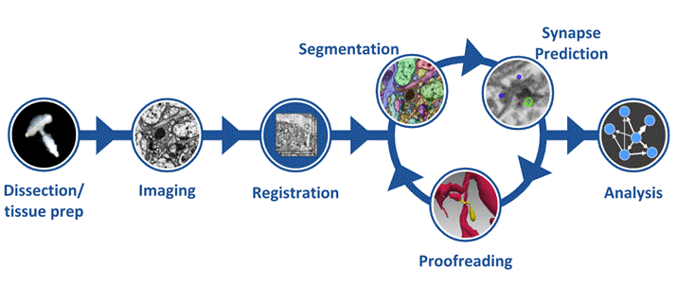

Structural connectome
Computer Science
Fuzzy modeling
Fuzzy Logic-Based estimation of random graph generation models as approximation for drosophila medulla structural connectome
High-level connectome reconstruction pipeline
https://www.janelia.org/project-team/flyem/hemibrain

Slide 3
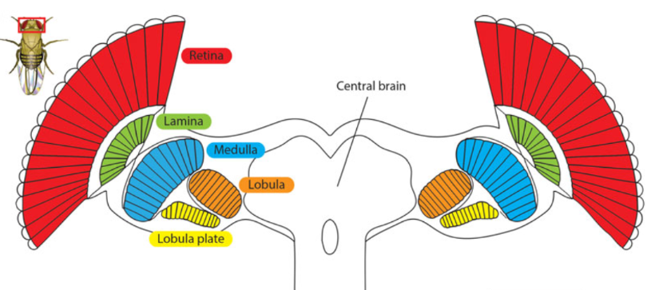

Structural connectome of optic lobe
Computer Science
Fuzzy modeling
Fuzzy Logic-Based estimation of random graph generation models as approximation for drosophila medulla structural connectome
Optic lobe
Drosophila melanogaster

Slide 4

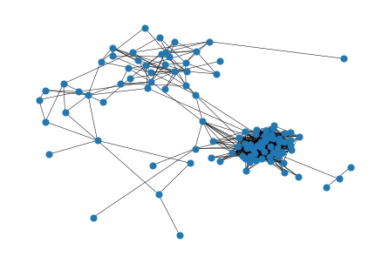

Medulla connectome
Computer Science
Fuzzy modeling
Fuzzy Logic-Based estimation of random graph generation models as approximation for drosophila medulla structural connectome
Medulla is the ﬁrst neuropile where motion from the
local ﬁeld is detected
https://neuprint.janelia.org
~4300 neurons and ~1000 connections

Slide 5
Problem definition
Computer Science
Fuzzy modeling
Fuzzy Logic-Based estimation of random graph generation models as approximation for drosophila medulla structural connectome
How to distinguish a random component
from a pattern in the process of transmitting a nerve impulse?
Connectome graph
Random graph based on connectome parameters
Dynamic process or static properties comparing

Slide 6
Random models
Computer Science
Fuzzy modeling
Fuzzy Logic-Based estimation of random graph generation models as approximation for drosophila medulla structural connectome
Erdos-Renyi
Geometric
Barabasi-Albert
Chung Lu
Geometric Chung Lu
edge density
maximum distance between nodes
number of nodes
number of nodes
number of nodes
expected nodes degrees vector
expected nodes degrees vector

Slide 7
Estimated parameters
Computer Science
Fuzzy modeling
Fuzzy Logic-Based estimation of random graph generation models as approximation for drosophila medulla structural connectome
Edge density
Connected Components amount
Degrees vector
Triangles amount
Clustering coefficient
PageRank vector
Eigenvalues of adjacency matrix
Weights vector

Slide 8
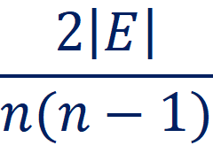
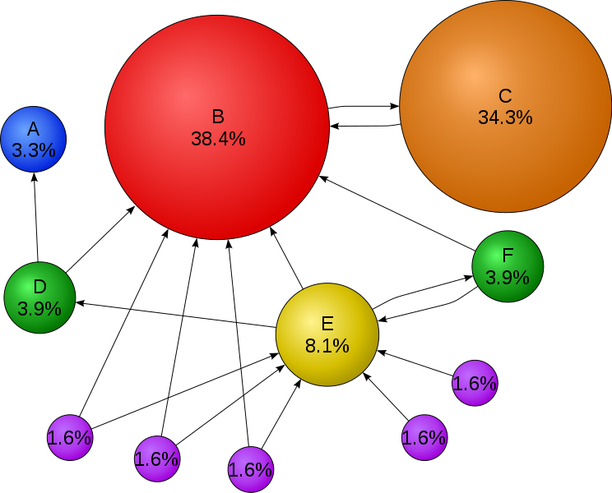
Estimated parameters
Computer Science
Fuzzy modeling
Fuzzy Logic-Based estimation of random graph generation models as approximation for drosophila medulla structural connectome
Edge density (E – set of edges, n – number of nodes):
PageRank vector illustrates the importance of nodes. This parameter demonstrates the probability to be in the node after random walk.
Degrees vector – vector of nodes degrees (the number of edges that are incident to the vertex)
Clustering coefficient – averaged local coefficients. The local clustering coefficient for a vertex is determined by the ratio of connections between vertices in its neighborhood divided by the maximum possible number of connections between them.
https://en.wikipedia.org/wiki/PageRank

Slide 9
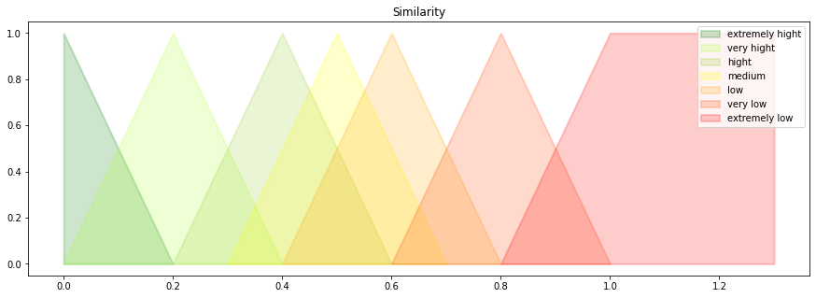
Experiment
Computer Science
Fuzzy modeling
Fuzzy Logic-Based estimation of random graph generation models as approximation for drosophila medulla structural connectome
In the following steps, all parameters greater than 1 will be equated to 1, that is it will be the triangular function
Relative error of graph approximation and linguistic labels for “similarity”

Slide 10
Experiment
Computer Science
Fuzzy modeling
Fuzzy Logic-Based estimation of random graph generation models as approximation for drosophila medulla structural connectome
Model/Parameter | Edge density | Connected Components | Degrees | Triangles | Clustering | PageRank | Eigenvalues | Weights
Erdos-Renyi | 0.3 | 0.5 | 0.47 | 0.85 | 0.67 | 0.19 | 11.09 | 11.05
Geometric | 0.75 | 3.48 | 0.81 | 0.97 | 0.14 | 0.14 | 0.47 | 1.72
Barabasi-Albert | 0.7 | 0.5 | 0.73 | 0.99 | 0.67 | 0.54 | 5.55 | 10.47
Chung Lu | 0.07 | 0.49 | 0.09 | 0.33 | 0.09 | 0.3 | 10.89 | 11.04
Geometric Chung Lu | 0.65 | 0.5 | 0.57 | 1.33 | 0.38 | 0.25 | 12.38 | 10.15

Slide 11
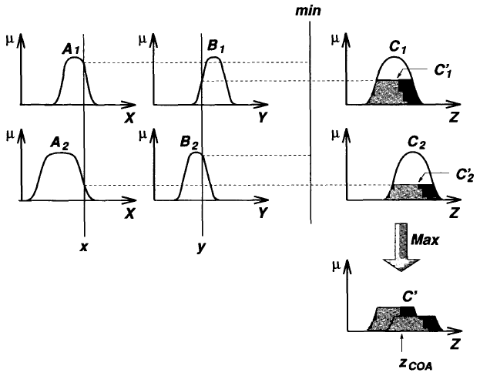
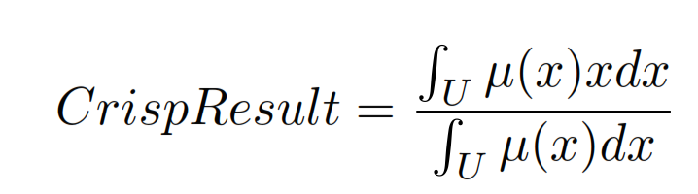
Mamdani model
Computer Science
Fuzzy modeling
Fuzzy Logic-Based estimation of random graph generation models as approximation for drosophila medulla structural connectome
Center of Area defuzzification method provides crisp result:

Slide 12
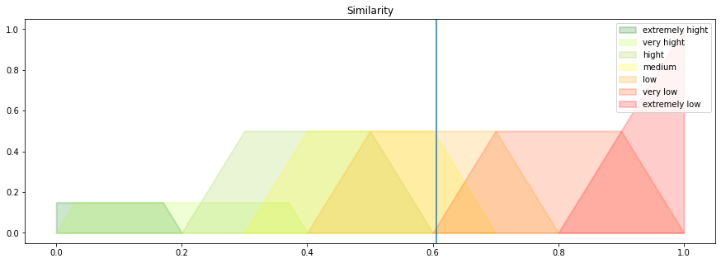
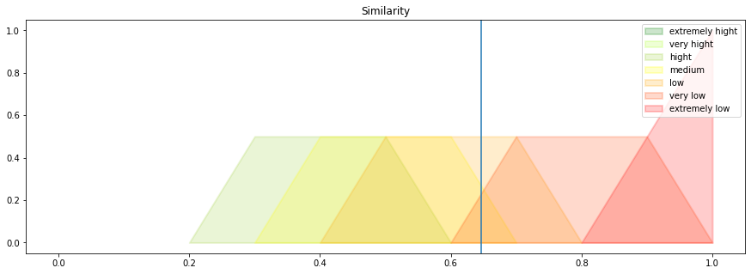
Results
Computer Science
Fuzzy modeling
Fuzzy Logic-Based estimation of random graph generation models as approximation for drosophila medulla structural connectome
Erdos-Renyi aggregated relative error of graph 61%
Barabasi-Albert aggregated relative error of graph 65%

Slide 13
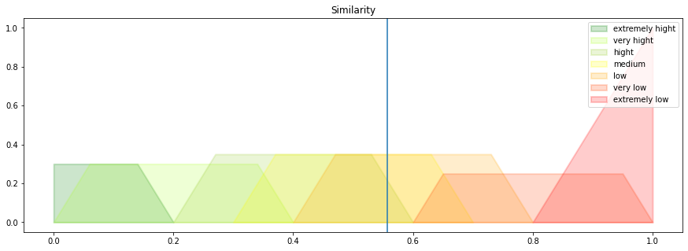
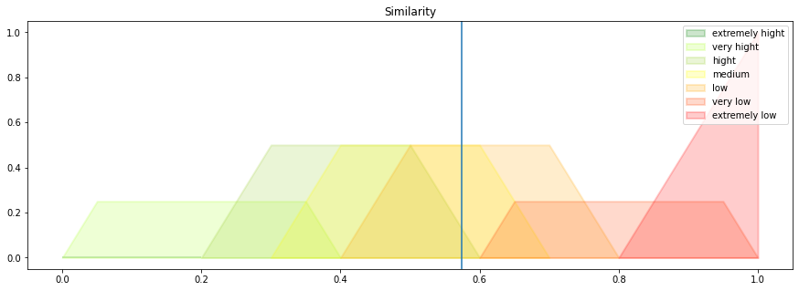
Results
Computer Science
Fuzzy modeling
Fuzzy Logic-Based estimation of random graph generation models as approximation for drosophila medulla structural connectome
Geometric model aggregated relative error of graph 56%
Geometric Chung Lu model aggregated relative error of graph 57%

Slide 14
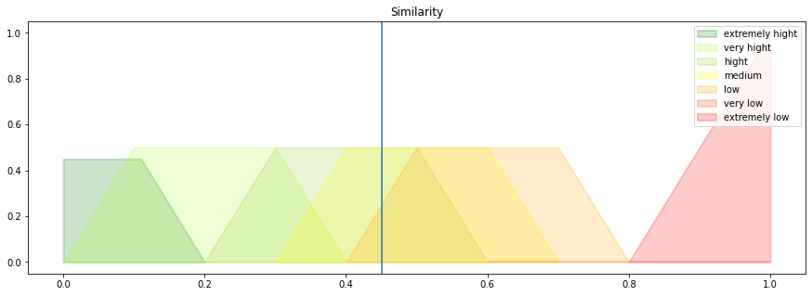
Results
Computer Science
Fuzzy modeling
Fuzzy Logic-Based estimation of random graph generation models as approximation for drosophila medulla structural connectome
Chung Lu model aggregated relative error of graph 45%

Slide 15
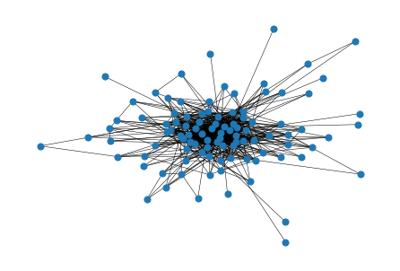
Chung Lu model and Medulla connectome
Computer Science
Fuzzy modeling
Fuzzy Logic-Based estimation of random graph generation models as approximation for drosophila medulla structural connectome
Chung Lu random graph
Medulla connectome graph
Model/Parameter | Edge density | Connected Components | Degrees | Triangles | Clustering | PageRank | Eigenvalues | Weights
Chung Lu | 0.07 | 0.49 | 0.09 | 0.33 | 0.09 | 0.3 | 10.89 | 11.04

Slide 16
References
Computer Science
Fuzzy modeling
Fuzzy Logic-Based estimation of random graph generation models as approximation for drosophila medulla structural connectome
Shan Xu, Michal Januszewski,Zhiyuan Lu, Shin-ya Takemura, 2020. A Connectome of the Adult Drosophila Central Brain. BiorXiv, the preprint server for biology.
Shin-ya Takemura, Arjun Bharioke, Zhiyuan Lu, 2013. A visual motion detection circuit suggested by Drosophila connectomics. Nature.
Shin-ya Takemura, 2014. Connectome of the ﬂy visual circuitry. Microscopy.
Zadeh L.A., 1996. Fuzzy logic = Computing with Words. IEEE Trans. Fuzzy Systems, 103–111.
E.H. Mamdani and S. Assilian, 1975. An experiment in linguistic synthesis with a fuzzy logic controller. International Journal of ManMachine Studies, 1-13.
P.Erdos and A.Renyi. On random graphs. Publicationes Mathematicae, 290-297.
Penrose, Mathew, 2003. Random geometric graphs. Oxford: Oxford University Press.
Barabasi, Albert-Laszlo; Albert, Reka, 1999. Emergence of scaling in random networks. Science, 509–512.
Karl Bringmann, Ralph Keusch and Johannes Lengler, 2019. Geometric inhomogeneous random graphs. Theoretical Computer Science.
Susama Agarwala, Franklin Kenter, 2021. A Geometric Chung Lu model and the Drosophila Medulla connectome.
Janelia Research Campus/FlyEm Hemibrain: [web-site]. URL:https://www.janelia.org/project-team/ﬂyem/hemibrain.
Janelia Research Campus/Neuroprint: [web-site]. URL:https://neuprint.janelia.org.

Slide 17




kashilova@edu.hse.ru
Computer Science
Fuzzy modeling
Fuzzy Logic-Based estimation of random graph generation models as approximation for drosophila medulla structural connectome
https://t.me/shilovashilova3110
+79771844176

