Slide 1

Credit Scoring in the Banking Sector
Oksana Tkachuk
Postgraduate Diploma in Data Science
June 2025

Slide 2
Background
Credit scoring is a standard risk assessment practice in UK banking.
Demographic and financial data are analyzed to identify default drivers.
The project uses real customer data including credit details, profiles, and feedback.

Slide 3

Objectives
Analyze defaulters and identify key risk factors.
Build a logistic regression model using training data.
Compare it with ML methods: Naïve Bayes, Decision Tree, Random Forest.
Visualize and evaluate model performance (ROC, AUC, accuracy).
Apply sentiment analysis to customer feedback.

Slide 4
Phase 1 – Data Management

Slide 5

Data Overview
Imported 3 structured datasets:
customer credit details,
customer info,
customer profiles.
Merged using custid to create a master dataset

Slide 6

Data Preparation
Data Cleaning
Removed duplicate entries and filtered invalid records (e.g., veh = 11, selfemp = 11, missing debtinc or preloan).
Variable Transformation
Recoded categorical fields: gender, ms, child, house, account, deposit, preloan, etc.
Created grouped variable: debtinc_cat.

Slide 7
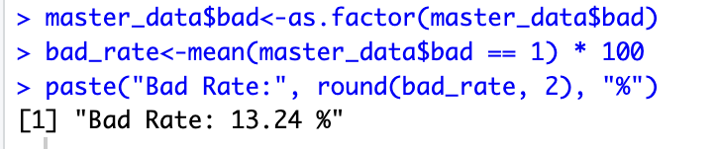
Default Rate
Calculated the overall Bad Rate in the dataset:

Slide 8
Phase 2 – Exploratory Data Analysis

Slide 9
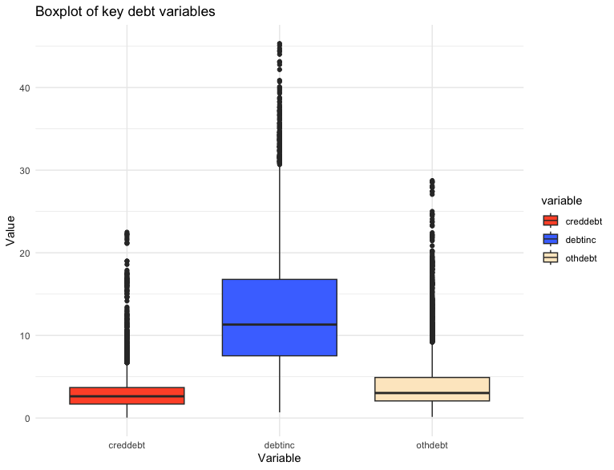
Boxplot of Key Debt Variables
debtinc
shows the largest spread with many outliers beyond 40%.
creddebt
has a low median (~3) and moderate variability.
othdebt
appears most stable with lower values and tighter distribution.

Slide 10
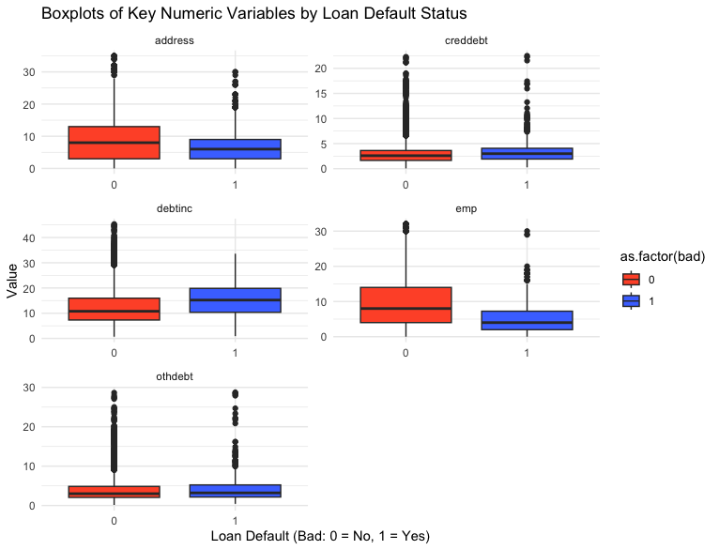
Numeric Variables by Default
emp, address
lower values observed in default group.
debtinc
higher in defaulters → aligns with logic: more debt → more default risk.
creddebt and othdebt
less separation, but outliers present in both classes.

Slide 11
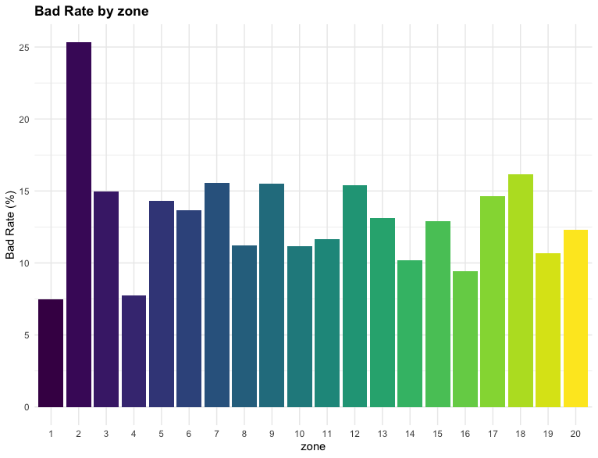
Bad Rate by Categorical Variables
Bad Rate by zone
Zone 2 shows highest default (>25%), zone 1 lowest (<8%)

Slide 12
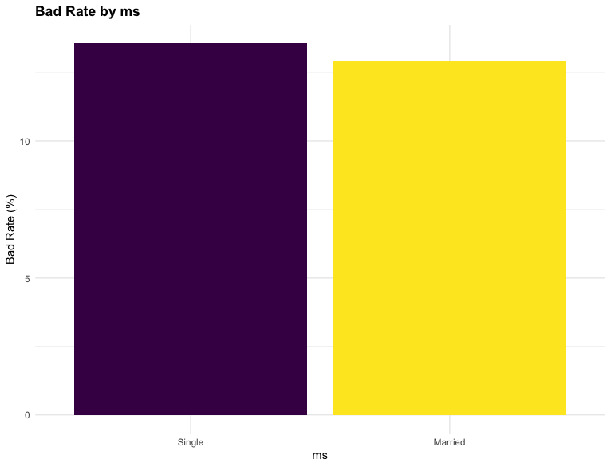
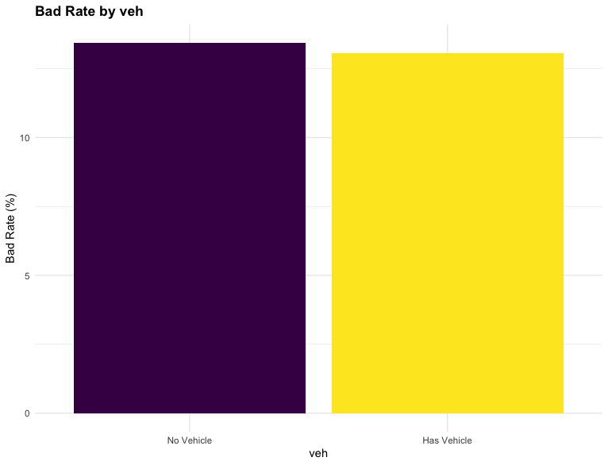
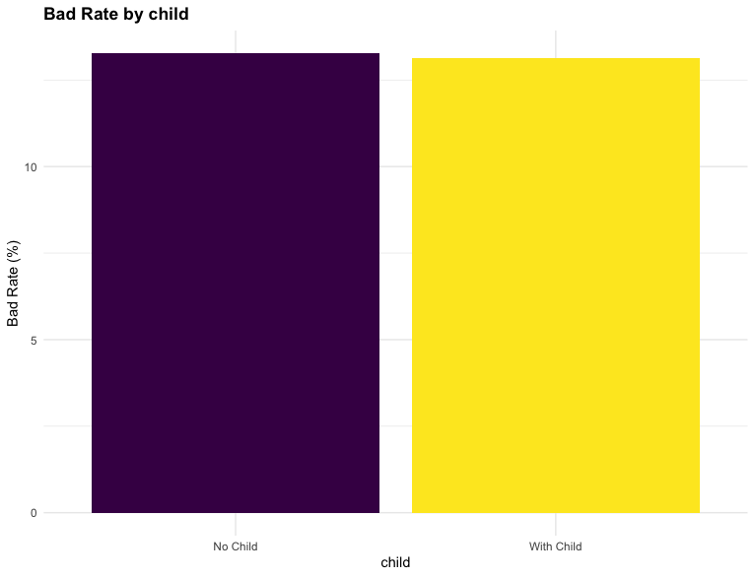
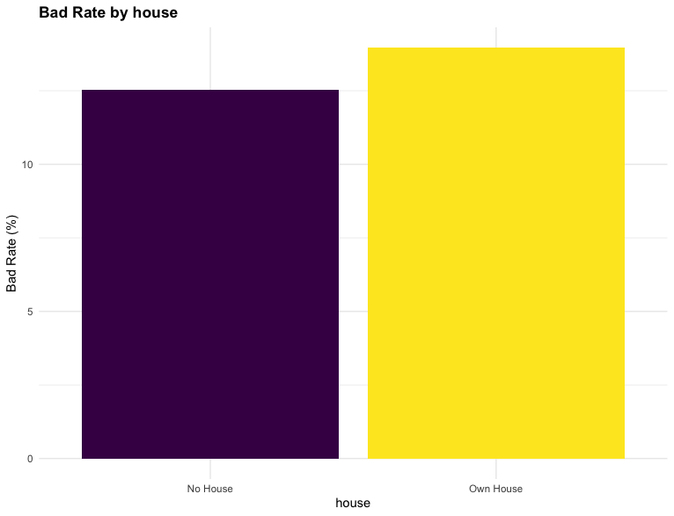
Bad Rate by Categorical Variables
ms
Singles have slightly higher bad rates than married individuals
veh
Vehicle ownership has minimal effect on default rate
child
Having children slightly increases default probability
house
Homeowners default slightly more — counterintuitive result

Slide 13
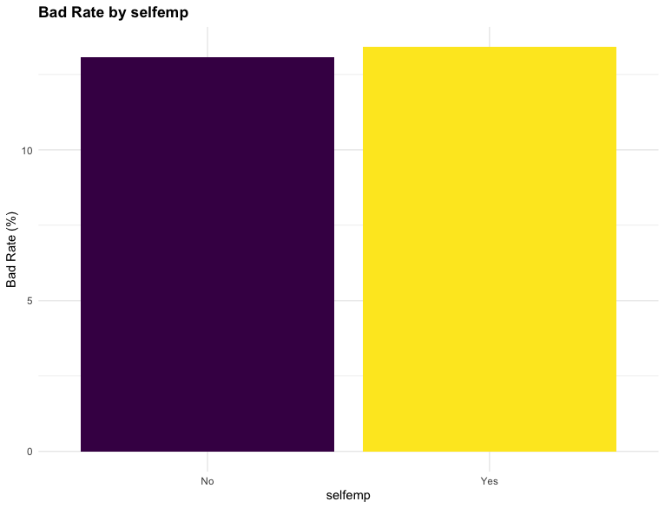
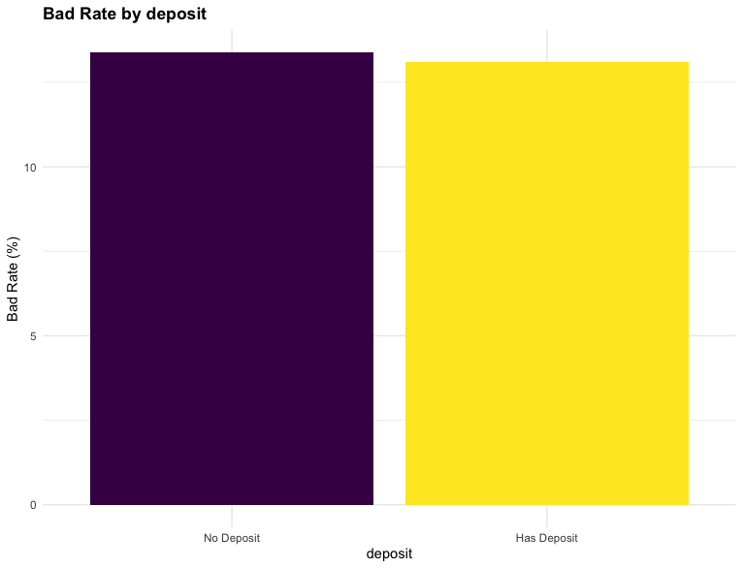
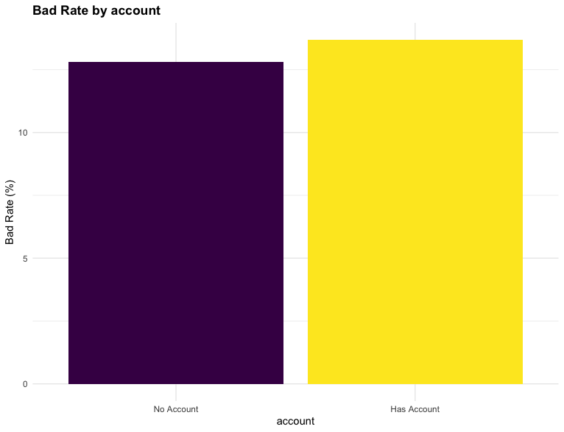
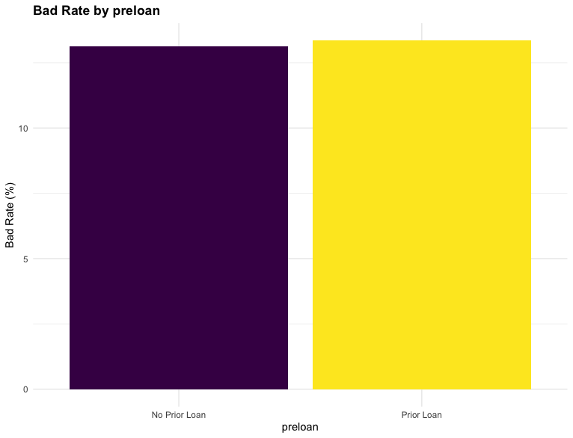
Bad Rate by Categorical Variables
deposit
Deposits do not reduce default risk significantly — rates are similar
selfemp
Self-employed show slightly elevated default risk
account
Account holders show slightly increased default rate
preloan
Customers with prior loans show slightly higher default rate

Slide 14
Bad Rate by Categorical Variables
Demographic variables (zone, gender, marital status, child) show moderate influence on default behavior.
Zone of residence shows the strongest variation in default rates (>15%), indicating geographic risk segmentation.
Expected safeguards like account or deposit do not significantly reduce risk.
Variables like prior loan history and self-employment are mildly associated with higher default probability.

Slide 15
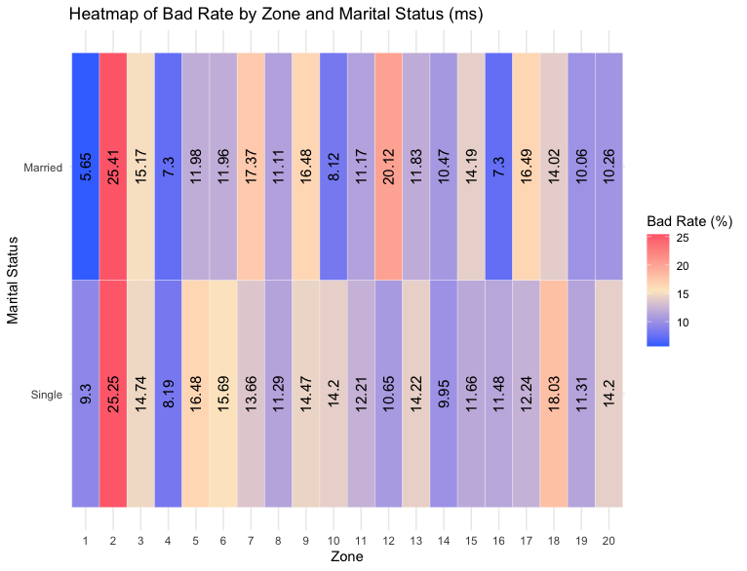
Heatmaps of Bad Rate
Heatmap 1: Zone × Marital Status
Zone 2 has the highest default rate for both groups (>25%)
Zone 1: Married clients have half the default rate compared to singles
Overall: Married clients tend to default less, but this varies by zone

Slide 16
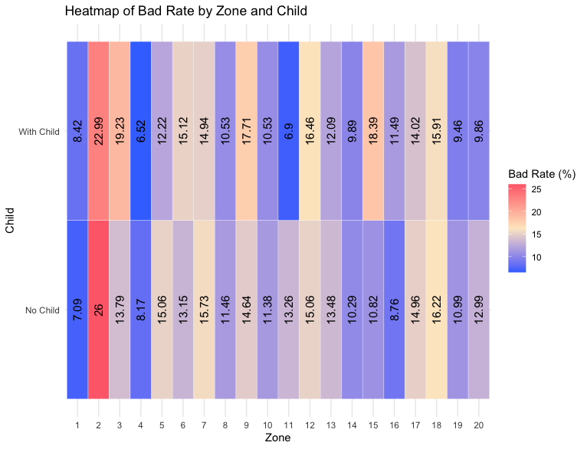
Heatmaps of Bad Rate
Heatmap 2: Zone × Child
Zone 2: With child = 23%, No child = 26% — both very high
In most zones, default rate is higher for clients with children
Some zones (e.g. 9, 10): No-child group shows slightly higher risk

Slide 17
Phase 3,4 – Logistic Regression Modeling, ML Comparison

Slide 18
Logistic Regression – Model 2
Train/Test split: 80% / 20%
Target variable: bad (1 = default)
Predictors: creddebt, emp, address, branch, debtinc_cat
All VIF values < 1.3 → no multicollinearity
Clean, interpretable model structure

Slide 19
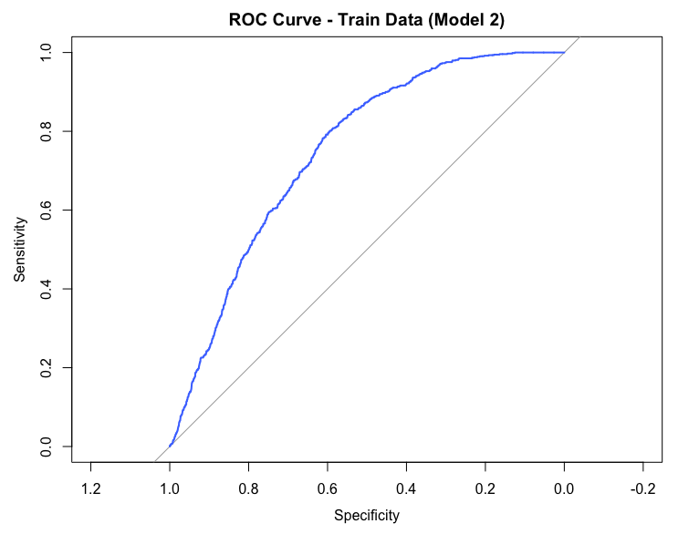
ROC Curve – Train Data (Model 2)
AUC = 0.7487
Clear separation from diagonal line
Strong discrimination on training set
High sensitivity to identify defaulters
Balanced performance across thresholds

Slide 20
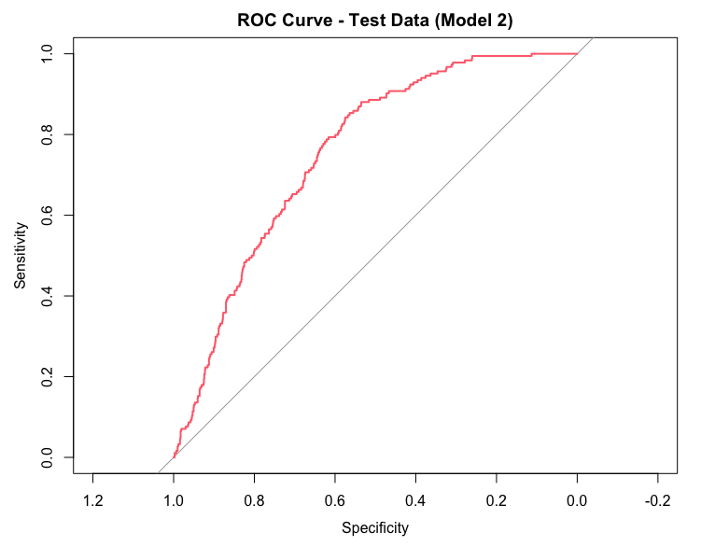
ROC Curve – Test Data (Model 2)
AUC = 0.755
No overfitting observed
Consistent generalization to unseen data
Model maintains high detection power
Suitable for real-world scoring
Higher debt-to-income ratio increases probability of default
Longer employment reduces risk

Slide 21
Classification Results – Train vs Test
Metric | Train | Test
Accuracy | 64.1% | 63.3%
Sensitivity | 76.6% | 79.4%
Specificity | 62.2% | 60.9%
AUC | 0.7487 | 0.7550
High sensitivity → effective detection of defaulters
Moderate specificity → some false positives tolerated
Stable results on both datasets → no overfitting
AUC ≈ 0.75 → reliable risk separation
Logistic regression is interpretable and deployable
Suitable as a baseline model before ML enhancement

Slide 22
Logistic Regression – Model 3 (Numeric debtinc)
Replaced debtinc_cat with numeric debtinc
Predictors: debtinc, creddebt, emp, address, branch
VIF values < 1.8 → no multicollinearity
All variables statistically significant (p < 0.01)
Model structure is simple, interpretable

Slide 23

ROC Curve – Train Data (Model 3)
AUC = 0.7483
Curve similar to Model 2
High sensitivity (~71%)
Balanced performance
Model fits training data well

Slide 24
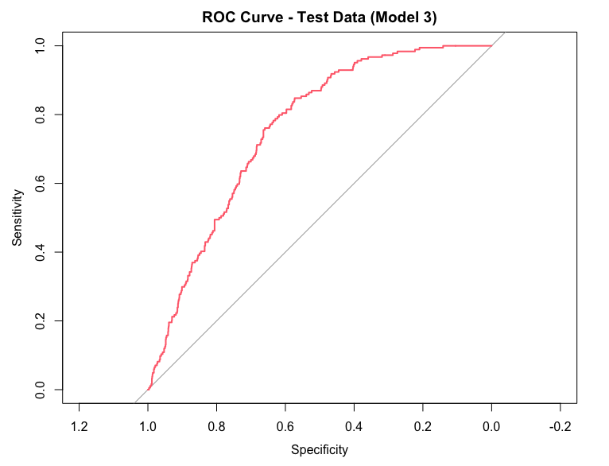
ROC Curve – Test Data (Model 3)
AUC = 0.7566
Slightly better than Model 2
Stable generalization
No overfitting observed
Performs well on unseen data

Slide 25
Classification Results – Train vs Test (Model 3)
Metric | Train | Test
Accuracy | 68.19% | 67.46%
Sensitivity | 71.22% | 72.83%
Specificity | 67.73% | 66.64%
AUC | 0.7483 | 0.7566
Slight improvement in accuracy
More balanced between sensitivity & specificity
Strong test performance

Slide 26
Naive Bayes – Model Overview
Applied on the same dataset with 80/20 split
Used all structured features except custid
Probabilistic model assuming feature independence
Fast, simple, and effective for binary classification
Good baseline for ML comparison

Slide 27
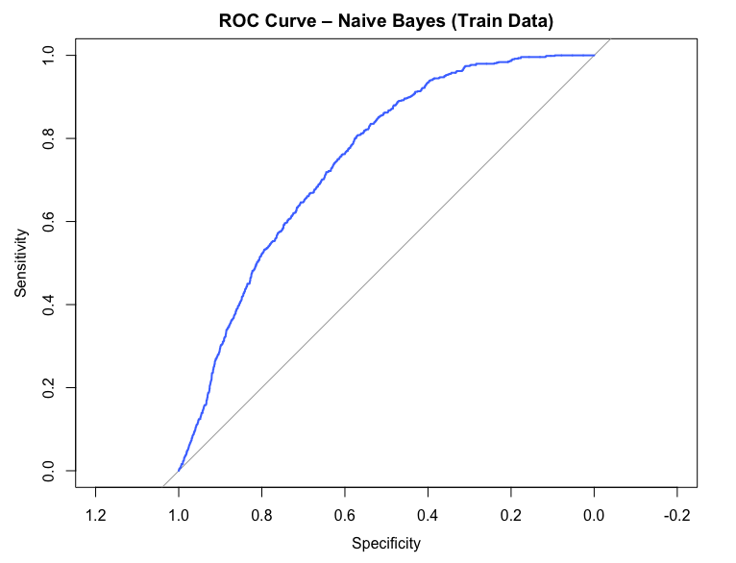
ROC Curve – Train Data (Naive Bayes)
AUC = 0.7484
Comparable to logistic models
Smooth, consistent curve
No sign of overfitting
Performs well on training data

Slide 28
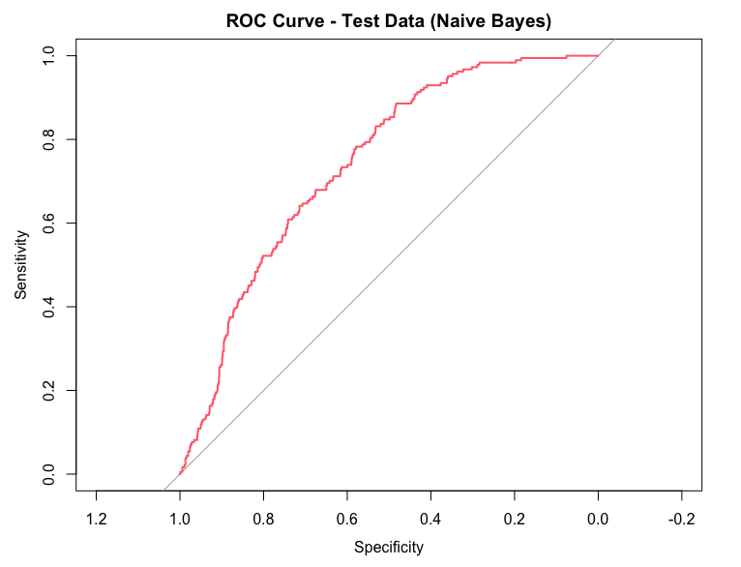
ROC Curve – Test Data (Naive Bayes)
AUC = 0.7423
Slightly lower than Model 3
Consistent with train performance
Good generalization
Balanced prediction capability

Slide 29
Classification Results – Train vs Test (Naive Bayes)
Metric | Train | Test
Accuracy | 65.49% | 64.3%
Sensitivity | 71.89% | 70.11%
Specificity | 64.51% | 63.42%
AUC | 0.7484 | 0.7423
Balanced model performance
Slightly lower AUC than logistic Model 3
Strong defaulter detection (high sensitivity)
Interpretable and easy to deploy

Slide 30
Decision Tree – Model Summary
Method: rpart (classification tree)
Target: bad (1 = default)
All structured features used (excluding custid)
Tree depth and complexity controlled (cp = 0.01, minsplit = 20)
Visualized with rpart.plot()

Slide 31
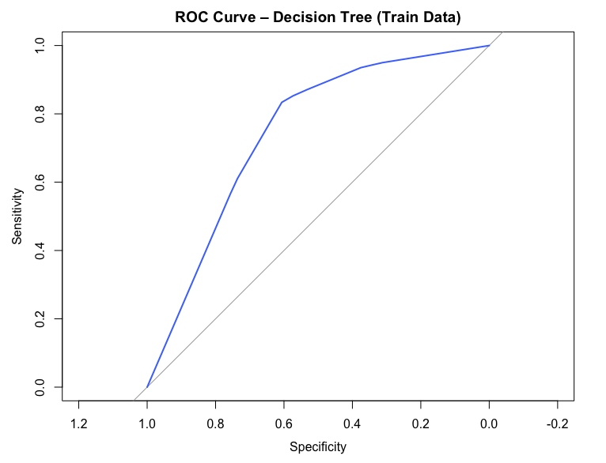
ROC Curve – Train Data (Decision Tree)
AUC = 0.7435
Curve is strong but less smooth than logistic
High sensitivity (~83%)
Slightly lower specificity (~61%)
Well fitted to training data

Slide 32
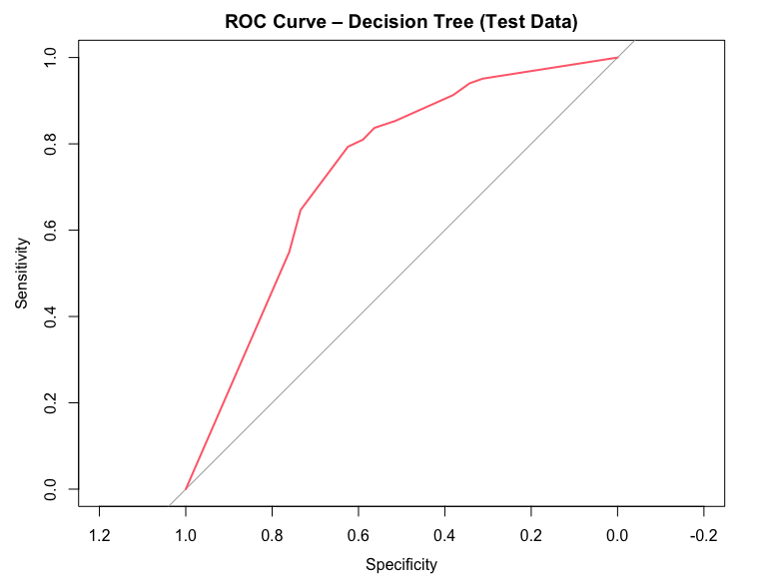
ROC Curve – Test Data (Decision Tree)
AUC = 0.7381
Good generalization on test set
Sensitivity remains high (~81%)
Specificity lower (~59%)
Performance consistent with training

Slide 33
Classification Results – Train vs Test (Decision Tree)
Metric | Train | Test
Accuracy | 63.64% | 61.86%
Sensitivity | 83.38% | 80.98%
Specificity | 60.63% | 58.96%
AUC | 0.7435 | 0.7381
Very high sensitivity – detects defaulters well
Specificity is lower → more false positives
Consistent results across datasets
Easy to visualize and interpret

Slide 34
Random Forest – Model Summary
Model type: Random Forest (500 trees)
Target: bad (1 = default)
Features: all structured variables (excluding custid)
Parameters: ntree = 500, mtry = 3
Captures complex non-linear relationships

Slide 35
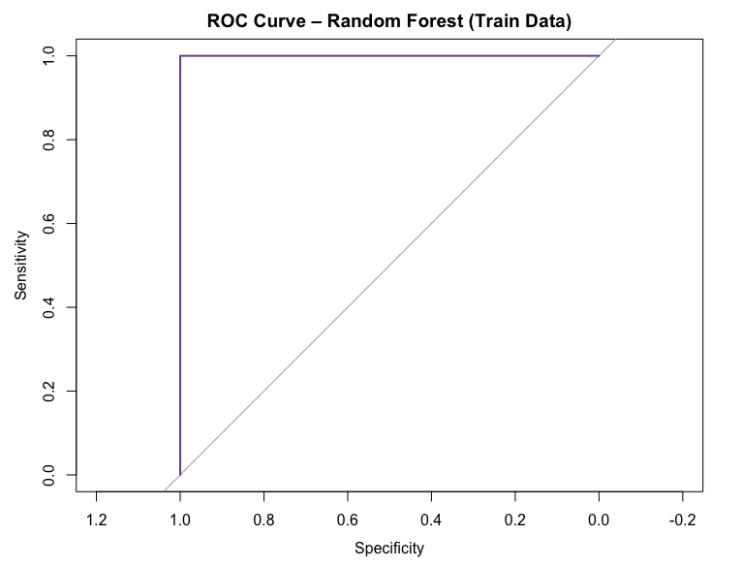
ROC Curve – Train Data (Random Forest)
AUC = 1.0000
Accuracy = 100%
Sensitivity = 100%, Specificity = 100%
Perfect fit on training data
Likely overfitting

Slide 36

ROC Curve – Test Data (Random Forest)
AUC = 0.7885
Accuracy = 86.81%
Sensitivity = 0.54%
Specificity = 99.92%
Model predicts most cases as non-defaulters
Severe imbalance in classification

Slide 37
Classification Results – Train vs Test (Random Forest)
Excellent train performance → clear overfitting
High accuracy hides low sensitivity
Model fails to catch defaulters in test data
Needs tuning (e.g. class weights, threshold)
Metric | Train | Test
Accuracy | 100.00% | 86.81%
Sensitivity | 100.00% | 0.54% ⚠
Specificity | 100.00% | 99.92%
AUC | 1.0000 | 0.7885

Slide 38
Model Comparison – Test Data Performance
Model | AUC | Accuracy | Sensitivity | Specificity
Logistic Model 2 | 0.7550 | 63.3% | 79.4% | 60.9%
Logistic Model 3 | 0.7566 | 67.5% | 72.8% | 66.6%
Naive Bayes | 0.7423 | 64.3% | 70.1% | 63.4%
Decision Tree | 0.7381 | 61.9% | 81.0% | 59.0%
Random Forest | 0.7885 | 86.8% | ⚠ 0.54% | 99.9%
Random Forest has highest AUC and accuracy, but fails to detect defaulters (very low sensitivity)
Decision Tree and Logistic Model 2 have the best sensitivity → better for risk control
Logistic Model 3 offers best balance of accuracy, sensitivity, and AUC
Naive Bayes performs consistently, slightly behind logistic models

Slide 39
Phase 5 – Text Analysis Results

Slide 40
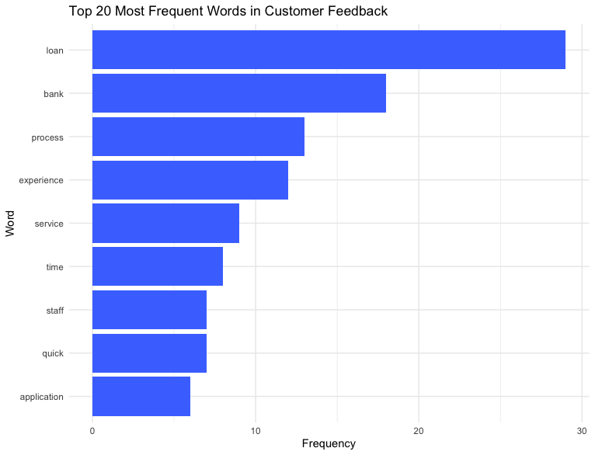
Top Feedback Words

Slide 41

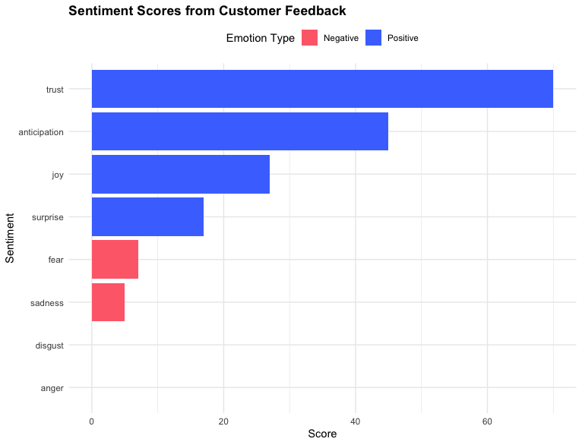
Word Cloud – Customer Feedback

Slide 42
Conclusions & Recommendations
Logistic regression and Naive Bayes performed similarly in AUC (~0.75), but logistic regression had better balance between sensitivity and specificity.
1
Random Forest had the highest AUC (0.79) but showed overfitting on train data.
2
Decision Tree gave clear rules but was less accurate overall.
3
Customer feedback analysis showed trust, anticipation, and joy as dominant sentiments.
4
Keywords like loan, process, and experience highlight what matters most to customers.
5
Use logistic regression as the core model due to its interpretability and stable test results.
6
Apply text sentiment monitoring to enhance customer satisfaction.
7
Continue improving loan process speed and customer service quality – key expectations.

