Slide 1
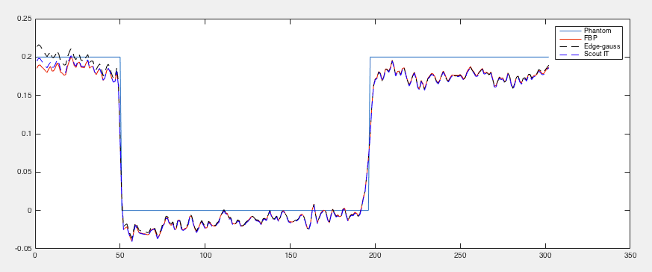
Ground truth
Global FBP
Edge-Gauss
ScoutIT

