Slide 1
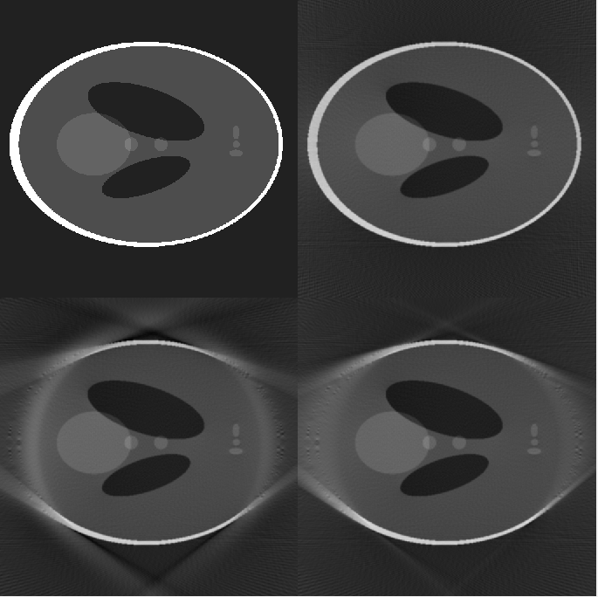
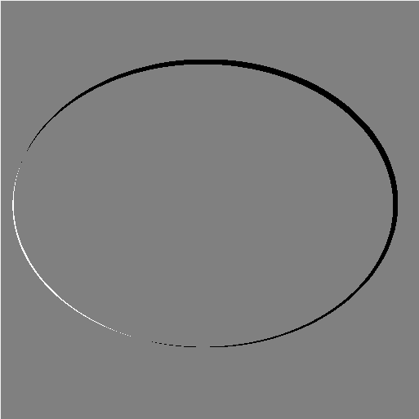
A. Phantom
B. Fan-beam (global)
E. (Convex hull of phantom)
- (Convex hull of estimated ellipse)
C. Edge-Gauss
D. Scout IT

